Slide 1
Sets
Dipanwita Debnath
8974890617
ddebnath.nita@gmail.com
AP, CSE Dept.
NIT Andhra Pradesh

Slide 2
Contents
Sets,
Operations on Sets,
Venn Diagrams,
Multi Sets, properties of set, set partition.

Slide 3
Set – Definition
A set is a well-defined collection of objects. A set can be written explicitly by listing its elements using set bracket. If the order of the elements is changed or any element of a set is repeated, it does not make any changes in the set.
Some Example of Sets:
a set of chairs,
the set of person in a village,
the set of integers,
the set of natural numbers less than 10,
Elements of a Set
The items present in a set are called either elements or members of a set. The elements of a set are enclosed in curly brackets separated by commas. To denote that an element is contained in a set, the symbol '∈' is used. In the above example, 2 ∈ A. If an element is not a member of a set, then it is denoted using the symbol '∉'. Here, 3 ∉ A.

Slide 4
Representation of a Set
Statement form
Roster or Tabular Form
Set Builder Notation
Statement form (Semantic Form)
In this representation, the well-defined description of the elements of the set is given. Below are some examples of the same.
1. The set of all even number less than 10.
2. The set of the number less than 10 and more than 1.
Roster or Tabular Form
The set is represented by listing all the elements comprising it. The elements are enclosed within braces and separated by commas.
Example 1 − Set of vowels in English alphabet, A={a,e,i,o,u}
Example 2 − Set of odd numbers less than 10, B={1,3,5,7,9}
Set Builder Form
The set is defined by specifying a property that elements of the set have in common. The set is described as A={x:p(x)}
Example 1 − The set {a,e,i,o,u} is written as −A={x:x is a vowel in English alphabet}
Example 2 − The set {1,3,5,7,9}is written as −B={x:1≤x<10 and (x%2)≠0}

Slide 5
Some Important Sets
N − the set of all natural numbers = {1,2,3,4,.....}
Z − the set of all integers = {.....,−3,−2,−1,0,1,2,3,.....}
Z+ − the set of all positive integers
Q − the set of all rational numbers
R − the set of all real numbers
W − the set of all whole numbers

Slide 6
Cardinality of a Set
Cardinality of a set S, denoted by |S|, is the number of elements of the set. The number is also referred as the cardinal number. If a set has an infinite number of elements, its cardinality is ∞.
Example − |{1,4,3,5}|=4,|{1,2,3,4,5,…}|=∞
Types of Sets
Sets can be classified into many types. Some of which are finite, infinite, subset, universal, proper, singleton set, etc.
Finite Set
As the name implies, a set with a finite or countable number of elements is called a finite set. Example, Set B = {k | k is a prime number less than 20}, which is B = {2,3,5,7,11,13,17,19}
Example − S={x|x∈N and 70>x>50}
Infinite Set
A set with an infinite number of elements is called an infinite set. Example: Set C = {Multiples of 3}, which is, C = {3,6,9,12,15 ..........}

Slide 7
Subset and Superset
For two sets A and B, if every element in set A is present in set B, then set A is a subset of set B(A ⊆ B) and B is the superset of set A(B ⊇ A).
Example: A = {1,2,3} B = {1,2,3,4,5,6}
A ⊆ B, since all the elements in set A are present in set B.
B ⊇ A denotes that set B is the superset of set A.
Proper Subset
The term “proper subset” can be defined as “subset of but not equal to”. A Set X is a proper subset of set Y (Written as X⊂Y) if every element of X is an element of set Y and |X|<|Y|.
Example − Let, X={1,2,3,4,5,6} and Y={1,2}. Here set Y⊂X since all elements in Y are contained in X too and X has at least one element is more than set Y.
Universal Set
It is a collection of all elements in a particular context or application. All the sets in that context or application are essentially subsets of this universal set. Universal sets are represented as U.
Example − We may define U as the set of all animals on earth. In this case, set of all mammals is a subset of U, set of all fishes is a subset of U, set of all insects is a subset of U, and so on.
Ordered set
Sometimes we care about the ordering of the elements in the set. We call them ordered sets . They are sometime referred as lists. For example: the ordered set {1, 2, 3} is different from {2, 1, 3}.

Slide 8
Empty Set or Null Set
An empty set contains no elements. It is denoted by ∅. As the number of elements in an empty set is finite, empty set is a finite set. The cardinality of empty set or null set is zero.
Example − S={x|x∈N and 7<x<8}=∅
Singleton Set or Unit Set
A set that has only one element is called a singleton set or also called a unit set. Example, Set A = { k | k is an integer between 3 and 5} which is A = {4}.
Equal Set
If two sets contain the same elements they are said to be equal.
Example − If A={1,2,6} and B={6,1,2}, they are equal as every element of set A is an element of set B and every element of set B is an element of set A.
Equivalent Set
If the cardinalities of two sets are same, they are called equivalent sets. Example − If A={1,2,6} and B={16,17,22}, they are equivalent as cardinality of A is equal to the cardinality of B. i.e. |A|=|B|=3
Multisets
In some context we may have to allow repetitions. We call them multisets . Thus in the multiset {1, 1, 2} is different from {1, 2} is different from {1, 1, 1, 2}. We can also have ordered multi-sets.

Slide 9
Overlapping Set
Two sets that have at least one common element are called overlapping sets.
Example − Let, A={1,2,6} and B={6,12,42}. There is a common element ‘6’, hence these sets are overlapping sets.
Disjoint Set
Two sets A and B are called disjoint sets if they do not have even one element in common. Therefore, disjoint sets have the following properties −
n(A∩B)=∅
n(A∪B)=n(A)+n(B)
Example − Let, A={1,2,6} and B={7,9,14}, there is not a single common element, hence these sets are not overlapping sets.

Slide 10
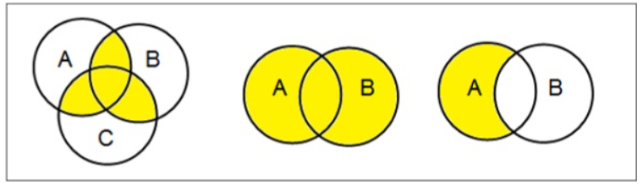
Visual Representation of Sets Using Venn Diagram
Venn diagram, invented in 1880 by John Venn, is a schematic diagram that shows all possible logical relations between different mathematical sets.
Venn Diagram is a pictorial representation of sets, with each set represented as a circle. The elements of a set are present inside the circles. Sometimes a rectangle encloses the circles, which represents the universal set. The Venn diagram represents how the given sets are related to each other.
Examples

Slide 11

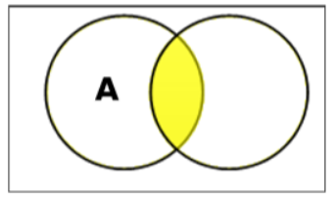
Set Operations
Set Operations include Set Union, Set Intersection, Set Difference, Complement of Set, and Cartesian Product.
Set Union
The union of sets A and B (denoted by A∪B) is the set of elements which are in A, in B, or in both A and B. Hence, A∪B={x|x∈A OR x∈B}.
Example − If A={10,11,12,13} and B = {13,14,15}, then A∪B={10,11,12,13,14,15}. (The common element occurs only once).
Set Intersection
The intersection of sets A and B (denoted by A∩B) is the set of elements which are in both A and B. Hence, A∩B={x|x∈A AND x∈B}.
Example − If A={11,12,13} and B={13,14,15}, then A∩B={13}

Slide 12
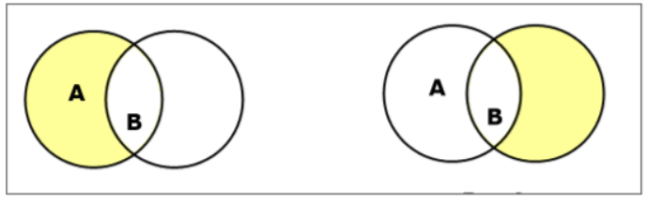
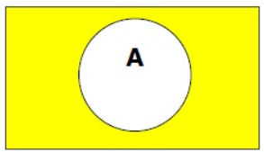
Set Difference/ Relative Complement
The set difference of sets A and B (denoted by A–B) is the set of elements which are only in A but not in B. Hence, A−B={x|x∈A AND x∉B}.
Example − If A={10,11,12,13} and B={13,14,15}, then (A−B)={10,11,12} and (B−A)={14,15}. Here, we can see (A−B)≠(B−A).
Complement of a Set
The complement of a set A (denoted by A′) is the set of elements which are not in set A. Hence, A′={x|x∉A}.
More specifically, A′=(U−A) where U is a universal set which contains all objects.
Example − If A={x|x belongs to set of odd integers} then A′={y|y does not belong to set of odd integers}

Slide 13
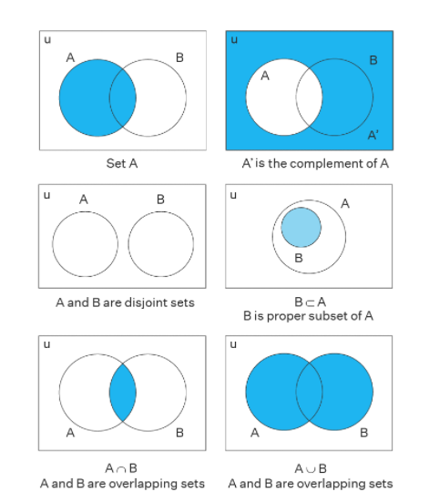
Some operations on set

Slide 14

Solve some problems
If |A| = 5 and |B| = 8 and |A ∪ B| = 11 what is the size of A ∩ B?
2.
3. prove the following using the sets A={1,2,6} and B={6,12,42}.
n(A∪B)=n(A)+n(B)−n(A∩B)
n(A∪B)=n(A−B)+n(B−A)+n(A∩B)
n(A)=n(A−B)+n(A∩B)
n(B)=n(B−A)+n(A∩B)

Slide 15
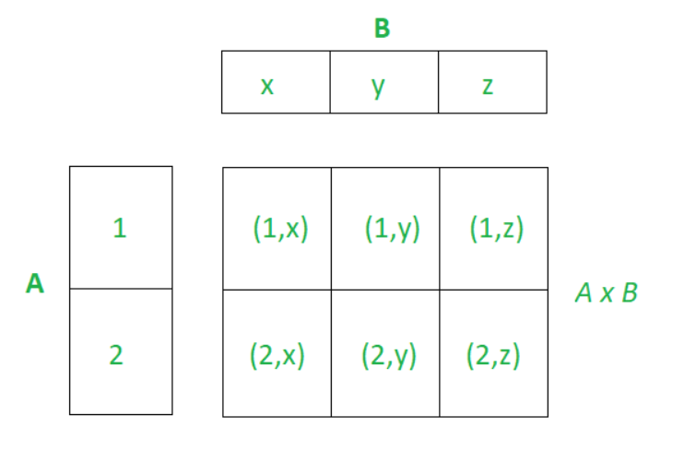
Cartesian Product / Cross Product
A Cartesian product of two non-empty sets A and B is the set of all possible ordered pairs where the first component of the pair is from A, and the second component of the pair is from B. The set of ordered pairs thus obtained is denoted by A×B.
Example − If we take two sets A={a,b} and B={1,2},
The Cartesian product of A and B is written as − A×B={(a,1),(a,2),(b,1),(b,2)}
The Cartesian product of B and A is written as − B×A={(1,a),(1,b),(2,a),(2,b)}
The Cartesian Product of two sets can be easily represented in the form of a matrix where both sets are on either axis, as shown in the image below. Cartesian Product of A = {1, 2} and B = {x, y, z}

Slide 16
Properties of Cartesian Product
The Cartesian Product is non-commutative: A × B ≠ B × A
Example: A = {1, 2} , B = {a, b}
A × B = {(1, a), (1, b), (2, a), (2, b)} B × A = {(a, 1), (b, 1), (b, 1), (b, 2)}
Therefore as A ≠ B we have A × B ≠ B × A
2. A × B = B × A, only if A = B
Proof:
Let A × B = B × A then we have
A ⊆ B and B ⊆ A, it follows that A = B
3. The cardinality of the Cartesian Product is defined as the number of elements in A × B and is equal to the product of cardinality of both sets: |A × B| = |A| * |B|
Proof:
Let a ∈ A then the number of ordered pair (a, b) such that b ∈ B is |B|.
Therefore we have |B| choices for b for each a where a ∈ A therefore the number of element in A×B is |A| * |B|.
Problem . Given A × B has 15 ordered pairs and A has 5 elements, find the number of elements in B?
We know |A × B| = |A| * |B|, 15 = 5 * |B|
Therefore B has 15 / 5 = 3 elements.

Slide 17
4. A × B = {∅}, if either A = {∅} or B = {∅}
Proof:
We know |{∅}| = 0
Now we have |A × B| = |{∅}| = 0
As |A × B| = |A| * |B| , we get |A| * |B| = 0
Thus at least one of |A| or |B| should be equal to 0
Hence either A = {∅} or B = {∅}
Problem 1: Find the value of x and y given (2x – y, 25) = (15, 2x + y)?
As we know from the property of ordered pairs, 2x – y = 15 and 25 = 2x + y.
Solving the linear equations we have x = 10 and y = 5.
Problem 2. Given A = {2, 3, 4 , 5} and B = {4 , 16 , 23}, a ∈ A, b ∈ B, find the set of ordered pairs such that a² < b?
We have the set of ordered pairs such that a2 < b is {(2, 16), (2, 23), (3, 16), (2, 23), (4, 23)}
Problem 3. If A = {9, 10} and B = {3, 4, 6}, find A × B and |A × B|?
A × B = {(9, 3), (9, 4), (9, 6), (10, 3), (10, 4), (10, 6)}
|A × B| = |A| * |B| = 2 * 3 = 6
Problem 4. If A × B = {(a, x), (a, y ), (b, x ), (b, y)}, find A and B?
We know A is the set of all first components in ordered pairs of A × B and
B is the set of the second component in the ordered pair of A × B.
Therefore A = {a, b} and B = {x, y}

Slide 18
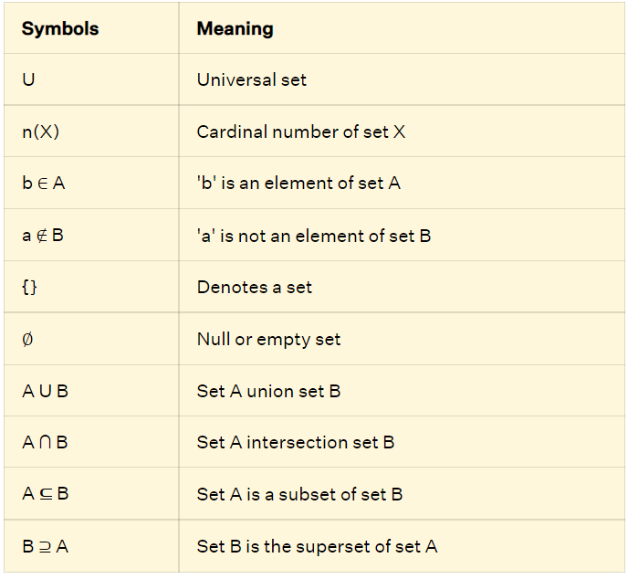
Sets Symbols Set symbols are used to define the elements of a given set. The following table shows some of these symbols and their meaning.

Slide 19
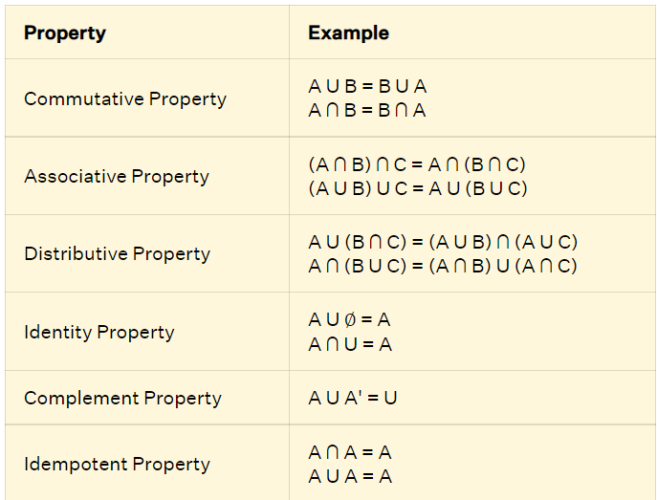
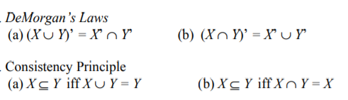
Properties of Sets Similar to numbers, sets also have properties like associative property, commutative property, and so on. There are six important properties of sets. Given, three sets A, B, and C, the properties for these sets are as follows.

Slide 20
Power Set
Power set of a set S is the set of all subsets of S including the empty set. The cardinality of a power set of a set S of cardinality n is 2power n
. Power set is denoted as P(S).
Example −
For a set S={a,b,c,d} let us calculate the subsets −
Subsets with 0 elements − {∅} (the empty set)
Subsets with 1 element − {a},{b},{c},{d}
Subsets with 2 elements − {a,b},{a,c},{a,d},{b,c},{b,d},{c,d}
Subsets with 3 elements − {a,b,c},{a,b,d},{a,c,d},{b,c,d}
Subsets with 4 elements − {a,b,c,d}
Hence, P(S)= {{∅},{a},{b},{c},{d},{a,b},{a,c},{a,d},{b,c},{b,d},{c,d},{a,b,c},{a,b,d},{a,c,d},{b,c,d},{a,b,c,d}}
|P(S)| = 16
Note − The power set of an empty set is also an empty set.
|P({∅})|=1
Cardinality of power set is 2power n
, where n is the number of elements in a set.

Slide 21
Partitioning of a Set
Partition of a set, say S, is a collection of n disjoint subsets, say P1,P2,…Pn that satisfies the following three conditions −
Pi does not contain the empty set.
[Pi≠{∅} for all 0<i≤n]
The union of the subsets must equal the entire original set.
[P1∪P2∪⋯∪Pn=S]
The intersection of any two distinct sets is empty.
[Pa∩Pb={∅}, for a≠b where n≥a,b≥0]
Example
Let S={a,b,c,d,e,f,g,h}
One probable partitioning is {a},{b,c,d},{e,f,g,h}
Another probable partitioning is {a,b},{c,d},{e,f,g,h}
Bell Numbers
Bell numbers give the count of the number of ways to partition a set. They are denoted by Bn where n is the cardinality of the set.
Example −
Let S={1,2,3}, n=|S|=3
The alternate partitions are −
1. ∅,{1,2,3}
2. {1},{2,3}
3. {1,2},{3}
4. {1,3},{2}
5. {1},{2},{3}
Hence B3=5

Slide 22
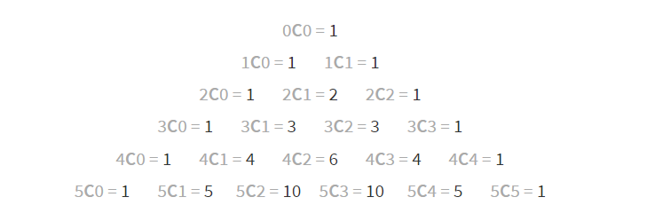
Find partitions

Slide 23
Example 1: Find the elements of the sets represented as follows and write the cardinal number of each set. a) Set A is the first 8 multiples of 7 b) Set B = {a,e,i,o,u} c) Set C = {x | x are even numbers between 20 and 40}
Solution:
a) Set A = {7,14,21,28,35,42,49,56}. These are the first 8 multiples of 7.
Since there are 8 elements in the set, cardinal number n (A) = 8
b) Set B = {a,e,i,o,u}. There are five elements in the set,
Therefore, the cardinal number of set B, n(B) = 5. c) Set C = {22,24,26,28,30,32,34,36,38}. These are the even numbers between 20 and 40, which make up the elements of the set C.
Therefore, the cardinal number of set C, n(C) = 9.

Slide 24
Example 2: If Set A = {a,b,c}, Set B = {a,b,c, p,q,r}, U = {a,b,c,d,p,q,r,s}, find the following using sets formulas, a) A U B b) A ∩ B c) A' d) Is A ⊆ B? (Here 'U' is the universal set).
Solution: a) A U B = {a,b,c,p,q,r} b) A ∩ B = {a,b,c} c) A' = {d,p,q,r,s}
d) A ⊆ B, (Set A is a subset of set B) since all the elements in set A are present in set B.
Example 3: Express the given set in set-builder form: A = { 2, 4, 6, 8, 10, 12, 14}
Solution: Given: A = { 2, 4, 6, 8, 10, 12, 14}
Using sets notations, we can represent the given set A in set-builder form as,
A = {x | x is an even natural number less than 15}
Example 4: Consider these three sets:
A = the set of all even numbers B = {2, 4, 6} C = {2, 3, 4, 6}
Here B ⊂ A since every element of B is also an even number, so is an element of A.
More formally, we could say B ⊂ A since if x ∈ B, then x ∈ A.
It is also true that B ⊂ C.
C is not a subset of A, since C contains an element, 3, that is not contained in A

Slide 25
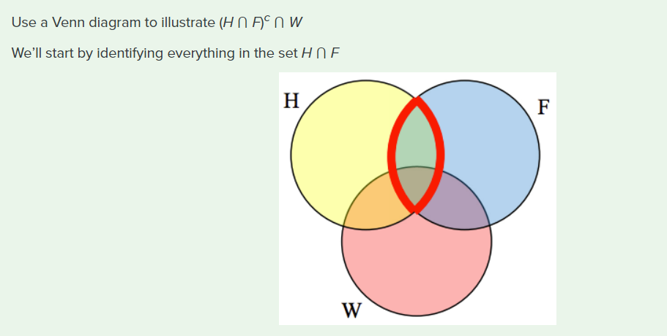

Slide 26
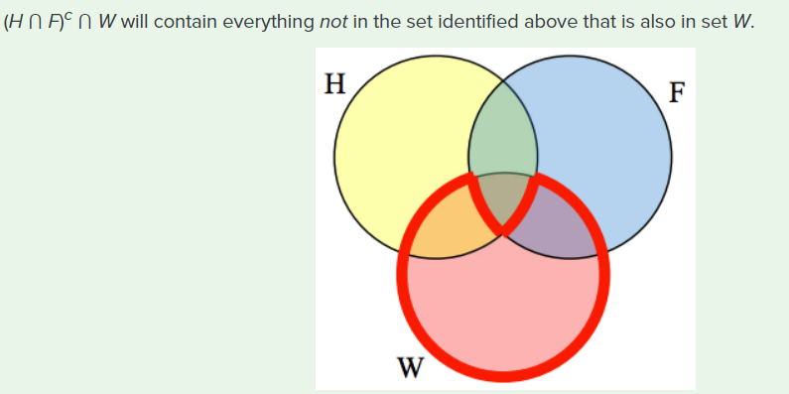
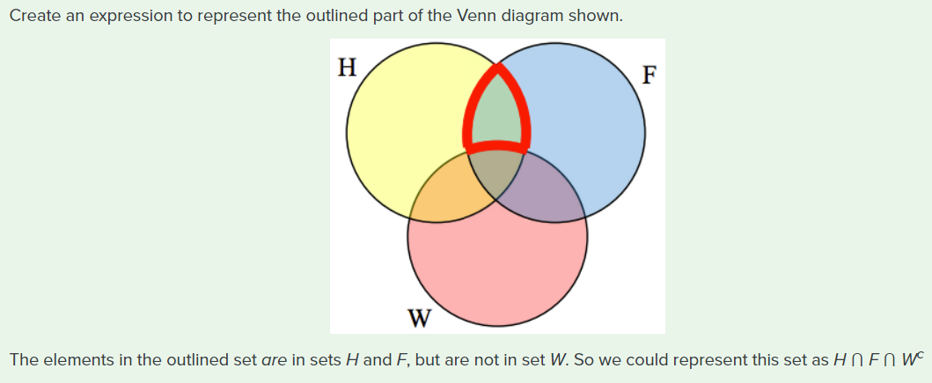

Slide 27
Let A = {1, 2, 3, 4, 5, 6} and B = {2, 4, 6, 8}.
What is the cardinality of B? A ⋃ B, A ⋂ B?
Answers
The cardinality of B is 4, since there are 4 elements in the set.
The cardinality of A ⋃ B is 7, since A ⋃ B = {1, 2, 3, 4, 5, 6, 8}, which contains 7 elements.
The cardinality of A ⋂ B is 3, since A ⋂ B = {2, 4, 6}, which contains 3 elements.
What is the cardinality of P = the set of English names for the months of the year?
Answers
The cardinality of this set is 12, since there are 12 months in the year.

Slide 28
CARDINALITY PROPERTIES
n(A ⋃ B) = n(A) + n(B) – n(A ⋂ B)
n(Ac) = n(U) – n(A)
Fifty students were surveyed, and asked if they were taking a social science (SS),
humanities (HM) or a natural science (NS) course the next quarter.
How many students are only taking a SS course?
21 were taking a SS course | 26 were taking a HM course
19 were taking a NS course | 9 were taking SS and HM
7 were taking SS and NS | 10 were taking HM and NS
3 were taking all three | 7 were taking none

Slide 29
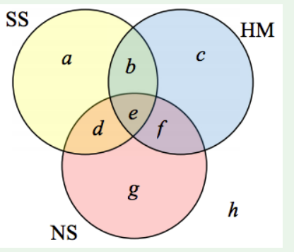
It might help to look at a Venn diagram. From the given data, we know that there are 3 students in region e and 7 students in region h.
Since 7 students were taking a SS and NS course, we know that n(d) + n(e) = 7. Since we know there are 3 students in region 3, there must be 7 – 3 = 4 students in region d.
Similarly, since there are 10 students taking HM and NS, which includes regions e and f, there must be 10 – 3 = 7 students in region f.
Since 9 students were taking SS and HM, there must be 9 – 3 = 6 students in region b.
Now, we know that 21 students were taking a SS course. This includes students from regions a, b, d, and e. Since we know the number of students in all but region a, we can determine that 21 – 6 – 4 – 3 = 8 students are in region a.
8 students are taking only a SS course.

Slide 30
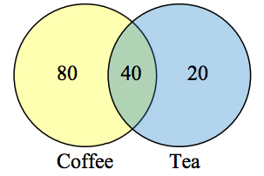
A survey asks 200 people “What beverage do you drink in the morning”, and offers choices:
Tea only
Coffee only
Both coffee and tea
Suppose 20 report tea only, 80 report coffee only, 40 report both. How many people drink tea in the morning?
How many people drink neither tea or coffee?
Answers
This question can most easily be answered by creating a Venn diagram. We can see that we can find the people who drink tea by adding
those who drink only tea to those who drink both: 60 people. We can also see that those who drink neither are those not contained in the
any of the three other groupings, so we can count those by subtracting from the cardinality of the universal set, 200.
200 – 20 – 80 – 40 = 60 people who drink neither.

Slide 31
A survey asks: “Which online services have you used in the last month?”
Twitter
Facebook
Have used both
The results show 40% of those surveyed have used Twitter, 70% have used Facebook, and 20% have used both. How many people have used neither Twitter or Facebook?
Answers
Let T be the set of all people who have used Twitter, and F be the set of all people who have used Facebook. Notice that while the cardinality of F is 70% and the cardinality of T is 40%, the cardinality of F ⋃ T is not simply 70% + 40%, since that would count those who use both services twice. To find the cardinality of F ⋃ T, we can add the cardinality of F and the cardinality of T, then subtract those in intersection that we’ve counted twice. In symbols,
n(F ⋃ T) = n(F) + n(T) – n(F ⋂ T) n(F ⋃ T) = 70% + 40% – 20% = 90%
Now, to find how many people have not used either service, we’re looking for the cardinality of (F ⋃ T)c . Since the universal set contains 100% of people and the cardinality of F ⋃ T = 90%, the cardinality of (F ⋃ T)c must be the other 10%.

Slide 32
TRY IT NOW
One hundred fifty people were surveyed and asked if they believed in UFOs, ghosts, and Bigfoot.
How many people surveyed believed in at least one of these things?
43 believed in UFOs | 44 believed in ghosts
25 believed in Bigfoot | 10 believed in UFOs and ghosts
8 believed in ghosts and Bigfoot | 5 believed in UFOs and Bigfoot
2 believed in all three

Slide 33
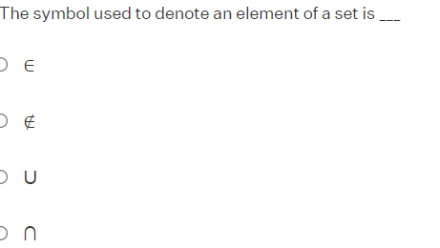
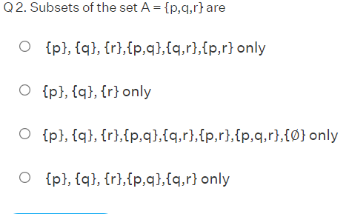

Slide 34
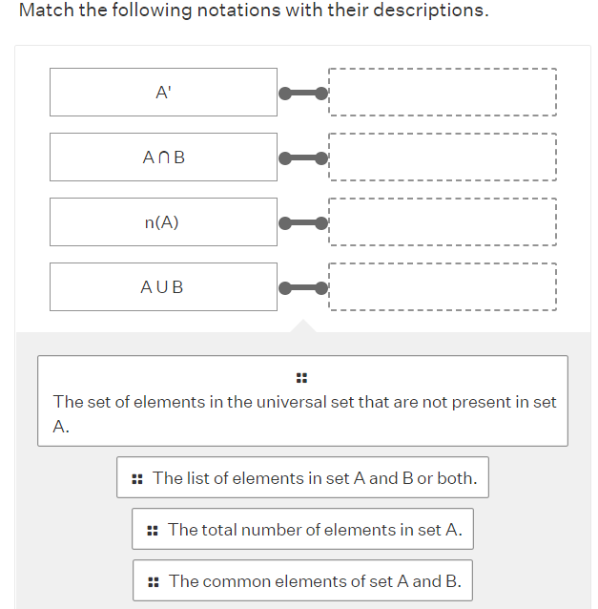

Slide 35
What is Sets in Mathematics and Examples?
Sets are a collection of distinct elements, which are enclosed in curly brackets, separated by commas. The list of items in a set is called the elements of a set. Examples are a collection of fruits, a collection of pictures. In another way, sets are represented as follows. Set A = {a,b,c,d}. Here, a,b,c,d are the elements of set A.
What are Different Sets Notations to Represent Sets?
Sets can be represented in three ways. Representing sets means a way of listing the elements of the set. They are as follows.
Semantic Notation: The elements of a set are represented by a single statement. For example, Set A is the number of days in a week.
Roster Notation: This form of representation of sets uses curly brackets to list the elements of the set. For example, Set A = {2,4,6,8,10}
Set Builder Notation: A set builder form represents the elements of a set by a common rule or a property. For example, {x | x is a prime number less than 20}
What are the Types of Sets?
Sets differ from each depending upon elements present in them. Based on this, we have the following types of sets. They are singleton sets, finite and infinite sets, empty or null sets, equal sets, unequal sets, equivalent sets, overlapping sets, disjoint sets, subsets, supersets, power sets, and universal sets.
What are the Properties of Sets in Set-Theory?
Different properties associated with sets in math are,
Commutative Property: A U B = B U A and A ∩ B = B ∩ A
Associative Property: (A ∩ B) ∩ C = A ∩ (B ∩ C) and (A U B) U C = A U (B U C)
Distributive Property: A U (B ∩ C) = (A U B) ∩ (A U C) and A ∩ (B U C) = (A ∩ B) U (A ∩ C)
Identity Property: A U ∅ = A and A ∩ U = A
Complement Property: A U A' = U
Idempotent Property: A ∩ A = A and A U A = A

Slide 36
What is the Union of Sets?
The union of two sets A and B are the elements from both set A and B, or both combined together. It is denoted using the symbol 'U'. For example, if set A = {1,2,3} and set B = {4,5,6}, then A U B = {1,2,3,4,5,6}. AUB is read as 'A union B'.
What is the Intersection of Sets?
The intersection of two sets A and B are the elements that are common to both set A and B. It is denoted using the symbol '∩'. For example, if set A = {1,2,3} and set B = {3,4,5}, then A ∩ B = {3}. A ∩ B is read as 'A intersection B'.
What are Subsets and Supersets?
If every element in a set A is present in set B, then set B is the superset of set A and set A is a subset of set B. Example: A = {1,4,5} B = {1,2,3,4,5,6} Since all elements of set A are present in set B. ⇒ A ⊆ B and B ⊇ A.
What are Universal Sets?
A universal set, denoted by the letter 'U', is the collection of all the elements in regard to a particular subject. Example: Let U = {The list of all road transport vehicles}. Here, a set of cycles is a subset of this universal set.
What is Complement in Sets?
The complement of a set which is denoted by A', is the set of all elements in the universal set that are not present in set A. In other words, A' is denoted as U - A, which is the difference in the elements of the universal set and set A.
What is Cartesian Product in Sets?
Cartesian product of two sets, denoted by A×B, is the product of two non-empty sets, wherein ordered pairs of elements are obtained. For example, if A = {1,2} and B= {3,4}, then A×B = { (1,3), (1,4), (2,3), (2,4)}.
What is the Use of Venn Diagram in Sets?
Venn Diagram is a pictorial representation of the relationship between two or more sets. Circles are used to represent sets. Each circle represents a set. A rectangle that encloses the circles represents the universal set.

