Slide 1
Sets and Relations
Dipanwita Debnath
8974890617
ddebnath.nita@gmail.com
AP, CSE Dept.
NIT Andhra Pradesh

Slide 2
Contents:
Binary Relations,
Equivalence Relations,
Partial Orders
Ordering Relations,
Operations on Relations,

Slide 4
Some examples:
Definition (ordered n-tuple): An ordered n-tuple is a set of n objects with an order associated with them. If n objects are represented by x₁, x₂, ..., x_{n}, then we write the ordered n-tuple as <x₁, x₂, ..., x_{n}> .
Example 1: Let A₁ be a set of names, A₂ a set of addresses, and A₃ a set of telephone numbers. Then a set of 3-tuples < name, address, telephone number > such as { < Amy Angels, 35 Mediterranean Ave, 224-1357 >, < Barbara Braves, 221 Atlantic Ave, 301-1734 >, < Charles Cubs, 312 Baltic Ave, 223-9876 > }, is a 3-ary (ternary) relation over A₁, A₂ and A₃.
Example 2: Let A₁ be a set of names. Then a set of 1-tuples such as { < Amy >, < Barbara >, < Charles > }, is a 1-ary (unary) relation over A₁. A unary relation represents a property/characteristic, such as tall, rich etc., shared by the members of A₁ listed in the relation.
Definition (Cartesian product): Let A₁, ..., A_{n} be n sets. Then the set of all ordered n-tuples <x₁, ..., x_{n}> ,
where x_{i} A_{i} for all i, 1 i n , is called the Cartesian product of A₁, ..., A_{n}, and is denoted by A₁ ... A_{n} .
Definition (equality of n-tuples): Two ordered n-tuples <x₁, ..., x_{n}> and <y₁, ..., y_{n}> are equal if and only if x_{i} = y_{i} for all i, 1 i n . For example the ordered 3-tuple <1, 2, 3> can be equal to only <1, 2, 3> and nothing else. It is not equal to the ordered n-tuple <2, 3, 1> for example.
Definition (n-ary relation): An n-ary relation on sets A₁, ..., A_{n} is a set of ordered n-tuples <a₁, ..., a_{n}> where
a_{i} is an element of A_{i} for all i, 1 i n . Thus an n-ary relation on sets A₁, ..., A_{n} is a subset of Cartesian product A₁ ... A_{n} .

Slide 5
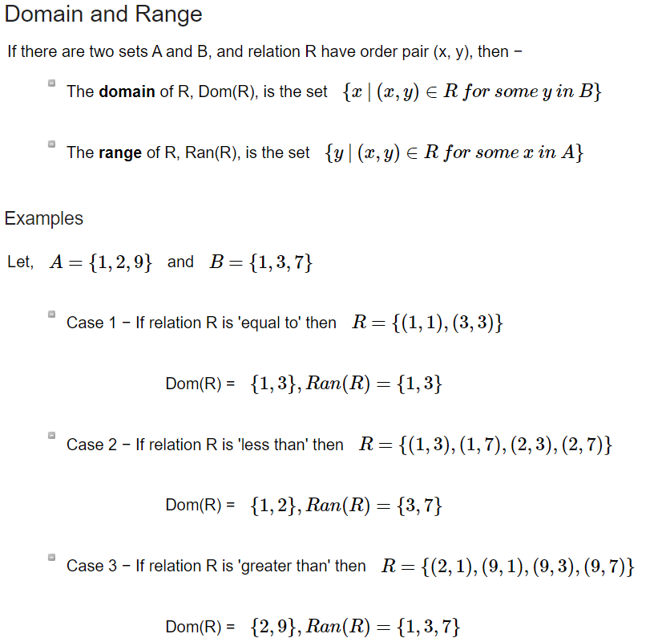

Slide 6
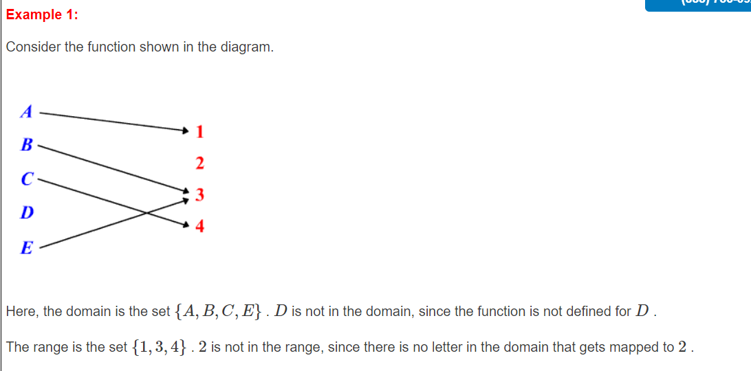

Slide 8
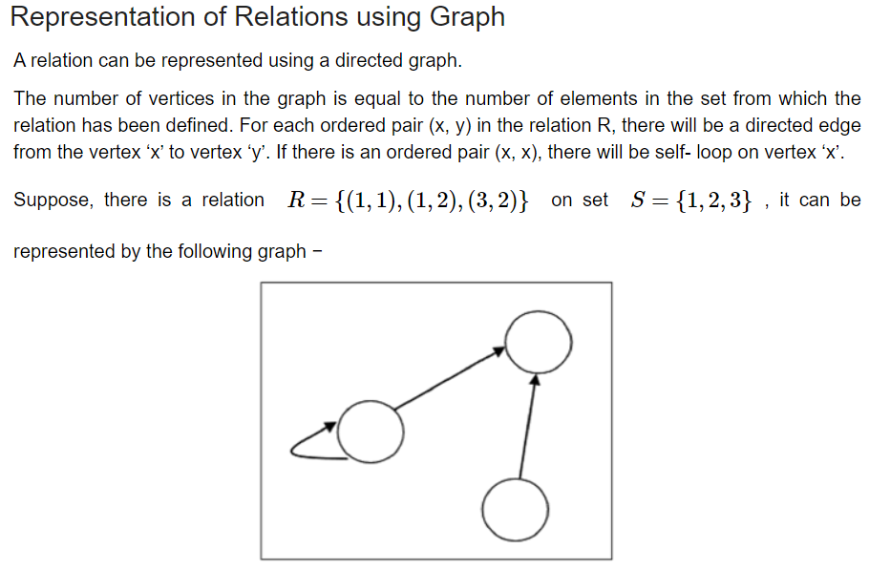

Slide 9
Graph Representation of a Binary Relation:
If A and B are two finite sets and R is a binary relation between A and B we can represent this relation as a graph (set of vertices and edges).
A = {1, 3, 5 ,7}, B = {2, 4, 6, 8}
R = {(a,b): a < b}
1
2
We call this graph a directed graph.
3
4
5
6
7
8

Slide 10
Example:
A = {1, 2, 3, 4, 5, 6}. R is a relation on A defined by the following directed graph.
1
2
Exercise: Give a rule-based
definition of R
6
3
R = {(a,b): a divides b}
5
4

Slide 11
Matrix Representation of a Binary Relation:
If A and B are finite sets and R is a binary relation between A and B then create a matrix, M, with the following properties:
the rows of the matrix are indexed by the elements of A
the columns of the matrix are indexed by elements of B
M(a_{i},b_{j}) = 1 if (a_{i},b_{j}) belongs to R; 0 otherwise
B
2 4 6 8
Exercise: Give a rule-based definition of R
1
0 1 1 1
3
0 0 1 1
R = {(a,b): a + 1 < b}
A
5
0 0 0 1
7
0 0 0 0

Slide 12
Combining Relations
Two relations can be combined in a similar way to combining two sets.

Slide 13
Some examples:
Example 1.
Let A = {1, 2, 3}. R0 is an example unary relation. R1 to R4 are binary relations defined on A.
R0 = {2, 3} R1 = {(1, 1),(2, 2),(3, 3)} R2 = {(1, 1),(2, 1),(3, 2)} R3 = φ R4 = A × A
Example 2.
S = {dm,dsa,alg,oop,c++,java}.
R5 = {(x, y) | x, y ∈ S and x is a prerequisite for y}. R5 = {(dsa,alg), (dm,alg), (dm,oop), (oop,c++)}.
Example 3.
Let I = {i1, i2, . . . , im} be the items in a supermarket.
A ternary relation R3 on I is defined as R3 = {(i1, i4, i3),(i2, i1, i7),(i7, i8, i9)}, R3 ⊆ I × I × I

Slide 14
Exercise:
If X = {1, 2, 3, 4, 5, 6}, find R = { (x,y): x is a divisor of y}
R = { (1,1), (1,2), (1,3), (1,4), (1,5), (1,6), (2,2), (2,4), (2,6), (3,3), (3,6) }

Slide 15
Relations
Types of Relations
There are 10 main types of relations which include:
Empty Relation
Universal Relation
Identity Relation
Inverse Relation
Reflexive Relation
Irreflexive relation
Symmetric Relation
Asymmetric Relation
Antisymmetric Relations
Transitive Relation
Equivalence Relation
Other two relations are
Equivalent relation
Partial ordering

Slide 17
Relations
1. Empty Relation
An empty relation (or void relation) is one in which there is no relation between any elements of a set. For example, if set A = {1, 2, 3} then, one of the void relations can be R = {x, y} where, |x – y| = 8.
2. Universal Relation
A universal (or full relation) is a type of relation in which every element of a set is related to each other.
R = A × A
3. Identity Relation
In an identity relation, every element of a set is related to itself only. For example, in a set A = {a, b, c}, the identity relation will be I = {a, a}, {b, b}, {c, c}. For identity relation,
I = {(a, a), a ∈ A}
4. Inverse Relation
Inverse relation is seen when a set has elements which are inverse pairs of another set. For example if set A = {(a, b), (c, d)}, then inverse relation will be R⁻¹ = {(b, a), (d, c)}. So, for an inverse relation,
R⁻¹ = {(b, a): (a, b) ∈ R}

Slide 18
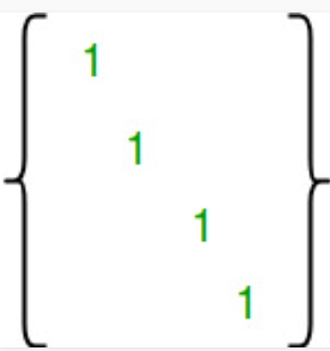
Relations
5. Reflexive Relation:
A relation R on set A is said to be a reflexive if (a, a) ∈ R for every a ∈ A.
Example: If A = {1, 2, 3, 4} then R = {(1, 1) (2, 2), (1, 3), (2, 4), (3, 3), (3, 4), (4, 4)}. Is a relation reflexive?
Solution: The relation is reflexive as for every a ∈ A. (a, a) ∈ R, i.e. (1, 1), (2, 2), (3, 3), (4, 4) ∈ R.
Number of Reflexive Relations on a Set A: 2^{n(n-1)}.
Maximum lengthed Reflexive Relations on a Set A: n2
Minimum lengthed Reflexive Relations on a Set A: n

Slide 19
Relations
6. Irreflexive Relation:
A relation R on set A is said to be irreflexive if (a, a) ∉ R for every a ∈ A.
Example: Let A = {1, 2, 3} and R = {(1, 2), (2, 2), (3, 1), (1, 3)}. Is the relation R reflexive or irreflexive?
Solution: The relation R is not reflexive as for every a ∈ A, (a, a) ∉ R, i.e., (1, 1) and (3, 3) ∉ R. The relation R is not irreflexive as (a, a) ∉ R, for some a ∈ A, i.e., (2, 2) ∈ R.
Number of irreflexive Relations on a Set A: 2^{n(n-1)}.
Maximum lengthed irreflexive Relations on a Set A: n2 -n
Minimum lengthed irreflexive Relations on a Set A: null

Slide 20
Relations
7. Symmetric Relation:
A relation R on set A is said to be symmetric iff (a, b) ∈ R ⟺ (b, a) ∈ R.
Example: Let A = {1, 2, 3} and R = {(1, 1), (2, 2), (1, 2), (2, 1), (2, 3), (3, 2)}. Is a relation R symmetric or not?
Solution: The relation is symmetric as for every (a, b) ∈ R, we have (b, a) ∈ R, i.e., (1, 2), (2, 1), (2, 3), (3, 2) ∈ R but not reflexive because (3, 3) ∉ R.
A relation has ordered pairs (a,b). Now for a symmetric relation, if (a,b) is present in R, then (b,a) must be present in R. In Matrix form, if a₁₂ is present in relation, then a₂₁ is also present in relation and As we know reflexive relation is part of symmetric relation. So from total n² pairs, only n(n+1)/2 pairs will be chosen for symmetric relation. So total number of symmetric relation will be 2^{n(n+1)/2}.
Number of Symmetric Relation on a Set A: 2^{n(n+1)/2}. (only half of non diagonal metters)
Maximum lengthed Symmetric Relation on a Set A: n2
Minimum lengthed Symmetric Relation on a Set A: null

Slide 21
Relations
8. Antisymmetric Relation:
A relation R on a set A is antisymmetric iff (a, b) ∈ R and (b, a) ∈ R then a = b.
Example1: Let A = {1, 2, 3} and R = {(1, 1), (2, 2)}. Is the relation R antisymmetric?
Solution: The relation R is antisymmetric as a = b when (a, b) and (b, a) both belong to R.
Example2: Let A = {4, 5, 6} and R = {(4, 4), (4, 5), (5, 4), (5, 6), (4, 6)}. Is the relation R antisymmetric?
Solution: The relation R is not antisymmetric as 4 ≠ 5 but (4, 5) and (5, 4) both belong to R.
A relation has ordered pairs (a,b). For anti-symmetric relation, if (a,b) and (b,a) is present in relation R, then a = b.(That means a is in relation with itself for any a). So for (a,a), total number of ordered pairs = n and total number of relation = 2^{n}.
if (a,b) and (b,a) both are not present in relation or Either (a,b) or (b,a) is not present in relation. So there are three possibilities and total number of ordered pairs for this condition is n(n-1)/2. (selecting a pair is same as selecting the two numbers from n without repetition) As we have to find number of ordered pairs where a ≠ b. it is like opposite of symmetric relation means total number of ordered pairs = (n²) – symmetric ordered pairs(n(n+1)/2) = n(n-1)/2. So, total number of relation is 3^{n(n-1)/2}. So total number of anti-symmetric relation is 2^{n}.3^{n(n-1)/2}.
Number of Symmetric Relation on a Set A: 2^{n} 3^{n(n-1)/2}.
Maximum lengthed Symmetric Relation on a Set A: n2 – (n2-n)/2
Minimum lengthed Symmetric Relation on a Set A: null

Slide 22
Relations
9. Asymmetric Relation:
A relation R on a set A is called an Asymmetric Relation if for every (a, b) ∈ R implies that (b, a) does not belong to R.
In Asymmetric Relations, element a can not be in relation with itself. (i.e. there is no aRa ∀ a∈A relation.) And Then it is same as Anti-Symmetric Relations.(i.e. you have three choice for pairs (a,b) (b,a)). Therefore there are 3^{n(n-1)/2} Asymmetric Relations possible.
Number of Symmetric Relation on a Set A: 3^{n(n-1)/2}.
Maximum lengthed Symmetric Relation on a Set A: n2 – ((n2-n)/2 + n)
Minimum lengthed Symmetric Relation on a Set A: null

Slide 23
Relations
10. Transitive Relations:
A Relation R on set A is said to be transitive iff (a, b) ∈ R and (b, c) ∈ R ⟺ (a, c) ∈ R.
Example1: Let A = {1, 2, 3} and R = {(1, 2), (2, 1), (1, 1), (2, 2)}. Is the relation transitive?
Solution: The relation R is transitive as for every (a, b) (b, c) belong to R, we have (a, c) ∈ R i.e, (1, 2) (2, 1) ∈ R ⇒ (1, 1) ∈ R.
Note1: The Relation ≤, ⊆ and / are transitive, i.e., a ≤ b, b ≤ c then a ≤ c (ii) Let a ⊆ b, b ⊆ c then a ⊆ c (iii) Let a/b, b/c then a/c.
Number of transitive Relation on a Set A:
Maximum lengthed transitive Relation on a Set A: n2
Minimum lengthed transitive Relation on a Set A: null

Slide 25
Closure of a Relation
Let R ⊆ A × A be a non reflexive relation.
To make R a reflexive relation, one can add the elements from R0 = (A×A)\R to R so that R∪R0 (⊆ A×A) is reflexive.
An interesting question is what will be the minimum cardinality of the set R0 such that R ∪ R0 is a reflexive relation.
Closure operation deals with such minimum cardinality sets.
Let A be a finite set and R ⊆ A × A. Reflexive closure of R, denoted as r(R) is a relation R0 ⊆ A × A such that
(i) R0 ⊇ R
(ii) R0 is reflexive.
(iii) For any reflexive relation R00 (6= R0 ) such that R00 ⊃ R, then R00 ⊃ R0 .
Similarly, we can define symmetric closure s(R) of R and transitive closure t(R) of R.

Slide 27
Understanding Relations as digraphs.
If R is a relation represented as a di-graph then
R is reflexive if every node has a loop to itself attached.
R is symmetric if every directed edge is directed in both directions.
R is antisymmetric if there is no bi-directional edge.
If there is a directed edge from x to y and another from y to z then there is a directed edge from x to z
y
x
z

Slide 28
Understanding Relations as Matrices:
Given a binary relation R on a finite set X.
Let M be the matrix whose rows and columns are indexed by the elements of X.
R is reflexive if the elements on the leading diagonal area all 1(T).
R is symmetric if the matrix is symmetric about the main diagonal.
R is antisymmetric if there are no symmetrical elements. Hence if m_{ij} == 1 the m_{ji} != 1.
The text says transitivity is not readily apparent. We'll see!

Slide 29
Example:
Let A = {1,2,3,6,12,18}. Let R be the relation “is a divisor of”.
R is reflexive (a is a divisor of a), anti-symmetric (a is a divisor of b and b is a divisor of a implies a == b) and transitive (a is a divisor of b and b is a divisor of c implies a is a divisor of c).
R is a partial order.
12
18
aRb as long as there
is a path up the diagram
from a to b.
2
6
3
1

Slide 30
Relations
Equivalence relation: (RST properties)
R is an Equivalence relation, if R satisfies :
Reflexivity,
Symmetricity and
Transitivity.

Slide 31
Relations
Partial Orders (RAT)
A binary relation R is a partial order over a set A if and only if it is:
● reflexive,
● antisymmetric, and
● transitive.
If a relation R on a set A follows the above mentioned properties then it is called a partially ordered set or poset.
Example: Show whether the relation (x, y) ∈ R, if, x ≥ y defined on the set of +ve integers is a partial order relation.
Solution: Consider the set A = {1, 2, 3, 4} containing four +ve integers. Find the relation for this set such as R = {(2, 1), (3, 1), (3, 2), (4, 1), (4, 2), (4, 3), (1, 1), (2, 2), (3, 3), (4, 4)}.
Reflexive: The relation is reflexive as for every a ∈ A. (a, a) ∈ R, i.e. (1, 1), (2, 2), (3, 3), (4, 4) ∈ R.
Antisymmetric: The relation is antisymmetric as whenever (a, b) and (b, a) ∈ R, we have a = b.
Transitive: The relation is transitive as whenever (a, b) and (b, c) ∈ R, we have (a, c) ∈ R.
Example: (4, 2) ∈ R and (2, 1) ∈ R, implies (4, 1) ∈ R.
As the relation is reflexive, antisymmetric and transitive. Hence, it is a partial order relation.

Slide 32
Relations
Compatible Relation
A binary relation R on a set A that is Reflexive and symmetric is called Compatible Relation.
Every Equivalence Relation is compatible, but every compatible relation need not be an equivalence.
Example: Set of a friend is compatible but may not be an equivalence relation.
Friend Friend a → b, b → c but possible that a and c are not friends.

Slide 33
Theorem 1. If R1 and R2 are reflexive, and symmetric, then R1 ∪ R2 is reflexive, and symmetric.
Proof. Clearly, for each a ∈ A, there exists (a, a) ∈ R1 and thus, (a, a) ∈ R1 ∪ R2. Therefore, R1 ∪ R2 is reflexive. We can claim that if (a, b) ∈ R1 ∪ R2, then (b, a) ∈ R1 ∪ R2.
Case 1: if (a, b) ∈ R1, then (b, a) ∈ R1 as R1 is symmetric and this implies that (b, a) ∈ R1 ∪ R2.
Case 2: if (a, b) ∈ R2, then (b, a) ∈ R2 as R2 is symmetric and this implies that (b, a) ∈ R1 ∪ R2.
Therefore, we can conclude that R1 ∪ R2 is symmetric and thus the theorem follows.
Remark: If R1 is transitive and R2 is transitive, then R1 ∪ R2 need not be transitive.
Minimal counter example: Let A = {1, 2} such that R1 = {(1, 2)} and R2 = {(2, 1)}. R1 ∪ R2 = {(1, 2),(2, 1)} and (1, 1) ∈/ R1 ∪ R2 implies that R1 ∪ R2 is not transitive.
Note: From the above claim and theorem, it follows that if R1 and R2 are equivalence relations, then R1 ∪ R2 need not be an equivalence relation. Is R1 ∩ R2 an equivalence relation ?

Slide 34
Theorem 2. If R1 and R2 are equivalence relations, then R1 ∩ R2 is an equivalence relation.
Proof. Clearly, for each a ∈ A, there exists (a, a) ∈ R1 and (a, a) ∈ R1. Therefore, for all a ∈ A, (a, a) ∈ R1 ∩ R2. Therefore, R1 ∩ R2 is reflexive. We now claim that if (a, b) ∈ R1 ∩ R2, then (b, a) ∈ R1∩R2. Note that (a, b) ∈ R1 and (a, b) ∈ R2. Since R1 and R2 are symmetric (b, a) ∈ R1 and (b, a) ∈ R2. Therefore (b, a) ∈ R1 ∩ R2. If (a, b),(b, c) ∈ R1 ∩ R2, then (a, b),(b, c) ∈ R1 and (a, b),(b, c) ∈ R2. Since R1 is transitive, (a, c) ∈ R1. Similarly, since R2 is transitive, (a, c) ∈ R2. This implies that (a, c) ∈ R1 ∩ R2. Therefore, we can conclude that R1 ∪ R2 is transitive and thus, the theorem follows.
Remark: If R1 and R2 are equivalence relations on A,
1. R1 − R2 is not an equivalence relation (reflexivity fails).
2. R1 − R2 is not a partial order (since R1 − R2 is not reflexive).
3. R1⊕R2 = R1∪R2−(R1∩R2) is neither equivalence relation nor partial order (reflexivity fails)
Remark: If R1 is antisymmetric and R2 is antisymmetric, then R1 ∪ R2 need not be antisymmetric.
Minimal counter example: Let A = {1, 2} such that R1 = {(1, 2)} and R2 = {(2, 1)}. (1, 2),(2, 1) ∈ R1 ∪ R2 and 1 6= 2 implies that R1 ∪ R2 is not antisymmetric.
Note: From the above claim it follows that if R1, R2 are partial order, then R1 ∪ R2 need not be a partial order. Is R1 ∩ R2 a partial order ?

Slide 35
Theorem 3. If R1 and R2 are partial order, then R1 ∩ R2 is a partial order.
Proof. From the proof of Theorem 2, if R1 and R2 are reflexive, transitive, then R1 ∩ R2 is reflexive, transitive. Now we shall show that if R1 and R2 are antisymmetric, then R1 ∩ R2 is antisymmetric. On the contrary, assume that R1 ∩ R2 is not antisymmetric. I.e., there exist (a, b),(b, a) ∈ R1 ∩ R2 such that a 6= b. Note that (a, b),(b, a) ∈ R1 and (a, b),(b, a) ∈ R2 and it follows that R1 and R2 are not antisymmetric, which is a contradiction. Therefore, our assumption is wrong and R1 ∩ R2 is antisymmetric. This implies that R1 ∩ R2 is a partial order. This completes the proof of the theorem.

Slide 36
Example
R is a relation from {1,2,3} to {1,2,3,4}
R ={(1,1),(1,4),(2,3),(3,1),(3,4)}
S is a relation from {1,2,3,4} to {0,1,2}
S = {(1,0),(2,0),(3,1),(3,2),(4,1)}
R□S = {(1,0),(1,1),(2,1),(2,2),(3,0),(3,1)}

Slide 37
Composite Relations
Composition of Relations Let R1 ⊆ A × B and R2 ⊆ B × C,
Composition of R2 on R1, denoted as R1 ◦ R2 or simply R1R2 is defined as R1 ◦ R2 = {(a, c) | a ∈ A, c ∈ C∧∃b ∈ B such that ((a, b) ∈ R1,(b, c) ∈ R2)}.
Note: If R1 ⊆ A × B and R2 ⊆ C × D, then R1 ◦ R2 is undefined. Let R1 ⊆ A × B, R2, R3 ⊆ B × C, R4 ⊆ C × D.
Theorem 4. R1(R2 ∪ R3) = R1R2 ∪ R1R3
Proof. Consider (a, c) ∈ R1(R2 ∪ R3) ⇐⇒ by definition, ∃b ∈ B such that (a, b) ∈ R1 ∧ (b, c) ∈ R2 ∪ R3.
⇐⇒ ∃b[(a, b) ∈ R1 ∧ ((b, c) ∈ R2 ∨ (b, c) ∈ R3)]
⇐⇒ ∃b[((a, b) ∈ R1 ∧ (b, c) ∈ R2) ∨ ((a, b) ∈ R1 ∧ (b, c) ∈ R3)] (distribution law)
⇐⇒ ∃b[((a, b) ∈ R1 ∧ (b, c) ∈ R2)] ∨ ∃b[((a, b) ∈ R1 ∧ (b, c) ∈ R3)]
⇐⇒ (a, c) ∈ R1R2 ∨ (a, c) ∈ R1R3
⇐⇒ (a, c) ∈ R1R2 ∪ R1R3

Slide 38
Theorem 5. R1(R2 ∩ R3) ⊂ R1R2 ∩ R1R3
Proof. Let (a, c) ∈ R1(R2 ∩ R3) by definition, ∃b((a, b) ∈ R1 ∧ (b, c) ∈ R2 ∩ R3)
⇐⇒ ∃b[(a, b) ∈ R1 ∧ (b, c) ∈ R2 ∧ (b, c) ∈ R3]
⇐⇒ ∃b[(a, b) ∈ R1 ∧ (b, c) ∈ R2 ∧ (a, b) ∈ R1 ∧ (b, c) ∈ R3]
=⇒ ∃b[(a, b) ∈ R1 ∧ (b, c) ∈ R2] ∧ ∃b[(a, b) ∈ R1 ∧ (b, c) ∈ R3]
Note that, the bi-conditional operator is changed to implication as existential quantifier respects implication with respect to ’and’ operator. =⇒ (a, c) ∈ R1R2 ∧ (a, c) ∈ R1R3 =⇒ (a, c) ∈ R1R2 ∩ R1R3
Theorem 6. R1 ⊆ A × B, R2 ⊆ B × C, R3 ⊆ C × D. (R1R2)R3 = R1(R2R3)
Proof. Let (a, d) ∈ (R1R2)R3 by definition, ∃c((a, c) ∈ R1R2 ∧ (c, d) ∈ R3)
⇐⇒ ∃c [∃b[(a, b) ∈ R1 ∧ (b, c) ∈ R2] ∧ (c, d) ∈ R3]
⇐⇒ ∃c ∃b [(a, b) ∈ R1 ∧ (b, c) ∈ R2 ∧ (c, d) ∈ R3]
⇐⇒ ∃b ∃c [(a, b) ∈ R1 ∧ (b, c) ∈ R2 ∧ (c, d) ∈ R3]
⇐⇒ ∃b [(a, b) ∈ R1 ∧ ∃c [(b, c) ∈ R2 ∧ (c, d) ∈ R3]]
⇐⇒ ∃b [(a, b) ∈ R1 ∧ (b, d) ∈ R2R3]
⇐⇒ (a, d) ∈ R1(R2R3)
Claim: If R1 and R2 are both reflexive, then R1 ◦ R2 is reflexive.
Note that for all a, (a, a) ∈ R1, and (a, a) ∈ R2. This implies that for all a, (a, a) ∈ R1 ◦ R2.

