Slide 1
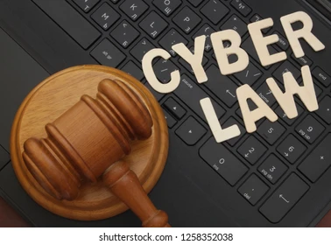
What are Cyber Laws ?
Cyberspace
The computer-generated world of internet is known as cyberspace.
Cyber Law
The laws prevailing the cyberspace are known as Cyber laws.
Cyber law is the branch of law that deals with legal issues related to use of inter-networked information and Technology.
cyber law is the law governing computers and the internet.

Slide 2

Information Technology Act 2000
The Information Technology Act 2000 was the first Cyber Law in India.
It was enacted on 9th June 2000.

Slide 3

Cyber Law and Intellectual Property

Slide 4
Intellectual Property
An important part of cyber law is intellectual property.
It refers to creations of the mind. It can be an Invention , Design , Brand Name.
Copyright
It protects the rights of Companies and Individuals to get profit from their creative work.
Ex:- You tube, Telegram
Fraud
The major motive of this law is to protect people from online fraud.
Ex :- Identity theft,

Slide 5
Patents
Patents are generally used to protect an invention.
These are used on the internet for two main reasons
i. For new software
ii. New online business methods.
Trademarks
A trademark can be any word, phrase, symbol or any combination of these things that identifies goods or services.
Trademarks are used for the websites.
Ex :- Twitter®

Slide 6
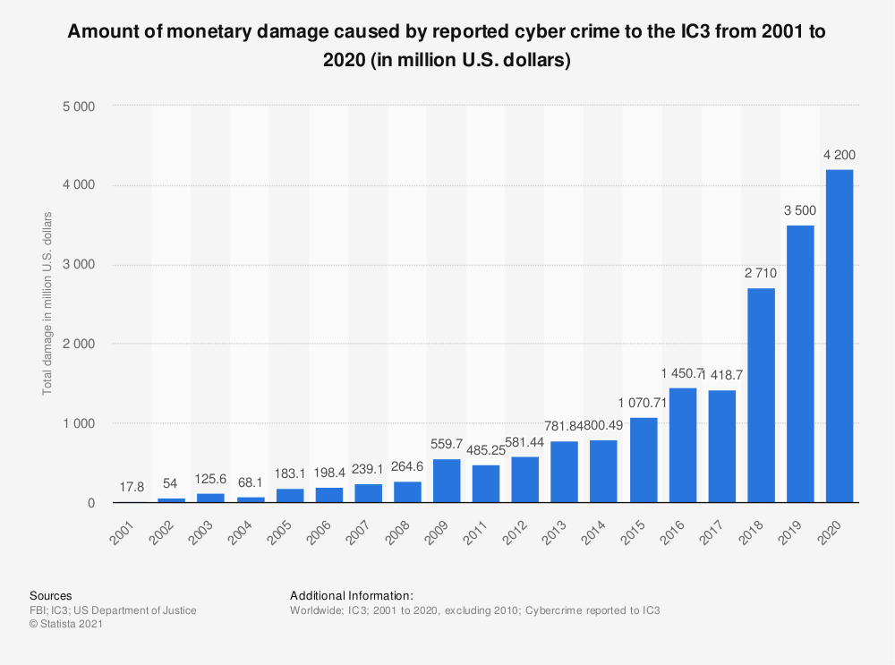
Cyber Crimes statistics

