Slide 1
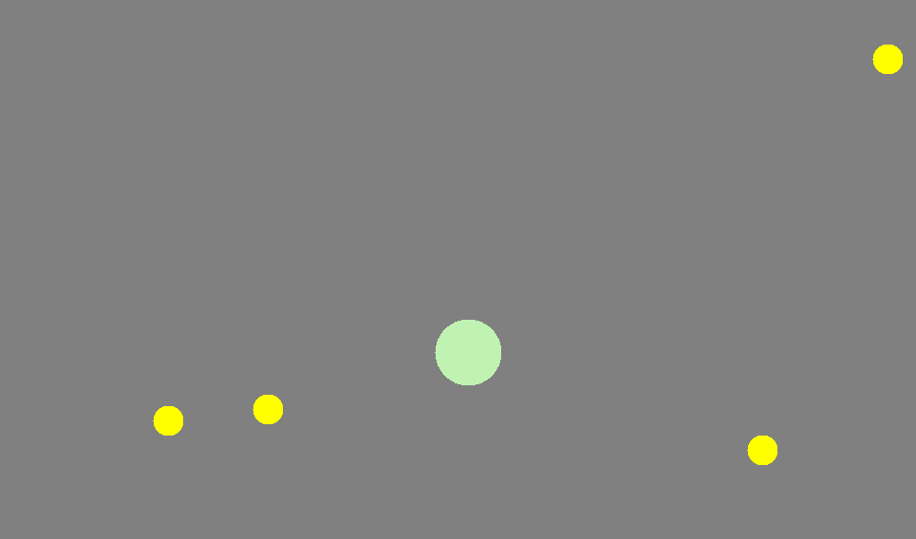
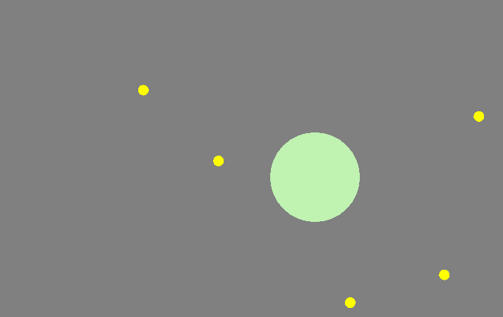
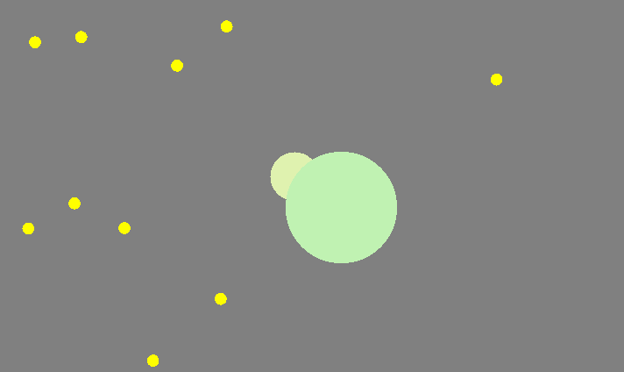
AGAR.io
Initially, the player starts at a random location and moves around using mouse pointers. The size of the player is small and moves on the canvas at very fast speed. The player eats the yellow food by moving over it and gained size.
Server
Thread
Game Data
As the player keeps eating food, it gains size and this reduces its speed. Therefore, the bigger a player is, the slower it will be. This makes it harder for the player to explore the canvas looking for food and other opponents.
Thread 1
Thread 2
Thread 3
Client
The game follows classic server-client architecture where one server is able to handle multiple client request. Each client connects to server’s IP and port, and gains access to the game data. This game data keeps track of all player’s location periodically broadcasts it to the clients. A player sends update location message to the server, which is then sent to all other players to render it on their own canvas.
Even though the player is slow when it is big, it still has an advantage over other players who as smaller than it, as it is able to consume players who are smaller than it. The players can try to escape by boosting for a limited time, but it is still hard for smaller players to survive when surrounded by bigger players.

