Slide 1
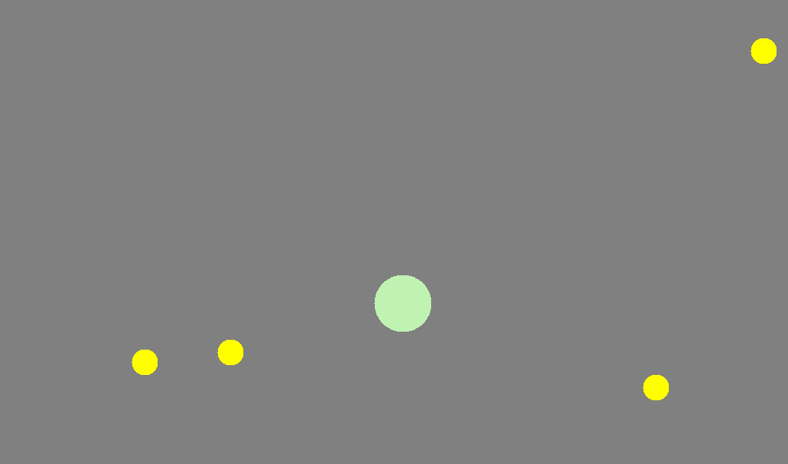
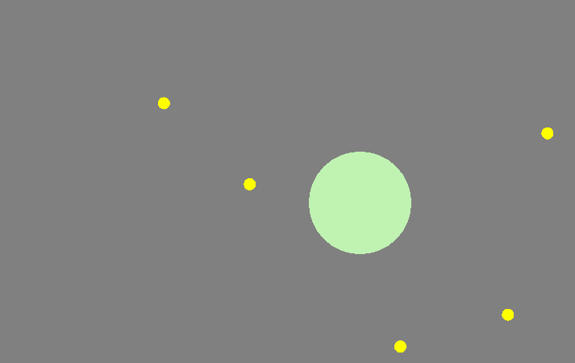
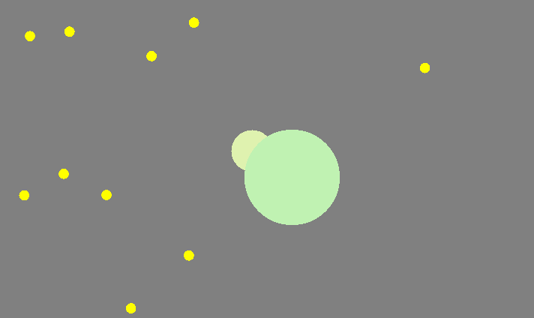
Agar.io
Gameplay
Architecture
Server
Initially, the player starts at a random location and moves around using mouse pointers. The size of the player is small and moves on the canvas at very fast speed. The player eats the yellow food by moving over it and gained size.
Game loop
Message receiver
Process
Wait for message and update player location
Spawn
sender
As the player keeps eating food, it gains size and this reduces its speed. Therefore, the bigger a player is, the slower it will be. This makes it harder for the player to explore the canvas looking for food and other opponents.
Every 1/60 seconds
Retrieve game state
Player location
Game state
Wait for responds and update game state
Every 1/60 seconds
Update player’s location locally
Send players' location to server
Response handles
Even though the player is slow when it is big, it still has an advantage over other players who as smaller than it, as it is able to consume players who are smaller than it. The players can try to escape by boosting for a limited time, but it is still hard for smaller players to survive when surrounded by bigger players.
Input handler
Message handler
Client
Render
Technical Difficulties
Draw Current Game state
Flicker due to messaging delays
Rendering large canvas on smaller screen
Scaling of canvas
Vigneet Somura, Ankit Soni, Varun Patni

