Slide 1

LLM Based Chatbot Assistant
Using Llama
Vignesh Kumar Reddy V
CB.SC.I5DAS21166
Int.Msc.Data Science
Sem: VIII

Slide 2
Project Aim & Objective
Aim: Develop an intelligent system integrating recommendation, RAG, agents, and databases for efficient decision-making.
Objectives:
Implement recommendation using FP-Growth
Develop a FAISS RAG system for efficient retrieval
Store and manage structured/unstructured data using FastAPI Session Storage & MongoDB
Build AI-powered Agents to assist in various tasks
Maintain session history for better context handling in LLMs

Slide 3
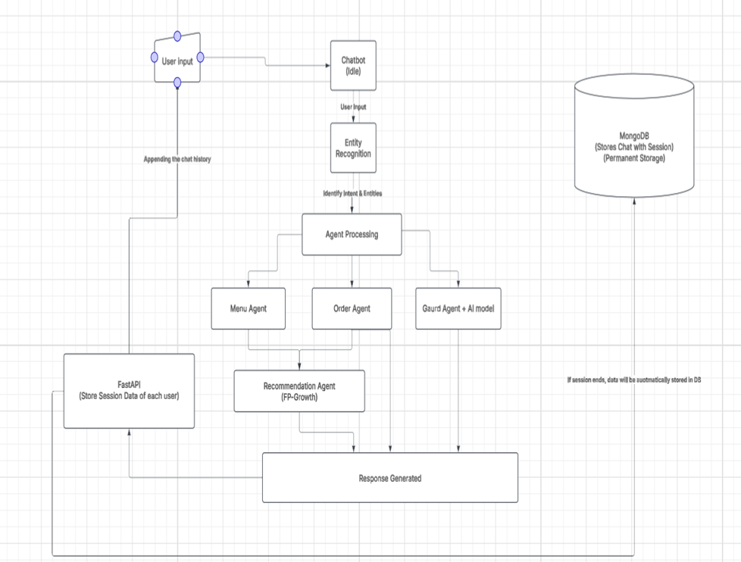
Work flow

Slide 4
Completed Work - Recommendation System
Implemented: FP-Growth for generating recommendations
How it works:
If items X and Y are frequently bought together, the system recommends Y when X is purchased.
Used Confidence and Lift metrics to ensure strong and relevant recommendations.
Why FP-Growth?
Memory Efficient: Works well with large datasets by compressing transactions into a tree structure.
Fast Processing: Directly extracts frequent item sets without multiple scans.

Slide 5
Completed Work - FAISS RAG System
Implemented: FAISS (Facebook AI Similarity Search) for RAG (Retrieval-Augmented Generation)
Key Features:
Inner Product search or cosine similarity
Supports high-dimensional vector storage
Efficient retrieval for LLM-based responses

Slide 6
Completed Work - MongoDB for Chats & Sessions
Used for:
Storing chat history
Managing sessions across different interactions
Preserving user context for better AI-driven responses

Slide 7
Completed Work - FastAPI Session History for LLMs
Objective: Store and track session history to enhance LLM understanding of user intent
Why?
Context retention across multiple interactions
More accurate responses from LLMs
Seamless user experience

Slide 8
Completed Work - Agents Development
Planned Agents:
Menu Agent – With FAISS retrieve documents and give context to llama.
Recommendation Agent – Provides personalized suggestions based on retrieved entities using FP-Growth
Order Agent – Will handle order-specific queries like item selection and quantity; currently managed by LLaMA for basic order understanding.

Slide 9
Solving Real-World Problems
Handles repetitive customer queries instantly
Provides personalized suggestions, unlike static bots
Works well on simple systems — no need for high-end infrastructure
Remembers context within a session for better interaction
Reduces human effort in small business environments

Slide 10
Future Work
After Mini-project
Improving RAG system with Advanced Algorithms
Implementing Redis to scale better
Improving Recommendation models with different Machine learning or deep learning approaches.
Add dedicated intent classifier to reduce LLM load.
Implement a user authentication system to enable login-based access and retain past chat history across sessions for better personalization.

Slide 11
References
FAISS (Facebook AI Similarity Search):
The Faiss Library
Authors: Matthijs Douze, Maximilien Guzhva, Vincent Leordeanu, Jeff Johnson, Hervé Jégou, and Tomasz Malisiewicz Published: January 2024
Retrieval-Augmented Generation (RAG):
Retrieval-Augmented Generation for Knowledge-Intensive NLP Tasks
Authors: Patrick Lewis, Ethan Perez, Aleksandara Piktus, Fabio Petroni, Vladimir Karpukhin, Naman Goyal, Heinrich Küttler, Mike Lewis, Wen-tau Yih, Tim Rocktäschel, Sebastian Riedel, and Douwe Kiela Published: May 2020

Slide 12
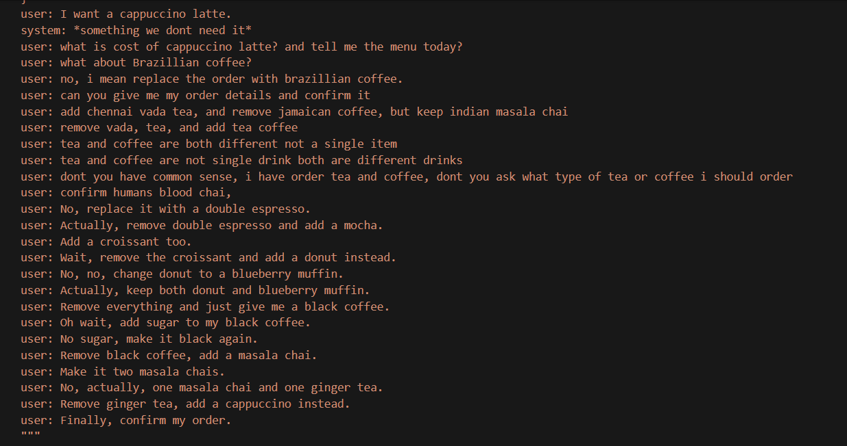
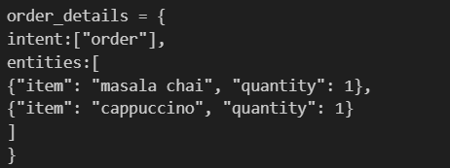

Slide 13
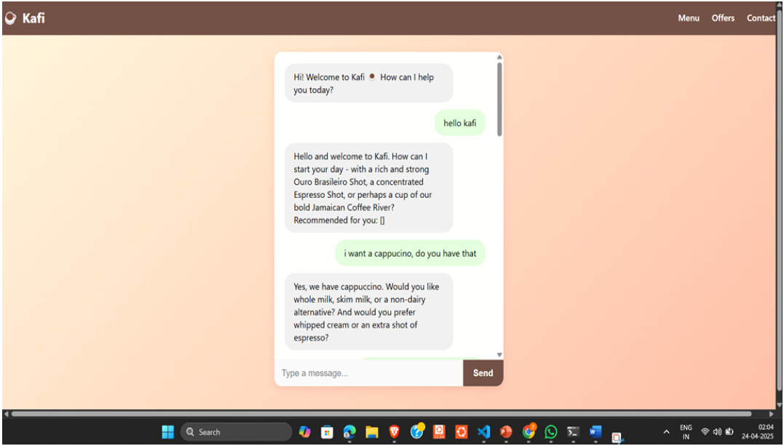
Outputs

Slide 14
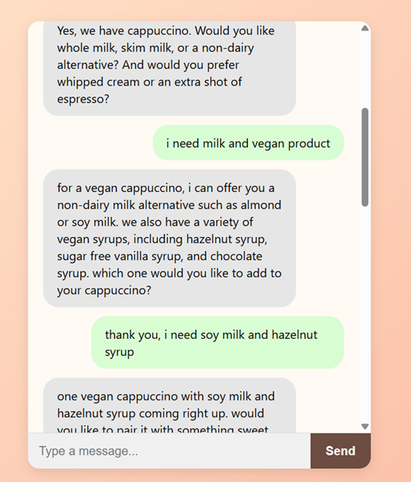
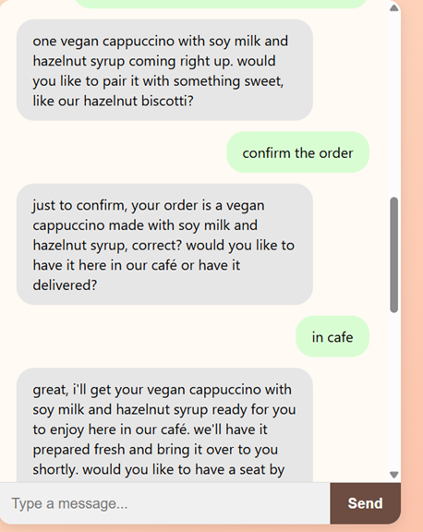

Slide 15
