Slide 1
FOOD FIESTA
Food Delivery Platform
Avula Siddartha (2411CS030034)
Brahmadeavara Vignesh (2411CS030068)
Bujangari Jashwanth (2411CS030072)
CH.Nanda (2411CS030080)

Slide 2
INTRODUCTION
What is Food Fiesta?
Food Fiesta is a food ordering and delivery website. It's one application, but with four different logins depending on who you are.
Customers
Restaurants
Delivery Riders
Admin
Browse restaurants, order food & track delivery
Manage their menu & incoming orders
Pick up and deliver orders
Manage the whole platform
The journey it covers:
1
2
3
4
5
Pick a
Restaurant
Order
Food
Restaurant
Prepares It
Rider
Delivers It
Track &
Review
Food Fiesta — Food Delivery Platform
2

Slide 3
EXISTING SYSTEM
The old way of ordering food
1
Phone Call Orders
Customers call the restaurant directly — no digital record is kept
2
Manual Coordination
Restaurants tell delivery staff verbally or over WhatsApp
3
No Order Tracking
Customers have no way to know if their food is being prepared or on the way
4
No Central View
There's no single place to see all orders, restaurants, or complaints
5
Manual Discounts
Offers and coupons are tracked by hand, so mistakes happen easily
6
Lost or Delayed Orders
Nothing is written down properly, so orders get mixed up or missed
Bottom line: managing multiple restaurants and riders this way becomes very hard to scale.
Food Fiesta — Food Delivery Platform
3

Slide 4
PROPOSED SYSTEM
How Food Fiesta solves it
1
One Platform, One System
Customer, restaurant, rider & admin all use the same system — just different logins
2
Step-by-Step Order Tracking
Placed → Preparing → Ready → Picked Up → On the Way → Delivered
3
Live Status Updates
Customers see real-time updates instead of calling to ask “where's my food?”
4
Restaurant Dashboard
Restaurants see and manage all their incoming orders in one place
5
Delivery Pool for Riders
Riders see a list of available orders and accept deliveries themselves
6
Admin Control Center
Approve restaurants, manage coupons, and handle complaints centrally
7
Built-in Coupons & Reviews
Discounts and ratings are handled automatically, not tracked by hand
8
Ready to Grow
Simple demo setup today — built so a real database & stronger security can be added later
Food Fiesta — Food Delivery Platform
4

Slide 5
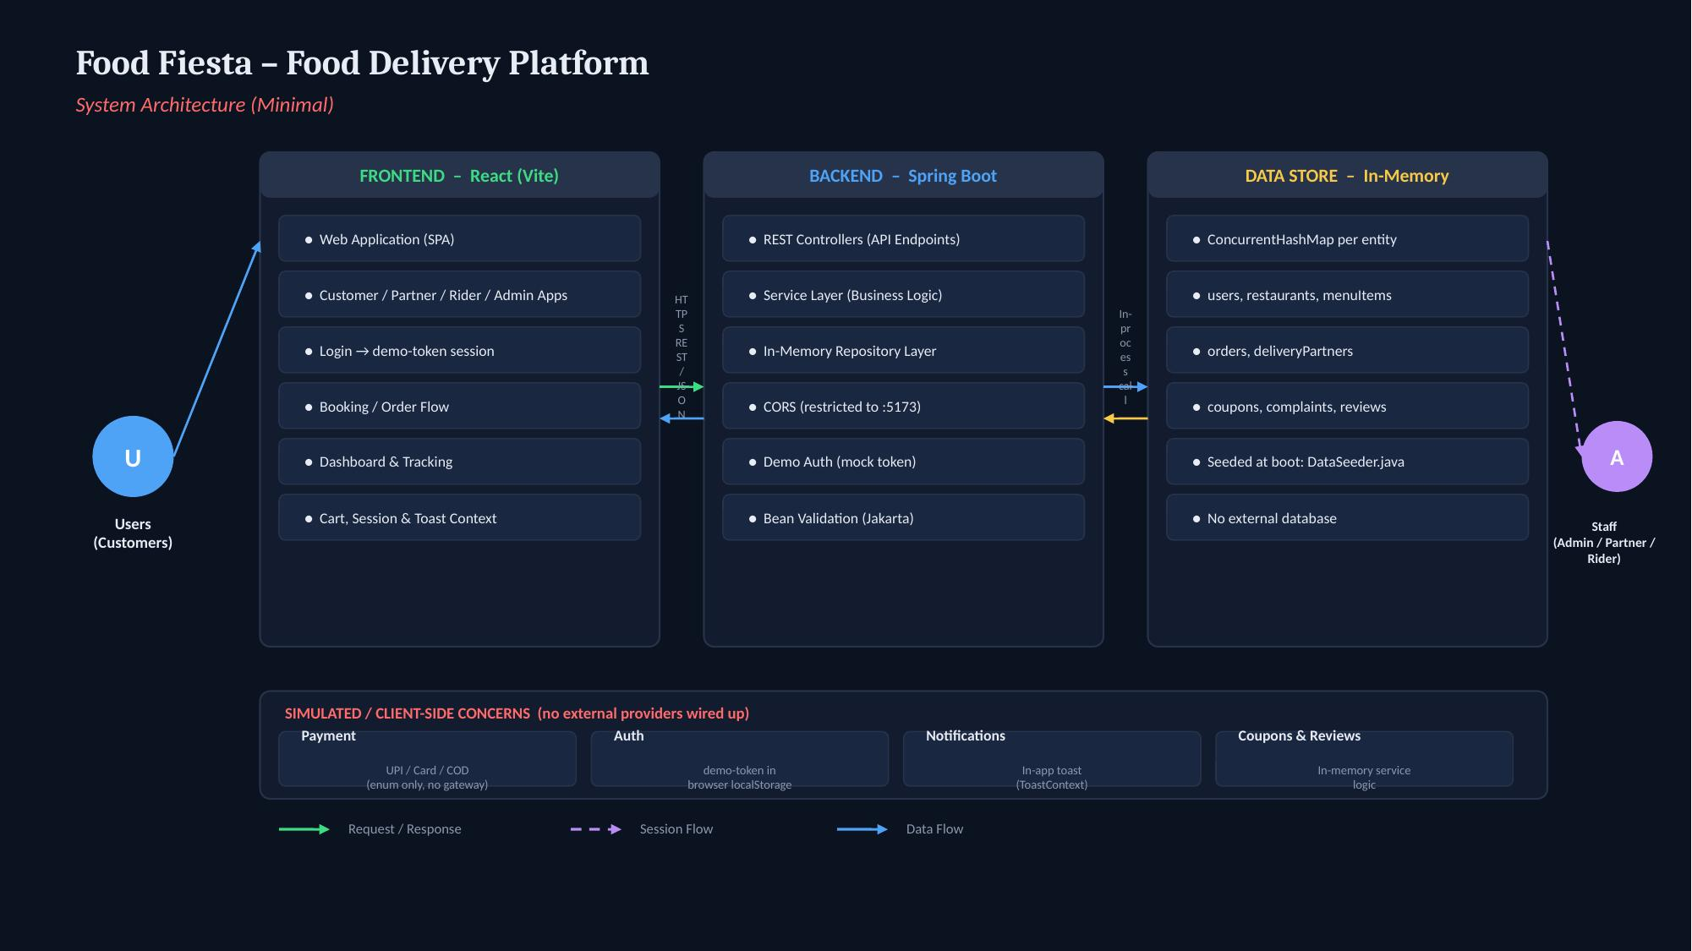
System Architecture

Slide 6
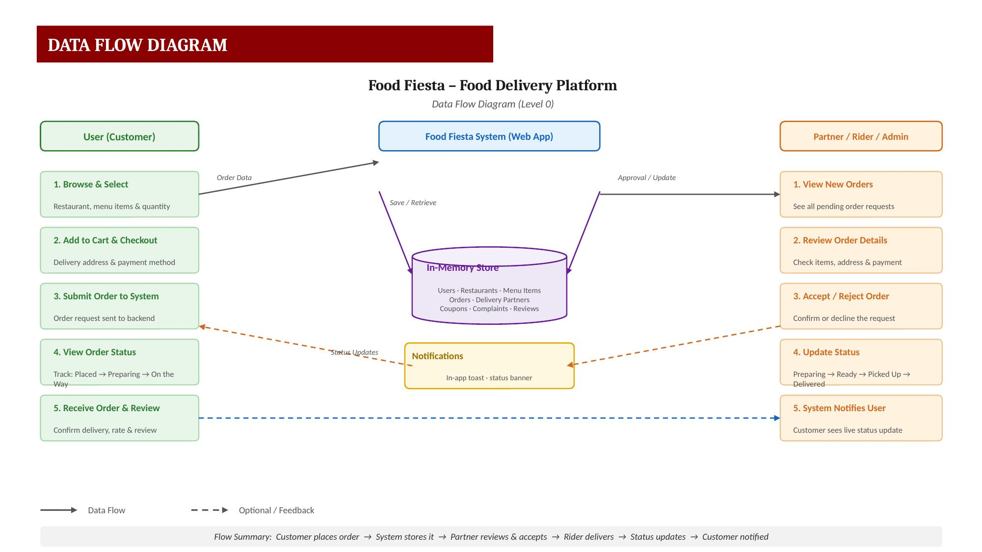

Slide 7
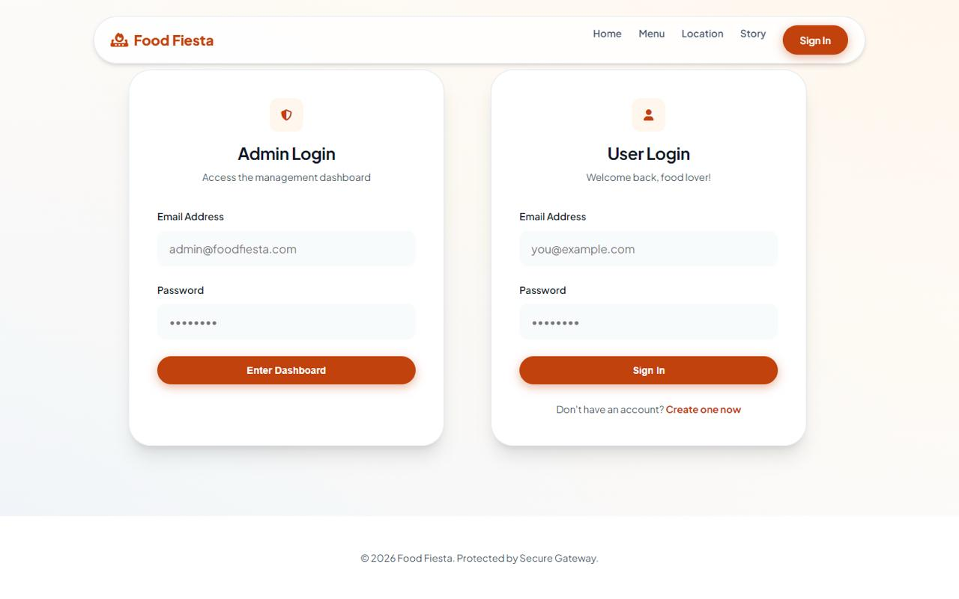
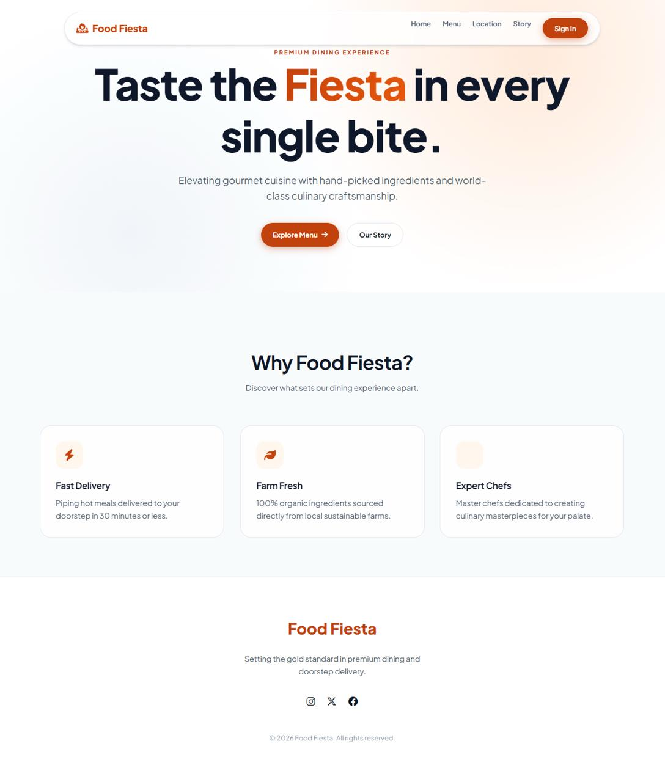
ScreenShots

Slide 8
CONCLUSION
Food Fiesta brings the entire food ordering process — from browsing to delivery — onto one simple, connected platform.
✓
Replaces phone calls and manual coordination with a single digital system
✓
Gives customers real-time visibility into their order, every step of the way
✓
Gives restaurants and riders their own easy-to-use dashboards
✓
Gives admins full control and oversight of the platform
✓
Built on a clean, layered architecture (React frontend + Spring Boot backend) that's easy to extend
✓
A simple, working demo today — with a clear path to a production-ready system
Thank You

