Slide 1
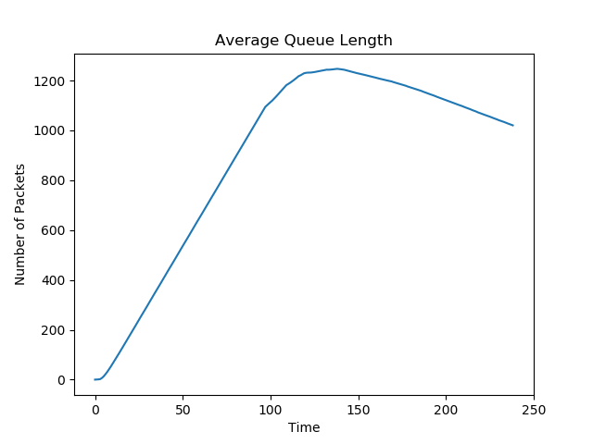
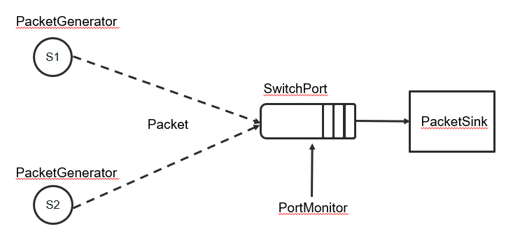
An Investigation into the use of Reinforcement Learning for Enhanced Queue Stability in RED Gateways
Vignesh Pagadala
Vignesh.Pagadala@colostate.edu
Department of Computer Science
Colorado State University
Abstract
Queue length calculation
Reinforcement learning
Despite being a well-established congestion-avoidance scheme in packet-switched networks, there happens to be a general reluctance amongst network administrators in implementing Random Early Detection (RED) in their network gateways.
This is due to the presence of several adjustable parameters associated with RED, whose values are to be determined by the network administrators themselves.
There happens to be no known methods which espouse on how to manually set these values to achieve peak network performance. To circumvent this problem, several studies have relied on automating this procedure, using feedback about the performance over discretized time intervals, and information regarding the state of the network to arrive at an optimum solution.
In this work we shall adopt a reinforcement-learning-based approach to arrive at the optimal values of the control parameters. We shall use Q-Reinforcement, and describe the state using the control parameters Qmax and Qmin. The goal will be defined by the network administrator in terms of packet drops, queue stability and link usage.
Instantaneous queue length value - bad
Exponential Weighted Moving Average (EWMA)
Lower value of w allows for softer variation in avg.
How can we translate this into a reinforcement learning problem?
Control parameters varied: Qmax and Qmin
Q-Reinforcement
State-Action description and Q-table population procedure (SARSA)
State: (Qmax, Qmin)
Actions: ("_+", "_-", "+_", "-_")
Qmax varies from 1 to buffer length, Qmin varies from 1 to Qmax.
Goal state? Expected range of values for CWND, DROP and STD
Performance measure
Source congestion window size (CWND):
Indicates link utilization. We would like this to high.
Number of packets dropped (DROP)
Average queue length stability (STD)
Measured by calculating standard deviation observed in average queue lengths over time.
We try to optimize the control parameters for large CWND, low packet drops and low standard deviation.
results
Buffer size of 2000 packets
Line service capacity of outbound link: 12.5 packets/second
Two sources with max CWND threshold of 30 p/s
Weight calculated using:
(as suggested by Floyd et al.)
Random early detection
Well-established congestion-avoidance scheme.
General reluctance amongst network administrators in implementing RED.
Due to presence of multiple adjustable parameters – manual configuration paradigm not available.
Using reinforcement learning to find optimum values?
Experimental setup
1000 learning iterations, with an Epsilon Decay Factor of 0.4, and learning rate of 0.01.
Goal state:
STD < 350 packets
DROP < 35
CWND > 2
Output:
MaxQ: 1858
MinQ: 993
Control parameters
Packets Dropped: 28
CWND total: 2.875
conclusions
Probability Function:
MaxP: Maximum drop probability
Qmax: Maximum queue length threshold
Qmin: Minimum queue length threshold
W: Weight associated with queue length calculation
The experiments showed that the values obtained through the use of reinforcement learning seem intuitively correct.
A degree of uncertainty involved due to the probabilistic drop.
Discreet-event simulator package by Grotto Networking using SimPy.
Classes - Packet, PacketGenerator, PacketSink, SwitchPort (simulates the queue), PortMonitor (logs data).
CWND at each source starts at 1 packet/second and goes up to threshold. Threshold gets halved after packet drop is 'detected' (additive increase, multiplicative decrease).
references
Floyd, Sally, and Van Jacobson. ”Random early detection gateways for congestion avoidance.” IEEE/ACM Transactions on networking 1.4 (1993): 397-413.
2. Jacobson, Van, K. Nichols, and K. Poduri. ”RED in a Different Light.” Draft, Cisco Systems (1999).

