Slide 1

To-Do List Using Python
Vignesh Palanirajan – PES2UG22CS661
Vedant Kamlesh Marathe – PES2UG22CS653

Slide 2

Aim of the Project
To create a to-do list program with a simple , clean and a neat GUI
To allow the user to add any task to the list and delete any task of the list as per the user’s requirements
To create multiple lists with any name of the user’s choice, delete a list and open any existing list

Slide 3
Objective
To create a to-do list program with a simple , clean and a neat GUI
To make use of text files to store the task lists
Each task is to be stores in each line of the text file, in order
Make use of GUI to display the task lists and allow the user to manage the task lists

Slide 4
Functional Modules in the Project
Tkinter module – for the graphic user interface of the todo list program
OS module – for deleting the list file in the delete list window

Slide 5

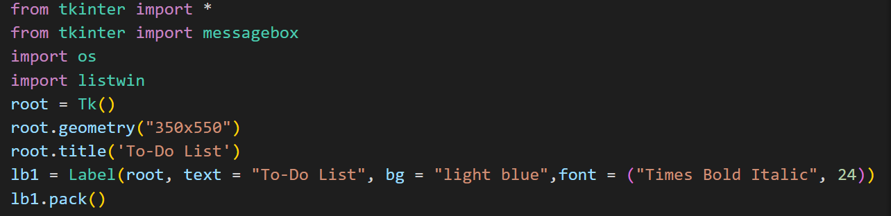
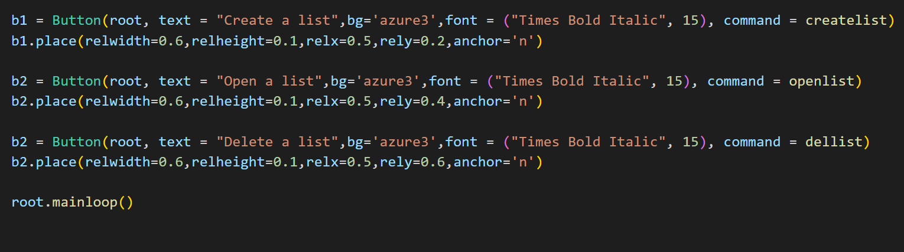
Pseudocode of the functional modules
Tkinter module

Slide 6
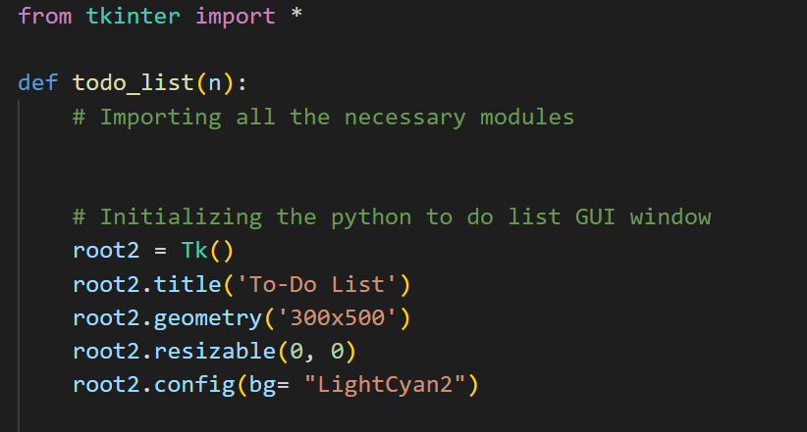
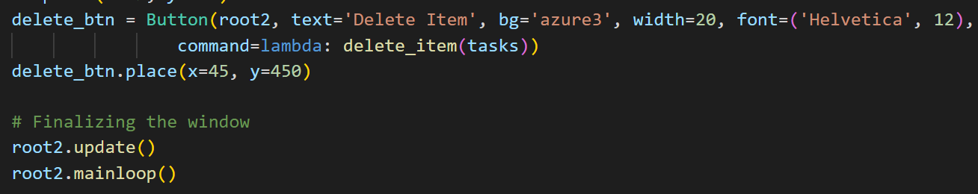
Pseudocode of the functional modules
Tkinter module

Slide 7
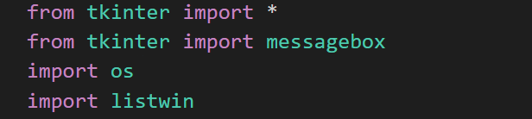
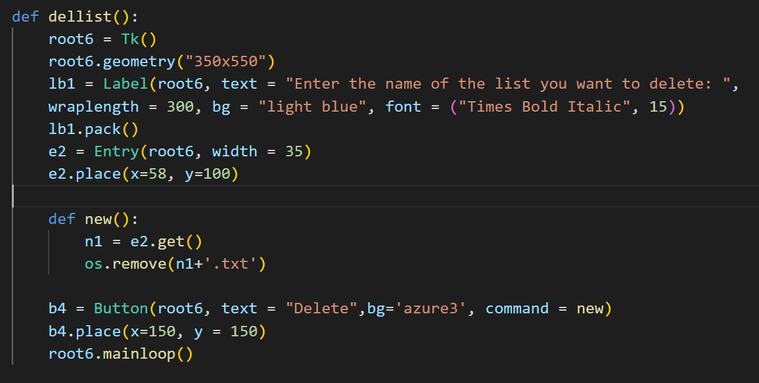
Pseudocode of the functional modules
OS module

Slide 8
Applications of the project
This to-do list programs will help the users in their day-to-day lives
The users can organize their lives and increase their day-to-day productivity
Due to simple and efficient GUI, anyone will be able to use it with ease
The user can use this program to create any kind of list as per their requirements such as to-do lists, movie lists, grocery lists, etc…

Slide 9
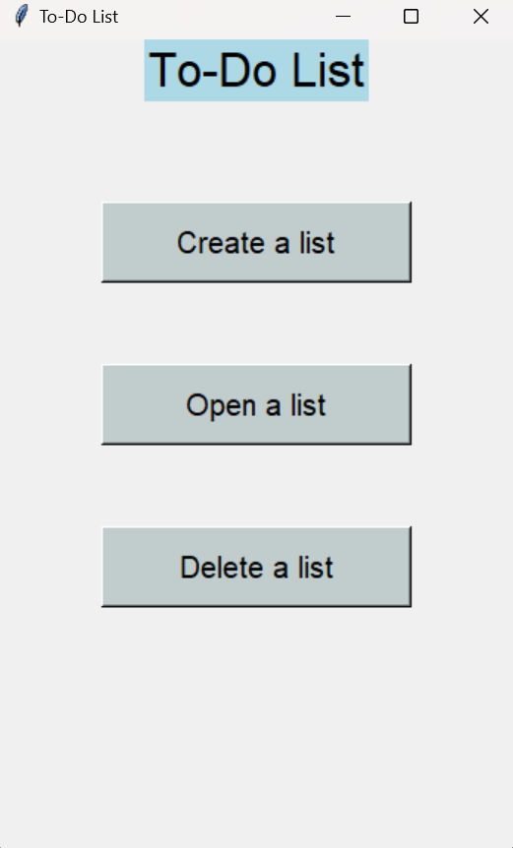
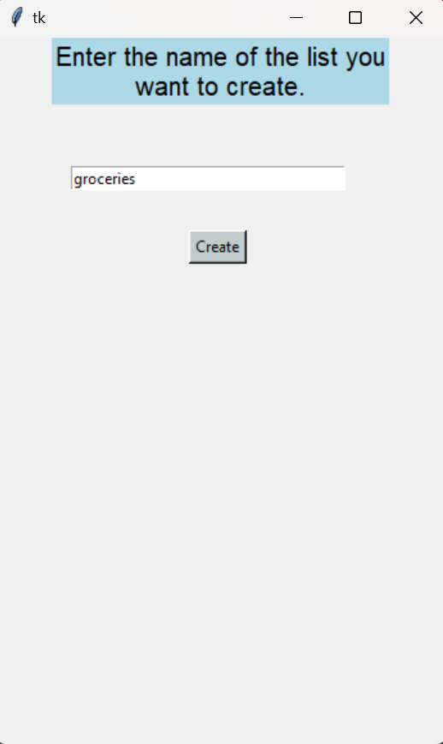
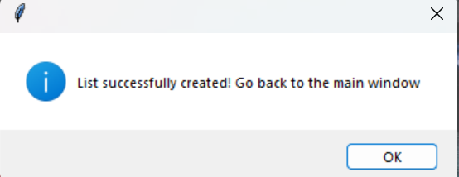
Output Screen Shots
Confirmation Window
Main Window
Create List Window

Slide 10
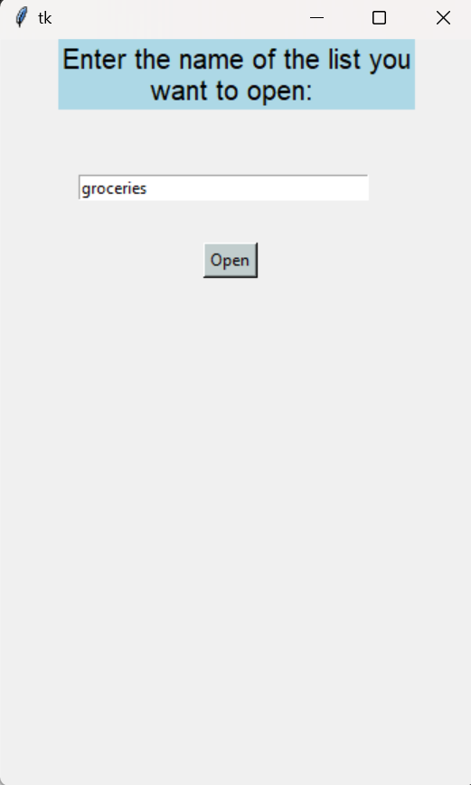
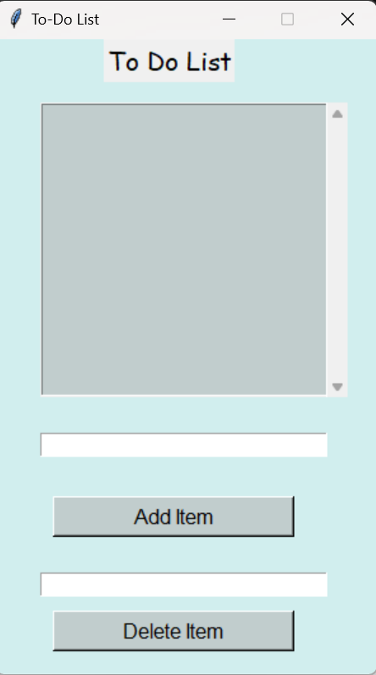
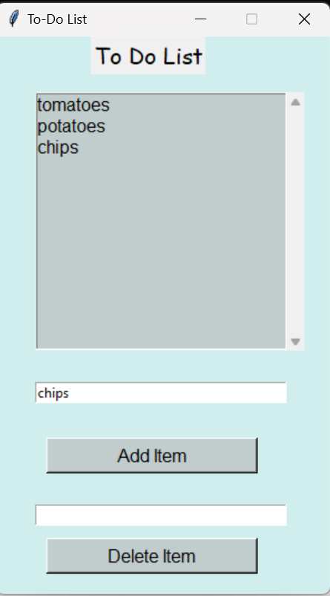
Output Screen Shots
Open List Window
To-do List Window
Adding items

Slide 11
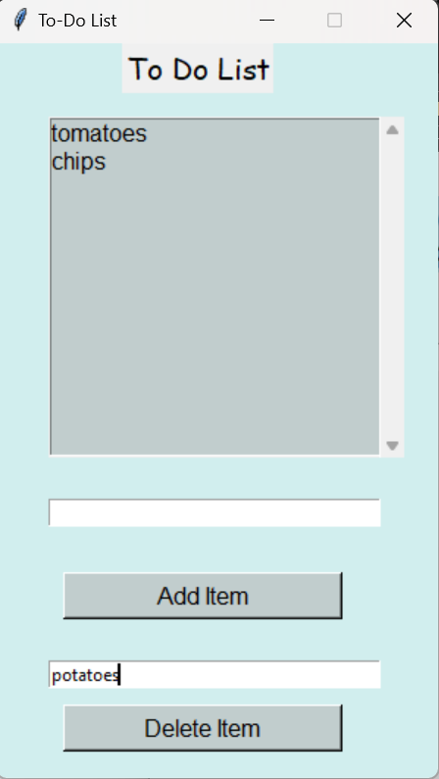
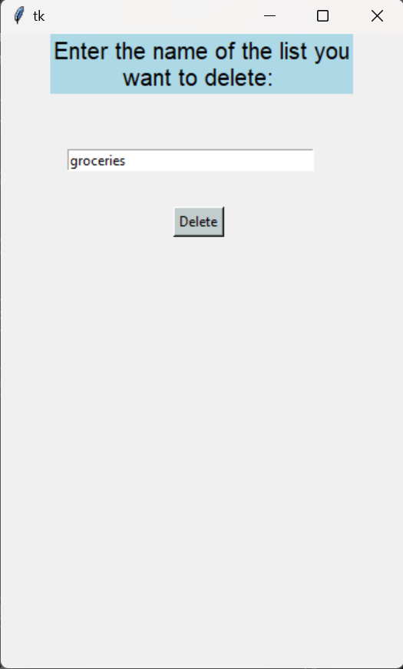
Output Screen Shots
Deleting Items
Main Window
Delete List Window

Slide 12
References
https://www.youtube.com/watch?v=wEv3BworNK8
https://www.plus2net.com/python/tkinter-colors.php
https://www.geeksforgeeks.org/python-program-to-delete-specific-line-from-file/
https://www.tutorialspoint.com/python/tk_listbox.htm
https://www.pesuacademy.com/Academy/s

Slide 13
THANK YOU

