Slide 1

Smart Classroom & AI Timetable Generator
An easy-to-use platform that builds conflict-free class schedules automatically and keeps classrooms quiet and ready for learning.

Slide 2
Old Way Problems vs Our Solution
The Old Manual Way
Our Smart Solution
Creating timetables by hand takes days. Teachers get booked in two rooms at once, classrooms get overcrowded, and noisy hallways break student concentration during lectures.
Our AI system builds perfect timetables in seconds with zero room conflicts. Smart classroom sensors monitor noise and access doors to keep learning calm and focused.

Slide 3
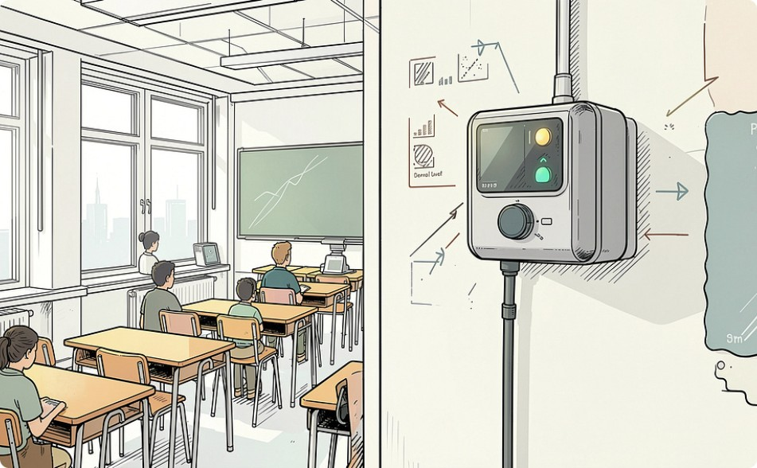
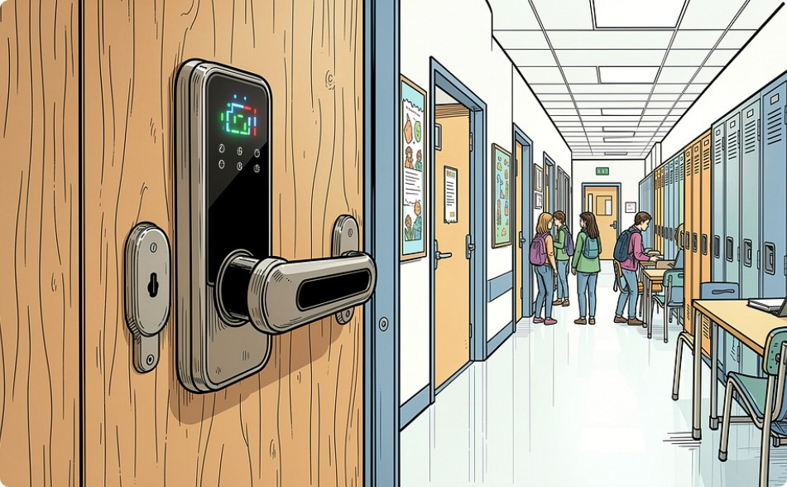
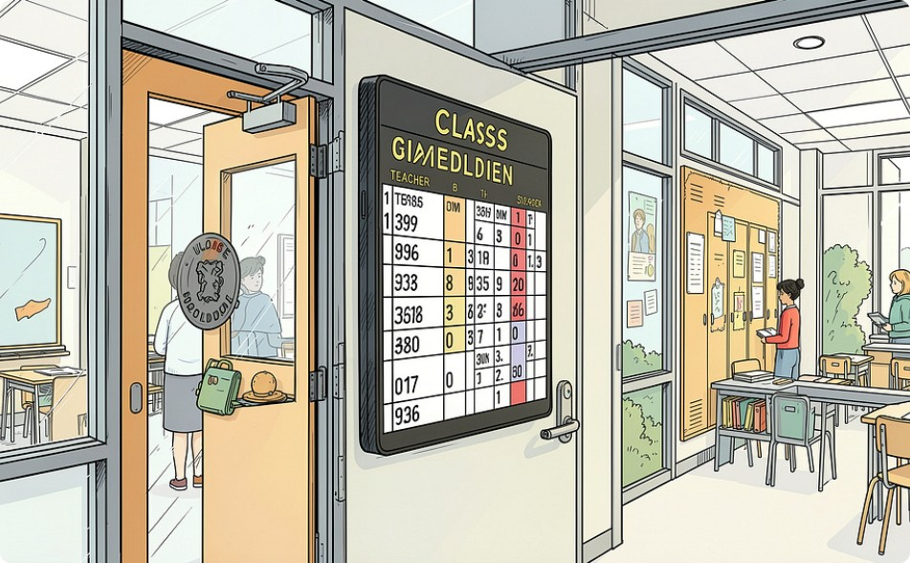
Smart Classroom Equipment
Noise & Sound Sensors
Smart Door Entry
Live Outside Displays
Automatically checks room sound levels to help teachers maintain a quiet study environment.
Door locks open only for scheduled classes, stopping unwanted walk-ins during lectures.
Digital screens outside each room show the active class name, teacher, and next session.

Slide 4



Core Modules of System
Teacher Rules
Room Matcher
AI Schedule Generator
Stores working hours, preferred break times, subject expertise, and daily limits for every teacher.
Assigns classes based on seating capacity, lab equipment, projector availability, and student count.
Tests thousands of timetable slot patterns instantly to produce 100% clash-free weekly schedules.

Slide 5

Disturbance-Free Study
Quiet Learning Spaces
No Hallway Confusion
Sensors send a soft alert if sound levels get too loud during study hours.
Clear schedule displays outside doors prevent students from wandering into wrong classes.
Smart Room Settings
Lights and temperature adjust automatically when lectures start.

Slide 6



AI Scheduling Workflow
1. Upload Data
2. Run AI Generator
3. Publish & Sync
Enter teacher lists, subjects, room capacities, and student batch details.
Algorithm checks all rules and instantly fixes timing overlaps.
Schedule updates live across campus displays and student phones.

Slide 7
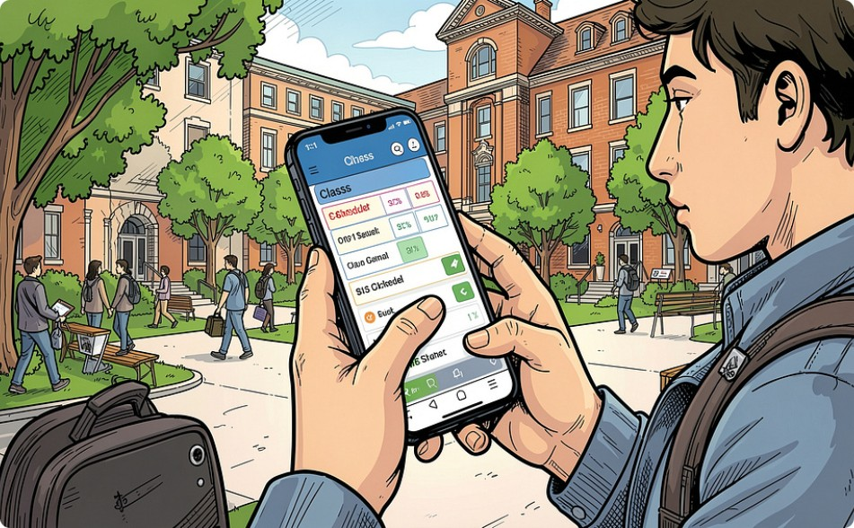
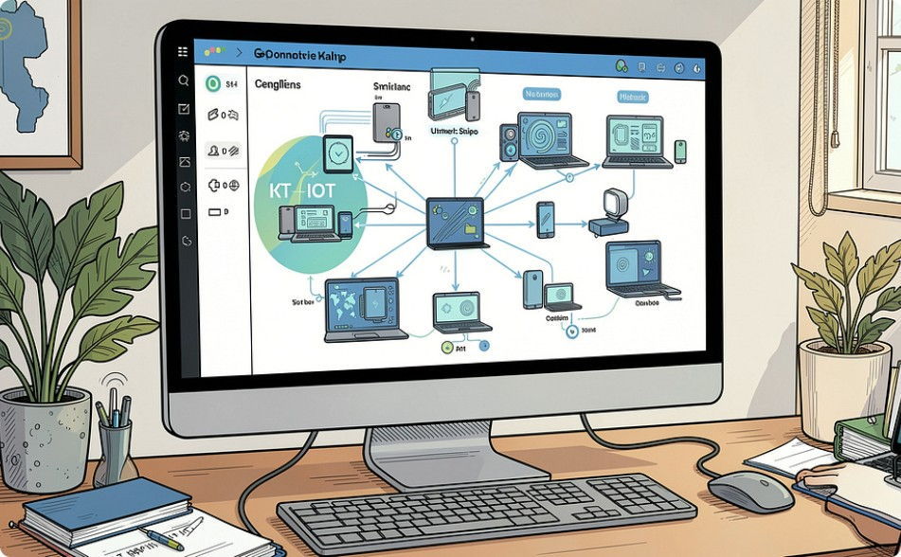

Smart Campus Ecosystem
Student Mobile App
Smart Campus Mesh
Automated Rooms
View daily class timetable, instant room changes, and live class notifications.
Connects all classroom doors, displays, and sensors to one web dashboard.
Rooms automatically turn off lights when empty to save school electricity.

Slide 8




Project Implementation Plan
Collect Data
Train AI Engine
Install Sensors
Launch App
Gather lists of teachers, subjects, rooms, and class sizes.
Set rules in the AI generator to stop schedule overlaps.
Place noise sensors and digital room displays in classrooms.
Deploy web portal and mobile app for staff and students.

Slide 9
Thank You!
PROJECT PRESENTATION DESIGNED BY
Manikanta Vignesh & Ram Charan

