Slide 1
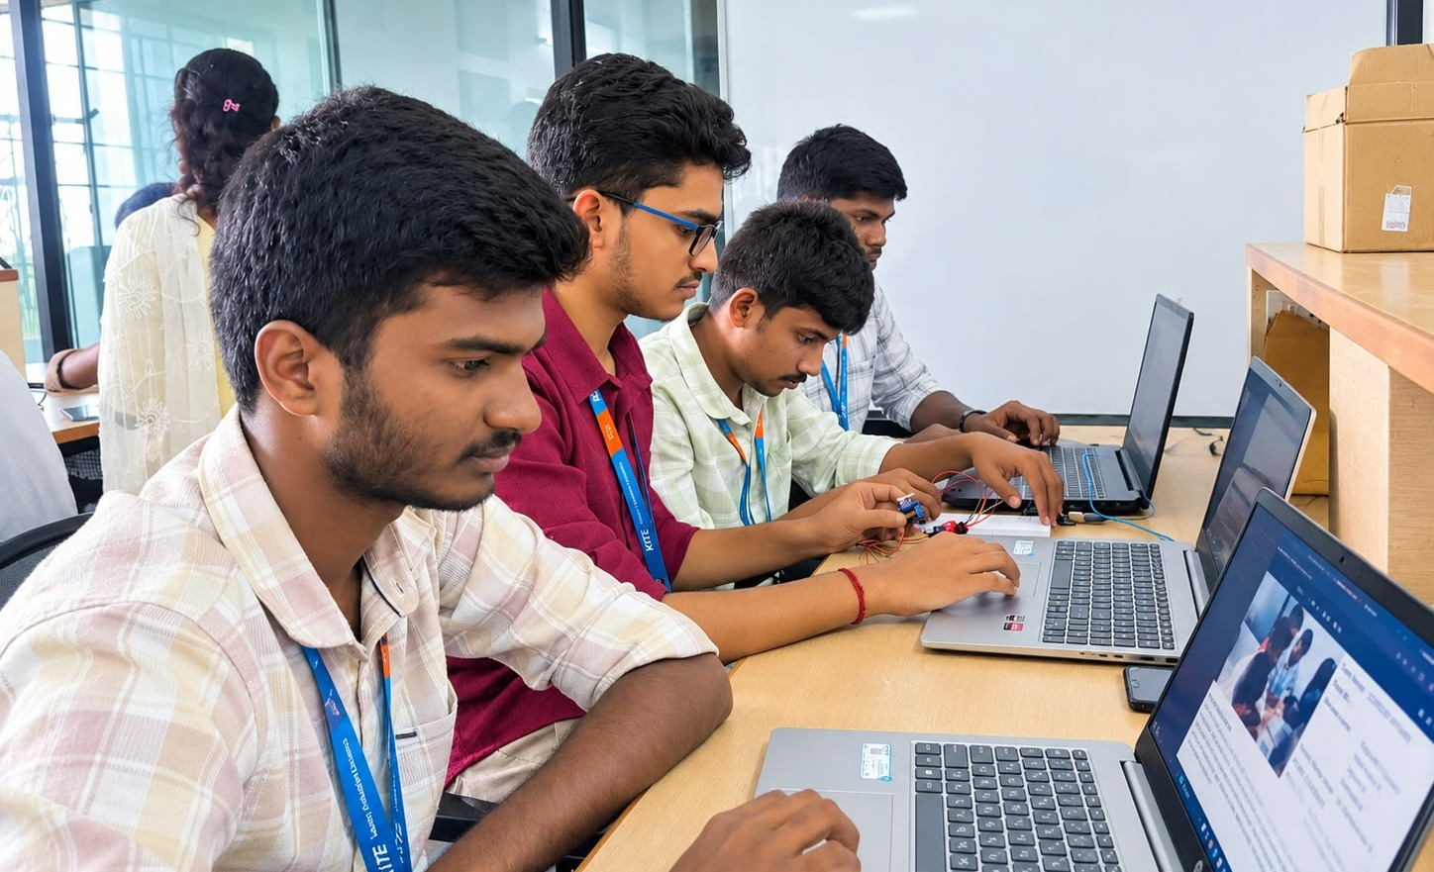
Team Name:
CURRENT AFFAIRS
Team ID :
EC013
Members name:
Ragupathi V
Navin Kumar S
Vignesh R
Yashvanth B
Faculty Mentor Name:
Dr. Kamalakannan S
PS NO:
ECW260045
Project Title :
RainGuard: Rain Detection & Outdoor Clothes Protection Alert
Project Description:
RainGuard detects rain using a rain sensor (with a humidity sensor to avoid false alarms) connected to an Arduino microcontroller. When rain is sensed, the Arduino drives a small motor-based model mechanism that slides the clothes line under shelter, protecting the clothes without anyone being present. Once the rain stops and the sensor dries, the clothes are moved back out automatically, with a manual override switch available. The solution is low-cost, simple to build and useful for homes, hostels and apartments.

