Slide 1

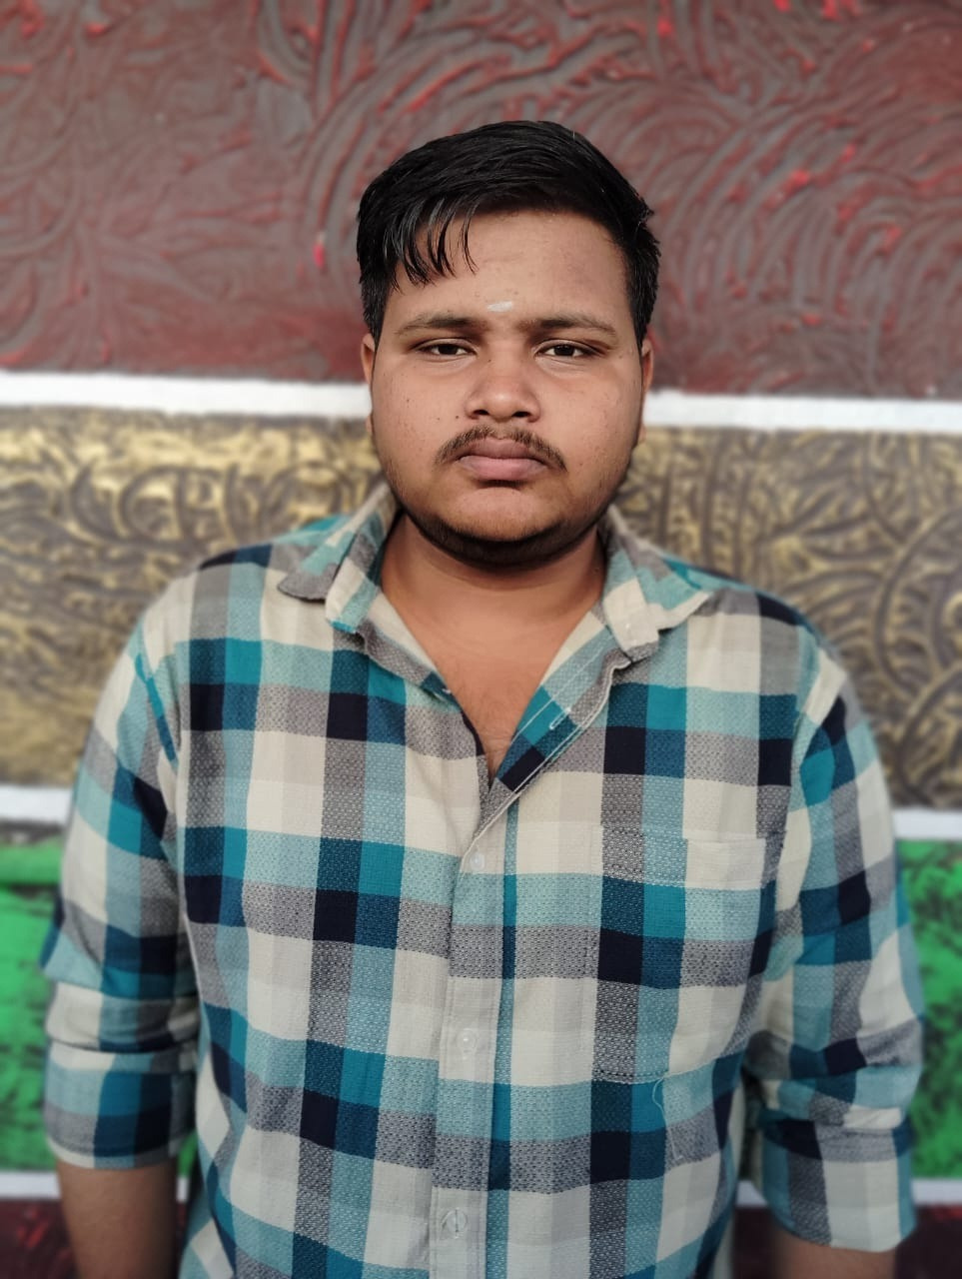
CYBER SECURITY
portfolio
for
R.VIGNESH
Page | 01

Slide 2

__A___B___O____U___T___ _M____E
NAME
: R.VIGNESH
REG.NO&NM ID
: 2422k1909&
248F205C502CFEC85974C4A2DF148361
DEPARTMENT
: Bsc.Computer Science
COLLEGE
: Cikanna Government Arts college
UNIVERSTY
: Bharathiyar University

Slide 3

AGENDA
_____________________
6)Features & functionality
1)Problem statement
2)Program overview
7)Results & screenshots
3)End user
8)Conclusion
4)Tools & technologies
9)Github link
5)Portfolio design & layout

Slide 4


individual's expertise in cybersecurity.
Problem Statement:
_______________________________________________________________________
Create a professional cybersecurity portfolio website that showcases skills, experience, and projects to potential employers, clients, or collaborators. The website should be visually appealing, easy to navigate, and provide a clear overview of the individual's expertise in cybersecurity.
Page | 02

Slide 5
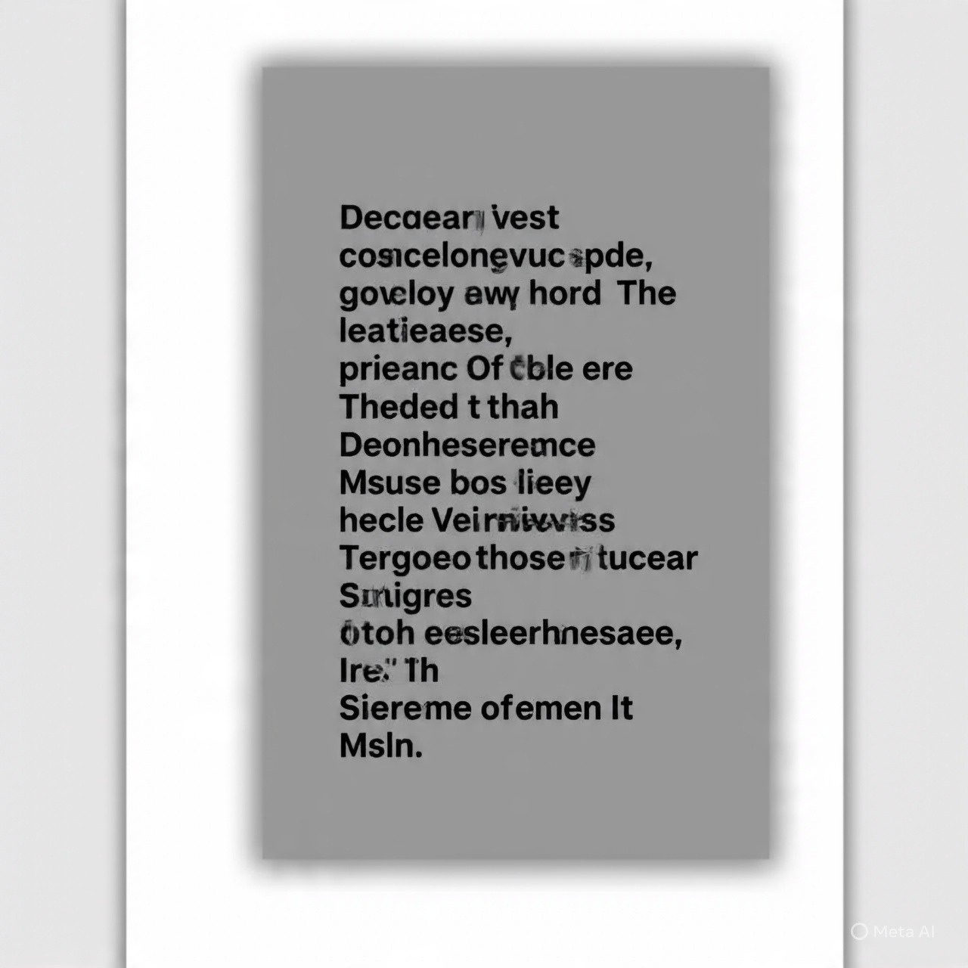
Adeline Palmerston
_
P____r___o___g____r___a___m_____ __O_____v____e___r___v___i__e___w______:_
The cybers ecurity portfolio website is designed to:
___
___
Showcase the individual's skills and experience in cybersecurity • Provide a platform to share projects and achievements
• Demonstrate expertise in various areas of cybersecurity, such as threat analysis, penetration testing, and incident response
• Establish credibility and build trust with potential employers, clients, or collaborators
Page | 03

Slide 6
Adeline Palmerston
Home
Photo
About Me
Contact
End-user:
___________________________
Thetargetaudienceforthe cybersecurity portfolio website includes:
• Potential employers in the cyber security • Clients seeking cybersecurity services
• Collaborators or partners in cybersecurity projects
• lndustry professionals and peers
Page | 04

Slide 7
Adeline Palmerston
Home
Photo
About Me
Contact
Tools & Technologies:
____
T__h__e___w___e___b__s__i_t_e___w___i_l__l__b__e___b__u___i_l_t__u___s__i_n__g__:______________________________________
• HTML5 for structuring conten,CSS3 for styling and layout
• JavaScript for interactive elements and dynamic content
• Front-end frameworks like React or Angular (optional)
• Back-end frameworks like Node.js or Django (optional)
• Database management systems like MySQL or MongoDB (optional
Page | 05

Slide 8

Adeline Palmerston
_P__o___r__t__f_o___l_i__o__ _D___e___s__i_g___n___ _
The portfolio design should be:
• Clean and minimalistic, with a focus on showcasing content • Responsive and adaptable to different screen sizes and devices • Visually appealing, with a consistent color scheme and typography
• Easy to navigate, with a clear and intuitive menuPag

Slide 9

Adeline PalmerstonHome
Photo
About Me
Contact
Features & Functionality:
_____________ _______________________________________________________
Thewebsiteshouldincludethefollowing features:
• Home page: A brief introduction to the individual and their expertise in cybersecurity
• About page: A more detailed bio, including education, experience, and skills
•Projects page: A showcase of completed projects, including descriptions, images, and
links to live demos or GitHub repositories
•Skills page: A list of technical skills and certifications
•Contact page: A contact form or email address for potential employers, clients, or
collaborators to get in touch
- *Blog or news section: A section for sharing articles, insights, or news related to
cybersecurity
Page | 07
By incorporating these features and design elements, the cybersecurity portfolio website will effectively showcase the individual's expertise and provide a professional online presence.

Slide 10
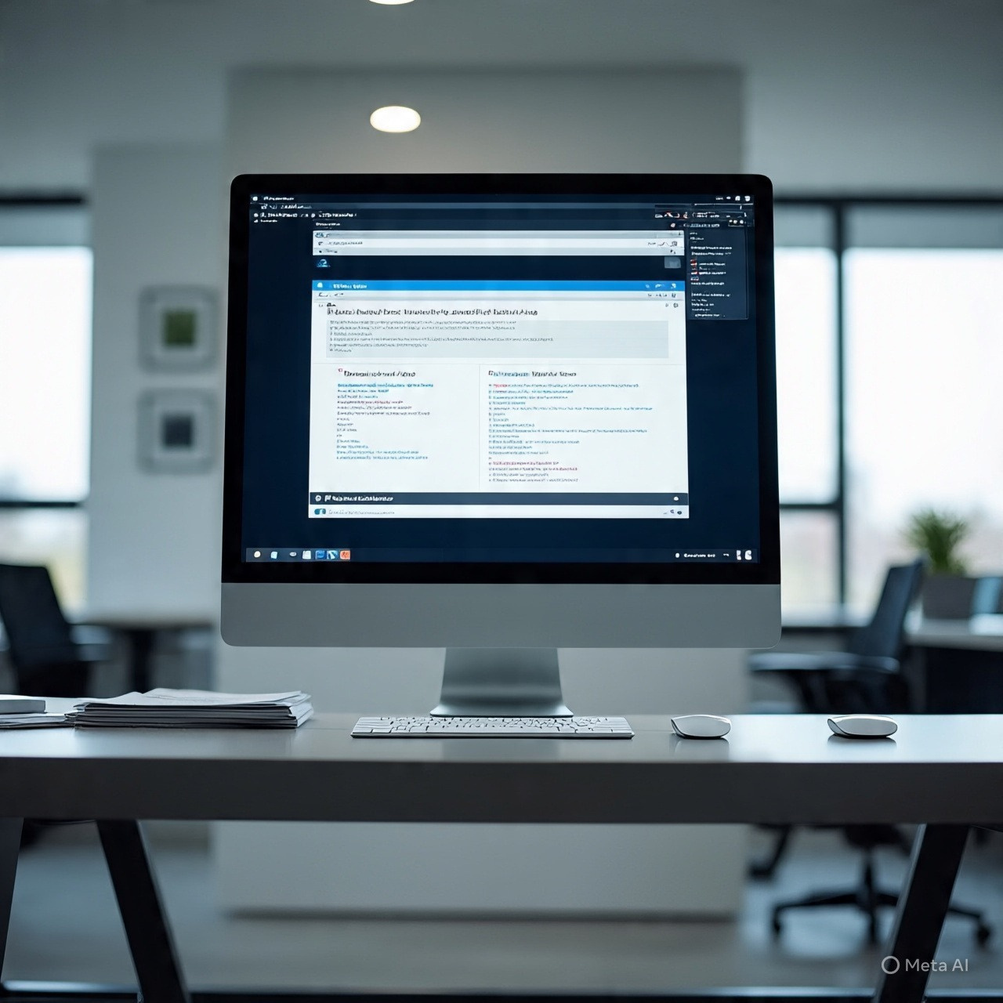
Adeline Palmerston
_R___e___s__u___l__t__s__:__
1)Showcase Projects:
Highlight your past work and accomplishments, including case studies and project highlights.
2)Services Section:
Describethe specific services you offer, such as
penetration testing, risk assessment, or incident response.
Page | 08

Slide 11
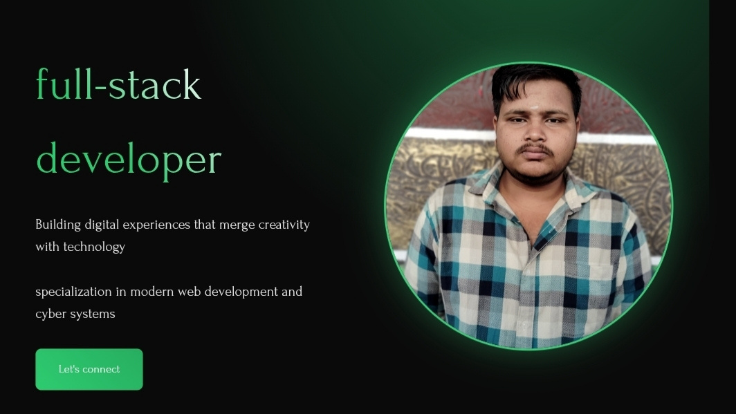
Adeline Palmerston
Home
Photo
About Me
Contact
_S___c__r__e___e___n____ _s__h___o____t_:
Page | 09

Slide 12

Adeline Palmerston
Home
Photo
About Me
Contact
Conclusion:
_______________________________
A well-designed cybersecurity portfolio website is crucial for establishing credibility
and attracting potential clients or employers. Ensure your website is ¹ ²:
• Responsive: Optimized for all devices, including desktops, laptops, tablets, and
smartphones.
• SEO-Friendly: Rank well in search engine results pages to increase visibility.
• Easy to Navigate: Use clear headings, structured navigation, and straightforward
messaging
Thank you for your visiting
Page | 10

Slide 13
GITHUB
.....................
.....................
LINK
https://github.com/vignesh01052007-gif/VIGNESH-R-TNSTC-FWD-DP-.git

Slide 14

THANK
YOU

