Slide 1
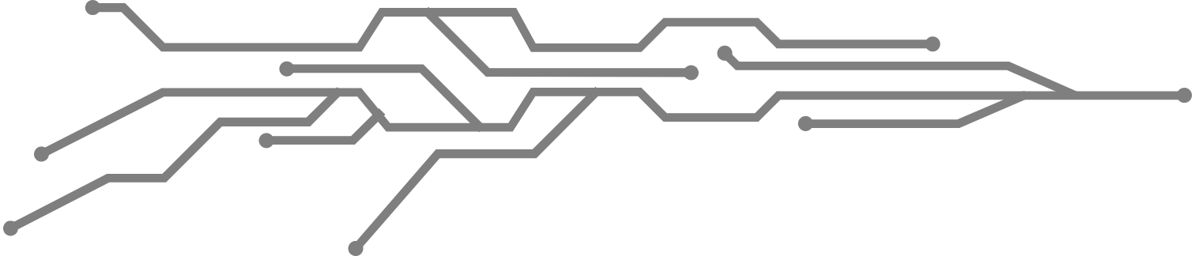
Create a Chatbot in Python
Vigneshwaran.S
912421104054

Slide 2
Table of Contents
01
Introduction to Chatbots
02
Problem Statement
03
Design Thinking Process
04
Phases of Development
05
Algorithms
06
Conclusion

Slide 3
Introduction to Chatbots:
Chatbots are computer programs designed to simulate conversation with human users, especially over the internet. They are becoming increasingly popular in various industries, including customer service, healthcare, and e-commerce. However, developing a chatbot can be a challenging task, requiring expertise in natural language processing, machine learning, and software engineering.

Slide 4
Problem Statement:
The problem we aim to solve is to develop a chatbot in Python that can provide intelligent responses to user queries in a conversational manner. The chatbot should be able to understand natural language input, extract relevant information, and generate appropriate output. Additionally, the chatbot should be able to learn from previous interactions and improve its performance over time.

Slide 5
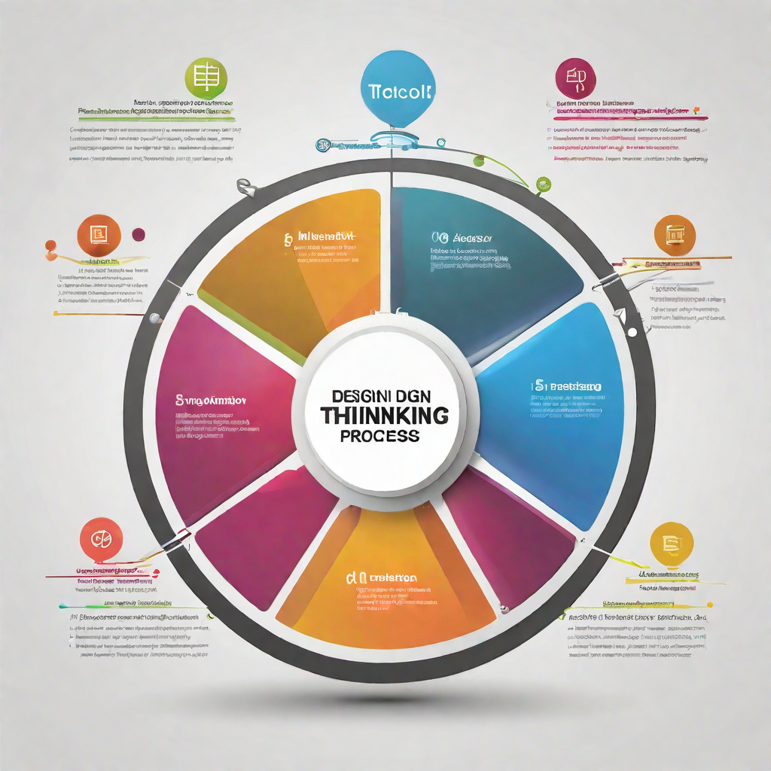
Design Thinking Process:
The design thinking process is a human-centered approach to problem-solving that involves empathy, creativity, and iteration. It consists of five stages: empathize, define, ideate, prototype, and test.

Slide 6
Phases of Development:
Planning and Research
Design and Prototyping
Development and Testing
Deployment and Maintenance
Phases may include: Data Collection, Preprocessing, Model Development, Testing, Deployment.

Slide 7
Phase 1: Planning and Research:
Phase 2: Design and Prototyping:
In this phase, the team identifies the problem statement and defines the scope of the chatbot project. The team also conducts research to identify the target audience and their preferences. This phase also involves identifying the features and functionalities that the chatbot will provide and selecting the appropriate technology stack.
In this phase, the team designs the user interface and user experience of the chatbot. The team also creates a prototype of the chatbot to test its functionality and usability. This phase involves creating user flows, wireframes, and mockups of the chatbot.

Slide 8
Phase 3: Development and Testing:
Phase 4: Deployment and Maintenance:
In this phase, the team develops the chatbot using Python programming language and integrates it with the selected technology stack. The team also conducts testing to identify and fix any bugs or issues in the chatbot. This phase involves coding the chatbot's functionality, integrating it with external APIs, and conducting unit and integration testing.
In this phase, the team deploys the chatbot to the selected platform and makes it available to the users. The team also provides ongoing maintenance and support to ensure that the chatbot continues to function properly. This phase involves deploying the chatbot to the selected platform, monitoring its performance, and providing ongoing maintenance and support.

Slide 9
Dataset Description:
The dataset used for training the chatbot model consists of a collection of text messages and their corresponding categories. These messages were collected from various sources, including customer service chats, social media interactions, and online forums.
The dataset was preprocessed to remove any irrelevant information and to standardize the format of the messages. The messages were also labeled with their corresponding categories to facilitate supervised learning.

Slide 10
Data Transformation:
The next step is data transformation, which involves converting the data into a format that can be easily processed by machine learning algorithms. This may include scaling the data, encoding categorical variables, and reducing the dimensionality of the data.
Data Cleaning:
The first step in data preprocessing is data cleaning. This involves removing any irrelevant or duplicate data points, handling missing values, and correcting any inconsistencies in the data.
Data Preprocessing
Data Integration:
Data integration is the process of combining and unifying data from different sources, formats, or locations into a single, coherent view. It involves cleaning, transforming, and organizing data to make it accessible and useful for analysis, reporting, and decision-making.
Data Integration:
It is the process of reducing the volume but producing the same or similar analytical results. This reduction in data can be achieved through various techniques, such as Aggregation, Sampling, Dimensionality reduction, Filtering.

Slide 11
Feature Extraction:
It is the process of selecting and transforming relevant features from raw data that can be used to train a machine learning model. In chatbot development, feature extraction is a crucial step as it helps to identify the most important elements of the conversation. Some commonly used feature extraction techniques in chatbot development include:
Bag-of-words:
This technique involves representing text as a bag of individual words, without considering the order in which they appear. It is a simple and effective way to extract features from text data.
TF-IDF:
Term Frequency-Inverse Document Frequency is a statistical measure used to evaluate how important a word is to a document. It is a popular technique for feature extraction in natural language processing tasks.
Word embeddings:
This technique involves representing words as vectors in a high-dimensional space, where similar words are closer together. It is a powerful technique for capturing semantic relationships between words.

Slide 12
Machine Learning Algorithm:
Supervised vs Unsupervised Learning
Supervised learning is employed to teach the chatbot specific responses, such as predefined answers to common questions. Unsupervised learning methods can help in clustering or categorizing conversations, identifying trending topics, and gaining a deeper understanding of user interactions.
Decision Trees
A decision tree for creating a chatbot is a structured representation of the decision-making process and conversational flow that a chatbot follows when interacting with users. It is essentially a visual or diagrammatic model that outlines the chatbot's responses and actions in different scenarios based on user inputs.
Naive Bayes
"Naive Bayes is a statistical classification algorithm that is commonly employed in chatbot development. It calculates the probability that a given input message belongs to a specific class or category, such as intent recognition (e.g., identifying the user's query). The algorithm assumes that the features (words or tokens in the text) are independent of each other, even though this assumption may not always hold true in natural language.

Slide 13
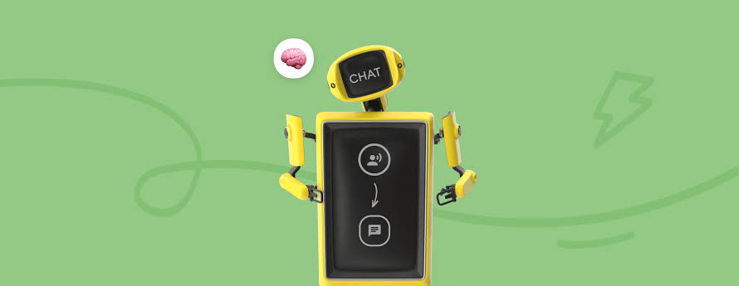
Model Training:
The chatbot model is trained using a dataset of preprocessed text messages. The training process involves feeding the dataset to the machine learning algorithm, which learns to predict the appropriate response for a given input message.

Slide 14
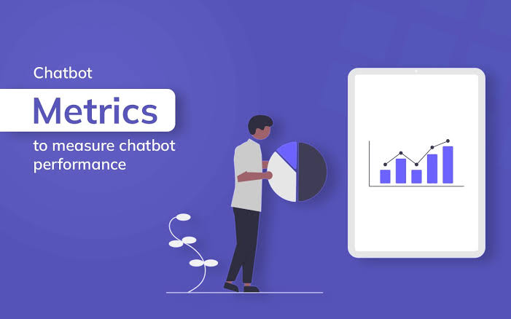
Evaluation Metrics:
To evaluate the performance of the chatbot model, several metrics are used, including accuracy, precision, recall, and F1 score. These metrics provide insight into the model's ability to correctly classify input messages and generate appropriate responses.

Slide 15
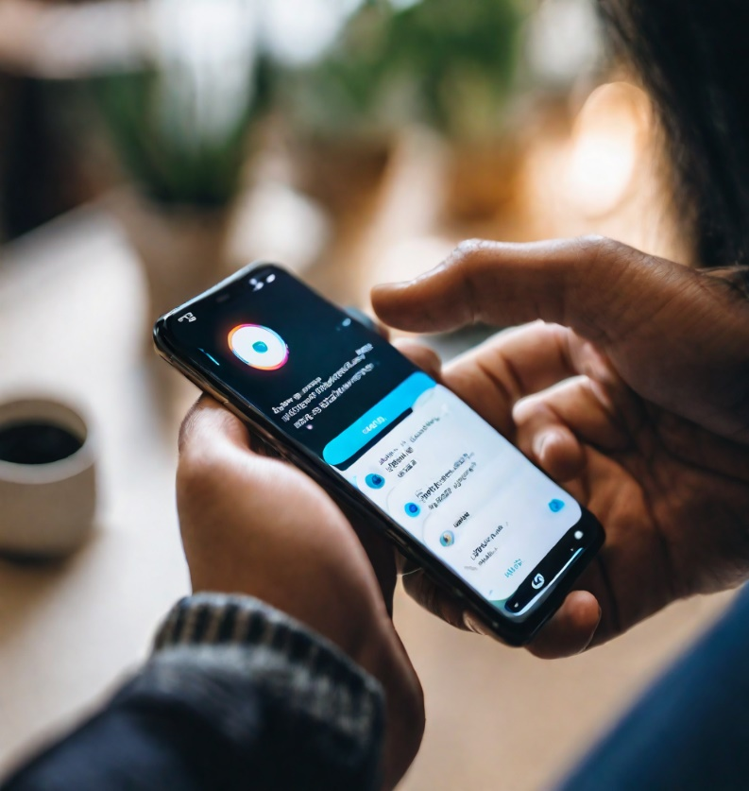
Innovative Techniques and Approaches:
During the development of the chatbot, we explored several innovative techniques and approaches to enhance its performance and user experience.
1. Transfer Learning
We utilized transfer learning to fine-tune a pre-trained language model for our chatbot. This approach helped us achieve better accuracy and faster training times.
2. Contextual Understanding
To improve the chatbot's ability to understand context, we incorporated a contextual understanding module that analyzes the user's previous messages and the current conversation flow to provide more accurate responses.
3. Multilingual Support
We implemented multilingual support for the chatbot, allowing it to understand and respond to messages in multiple languages. This feature was achieved by training the model on a multilingual dataset and incorporating language detection capabilities.

Slide 16
Libraries:
Here are the key libraries commonly used in chatbot development:
Natural Language Processing (NLP) Libraries:
NLTK (Natural Language Toolkit): It provides tools for tokenization, stemming, lemmatization, part-of-speech tagging, and more.
Example:
import nltk
sentence = "This is an example sentence."
tokens = nltk.word_tokenize(sentence)
print(tokens)
spaCy: spaCy is a popular NLP library known for its speed and accuracy.
Example:
import spacy
nlp = spacy.load("en_core_web_sm")
text = "SpaCy is a fast and efficient natural language processing library."
doc = nlp(text)
for token in doc:
print(token.text, token.pos_)

Slide 17
TextBlob: It provides easy-to-use APIs for common NLP tasks like sentiment analysis and part-of-speech tagging.
Example:
from textblob import TextBlob
text = "TextBlob is a simple NLP library for Python."
blob = TextBlob(text)
# Sentiment analysis
sentiment = blob.sentiment
print(sentiment)
# Part-of-speech tagging
tags = blob.tags
print(tags)
Machine Learning Libraries:
Scikit-learn: It can be used for tasks such as intent classification, sentiment analysis, and entity recognition in chatbots.
Example:
from sklearn.feature_extraction.text import TfidfVectorizer
from sklearn.svm import SVC
from sklearn.pipeline import Pipeline
text_clf = Pipeline([('tfidf', TfidfVectorizer()), ('clf', SVC())])
text_clf.fit(X_train, y_train)

Slide 18
TensorFlow and Keras: These libraries are used for building and training deep learning models, which can be applied to natural language understanding tasks.
Example:
import tensorflow as tf
from tensorflow import keras
model = keras.Sequential()
model.add(keras.layers.Dense(128, input_shape=(X_train.shape[1],), activation='relu'))
model.add(keras.layers.Dense(num_classes, activation='softmax’))
Web Frameworks:
Flask or Django: They provide a way to build the chatbot's user interface and handle HTTP requests and responses.
Example:
from flask import Flask, request, jsonify
app = Flask(__name)
@app.route('/chat', methods=['POST’])
def chat():
user_message = request.json['message']
# Process the message and generate a response
return jsonify({"response": chatbot_response})
if __name__ == '__main__':
app.run()

Slide 19
Sample coding:
import re
import long_responses as long
def message_probability(user_message, recognised_words, single_response=False, required_words=[]):
message_certainty = 0
has_required_words = True for word in user_message:
if word in recognised_words:
message_certainty += 1 percentage = float(message_certainty) / float(len(recognised_words)) for word in required_words:
if word not in user_message:
has_required_words = False
break if has_required_words or single_response:
return int(percentage * 100)
else:
return 0
def check_all_messages(message):
highest_prob_list = {} def response(bot_response, list_of_words, single_response=False, required_words=[]):
nonlocal highest_prob_list
highest_prob_list[bot_response] = message_probability(message, list_of_words, single_response, required_words)

Slide 20
#responses:
response('Hello!', ['hello', 'hi', 'hey', 'sup', 'heyo'], single_response=True)
response('See you!', ['bye', 'goodbye'], single_response=True)
response('I\'m doing fine, and you?', ['how', 'are', 'you', 'doing'], required_words=['how’])
response('You\'re welcome!', ['thank', 'thanks'], single_response=True)
response('Thank you!', ['i', 'love', 'code', 'palace'], required_words=['code', 'palace’])
response(long.R_ADVICE, ['give', 'advice'], required_words=['advice'])
response(long.R_EATING, ['what', 'you', 'eat'], required_words=['you', 'eat'])
best_match = max(highest_prob_list, key=highest_prob_list.get) return long.unknown() if highest_prob_list[best_match] < 1 else best_match
def get_response(user_input):
split_message = re.split(r'\s+|[,;?!.-]\s*', user_input.lower())
response = check_all_messages(split_message)
return response
while True:
print('Bot: ' + get_response(input('You: ‘)))

Slide 21
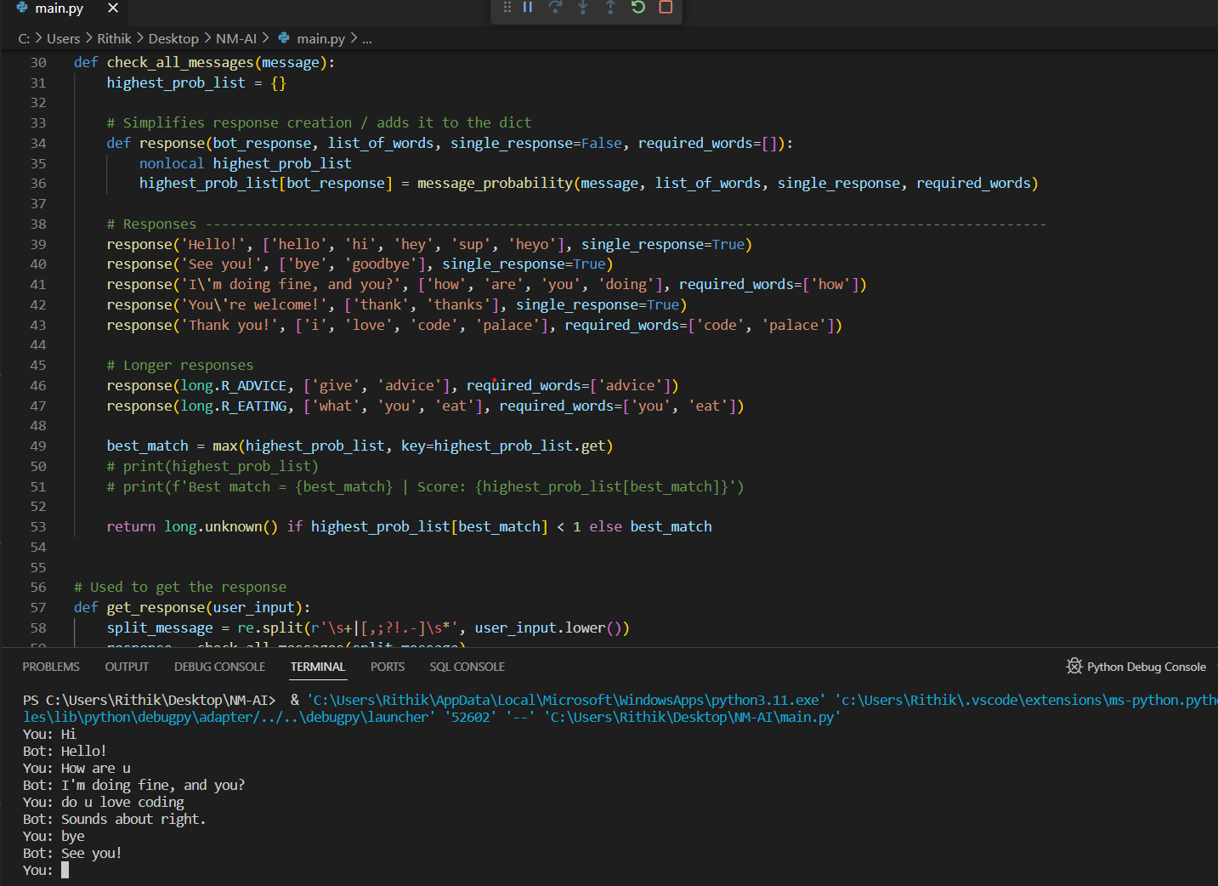

Slide 22
Conclusion:
In conclusion, building a chatbot in Python is a dynamic and evolving process that involves various aspects, from NLP and machine learning to user experience and ethics. It can be a valuable project for learning and practical applications, but it also requires ongoing maintenance and improvement to provide a positive user experience.

