Slide 1




NEXT GEN EMPLOYABILITY PROGRAM
Creating a future-ready workforce
Team Members
College Name:SEC
Student Name :S.Vigneshwaran
Student ID :au912421104054
Voting Application using Django Framework-vigneshwaran-(4054,SEC)

Slide 2

CAPSTONE PROJECT SHOWCASE
Project Title
Voting_Application_using_Django_Framework-Vigneshwaran_4054_SEC
Abstract | Problem Statement | Project Overview | Proposed Solution | Technology Used | Modelling & Results | Conclusion

Slide 3
Abstract for online voting application using Django:
Voting Application
With the advancement of technology, there is a growing need for secure and efficient voting systems to ensure the integrity and accessibility of democratic processes. This abstract presents a novel voting application designed to address these concerns.
The voting application employs state-of-the-art encryption techniques to safeguard the confidentiality and integrity of votes cast by users. Utilizing end-to-end encryption protocols, the application ensures that votes remain anonymous and tamper-proof throughout the entire voting

Slide 4
Problem Statement:
In modern democracies, the integrity and accessibility of the voting process are essential for ensuring fair representation and citizen engagement. However, traditional voting systems face challenges such as logistical complexities, potential security vulnerabilities, and limited accessibility for certain demographics.
The aim of this project is to develop a robust and user-friendly voting application that addresses these challenges..

Slide 5
Project Title :
Application name :Voting application
Category :Web Technology Full Stack Using Django
Features:
conduct polls with questions and multiple choices.
Allow user to vote for their preferred choice.
Display the votes for each questions.
Admin panel for adding and managing questions.
Technologies Used:
Django Framework to create a backend and handle database
SQLite Database Django come with sqlite by default

Slide 6
Proposed Solution:
Project Setup:Start a new Django project: django-admin startproject voting_app.Create a new Django app for the voting functionality: python manage.py startapp vote.
Models:Define models for your voting system. For example, you might have a Poll model to represent each poll and a Choice model to represent the choices for each poll.
Source :

Slide 7
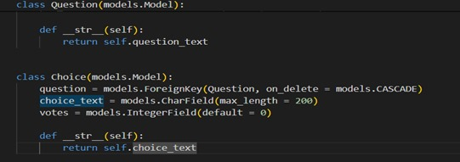
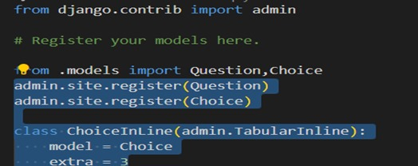
Models.py
Admin.py
Source :

Slide 8
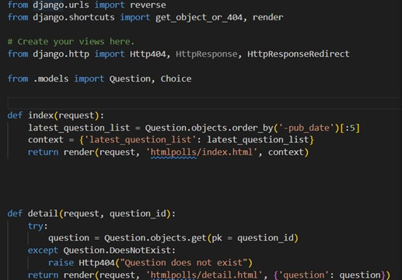
Views.py
Create view to handle displaying polls and submitting votes
Source :

Slide 9


Technology Used
Front-end
Back-end
Source :

Slide 10
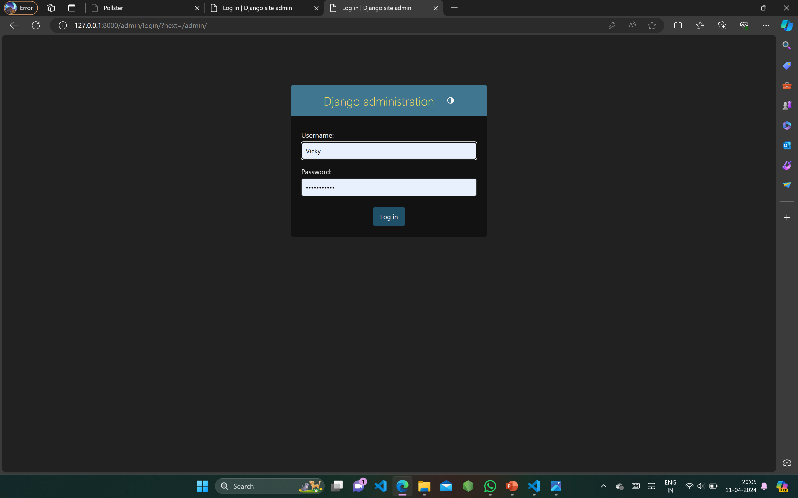
ADMIN PAGE:

Slide 11
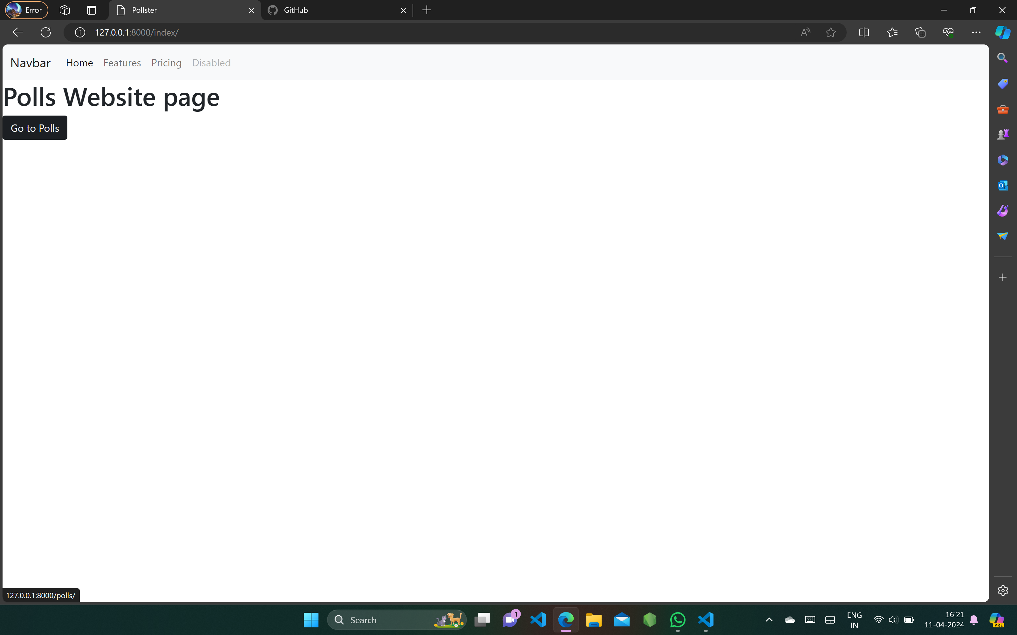
Homepage

Slide 12
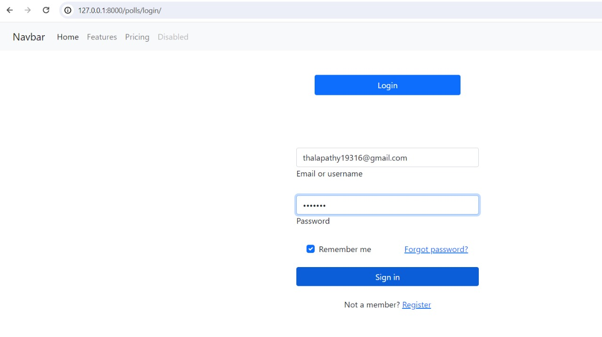
REGISTER PAGE

Slide 13
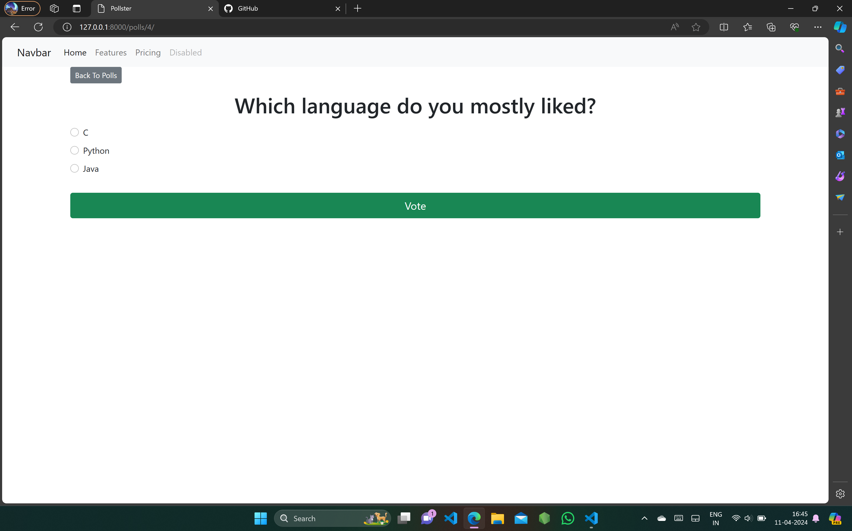
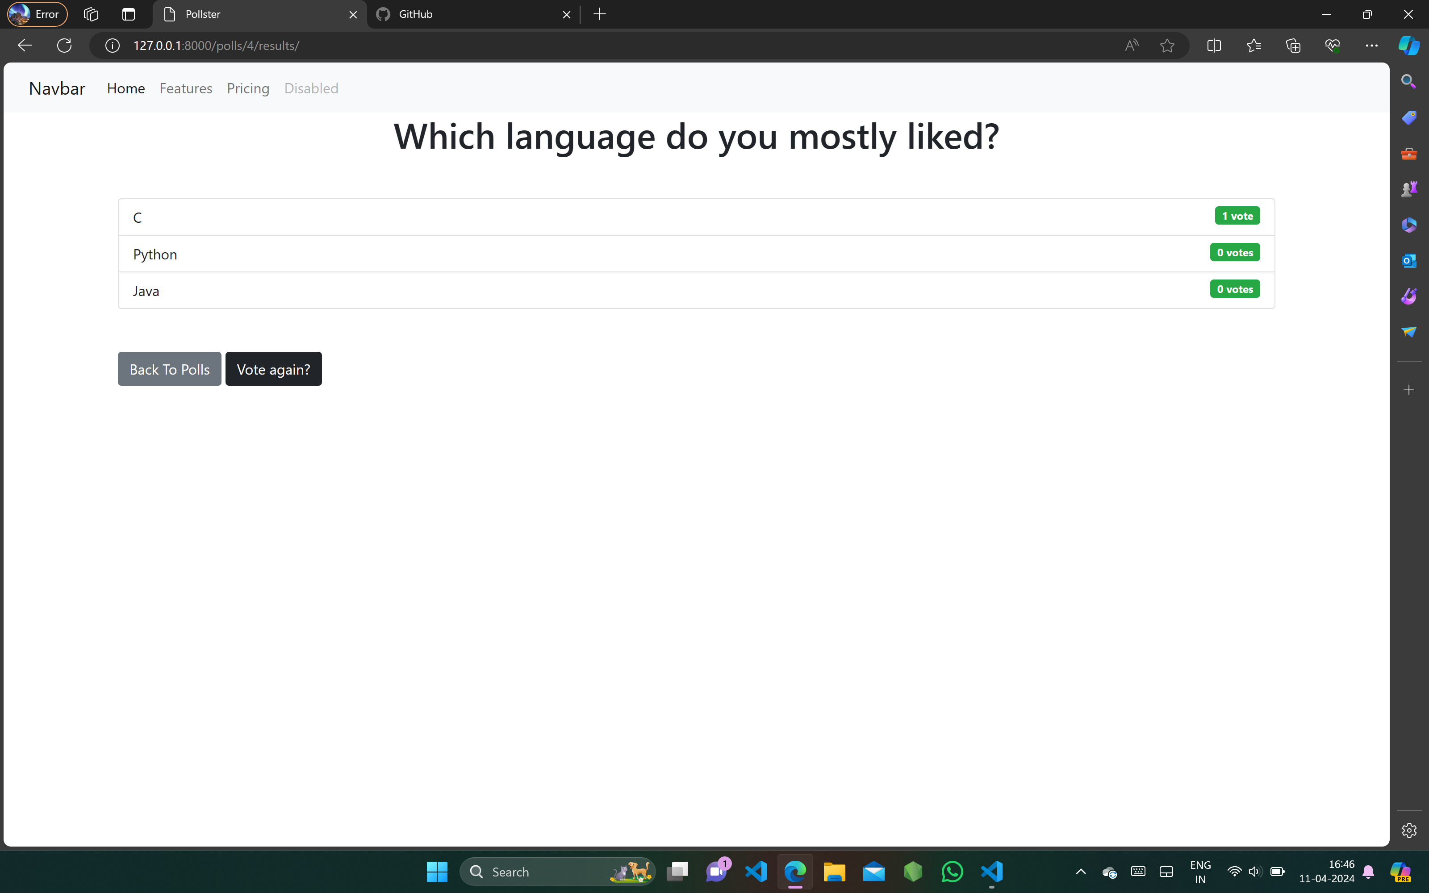
VOTING-1
BEFORE
AFTER

Slide 14
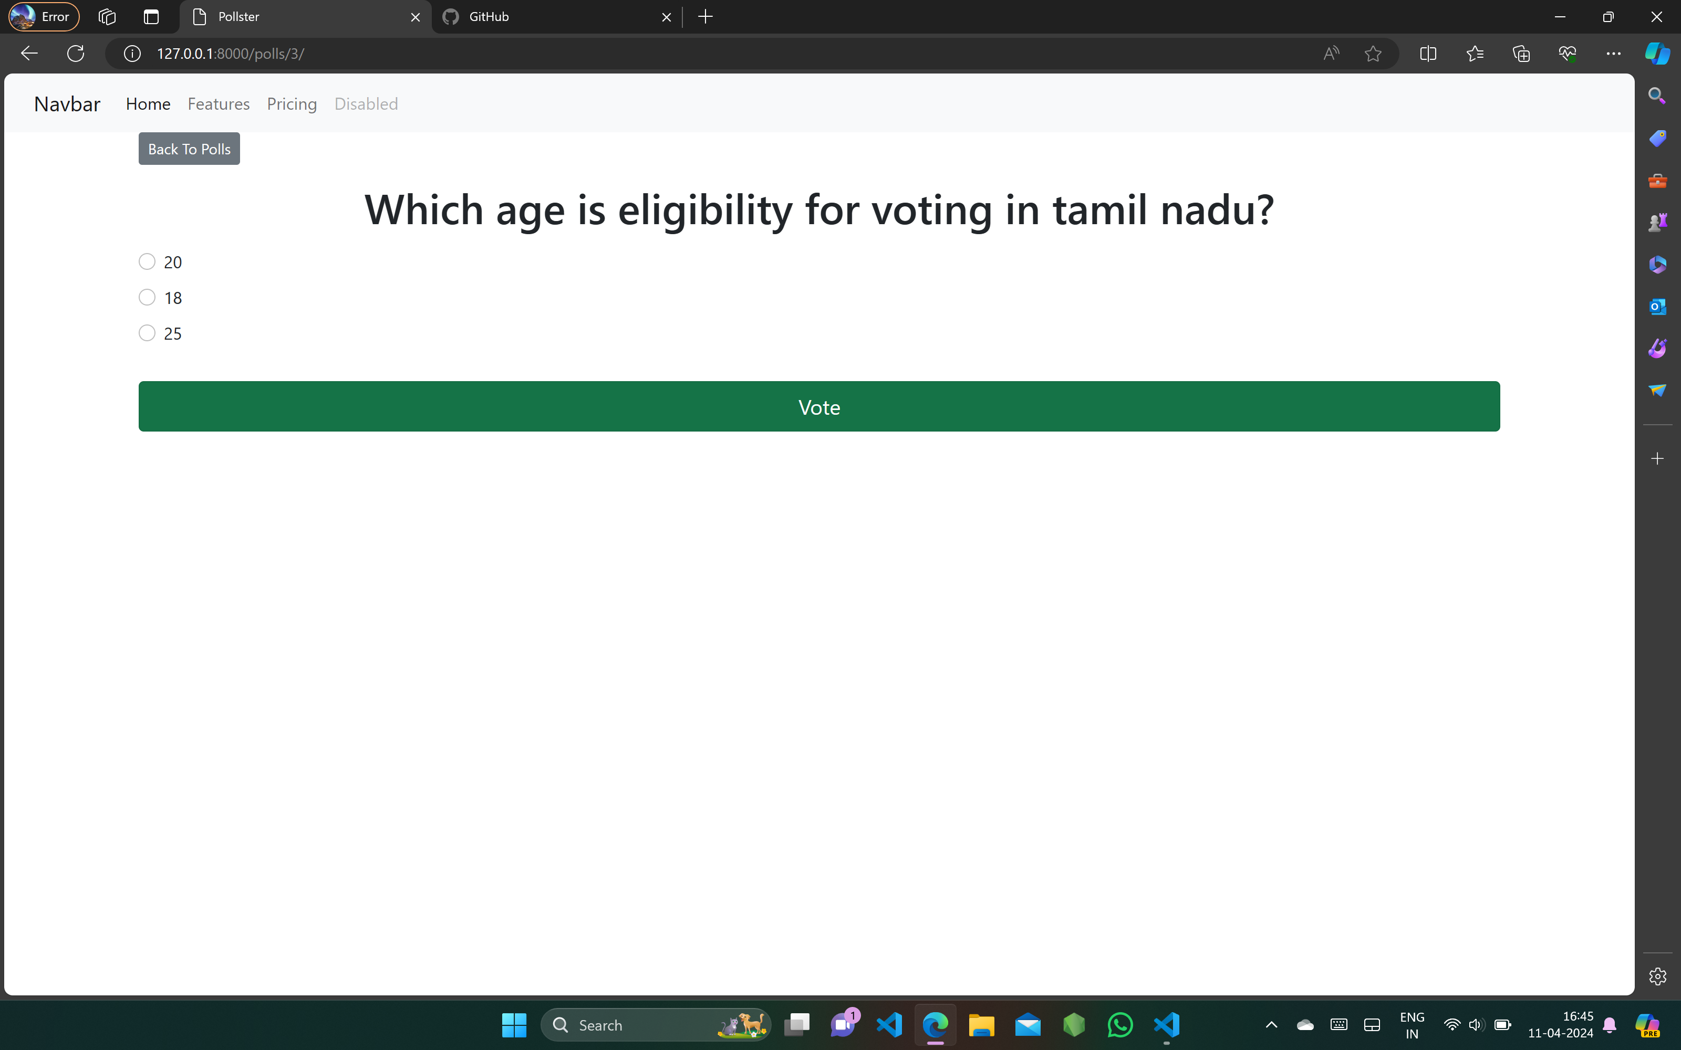

VOTING-3
BEFORE
AFTER

Slide 15
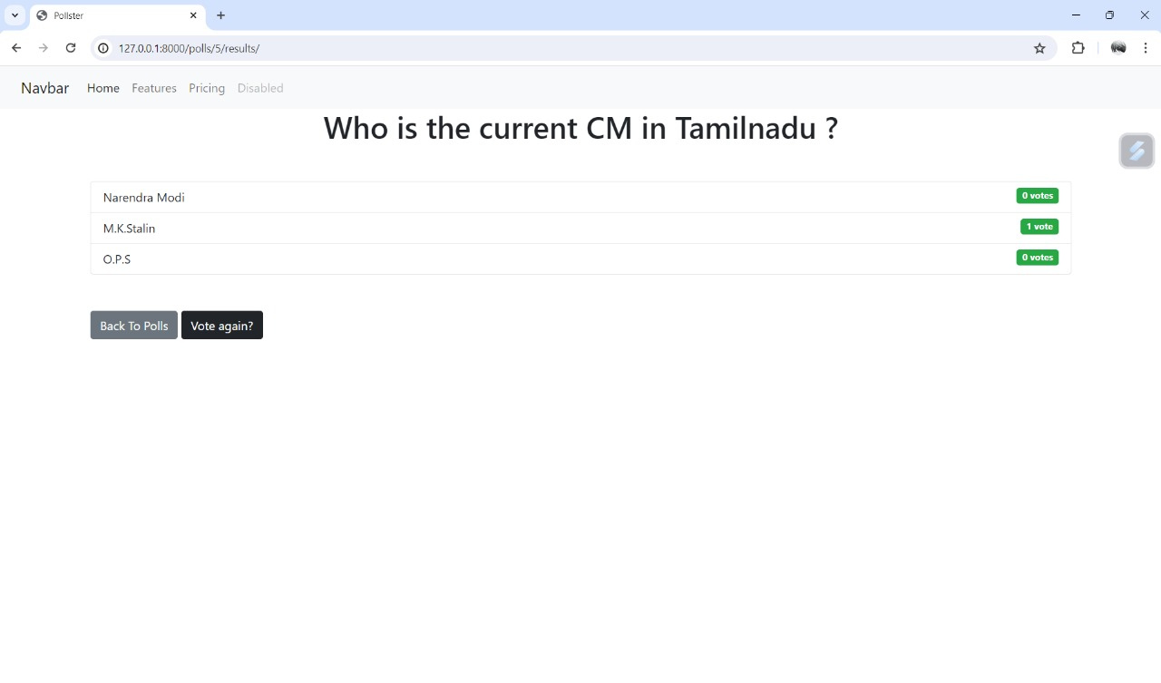

VOTING-3
AFTER
BEFORE

Slide 16
Future Enhancements:
If you're using Django for your voting application, here are some future enhancements tailored to that framework:
Django Channels for Real-Time Updates: Integrate Django Channels to enable real-time updates of voting results. This allows users to see live updates as votes are cast and counted, enhancing transparency and engagement.
Django Admin Customization for Election Management: Customize the Django admin interface to provide election administrators with intuitive tools for managing candidates, voter registration, polling stations, and other election-related tasks.
Django Internationalization for Multi-Language Support: Implement Django's internationalization (i18n) framework to provide multi-language support for the voting application. This allows users to access the application in their preferred language, promoting inclusivity and accessibility.
Django Form Validation for Data Integrity: Utilize Django's form validation framework to enforce data integrity rules and ensure the accuracy and validity of voter information, candidate nominations, and voting results.

Slide 17
Conclusion
In conclusion, a Django-based online voting system offers a robust and versatile platform for conducting secure, accessible, and transparent elections. By leveraging Django's extensive features and ecosystem, such as Django REST Framework, Django Channels, and Django Admin, along with custom enhancements tailored to the specific requirements of the voting application, you can create a highly functional and reliable system
.Through features like real-time updates, mobile voting support, advanced security measures, customizable administration tools, and multi-language support, a Django online voting system addresses key challenges in the electoral process while enhancing the user experience for both voters and administrators.
Overall, a Django online voting system provides a scalable, customizable, and efficient solution for conducting elections, fostering trust, participation, and confidence in the democratic process.

Slide 18
Thank You!
Notes:
Thank You !!

