Slide 1
Real-Time Code Collaboration Platform
Nandha Engineering College
(Autonomous)
Information Technology
22ITD01 – PROJECT FINAL REVIEW
TEAM MEMBERS
VISHNU RAJU V (22IT056)
JOTHEESWARAN M(22ITL02)
VIGNESHWARAN M (22ITL08)
MENTOR : R. ANAND AP/IT

Slide 2
Abstract
This project aims to build a Real-Time Code Collaboration Platform that enables multiple developers to write, edit, and execute code simultaneously in a shared environment. Inspired by the power of GitHub and VS Code, this platform integrates WebSockets for live synchronization, cursor tracking, in-app chat, version control, and a sandboxed code execution engine. The main objective is to eliminate collaboration friction for remote development teams and provide a seamless, browser-based coding experience with zero setup..

Slide 3
Introduction
Remote collaboration is critical for modern software development.
Existing tools like Google Docs don’t support live code execution.
Version management and conflict resolution are major pain points.
WebSockets and Docker enable real-time, isolated code collaboration at scale.

Slide 4
Requirements
Hardware Requirements
1. Processor: Intel i5 / i7 or equivalent
2. RAM: 16 GB recommended
3. Storage: 256 GB SSD or above
Software Requirements
1. Operating System: Windows 10/11
2. Programming Language: Python
3. IDE: Jupyter Notebook / VS Code / Colab

Slide 5
Literature Review
Title | Authors | Technology | Key Findings | Drawback
Real-Time Collaborative Editing | Ellis et al. | WebSockets + OT | Real-time sync with Operational Transformation | Conflict resolution complexity
Sandboxed Code Execution | Docker Inc. Docs | Docker Containers | Isolated execution per user session | Cold start latency overhead
Pub/Sub with Redis | Redis Labs | Redis Pub/Sub | Low-latency event broadcasting at scale | Single-threaded; needs clustering for scale
In-Browser Version Control | GitHub & Isomorphic-git | Git + REST API | Full commit history and rollback support | Merge conflicts in concurrent edits
Cursor Tracking & Presence | Frazee & Levin | WebSocket Events | Live user cursor and selection broadcast | Latency spikes on weak connections

Slide 6
Existing System
Developers use separate tools: GitHub for versioning, Slack for chat, local IDEs for coding
Platforms like CodeSandbox lack real-time multi-user cursor tracking
No integrated version control within a shared coding environment
Code execution requires local setup; no cloud sandbox exists
Communication is fragmented across different apps and contexts

Slide 7
Drawbacks of Existing System
No live cursor tracking or real-time co-editing in existing solutions
Code execution requires local environment setup by each user
Version history is managed externally with no in-app diff viewer
Chat and collaboration context is separated from code files
No single platform combines editing, running, versioning and chat

Slide 8
Proposed Work
Build a browser-based real-time code collaboration platform
Use OT/CRDT for conflict-free live multi-cursor editing
Integrate Docker sandboxed code execution for multiple languages
Add version control with commit history, diff viewer, and rollback
Deploy Redis-backed pub/sub for low-latency event broadcasting

Slide 9
Block Diagram

Slide 10
Modules
Module 1 – Real-Time Editor with WebSocket Sync
Module 2 – Chat System and Cursor Tracking
Module 3 – Version Control and Diff Management
Module 4 – Docker Code Execution Sandbox

Slide 11
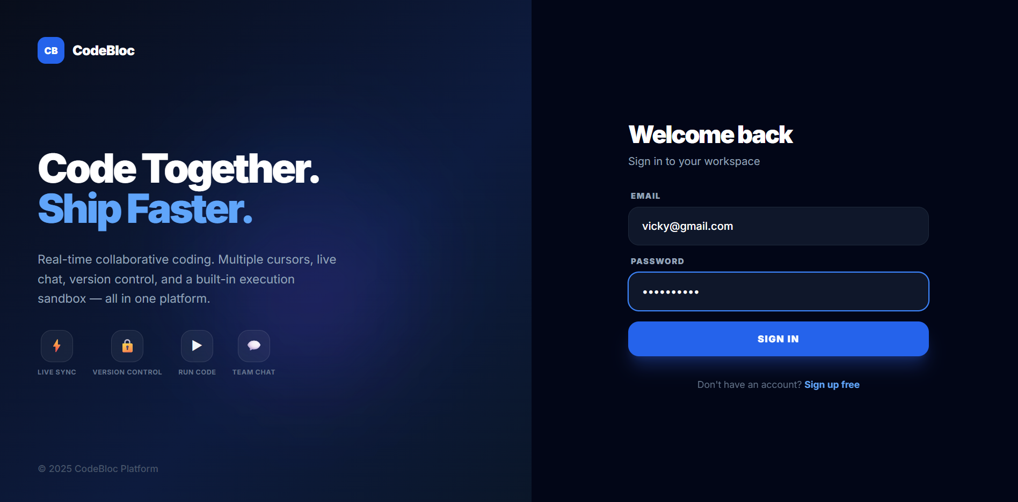
Project Output Screenshots
1. Login - Multi-user

Slide 12
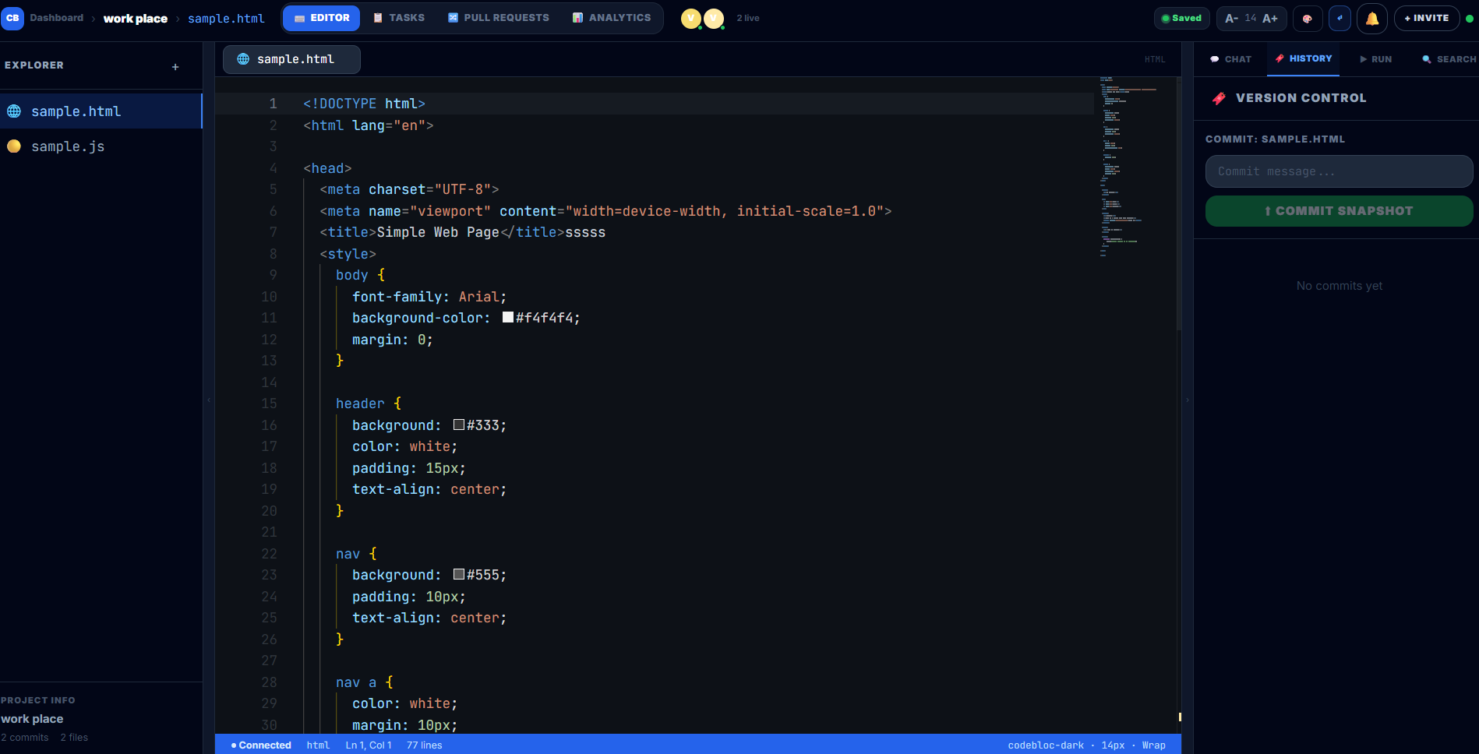
Project Output Screenshots
2. Live code - Multi-user :

Slide 13
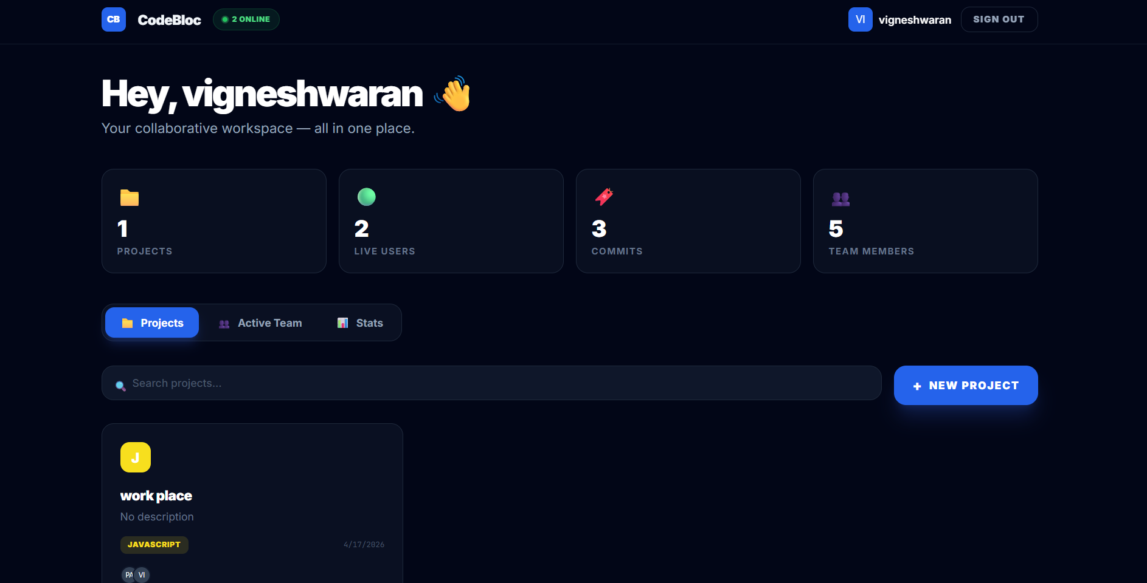
Project Output Screenshots
3. Dashboard :

Slide 14
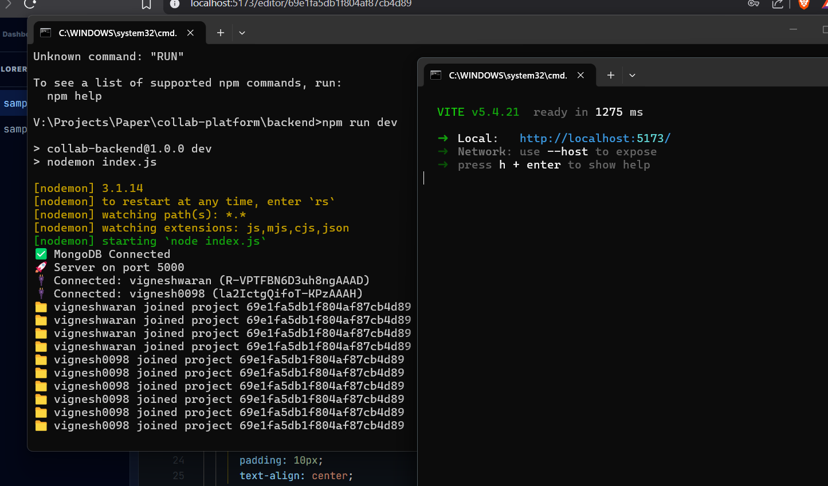
Project Output Screenshots
4. Server Runing :

Slide 15
Results & Discussion
WebSocket latency achieved under 50ms for real-time sync.
Key Metrics:
Concurrent Users Supported: 25+
Code Execution Response Time: <2 sec (Docker)
Version Snapshots Supported: 100+ commits/session
Cursor tracking lag reduced to under 30ms via Redis pub/sub.
Final Discussion:
Redis pub/sub architecture outperformed polling-based sync by 4x.

Slide 16
Conclusion
The platform successfully enables real-time multi-user code collaboration.
Docker sandboxing ensures safe, isolated code execution.
WebSocket and Redis architecture delivers low-latency performance.
A complete Mini GitHub + VS Code experience in the browser.

Slide 17
Future Work
Add AI-powered code completion (GitHub Copilot-style) integration.
Support more languages: Go, Rust, Java, C++.
Introduce team workspace with role-based access control.
Implement P2P WebRTC video/audio for pair programming sessions.

Slide 18
References
[1] Ellis, C., & Gibbs, S. (1989). "Concurrency control in groupware systems." ACM SIGMOD Record, 18(2), 399-407.
[2] Docker Inc. (2023). Container Docs. docs.docker.com. (Sandboxed code execution per session.)
[3] Redis Labs (2023). "Redis Pub/Sub Documentation." redis.io. (Real-time event broadcasting between collaboration sessions.)
[4] Mozilla MDN (2023). "The WebSocket API." developer.mozilla.org. (Core duplex communication for live collaborative editing.)
[5] Frazee, A. & Levin, J. (2017). "Presence and Cursor Tracking in Collaborative Editors." Proc. CSCW. (Inspiration for multi-user cursor and selection broadcast.)

