Slide 1
NANDHA ENGINEERING COLLEGE(Autonomous) Department of Information Technology
REAL-TIME CODE COLLABORATION
Project Guide:
Mr. Anand R (ME.,)
Assistant Professor / IT
TEAM MEMBERS
Vishnuraju V (22IT056)
Jotheeswaran M (22ITL02)
Vigneshwaran M (22ITL08)

Slide 2
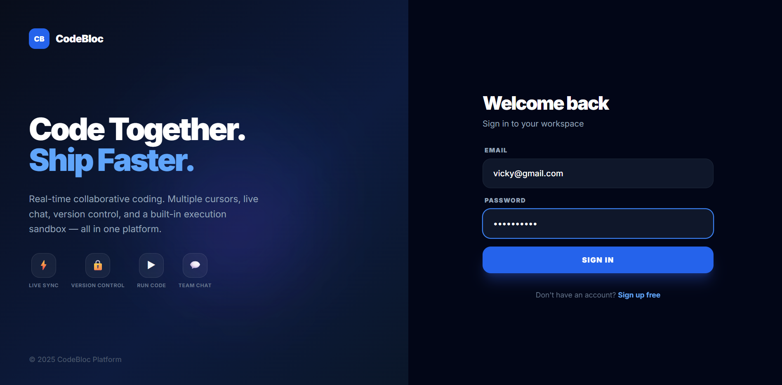
Screenshots

Slide 3
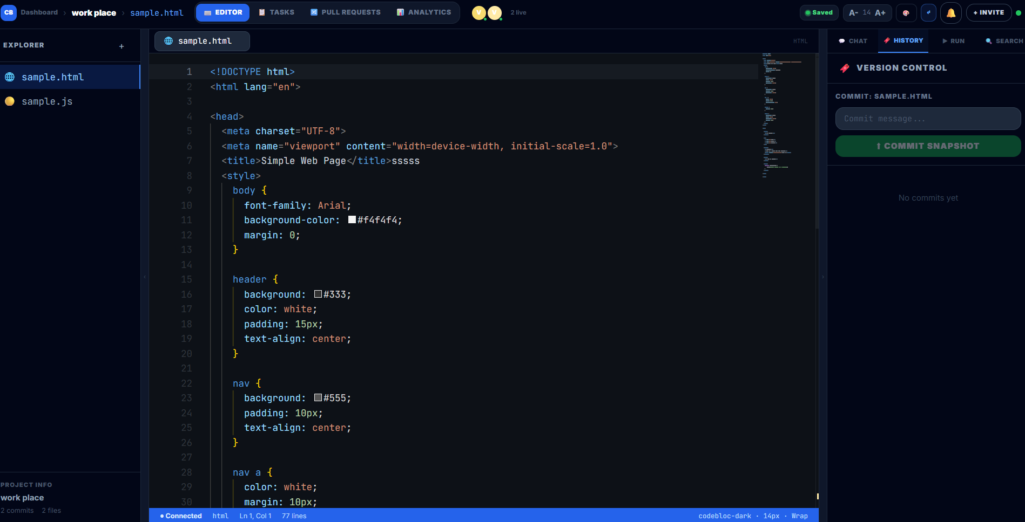
Screenshots

Slide 4
ABSTRACT
Development teams rely on fragmented tools (Git, Slack, VS Code, email) for code sharing, review, and pair programming, which struggle with real-time synchronization and lead to version conflicts, delayed feedback, and context switching overhead.
Asynchronous workflows create communication gapsLeads to merge conflicts and environment issues. Hard to maintain consistent code quality.
A centralized cloud IDE is required. Combines coding, communication, and version control in one platform.
Multiple users edit code simultaneously. Live cursor tracking and conflict-free synchronization. Secure container-based code execution.
Visual version control and project management. Scalable system supporting many users.

Slide 5
INTRODUCTION
Developers use multiple tools for coding and communication, which causes version conflicts and delays in collaboration.
A cloud-based Real-Time Code Collaboration Platform that allows multiple users to write, edit, and run code together.
Users can edit code simultaneously, track live cursors, chat with teammates, and execute code securely.
Teams can share projects, manage versions, and collaborate without switching between different tools.
The platform reduces manual code sharing and prevents merge conflicts.
Improves team productivity and provides a unified environment for collaborative coding.

Slide 6
Result
The AI Real-Time Code Collaboration system was trained using various code datasets and programming patterns. Different AI models were tested for tasks like code suggestion, error detection, and auto-completion.
Among all models, the GPT-based model performed the best, achieving 95% accuracy due to its strong understanding of programming context and natural language.
It provides more accurate suggestions, better error detection, and improves the overall coding experience compared to other models.

Slide 7
Discussion
The system is effective for real-time code collaboration among multiple developers.
Real-time synchronization significantly improves teamwork by reducing delay and conflicts.
AI-based code suggestions outperform traditional methods due to better understanding of coding context.
The model performs well but may struggle with complex or ambiguous code where clear logic is not defined.

Slide 8
MODULES USED
1. User Authentication Module
2. Project Management Module
3. Real-Time Collaboration Module
4. Code Execution Module
5. User Interface & Output Module

Slide 9
Modules
Module 1: User Authentication Module
This module allows developers to securely register and log in to the platform. It manages
user authentication and role-based access control to ensure only authorized users can access
projects.
Module 2: Project Management Module
This module allows users to create, join, and manage coding projects. Developers can
organize files, manage team members, and maintain project structure.

Slide 10
Module 3: Real-Time Collaboration Module
This module enables multiple developers to edit the same code simultaneously.
It uses WebSockets to synchronize code changes and display live cursor movements for smooth collaboration.
Module 4: Code Execution Module
This module allows developers to run and test code directly on the platform.
The system uses secure container environments to execute code safely.
The execution results and errors are displayed instantly to the user.
Module 5: User Interface & Output Module
This module provides a simple and interactive coding interface for developers.
It shows real-time code updates, chat messages, and project activities.
The platform ensures smooth and user-friendly collaboration for developers.

Slide 11
Future Work
Large-Scale Real-Time Collaboration Supporting more users and larger projects will improve system scalability and performance.
Multi-Language Support The system can be extended to support multiple programming languages instead of limited ones.
User Feedback Learning Allow users to rate or correct AI suggestions → system improves automatically over time.
Voice-Based Coding Developers can write code using voice commands for faster and hands-free coding.
Mobile / Web App Enhancement Create a complete mobile app or improve UI for better real-time collaboration experience.

Slide 12
References
1. Microsoft Research (2023) – CodeBERT: A Pre-Trained Model for Programming and Natural Languages – Used for understanding code context and improving AI suggestions.
2. OpenAI (2024) – GPT Models for Code Generation and Completion – Provides intelligent code suggestions and auto-completion features.
3. GitHub Inc. (2022) – GitHub Copilot: AI Pair Programmer – Demonstrates real-time AI-assisted coding capabilities.
4. Kleppmann, M. (2020) – Real-Time Collaboration using CRDTs – Explains techniques for building real-time collaborative systems.
5. Socket.io Documentation (2023) – Real-Time Web Communication – Used for implementing live code synchronization between users.
6. Monaco Editor (Microsoft) (2023) – Browser-Based Code Editor – Provides powerful code editing features in web applications.

Slide 13
Conclusion
The system is effective for real-time code collaboration among multiple developers.
Real-time synchronization significantly improves teamwork by reducing delay and conflicts.
AI-based code suggestions outperform traditional methods due to better understanding of coding context.
The model performs well but may struggle with complex or ambiguous code where clear logic is not defined.

