Slide 1
REAL-TIME CODE COLLABORATION PLATFORM
Nandha Engineering College (Autonomous) Department Of Information Technology
GUIDE:
Mr. ANAND R (AP/IT)
TEAM MEMBERS:
VISHNURAJU.V (22IT056)
JOTHEESWARAN.M (22ITL02)
VIGNESHWARAN.M (22ITL08)

Slide 2
ABSTRACT:
Development teams rely on fragmented tools (Git, Slack, VS Code, email) for code sharing, review, and pair programming, which struggle with real-time synchronization and lead to version conflicts, delayed feedback, and context switching overhead.
Asynchronous workflows create communication gapsLeads to merge conflicts and environment issues. Hard to maintain consistent code quality.
A centralized cloud IDE is required. Combines coding, communication, and version control in one platform.
Multiple users edit code simultaneously. Live cursor tracking and conflict-free synchronization. Secure container-based code execution.
Visual version control and project management. Scalable system supporting many users.

Slide 3
INTRODUCTION
Developers use multiple tools for coding and communication, which causes version conflicts and delays in collaboration.
A cloud-based Real-Time Code Collaboration Platform that allows multiple users to write, edit, and run code together.
Users can edit code simultaneously, track live cursors, chat with teammates, and execute code securely.
Teams can share projects, manage versions, and collaborate without switching between different tools.
The platform reduces manual code sharing and prevents merge conflicts.
Improves team productivity and provides a unified environment for collaborative coding.

Slide 4
LITERATURE REVIEW:
S.NO | AUTHOR | TITLE | METHODOLOGY USED | MERITS | DEMERITS
1 | Medha Wyawahare et al.(2025) | CollabCode: A Real-Time Code Sharing Space | Node.js, Express, WebSockets, Cloud storage. | Supports collaborative coding with chat and AI assistance. | Requires stable internet for synchronization.
2 | Ritesh Borale et al.(2025) | Web-Based Collaborative Code Editor | WebSockets for real-time synchronization. | Multiple users can edit code simultaneously. | Limited scalability for large teams.
3 | Aarti Gaikwad et al.(2024) | Collaborative Code Platform with AI Features | Microservices architecture with AI tools. | Provides AI-based coding assistance and collaboration. | Higher computational resource requirements.
4 | Aditi Dhawan et al.(2024) | RTC Code Editor for Collaborative Software Development | React.js, Node.js, WebRTC communication. | Enables pair programming and real-time debugging. | Security and performance challenges.

Slide 5
EXISTING WORK
Developers usually share code using tools like Git, email, or messaging apps, which makes collaboration slow.
Code changes are shared after commits, so team members cannot see updates instantly.
When multiple developers edit the same file, merge conflicts occur frequently.
Most platforms do not support simultaneous live coding by multiple users.
Developers run code on different systems, causing setup and compatibility problems.
Developers must use external tools for discussion, which breaks workflow and reduces productivity.

Slide 6
PROBLEM EXPLANATION:
Developers cannot edit the same code simultaneously, which slows down teamwork.
Multiple developers working on the same files often cause merge conflicts and code inconsistencies.
Teams rely on separate tools like Git, chat apps, and IDEs, making the workflow inefficient.
Different systems and configurations create compatibility issues during code execution.
Developers cannot see changes instantly, causing slow debugging and review processes.
A single system is required to provide real-time editing, communication, version control, and secure code execution in one place.

Slide 7
PROPOSED WORK
Implement real-time code editing so developers can write and update code together instantly.
Use WebSockets to synchronize code changes and show live cursor movements.
Provide a secure code execution environment using container technology.
Integrate chat and communication features for team collaboration.
Maintain version control to track code changes and manage project history.
Provide a simple and user-friendly interface for smooth and efficient collaborative coding.

Slide 8
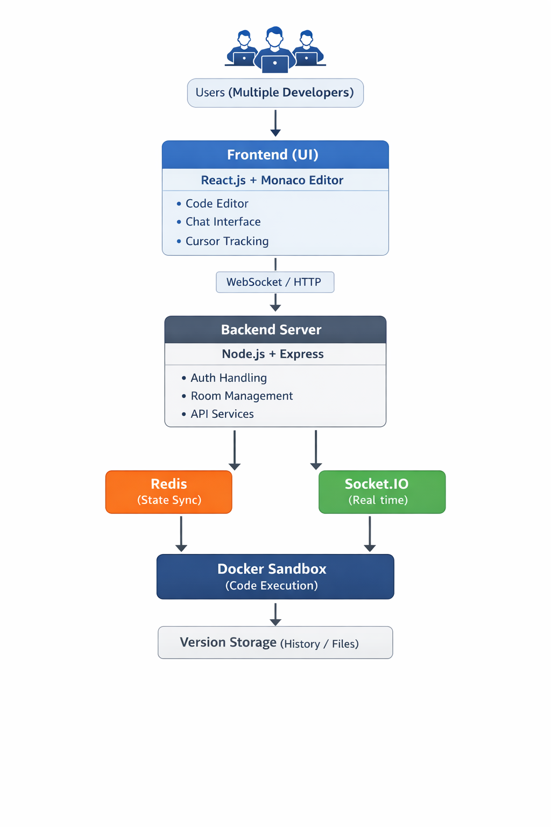
BLOCK DIAGRAM

Slide 9
MODULE EXPLANATION:
Module 1 : User Authentication Module
This module allows developers to securely register and log in to the platform.
It manages user authentication and role-based access control to ensure only authorized users can access projects.
Module 2 : Project Management Module
This module allows users to create, join, and manage coding projects.
Developers can organize files, manage team members, and maintain project structure.
Module 3 : Real-Time Collaboration Module
This module enables multiple developers to edit the same code simultaneously.
It uses WebSockets to synchronize code changes and display live cursor movements for smooth collaboration.

Slide 10
MODULE EXPLANATION:
Module 4 : Code Execution Module
This module allows developers to run and test code directly on the platform.
The system uses secure container environments to execute code safely.
The execution results and errors are displayed instantly to the user.
Module 5 : User Interface & Output Module
This module provides a simple and interactive coding interface for developers.
It shows real-time code updates, chat messages, and project activities.
The platform ensures smooth and user-friendly collaboration for developers.

Slide 11
MODULE DESIGN:
User Authentication Module Design:
This module allows developers to register and log in securely to the platform.
It verifies user identity and manages access to projects.
This ensures only authorized users can use the system.
Real-Time Collaboration Module Design:
This module enables multiple developers to edit code at the same time.
WebSockets synchronize code changes instantly.
It also shows live cursor movements of team members.
Code Execution Module Design:
This module allows developers to run and test code on the platform.
Code is executed in a secure container environment.
The output and errors are displayed instantly to the user.

Slide 12
MODULE IMPLEMENTATION:
User Authentication Implementation:
The system implements secure login and registration using Node.js and Express.js.
User details are stored in the database and verified during login.
Real-Time Collaboration Implementation:
WebSockets are used to synchronize code changes instantly between users.
When one developer edits code, the changes are updated for all connected users.
Code Execution Implementation:
The platform allows users to run code using a secure execution environment.
The system processes the code and executes it safely in containers.

Slide 13
SOFTWARE REQUIREMENTS:
Operating System: Windows 10 / 11 or Linux.
Programming Language: JavaScript (Node.js), HTML, CSS.
Libraries & Frameworks: React.js, Express.js, WebSockets, Docker.
Development Tools: VS Code, Git, Node Package Manager (NPM).
Database: MongoDB / PostgreSQL.
HARDWARE REQUIREMENTS:
Processor: Intel i5 or higher (or equivalent).
RAM: Minimum 8 GB.
Storage: Minimum 20 GB free space.
Optional: GPU for faster model training (NVIDIA recommended).
Optional: Cloud server for hosting and scalability.

Slide 14
CONCLUSION:
In this project, we developed a Real-Time Code Collaboration Platform that improves teamwork in software development.
The system allows multiple developers to edit code simultaneously, communicate with teammates, and run code in a secure environment.
By integrating real-time synchronization, project management, and version control, the platform simplifies collaborative coding and reduces development delays.
In the future, the system can be improved by adding AI coding assistance, advanced deployment features, and cloud scalability to support larger development teams and projects.

Slide 15
REFERENCES:
[1] M. Kleppmann and A. Beresford, “A Conflict-Free Replicated Data Type for Collaborative Editing,” IEEE Transactions on Parallel and Distributed Systems, 2020.
[2] GitHub Inc., “GitHub Codespaces: Cloud-Based Development Environment for Collaborative Programming,” GitHub Technical Documentation, 2021.
[3] J. Nichols and T. Lau, “Real-Time Collaborative Programming Systems for Distributed Development Teams,” International Journal of Software Engineering, 2022.
[4] Microsoft Corporation, “Visual Studio Live Share: Real-Time Collaborative Development Tool,” Microsoft Developer Documentation, 2023.

Slide 16
THANK YOU

