Slide 1
Hackathon
File created on: 02-09-2023 10:33:57

Slide 2
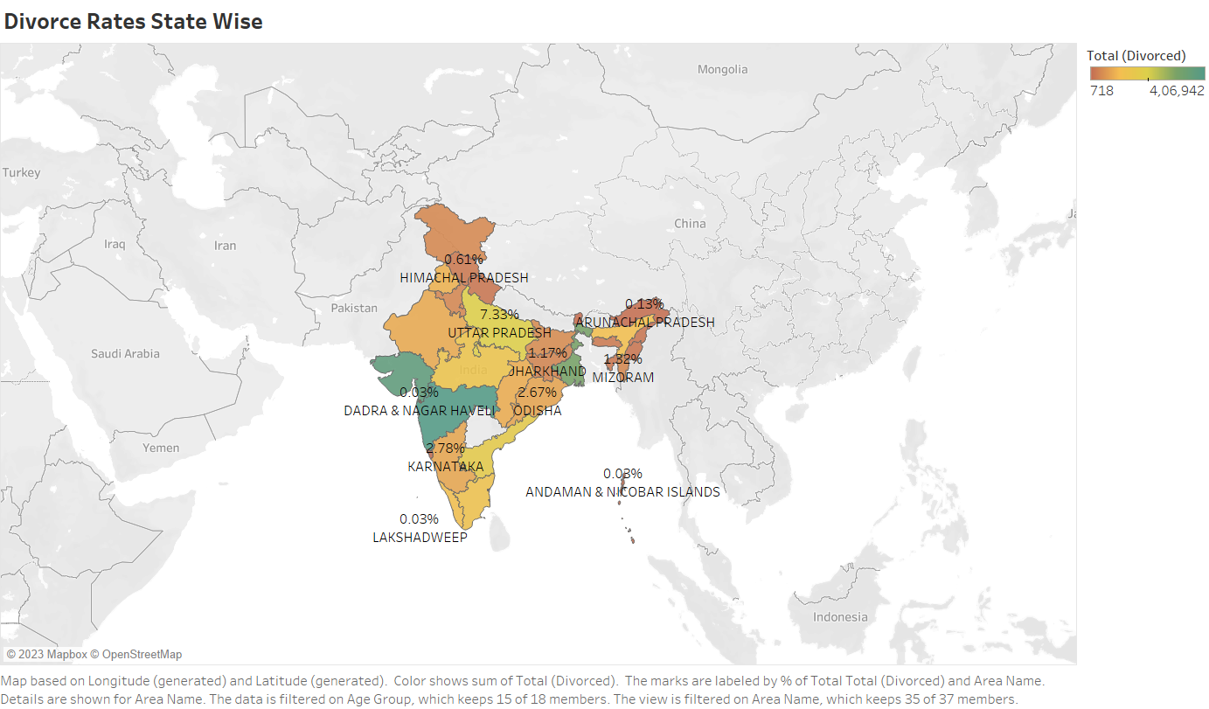

Slide 3
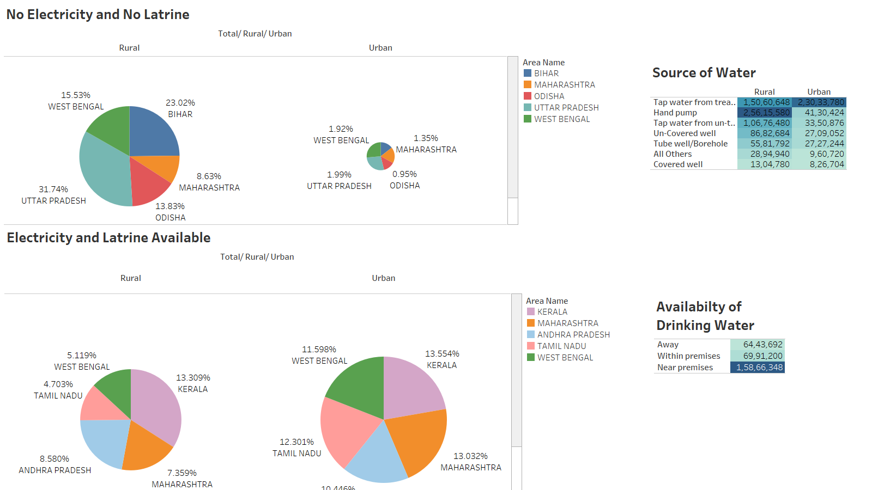

Slide 4
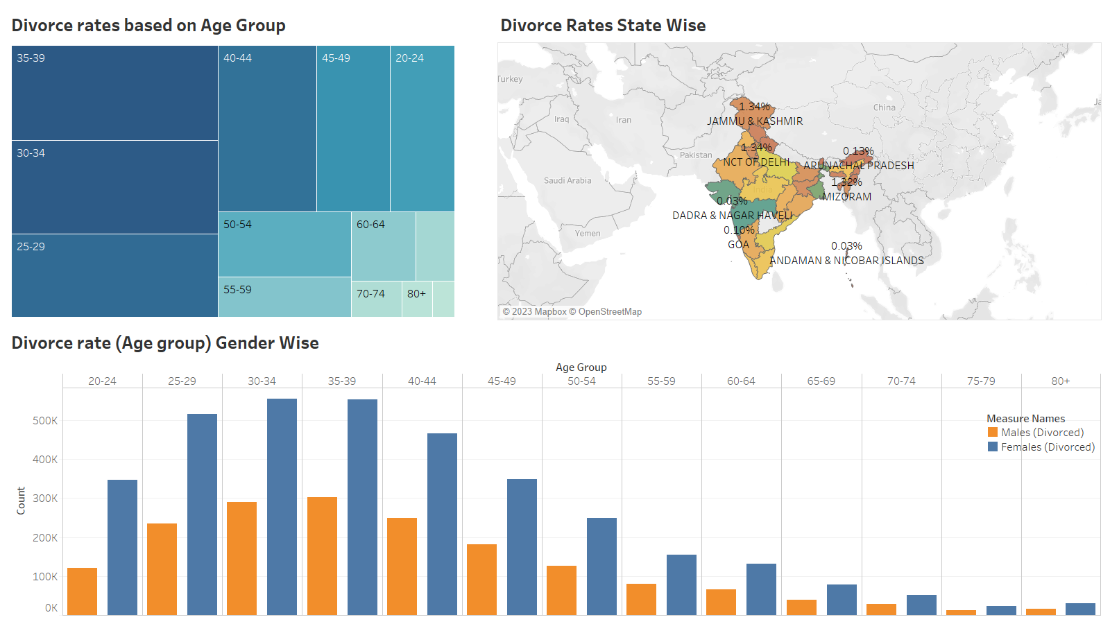

Slide 5
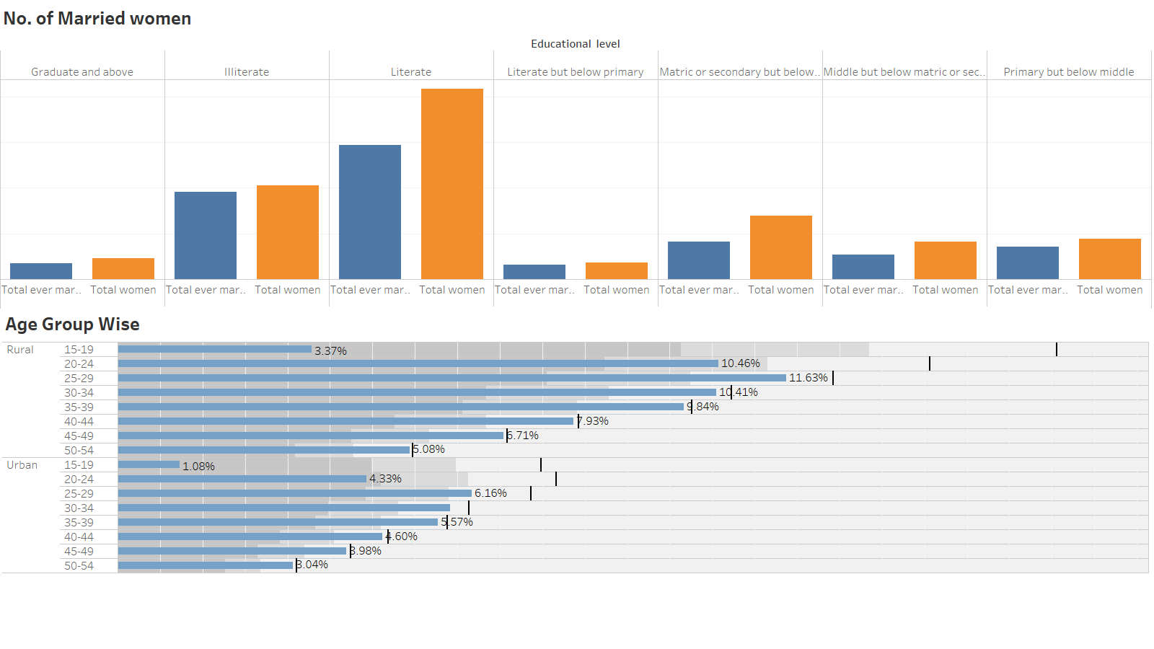

Slide 6
