Slide 1
CASE STUDY
Zomato Delivery Time Prediction
Applying Predictive Analytics to Forecast Food-Delivery Times Using Random Forest Regression
Subject
Applied Predictive Analytics
College
Chaitanya Bharathi Institute of Technology
PREPARED BY
Vignesh
Sri Vardhan
Harshith
160124771030
160124771031
160124771033

Slide 2
01 · THE CASE
Zomato & the Delivery-Time Problem
Company
9K
Zomato — one of India's largest online food-delivery and restaurant-discovery platforms, processing millions of orders daily across cities.
ORDERS ANALYZED
Business Problem
Delivery times are highly variable — driven by traffic, weather, distance and rider factors. Zomato needed a way to predict how long a delivery will actually take, so customers see accurate ETAs and operations can flag orders at risk of delay.
17
PREDICTIVE FEATURES
Data Used
Structured, tabular order-level data: rider age & rating, restaurant/delivery GPS coordinates, order & pickup timestamps, weather, traffic density, vehicle type, city type and festival flag.
Structured
TABULAR ORDER DATA
Applied Predictive Analytics | Chaitanya Bharathi Institute of Technology
2

Slide 3
02 · THE APPROACH
What Was Predicted — and How
Prediction target: Time_taken (min) — the actual delivery duration for each order, framed as a regression problem.
Data
Cleaning
›
Feature
Engineering
›
Label
Encoding
›
Random
Forest Model
›
Predictions
›
Power BI
Dashboard
Key Predictive Features
Distance & Location
Time Signals
Context
Rider & Order
Haversine distance between restaurant and drop point (km)
Order day / month / weekday, order & pickup time, pickup delay
Weather, road-traffic density, festival flag, city type
Rider age & rating, vehicle type & condition, order type, multiple deliveries
Model: Random Forest Regressor (100 trees) trained on an 80/20 train-test split, with categorical variables converted using Label Encoding.
Applied Predictive Analytics | Chaitanya Bharathi Institute of Technology
3

Slide 4
03 · RESULT & IMPACT
Results and Business Impact
9K
26.2
26.3
8.4%
TOTAL ORDERS SCORED
AVG. ACTUAL DELIVERY (MIN)
AVG. PREDICTED DELIVERY (MIN)
ORDERS FLAGGED HIGH-RISK
How the Model Was Evaluated
Business Impact
MAE & RMSE quantify the average error (in minutes) between predicted and actual delivery time.
R² Score measures how much of the variation in delivery time the model explains.
Feature Importance ranked Distance, Road Traffic Density and Pickup Delay as the strongest drivers of delivery time.
More accurate ETAs shown to customers, reducing complaints
Delay-risk flag lets ops teams intervene before an order is late
Traffic/weather-driven delay patterns surfaced by city and route
Insights feed directly into a live Power BI dashboard for monitoring
Applied Predictive Analytics | Chaitanya Bharathi Institute of Technology
4

Slide 5
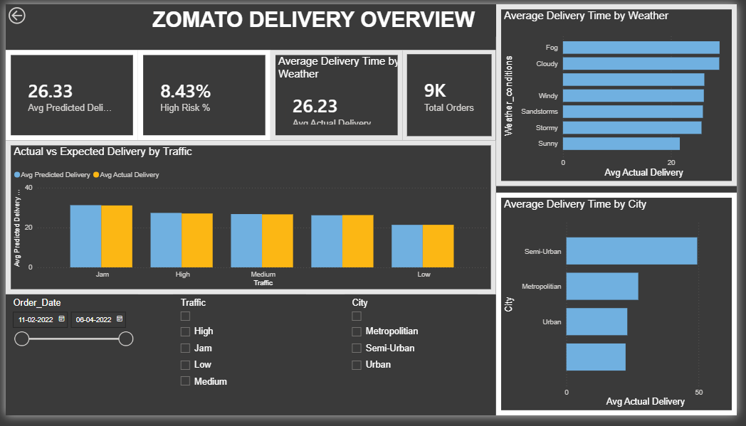
04 · DASHBOARD
Bringing It Together in Power BI
Model predictions were exported to CSV and visualized in an interactive Power BI report for delivery-time monitoring.
Dashboard Highlights
KPI cards: total orders, avg. actual vs predicted time, high-risk %
Predicted vs actual delivery time compared across traffic levels
Average delivery time broken down by weather and by city type
Filters for order date, traffic and city enable drill-down analysis
Applied Predictive Analytics | Chaitanya Bharathi Institute of Technology
5

Slide 6
05 · CONCEPTS
Predictive Analytics, BI, Statistics & Data Mining
Applied to this project: statistics summarized the data, data mining and BI explored patterns, and predictive analytics (Random Forest) forecast delivery time.
Statistics
Data Mining
Describes what happened
(means, distributions, tests)
Finds hidden patterns
in large datasets
All four share:
data-driven decision making
Business
Intelligence
Predictive
Analytics
Reports & dashboards on
past/current performance
Forecasts future outcomes
(this project's Random Forest)
Applied Predictive Analytics | Chaitanya Bharathi Institute of Technology
6

