Slide 1


Slide 2
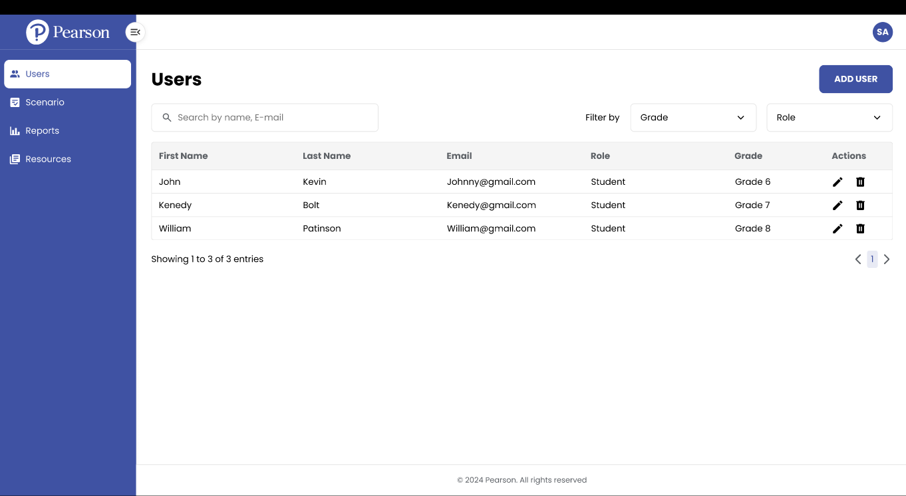

Slide 3
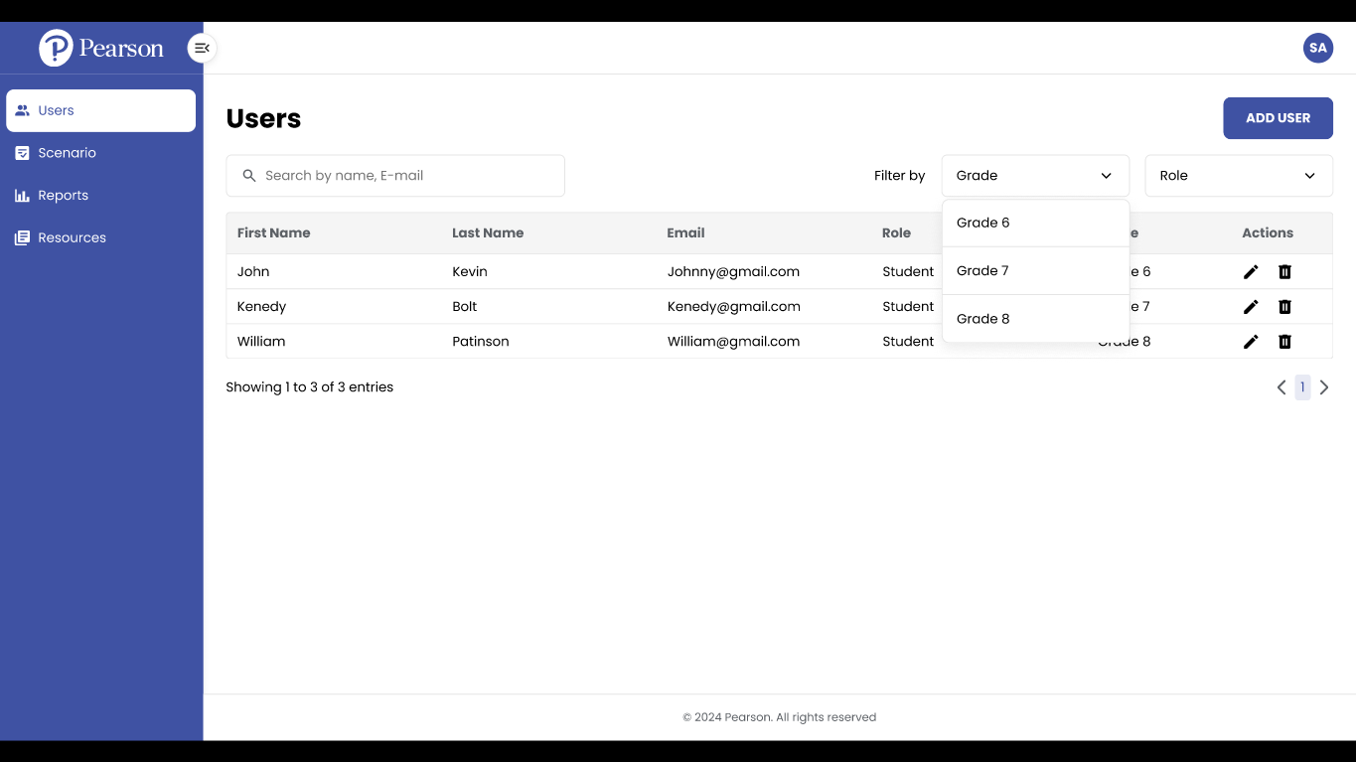

Slide 4
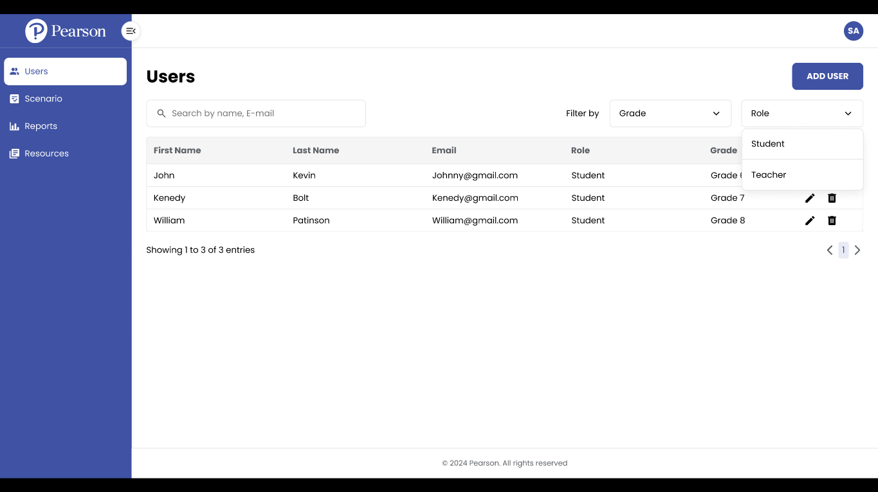

Slide 5
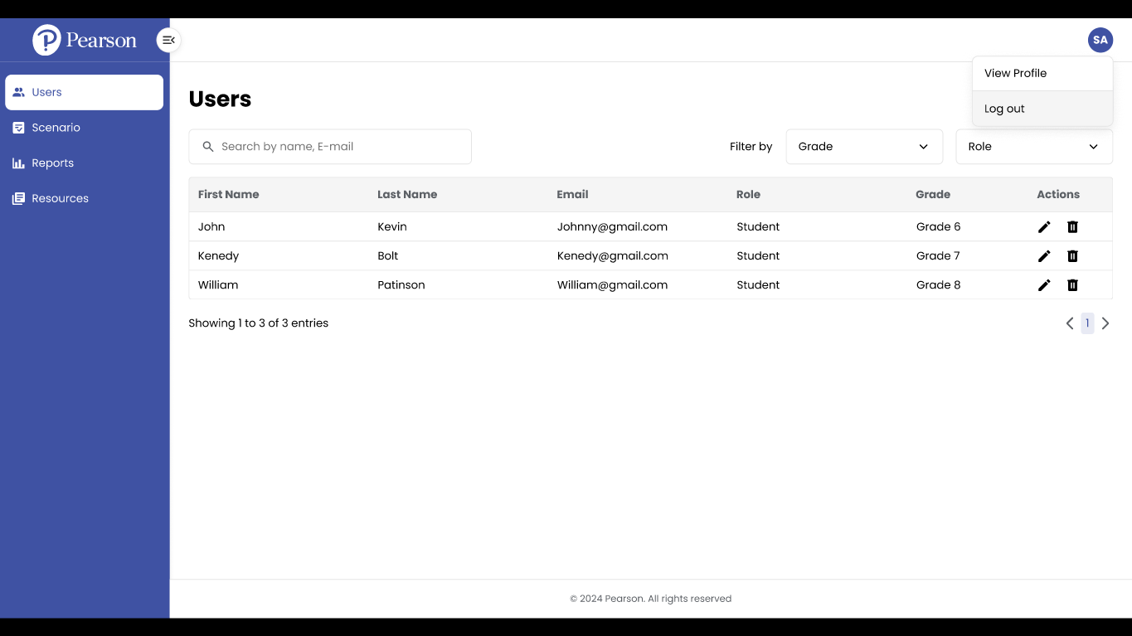

Slide 6
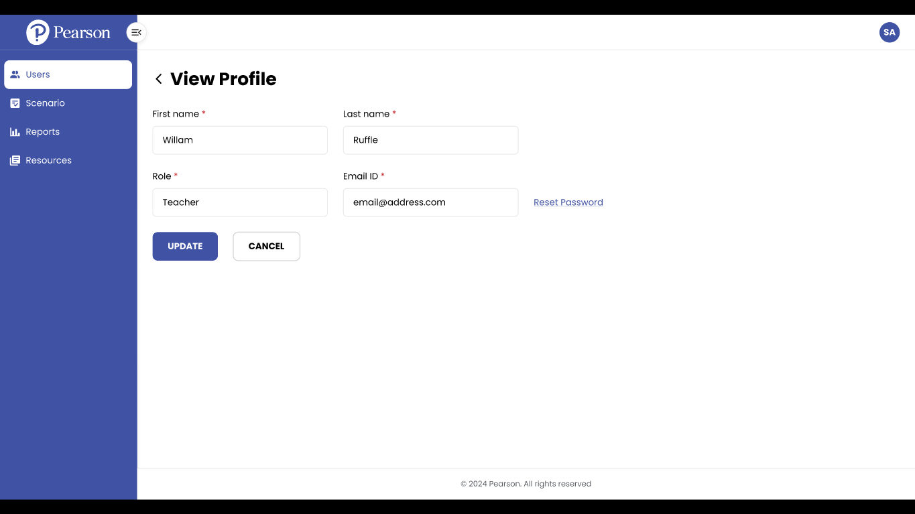

Slide 7
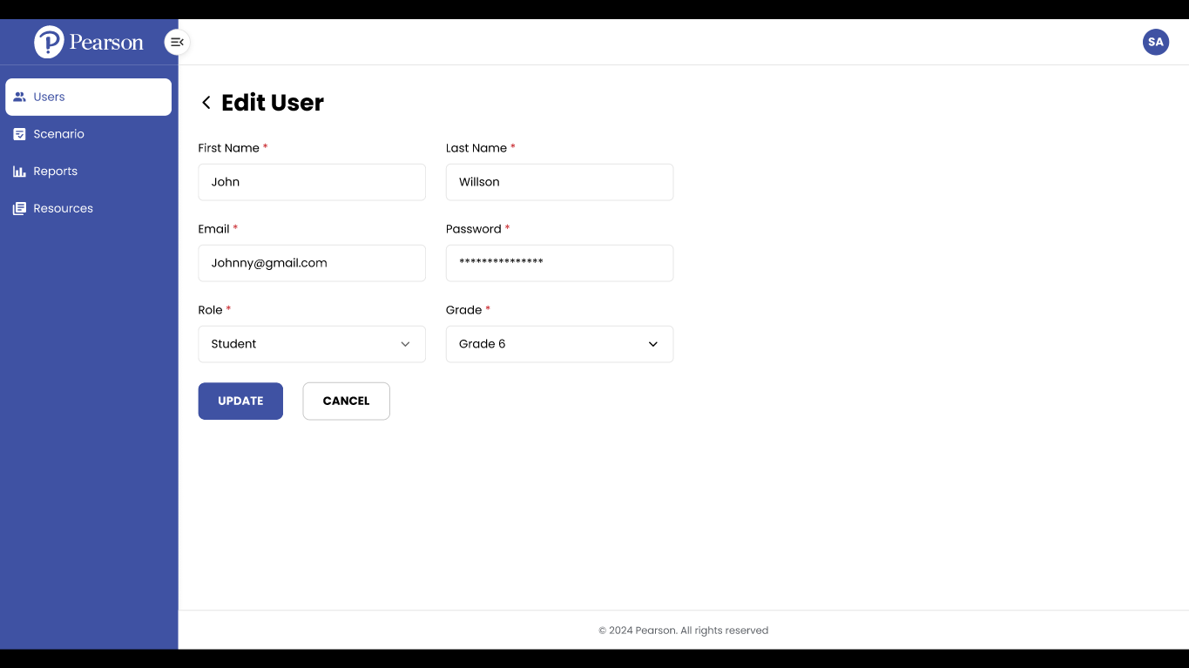

Slide 8
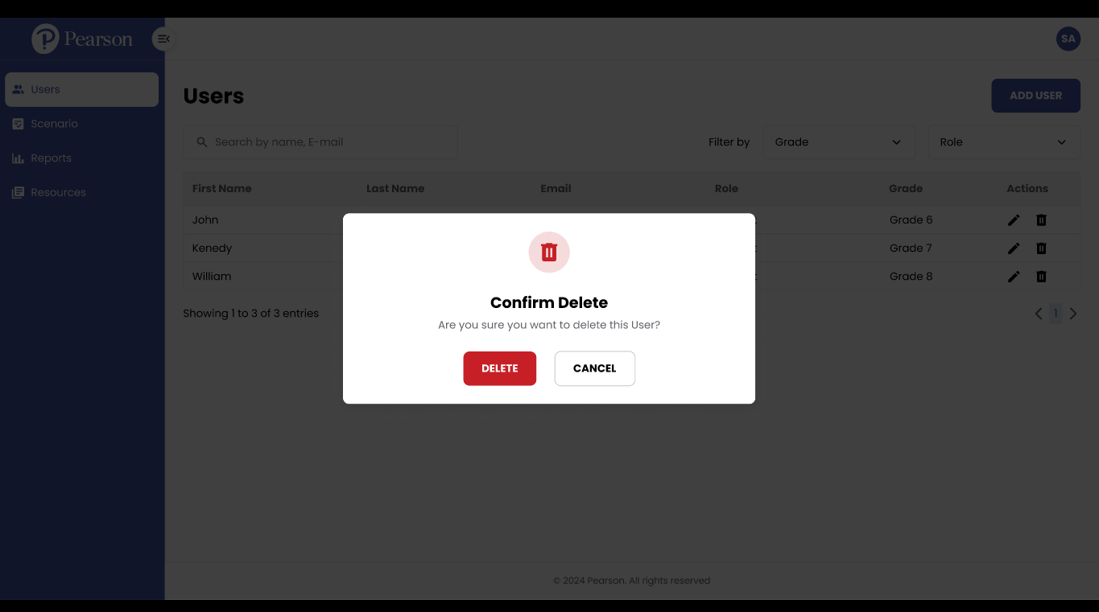

Slide 9
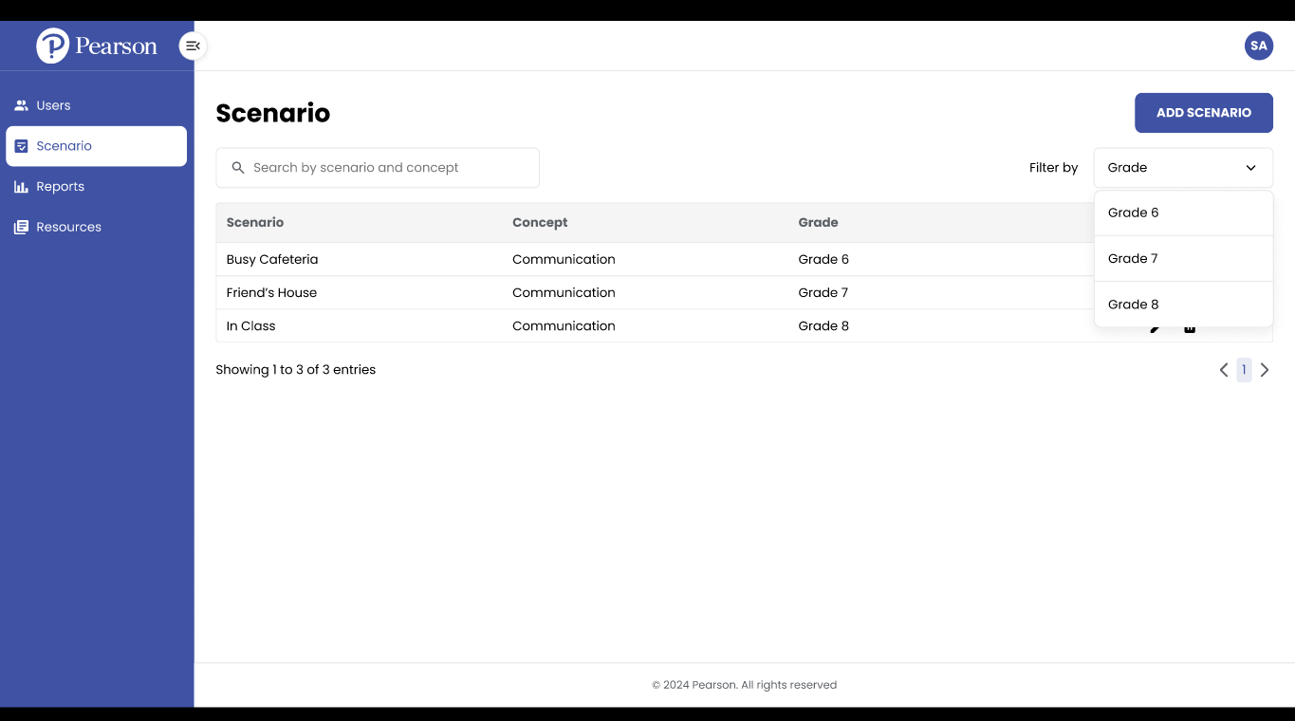

Slide 10
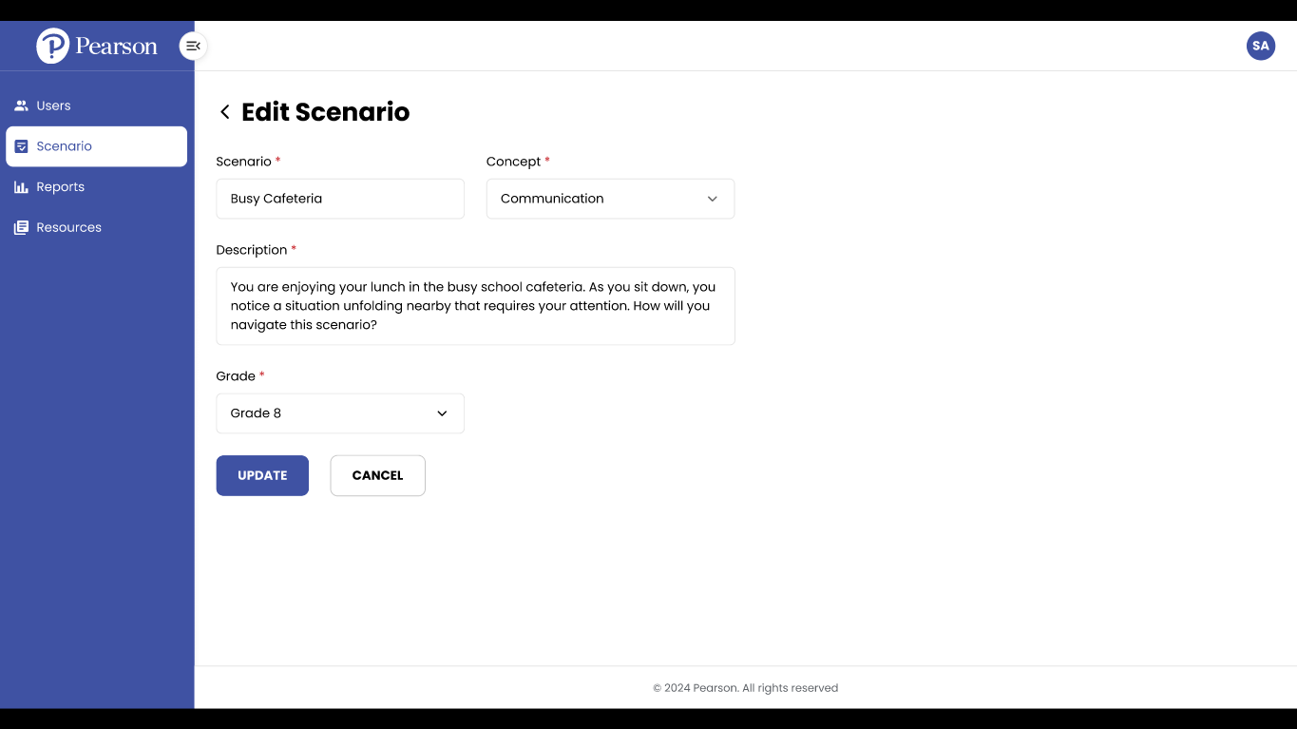

Slide 12
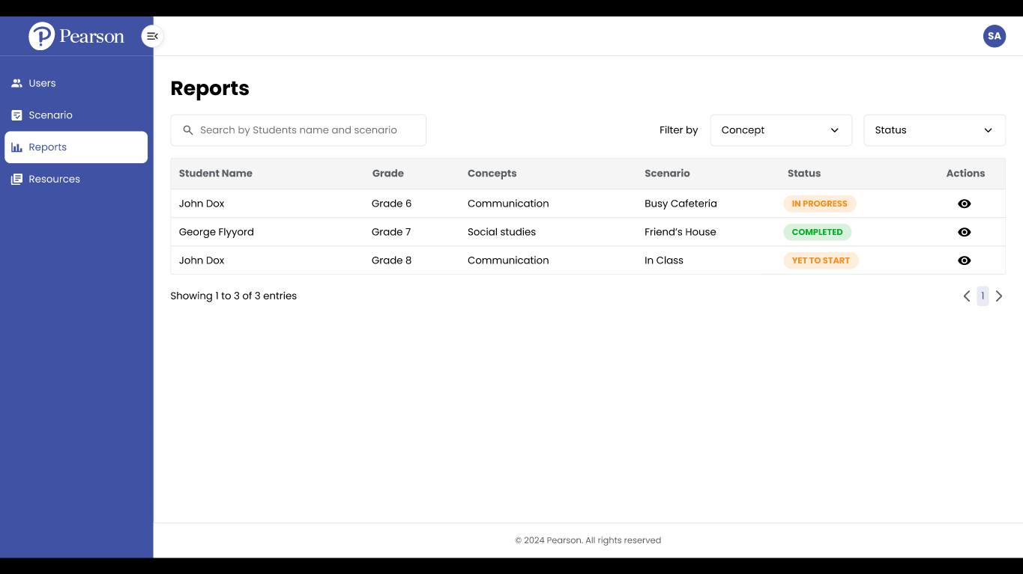

Slide 13
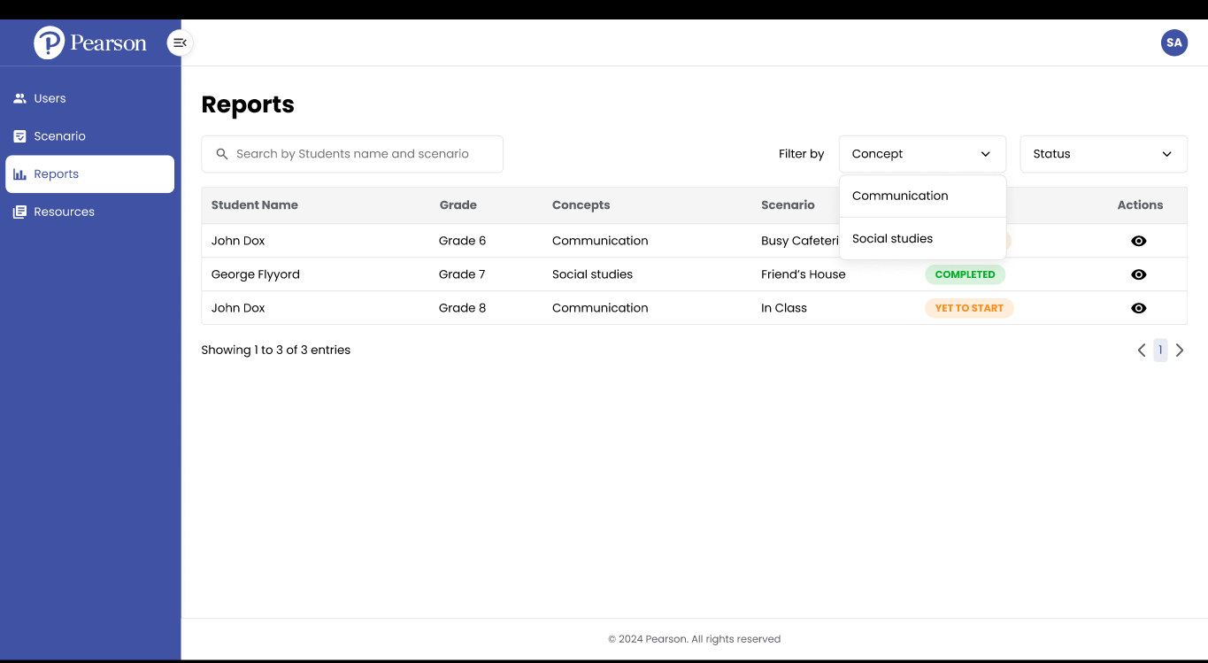

Slide 14
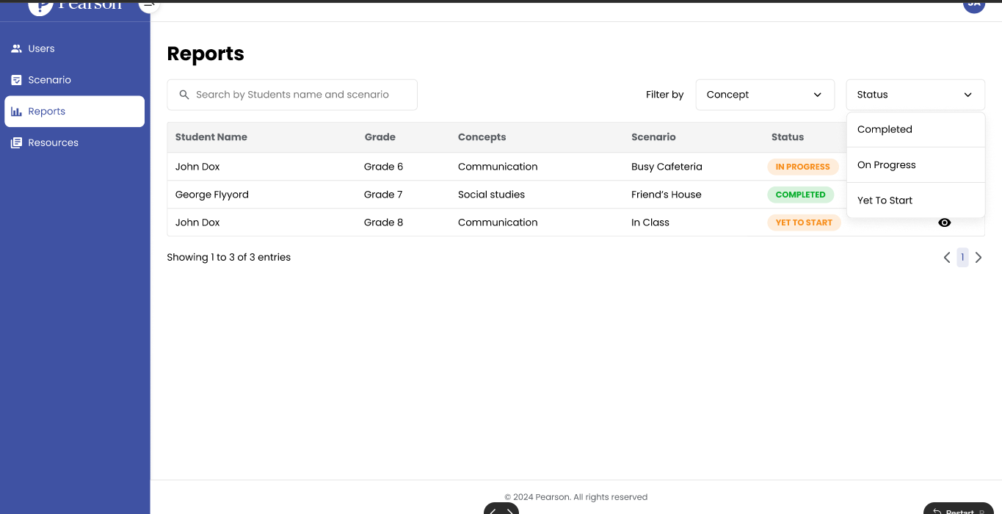

Slide 15
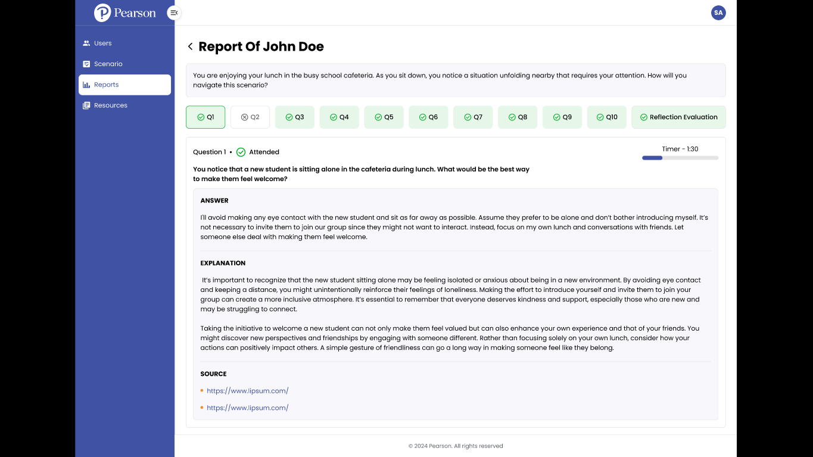

Slide 16
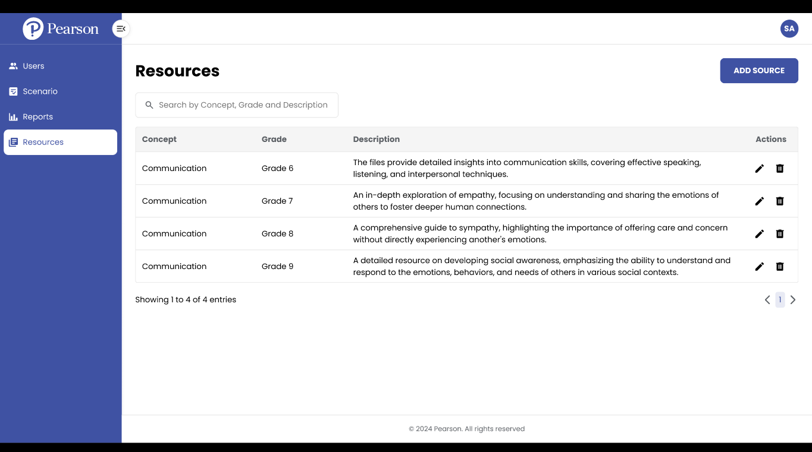

Slide 17
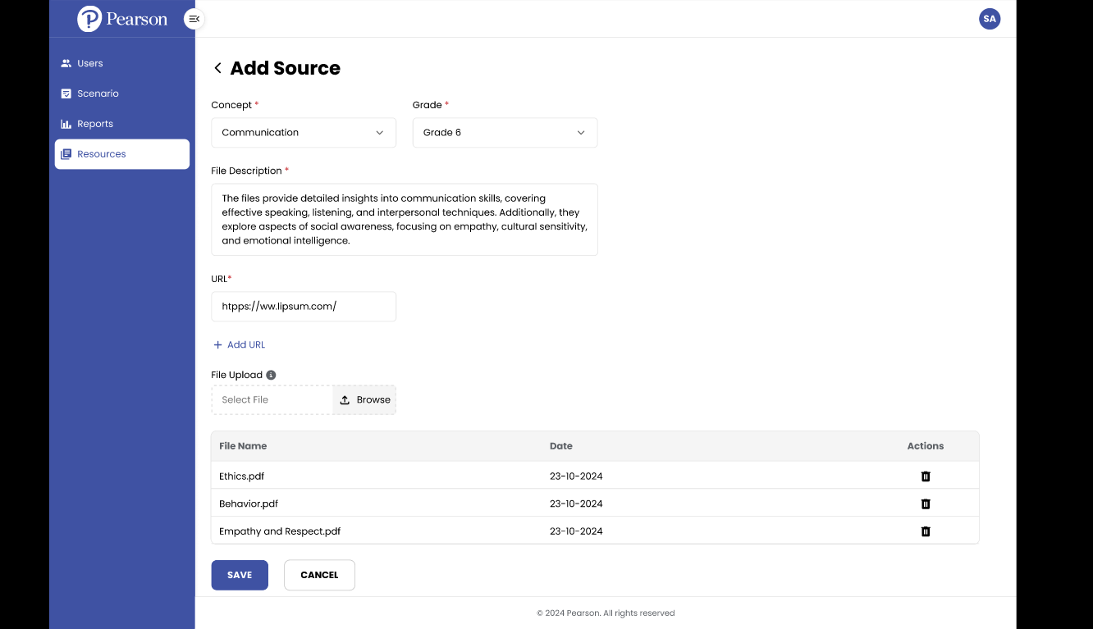

Slide 18
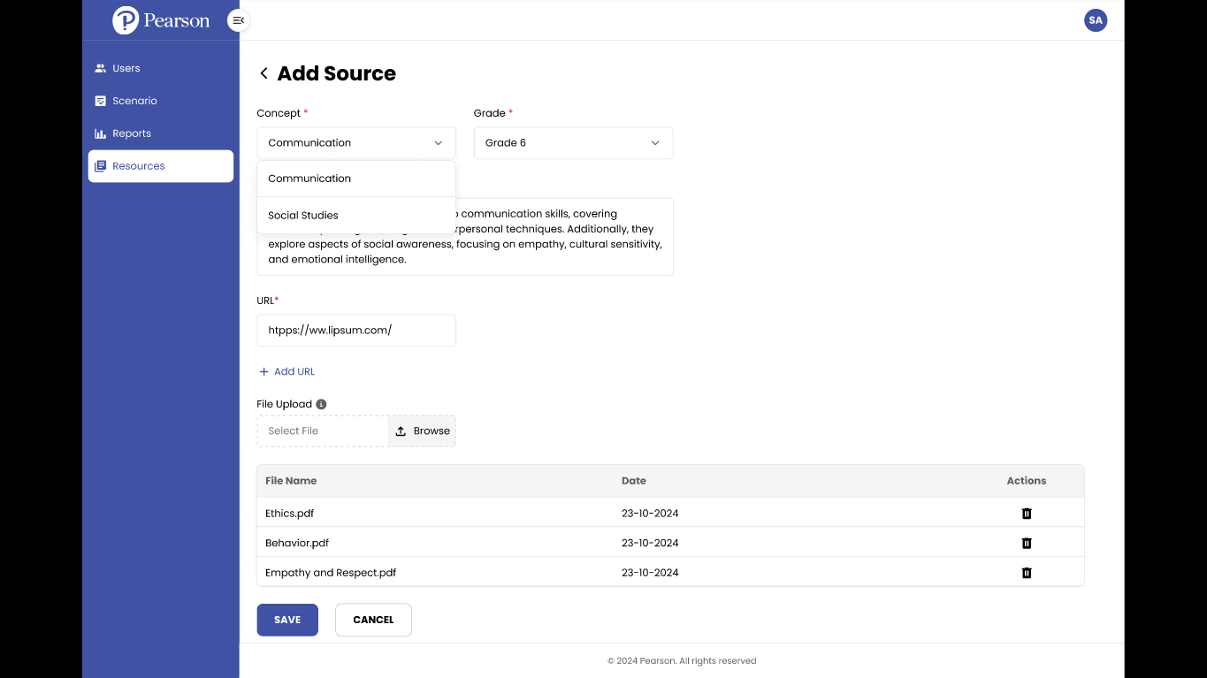

Slide 19
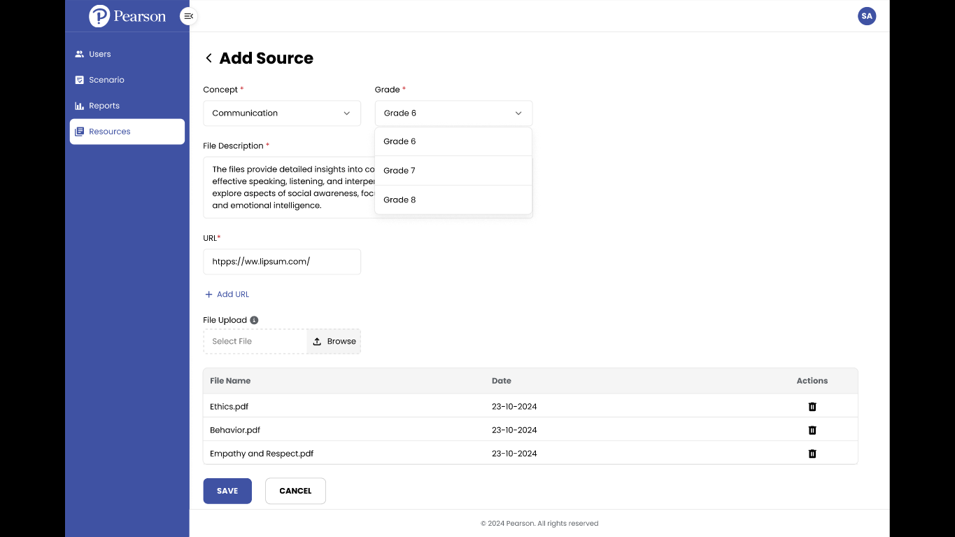

Slide 20
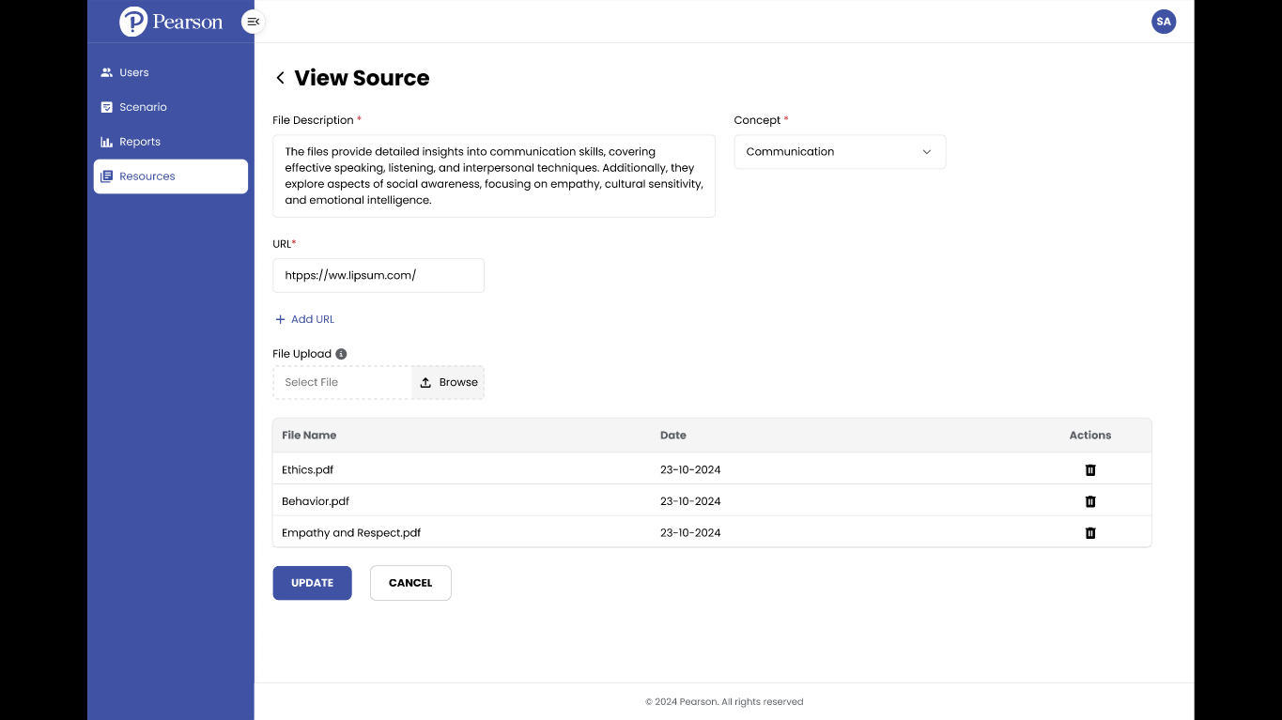

Slide 21
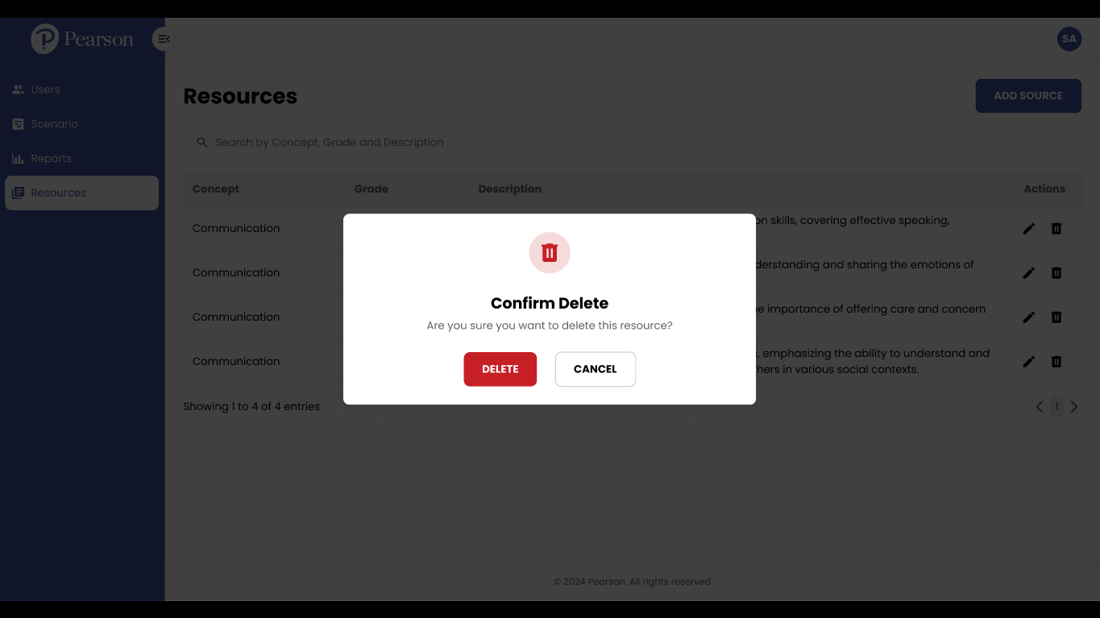

Slide 22
Figma: https://www.figma.com/proto/QQxlcG3lGCU4J8cHHr9hDw/Pearson-POC---UX%2FUI?node-id=180-25650&node-type=frame&t=pau0BCsA016ckdkS-0&starting-point-node-id=22%3A27519&show-proto-sidebar=1
Sketch: https://excalidraw.com/#room=b5935fea9269d5ab7020,ewFdj5M6WrAGYxTRZ2ybYg
Gitlab: http://gitlab1.integra.co.in/pearson-poc/python

