Slide 1
RESPONDENT CLASSIFICATION
VIGNESH

Slide 2
DATA OVERVIEW:
This dataset contains Survey regarding digital financial services.
It tries to capture the behaviour of people towards those services.
Responses of people from different zones and states are taken.
In general it captures the financial details of an individual like source of income ,investments,pension as well as the spending pattern.
NO.OF.RECORDS: | 18255
NO.OF.FEATURES: | 1235
DEPENDENT VARIABLE: | IS_FEMALE

Slide 3
PROBLEM STATEMENT
To predict whether the respondent is a female or not

Slide 4
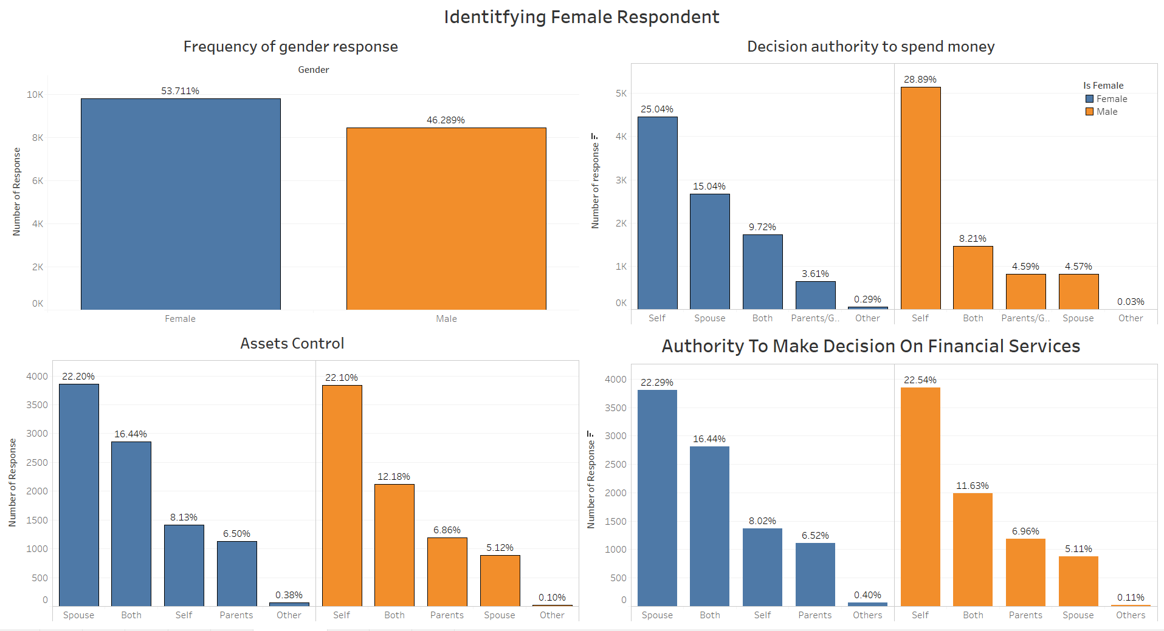
EXPLORATORY DATA ANALYSIS:

Slide 5
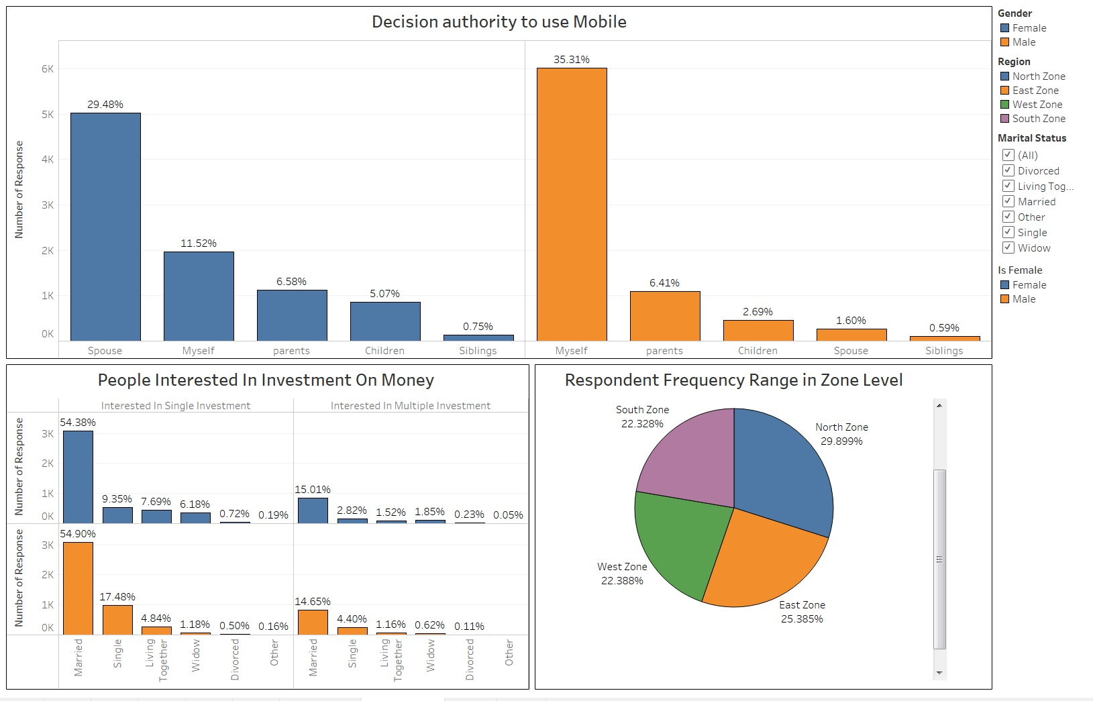
COND....

Slide 6
DATA JOURNEY:
Raw data-1235 Features
After Handling Null Values-431 features
After Correlation-377 Features
After VIF-78 Features
Location
Marital Status
Religion
Education
Household head
No of adults
No of Childrens
No of adults earning income
No of childrens earning income
Work status
Primary job
Acres
Relocate history
Family Financial status
Decision authority to use phone
Cost per mobile charge
Last received call
Bank offers a ATM card
Bank offers a credit card
PPF
Distance of nearest bank
Financial Advice
Planned for unexpected expenses
Unexpected medical expenses
Financial dependency
Asset Control
Authority to spend money on purchase
Authority to spend money
Language Proficiency
Investment on money
Informal group savings
Bank counter experience banking
Account Deposit limit<=1 lakh
Current account with cheque book
Current account without cheque book
Current account with overdraft facilities
Possible to make online transaction
Location
Marital Status
Religion
Education
Household head
No of adults
No of Children
No of adults earning income
No of children earning income
Work status
Primary job
Acres
Relocate history
Family Financial status
Decision authority to use phone
Cost per mobile charge
Last received call
Bank offers a ATM card
Bank offers a credit card
PPF
Distance of nearest bank
Financial Advice
Planned for unexpected expenses
Unexpected medical expenses
Financial dependency
Asset Control
Authority to spend money on purchase
Location
Marital Status
Religion
Education
Household head
No of adults
No of Children
No of adults earning income
No of children earning income
Work status
Primary job
Acres
Relocate history
Family Financial status
Decision authority to use phone
Cost per mobile charge
Last received call
Bank offers a ATM card
Bank offers a credit card
PPF
Distance of nearest bank
Financial Advice
Planned for unexpected expenses
Unexpected medical expenses
Financial dependency
Asset Control
Authority to spend money on purchase
Household Head
Work Status
Decision authority to use mobile
Financial advice
Marital Status
Financial dependency
Primary job
Location
Assert control
Education
No of adults
Authority to spend money on purchase
Family financial status
Authority to spend money
Reason for not borrowed from bank
How did you bought your phone?
Acres
Language Proficiency
Reading English
No of adults home
Decision authority to use phone
Cost per mobile charge
Last received call
Distance of nearest bank
Financial dependency

Slide 7
MODEL USED:
MODEL USED | ACCURACY (%) | PRECISION | RECALL | F1-SCORE | KAPPA(%)
RANDOM FOREST | 88.14% | 0.88 | 0.88 | 0.88 | 76.2%
DECISION TREE | 82.94% | 0.83 | 0.83 | 0.83 | 65.68%
LOGISTIC REGRESSION | 67.43% | 0.68 | 0.67 | 0.67 | 33.71%

Slide 8
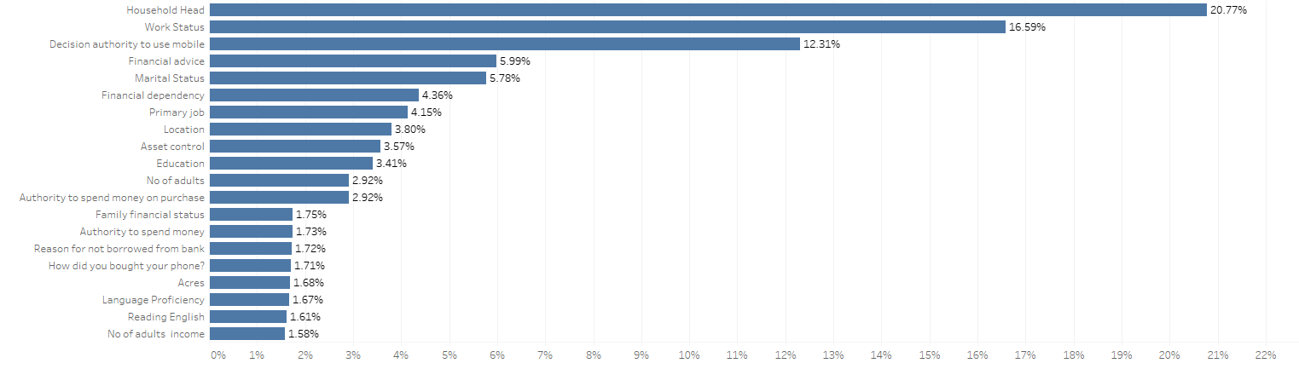
INFLUENCING VARIABLES:
Household Head
Work Status
Decision authority to use mobile
Financial advice
Marital Status
Financial dependency
Primary job
Location
Assert control
Education
No of adults
Authority to spend money on purchase
Family financial status
Authority to spend money
Reason for not borrowed from bank
How did you bought your phone?
Acres
Language Proficiency
Reading English
No of adults home

Slide 9
MODEL OUTCOME:
Based on this model , we can analyze the proportion of females aware of the different financial services available. This in turn gives an area where women empowerment should be concentrated .
Based on usage of existing digital services by the female gender , government can implement new schemes like making medical appointments online , seeking health information etc.

Slide 10
Thank you.

