Slide 1
Toxic comments Challenge
Project By
Senthil Kumar
Vignesh
Karthick Santhosh

Slide 2
Introduction
Process of deriving A Strong Baseline To Classify Toxic Comments.
Purpose of it is to process unstructured text information to filter out the negative comments and eliminate from a forum.

Slide 3
BUSINESS PROBLEM
The threat of abuse and harassment online means that many people stop expressing themselves and give up on seeking different opinions. Platforms struggle to effectively facilitate conversations, leading many communities to limit or completely shut down user comments.
Notes:
Data set used : IMDB data set

Slide 4
Data Analysis
Dataset consists of 8 columns where comment_text column contains sets of comments and there are six classifiers.
The Dataset belongs to Multi-class Multi label classification model. We need to predict whether the comment belongs to either of the six classifier and it can also have multiple labels.
We used TFIDF-Vectorizer, OnevsRest MultinomialNB classifier in a pipeline to predict the data.
Accuracy for the model is 90.4%

Slide 5

Methodology
Data Collection
Exploratory Data Analysis,User Defined Functions for Data Analysis
Applying Machine learning Model
User defined function for predictions

Slide 6
Step-By-STEP PROCEDURE
Data Preprocessing by filtering out stop words,stemming & word tokenization
Extracting Train,Test dataset with text comments and six categories
Exploratory Data Analysis
Using Flaskapp to add the model for webpage creation
Saving the model using pickle.dump
Training the model using Naive Bayes Classifier
Displaying the web page where input comments are added to predict the six Classifiers

Slide 7
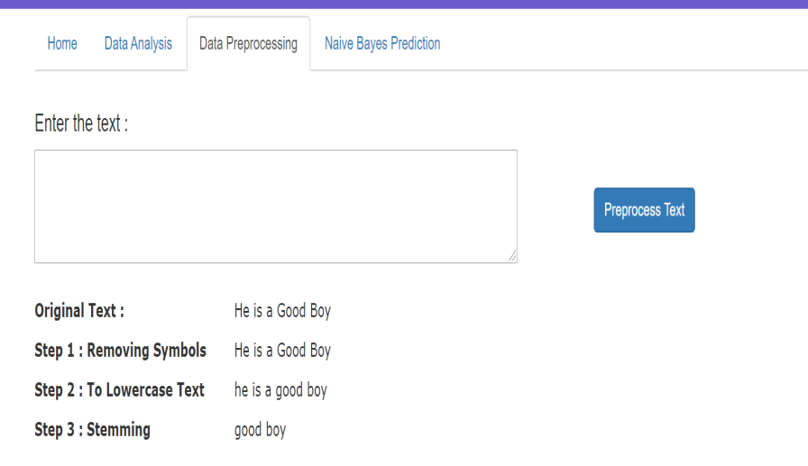
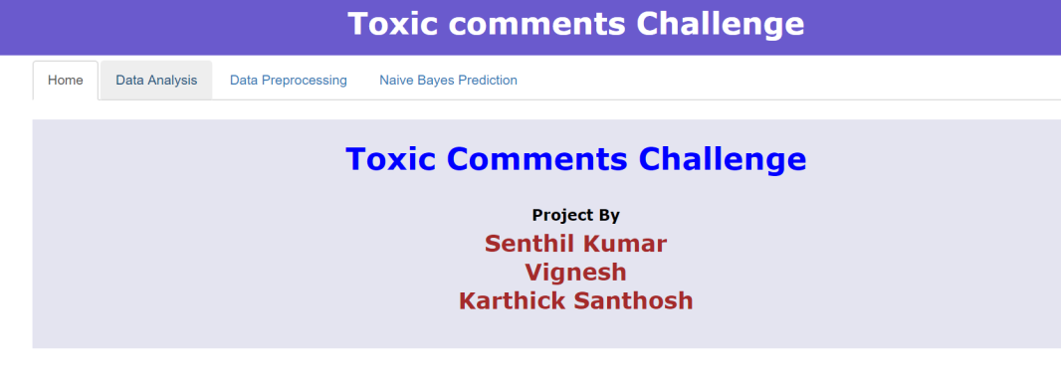
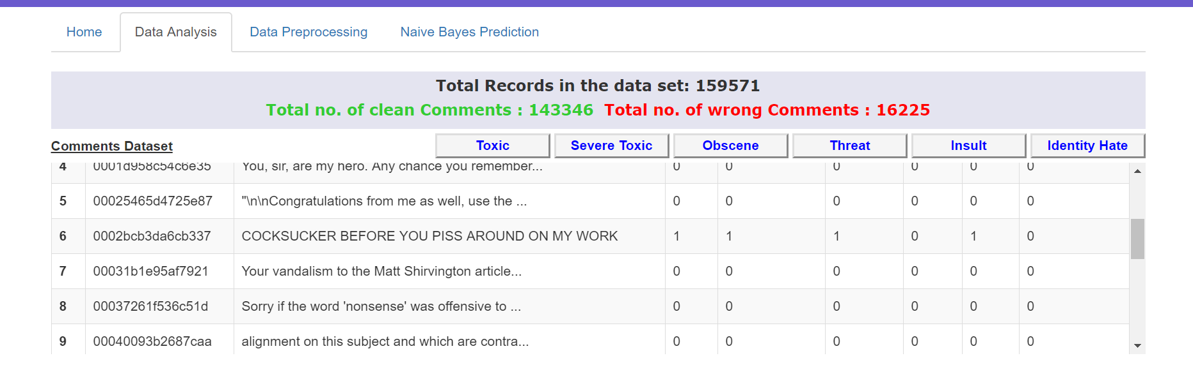
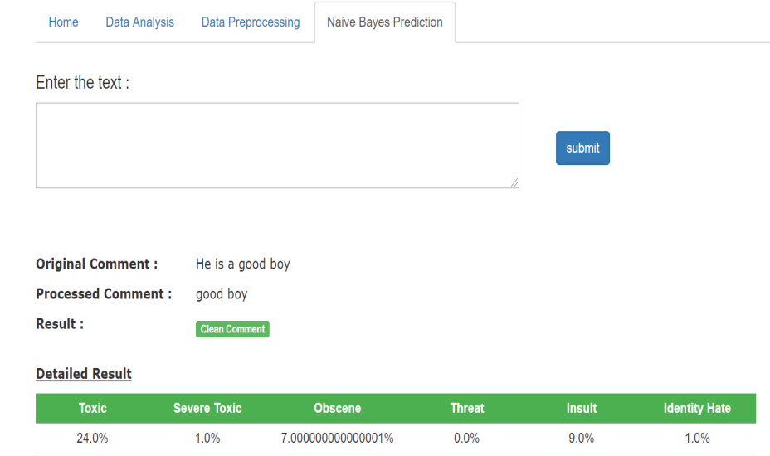
Data Presentation

