Slide 1
Digital Portfolio
STUDENT NAME: VIGNESH.K
REGISTER NO AND NMID: 37424U18022&astvu374tvu374u18022
DEPARTMENT:BSC COMPUTER SCIENCE
COLLEGE: GOVT ARTS AND SCIENCE COLLEGE
NATTRAMPALLI/THIRUVALLUVAR UNIVERSITY

Slide 2

BUILDING THE FEATURE

Slide 3


AGENDA
Problem Statement
Project Overview
End Users
Tools and Technologies
Portfolio design and Layout
Features and Functionality
Results and Screenshots
Conclusion
Github Link
3/21/2024 Annual Review

Slide 4

PROBLEM STATEMENT 1.Users face difficulties due to the absence of this feature, limiting functionality. 2.Current system does not fully meet user needs or expectations. 3. Lack of this feature reduces efficiency and user experience. 4. Competitor platforms already provide similar functionality, creating a gap. 5. Adding the feature will enhance usability, engagement, and overall satisfaction.
PROBLEM STATEMENT
1.Users face difficulties due to the absence of this feature, limiting functionality. 2.Current system does not fully meet user needs or expectations. 3. Lack of this feature reduces efficiency and user experience. 4. Competitor platforms already provide similar functionality, creating a gap. 5. Adding the feature will enhance usability, engagement, and overall satisfaction.

Slide 5

PROJECT OVERVIEW
1. Understand the problem arid gather detailed user requirements. 2. Plan the scope, resources, and timeline for development. 3. Design the feature with a focus ori usability and efficiency. 4. Develop and integrate the feature into the existing system. 5. Test thoroughly to ensure quality, performance, and reliability. 6. Deploy the feature, collect user feedback, and optimize

Slide 6

THE END USERS
1. Understand the problem and gather detailed user requirements. 2. Plan the scope, resources, and timeline for development. 3. Design the feature with a focus on usability and efficiency. 4. Develop and integrate the feature into the existing system. 5. Test thoroughly to ensure quality, performance, and reliability. 6. Deploy the feature, collect user feedback, and optimize further.

Slide 7

TOOLS AND TECHNIQUES
1. Programming Languages-e.g., Python, Java, or JavaScript for development. 2. Frameworks-like React, Angular, or Django to speed up building. 3. Databases-MySQL, MongoDB, or Firebase to store and manage data. 4. Version Control-Git/GitHub for tracking code changes and collaboration. 5. Testing Tools - Selenium, JUnit, or Fostman to ensure quality. 6. Danloumant Dlatforme - A/C Azure Docker for haetion anve

Slide 8
POTFOLIO DESIGN AND LAYOUT
1. Cover Page-Title of the project, your name, and a clean visual theme. 2. Introduction-Brief overview of the feature and its porpose. 3. Problem Statement-Explain the issue the feature is solving 4. Project Overview-Steps followed planning, design, development, testing, deployment. 5. Tools & Technologies-List of languages, franewdiks, and platforme used. 6. Screenshots & Results-Visuals of the feature, outcomes, and user
8

Slide 9
FEATURES AND FUNCTIONALITY
1. Feature Definition-The new capability added to the system to solve a specific problem. 2. Core Functionality-How the feature works to achieve its main purpose. 3. User Interaction-Simple, intuitive design so users can easily access and use it. 4. Integration-Works smoothly with existing system modules and services 5. Performance-Provides fast, reliable, and efficient results for the end use 6. Scalability-Can be improved or expanded in the future based on user

Slide 10
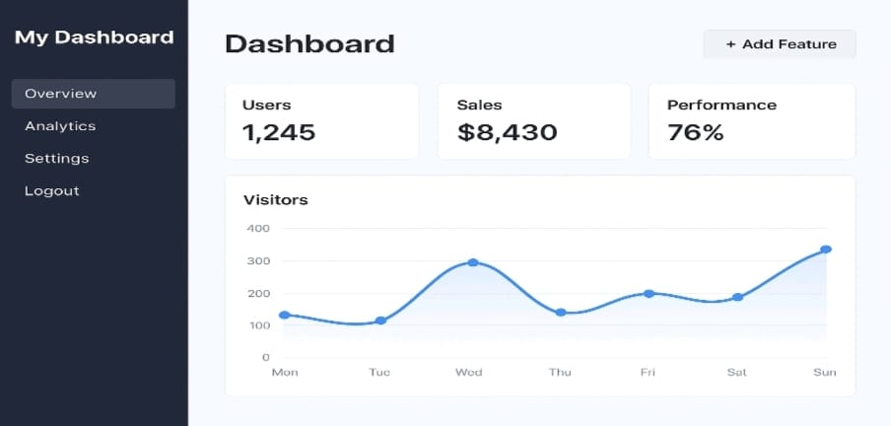
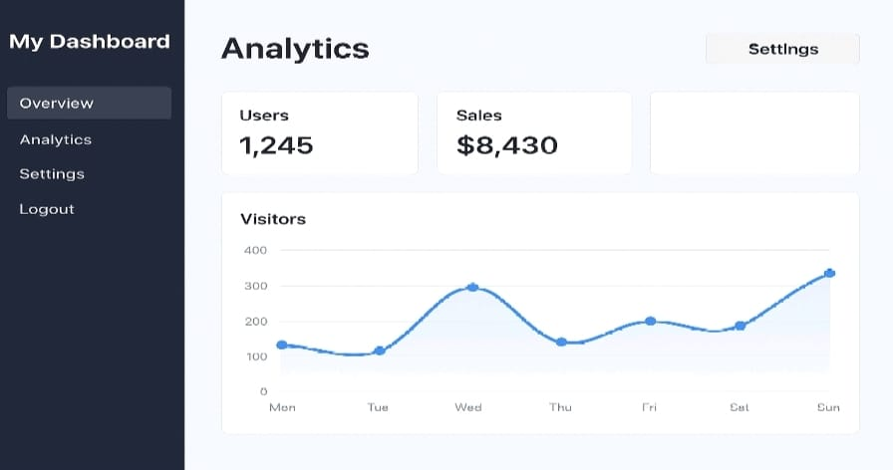

RESULTS AND SCREENSHOTS
1. Improved User Experience-Users find the system easier and more helpful. 2. Efficiency-Tasks are completed faster with less effort 3. Problem Solved - The specific issue identified in the problem statement is addressed. 4. Higher Engagement-Users interact more with the system because of added value. 5. Competitive Advantage-The system stays ahead or on par with competitors.
3/21/2024 Annual Review
10

Slide 11
CONCLUSION
1. The feature successfully addresses the identified problem. 2. It enhances overall usability and user satisfaction 3. Integration with existing systems was achieved smoothly. 4. The feature improves efficiency and productivity. 5. User feedback confirms its usefulness and value. 6. It lays the foundation for future improvements and scalability
11

