Slide 1
D.VIGNESH KUMAR 3 RD YEAR B.E CSE NM ID:au421221104055 Email.id:vignesh2008dhanasekaran@gmail.com
Final Project
3/21/2024 Annual Review
Notes:
3 RD YEAR B.E CSE
NM ID:au421221104055
Email.id:vignesh2008dhanasekaran@gmail.com

Slide 2
PROJECT TITLE
TEXT TO IMAGE GENERATION
3/21/2024 Annual Review

Slide 3


AGENDA
1. PROBLEM STATEMENT
2. PROJECT OVERVIEW
3. WHO ARE THE END USERS
4. YOUR SOLUTION AND ITS VALUE PROPOSITION
5.THE WOW IN YOUR SOLUTION
6. MODELLING
7.RESULT
8.CONCLUSION
3/21/2024 Annual Review

Slide 4

PROBLEM STATEMENT
1.Describe the challenge of creating realistic images from textual descriptions.
2.Highlight the limitations of existing methods and technologies in this domain.
3/21/2024 Annual Review

Slide 5

PROJECT OVERVIEW
1.Explain the objective of your project, which is to generate high-quality images from text inputs.
2.Provide an overview of the tools, techniques, and resources used in your project.
3/21/2024 Annual Review

Slide 6

WHO ARE THE END USERS?
1.Identify the target users of your text-to-image conversion system, such as designers, content creators, or artists.
2.Describe their needs for generating images efficiently and accurately.
3/21/2024 Annual Review

Slide 7

YOUR SOLUTION AND ITS VALUE PROPOSITION
1.Present your text-to-image conversion solution, showcasing its ability to produce realistic and relevant images based on textual descriptions.
2.Highlight the value it brings to users by saving time, improving productivity, and enhancing creativity.
3/21/2024 Annual Review

Slide 8

THE WOW IN YOUR SOLUTION
1.Showcase the unique features of your text-to-image conversion system, such as AI-powered image synthesis, style transfer capabilities, or real-time rendering.
2.Demonstrate how these features contribute to an exceptional user experience and output quality.
3/21/2024 Annual Review
8

Slide 9
MODELLING
Teams cam add wireframes
1.Explain the AI models, algorithms, and techniques used in your text-to-image conversion system, such as Generative Adversarial Networks (GANs), deep learning architectures, or image-to-text mapping methods.
2.Provide insights into the training data, pre-processing steps, and optimization strategies employed.
3/21/2024 Annual Review
9

Slide 10
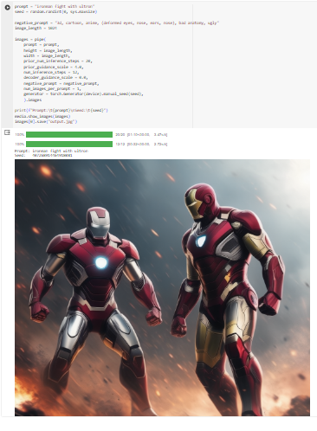
RESULTS
Demo Link
3/21/2024 Annual Review
10

