Slide 1
Genetic Semantic Graph Approach for Multi-document Summarization
Compiler design Project

Slide 2
Team members:
1.RAGHURAJ SV (2019103563 )
2.DHAMODHARAN S (2019103515)
3.VIGNESH G (2018103078)

Slide 3
Abstract
Obtaining training data for multi-document summarization (MDS) is time consuming and resource intensive.
we propose an unsupervised method for multi-document summarization.
we convert the original documents to a sentences, removing stop words, forming Semantic similarity matrix.
Then apply page rank algorithm to obtain rank for multiple clusters of sentences, and finally taking top ranked sentences to generate the final summary.

Slide 4
deliverables
Input: Multiple Text documents for summary.
Output: Single summary Text Summarized document.

Slide 5
Introduction
Main objective of automated document summarization is to perform this summarization without involving human input, except for running computer programs.
In this case, the end result is still in the form of some document, but with a few sentences based on the length we might want the summary to be.

Slide 6
Problem STATEMENT
Since the amount of material on the web is evolving quickly, for clients it isn't simple to discover pertinent and fitting data according to the prerequisites.
This issue is known as " Data Overloading".

Slide 7
Objective
The essential objective of various multi‐document summarization techniques is to create summaries which provide extensive inclusion.
Less redundancy in the information and extensive consistency between sentences.
A multidocument summarizer for making people get the crisp, important data from the enormous amount of data, a time saving in this busy modern world.

Slide 8
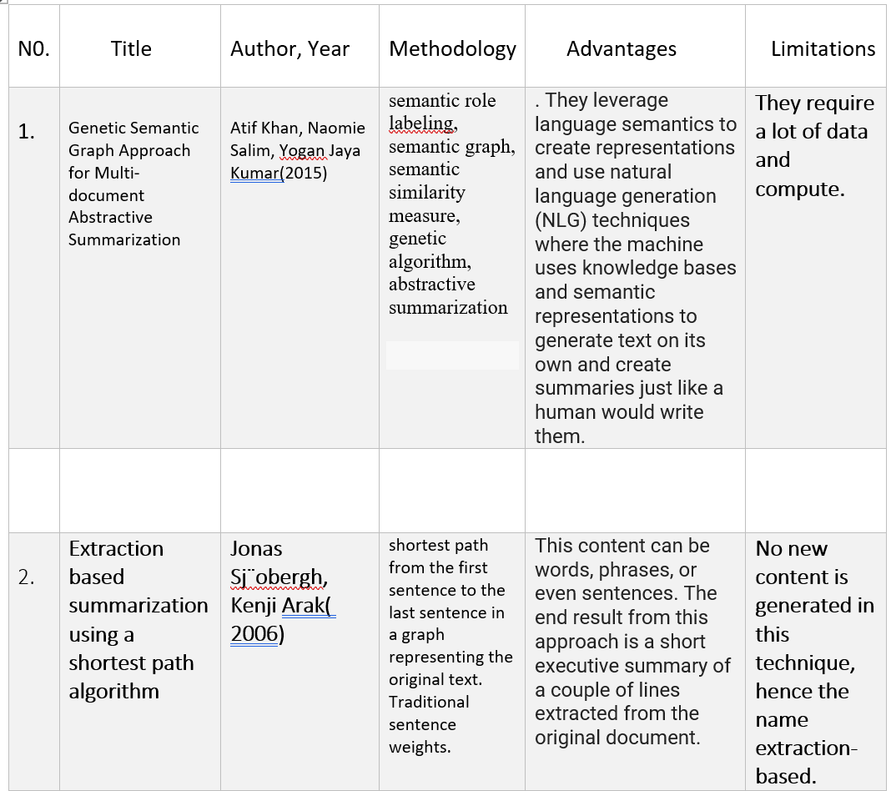
Literature Survey:

Slide 9
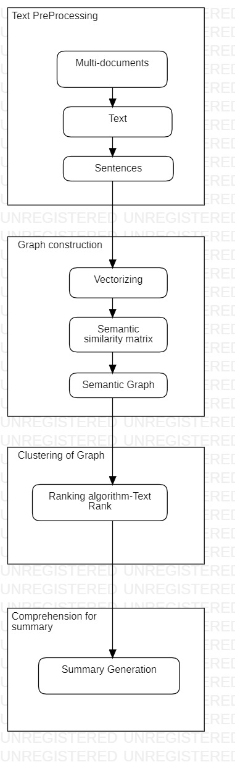
Block diagram

Slide 10
MODULE-1:
We concatenate documents and apply minimal text processing, mainly sentence split, as we want to keep documents raw for subsequent processing.
IMutliple document after recognition of tokens, Removing ambiguious sentences.
List of sentences from all the documents combined.

Slide 11
Pseudo code:
import re
DOCUMENT = re.sub(r'\n|\r', ' ', DOCUMENT)
DOCUMENT = DOCUMENT.strip()
print(DOCUMENT)
sentences=nltk.sent_tokenize(DOCUMENT)
print(sentences)
len(sentences)

Slide 12
Module-2:
Graph construction:
Decide on the number of sentences, k, that we want in the final summary .
Build a document­ term feature matrix using weights like TF­IDF or Bag of Words.
Compute a document similarity matrix by multiplying the matrix by its transpose.
Use these documents (sentences in our case) as the vertices and the similarities between each pair of documents as the weight or score
List of sentences from the previous step.
After vectorization and semantic similarity matrix only semantically connected sentences are obtained, sent into graph construction constructor, Semantic graph is output.

Slide 13
Pseudo code:
from sklearn.feature_extraction.text import TfidfVectorizer
import pandas as pd
tv = TfidfVectorizer(min_df=0., max_df=1., use_idf=True)
dt_matrix = tv.fit_transform(norm_sentences)
dt_matrix = dt_matrix.toarray()
vocab = tv.get_feature_names()
td_matrix = dt_matrix.T
print(td_matrix.shape)
pd.DataFrame(np.round(td_matrix, 2), index=vocab).head(15)

Slide 14
MODULE-3:
Clustering from graph:
The Text-Rank summarization algorithm internally uses the popular PageRank algorithm, which is used by Google for ranking websites and pages.
To understand Text-Rank better, we need to understand some of the concepts surrounding PageRank. The core algorithm in PageRank is a Graph­ based scoring or ranking algorithm, where pages are scored or ranked based on their importance.
Input: semantic Graph is fed as input for optimization phase
output: Semantic graph is clustered based on Text Rank algorithm.

Slide 15
Pseudo code:
scores = networkx.pagerank(similarity_graph)
ranked_sentences = sorted(((score, index) for index, score
in scores.items()), reverse=True)
ranked_sentences[:20]

Slide 16
MODULE-4:
Comprehension for summary:
Text ranking algorithm result is comprehensive based on the no. of lines output we need and the final output a summarized document is obtained.
Input: sentence clusters is fed as input.
Output: optimize the clusters into single text document

Slide 17
Pseudo code:
num_sentences=7;
top_sentence_indices = [ranked_sentences[index][1]
for index in range(num_sentences)]
top_sentence_indices.sort()

Slide 18
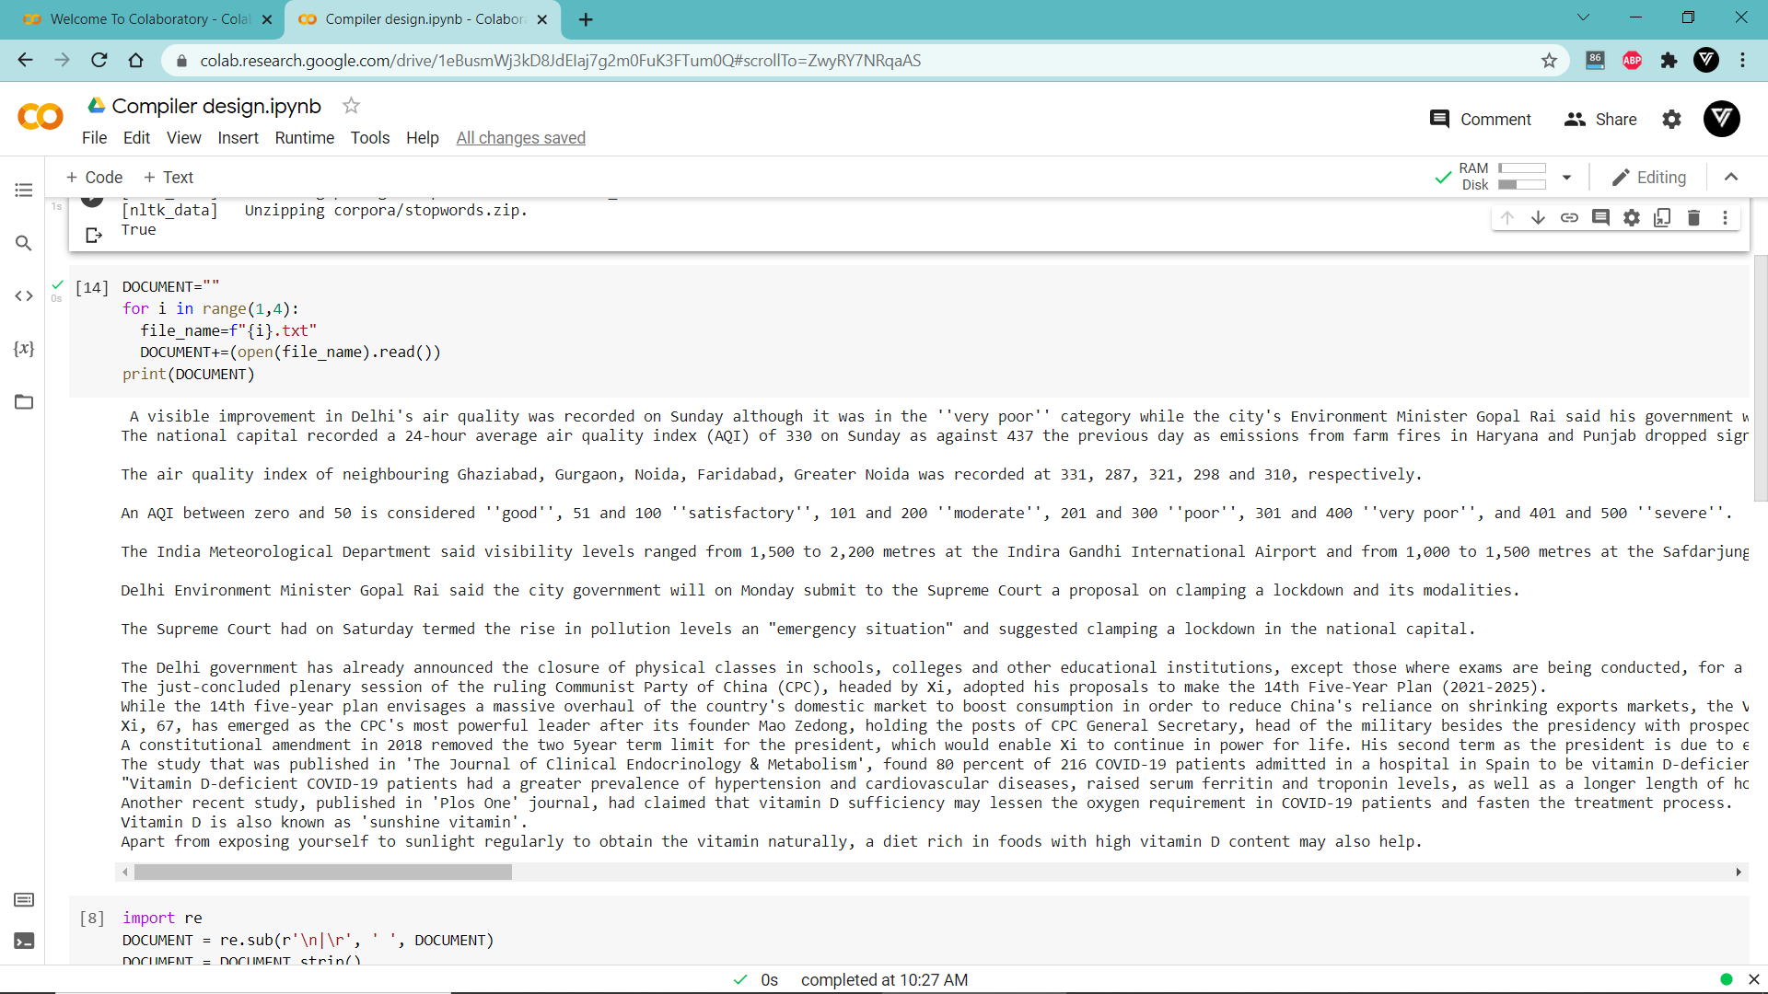
Implementation:

Slide 19
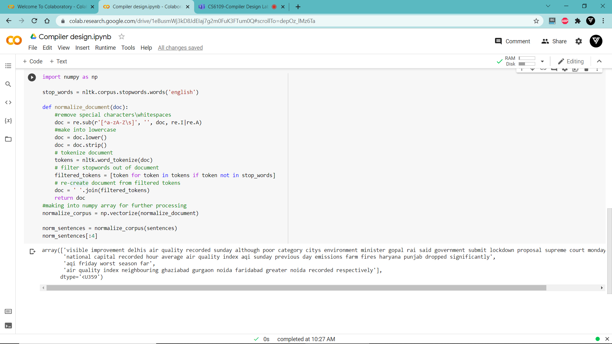
Implementation

Slide 20
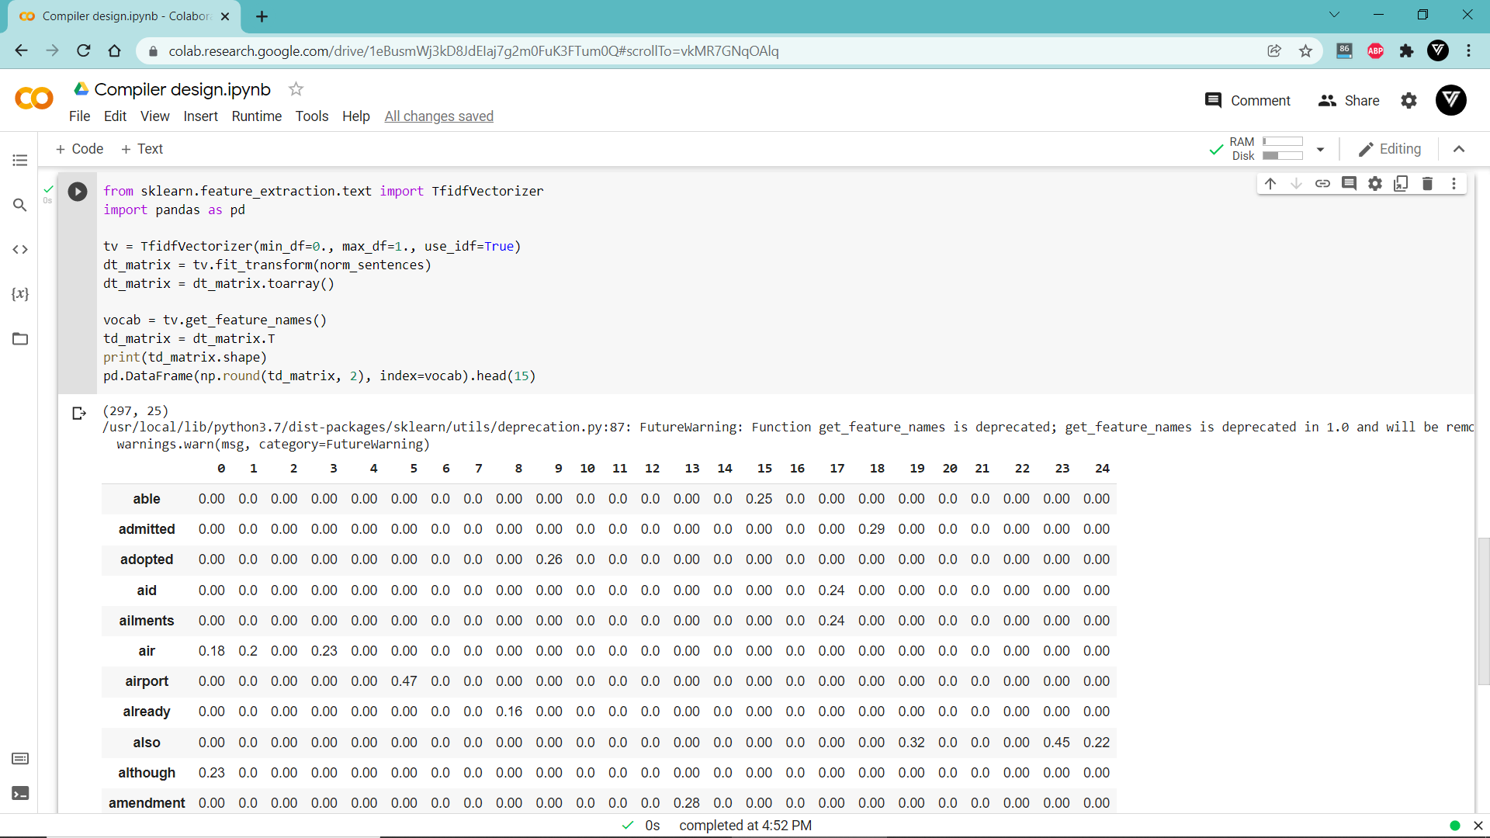
Implementation

Slide 21
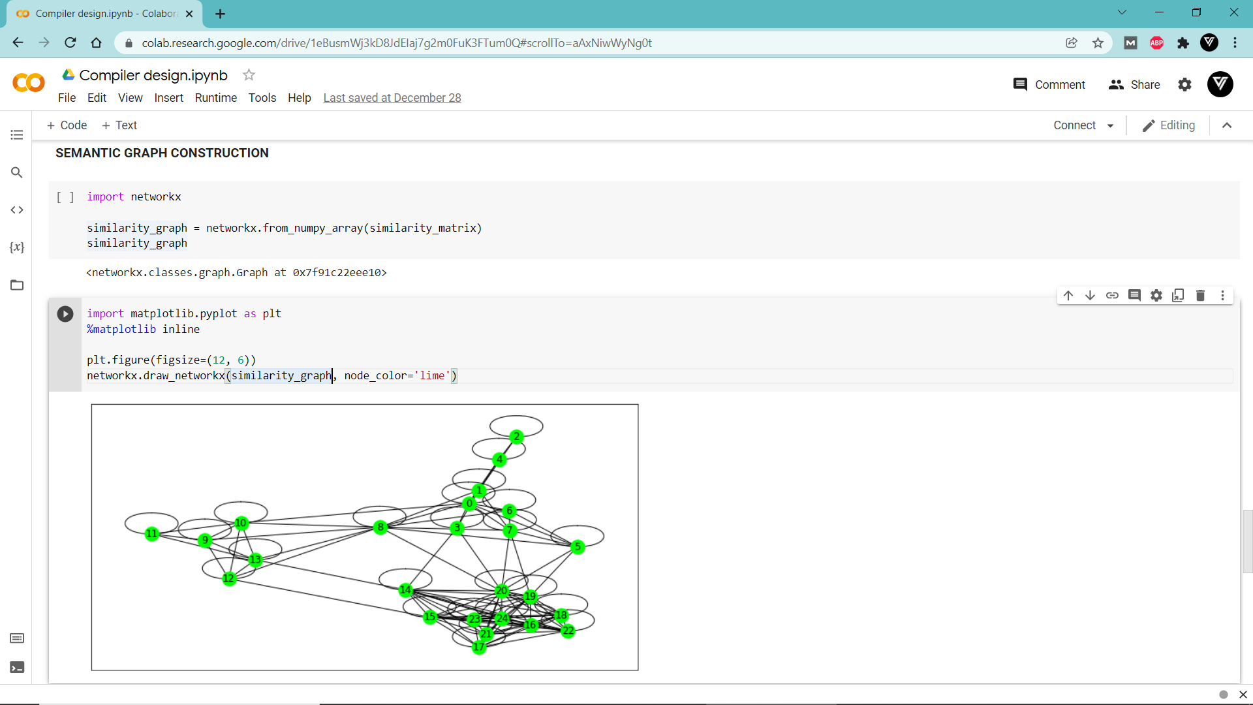
Implementation

Slide 22
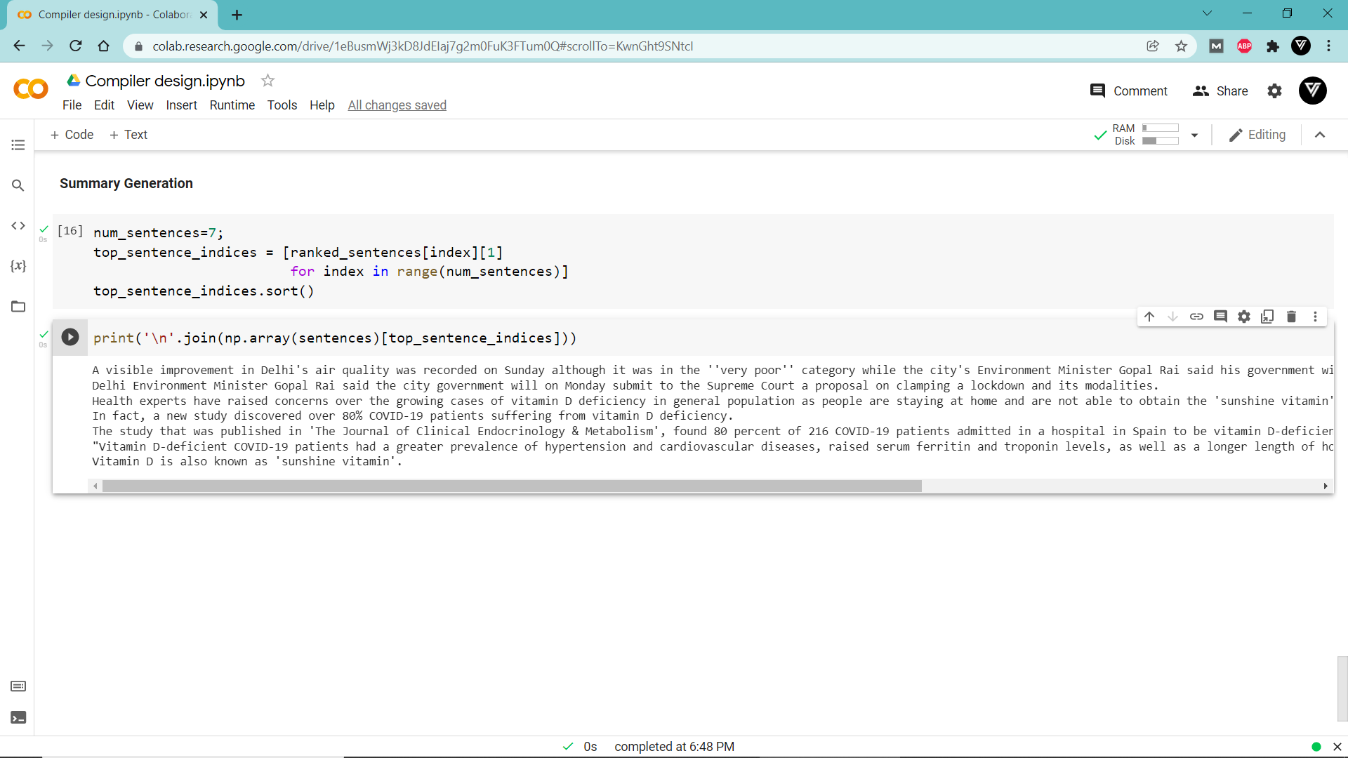
Output:

Slide 23
Conclusion
The semantic similarity measures assists in detecting redundancy by capturing semantically equivalent predicate argument structures.
The proposed Graph based approach incorporates PAS-to-PAS semantic similarity and PAS-to-document set relationship into the graph-based ranking algorithm, and experimental results demonstrate that modified ranking algorithm improves summarization results.
The approach is promising enough to be applicable to any domain and does not require any intervention of human experts.

Slide 24
References:
Genetic Semantic Graph Approach for Multi- document Abstractive Summarization(October 2015)Conference: Fifth International Conference on Digital Information Processing and Communications (ICDIPC), 2015At: Sierre, Switzerland
Extraction based summarization using a shortest path algorithm(February 2006)
Conference: Proceedings of the 12th Annual Natural Language Processing Conference NLP2006

Slide 25
The END
Thanks for watching

