Slide 1
CS6611 Creative and Innovative Project Topic: Data Security using Hybrid Cryptography and Steganography
Team Members:
G Vignesh
Dhamodaran S
Raghuraj SV

Slide 2
Abstract:
Security of Data is one of the most important aspects of one’s digital presence. With the advent of new and sophisticated technologies, existing data security systems are becoming less efficient in protecting data. Advanced data security protocols used in various applications like WhatsApp and Telegram are becoming inadequate to protect the privacy of an individual.
With advancements in Hardware, the time required to break a cryptographic system is becoming even lesser than earlier. Thus the requirement of a multi-layered encryption protocol that utilizes multiple advanced cryptographic algorithms implemented in a cascading manner is ever more necessary. In this project, data will be encrypted using multiple algorithms like AES, RSA, and Blowfish. The keys that will be used for encryption will also be secured similarly. Multi-layered encryption protocols are not widely used in current systems

Slide 3
Introduction:
The widen handling of digital media for information trans-mission through secure and unsecured channels exposes messages sent via networks to intruders or third parties. Encryption of messages in this modern age of technology be-comes necessary for ensuring that data sent via communications channels become protected and made difficult for deciphering. Enormous number of transfer of data and information takes place through internet, which is considered to be most efficient though it’s definitely a public access medium. Therefore to counterpart this weakness, many re-searchers have come up with efficient algorithms to encrypt this information from plain text into ciphers. In information security, encryption is the process of trans-forming information using an algorithm to make it unreadable to anyone except those possessing special knowledge, usually referred to as a key. The result of the process is encrypted information. The reverse process is referred to as decryption. Single cryptosystems are now a days cracked with latest hardware capabilities so a hybrid system is proposed in this paper.

Slide 4
Literature Survey:
Author | Title | Methodology | Advantage | Disadvantage
Putta Bharathi, Gayathri Annam, Jaya Bindu, Kandi Vamsi, Krishna Duggana and Anjali T. | Secure File Storage Using Hybrid Cryptography | The Input Data is divided into three sections, each of which is encoded with AES,DES and RSA respectively and keys are safely exchanged through incorporating into a picture. Keys are stored inside the image using LSB algorithm which provides. | The stored image file is completely secured, as the file is being encrypted by three encryption algorithm. The key is also safe as it embeds the key in image using LSB. | Needs active internet connection to connect with Azure cloud server • Splitting the document may lead to loss of information.
Chitra Biswas, Udayan Das Gupta and Md. Mokammel Haque | An Efficient Algorithm for Confidentiality, Integrity and Authentication Using Hybrid Cryptography and Steganography 2019 | Combination of AES and RSA algorithm. The symmetric key used for message encryption is also encrypted. A digital signature is created by encrypting the hash value of message used for integrity check at receiver end | • Both AES and RSA are used which increases the security of the file stored. • Digital signature reduces the risk of duplication or alteration. | • Digital signature will be highly dependent on the technology. We have to purchase digital certificates that are quite expensive.

Slide 5
Elza Jintcharadze, Maksim Iavich | Hybrid Implementation of Twofish, AES, ElGamal and RSA Cryptosystems | The paper presents comparative analyses AES, Twofish, RSA, and ElGamal cryptosystems. Based on those algorithms is created new hybrid cryptosystems Twofish+RSA, AES+RSA and AES+ElGamal. | AES + RSA is more secure. Twofish+RSA hybrid cryptosystem is faster. | ElGamal has a system parameter (the group) that is shared by many keys. As a result: RSA can have weak keys (badly generated and ).
Rutvik Dumre and Aashka Dave | Exploring LSB Steganography Possibilities in RGB Images | This paper aims at exploring image steganography using the least significant bit (LSB) approach combined with AES-128 encryption. n. It proposed to change the order of traversing the RGB planes while embedding a secret message in the image. | Messages don’t attract attention to themselves. Structure of data is not usually altered. | Image is distorted. Message easily lost if picture subject to compression such as JPEG

Slide 6
S. Joseph Gladwin and Pasumarthi Lakshmi Gowthami | Combined Cryptography and Steganography for Enhanced Security in Suboptimal Images | Ciphertext and DCT coefficients of an image, embedded into the base image based on LSB watermarking. The ciphertext is generated based on the Hill Cipher algorithm along with Elliptic curve cryptography. | Distinguishes letter frequency. Its simple, fast and has high throughput. | Hill-Cipher encrypts identical plaintext blocks to identical ciphertext blocks and cannot encrypt images that contain large areas of a single color.
Jigar Chauhan, Neekhil Dedhia, Bhagyashri Kulkarni | Enhancing Data Security by using Hybrid Cryptographic Algorithm | The user gives the plain text where the plain text is divided into two halves which again is splitted into two. DES is applied to four quarters. Then they are combined into two and AES is applied | The hybrid model gives a better nonlinearity to the plain AES and as it is merged with DES, there is better diffusion. | AES uses too simple algebraic structure. DES encryption can be broken using brute force search

Slide 7
Muhammad Abdul Muin, Muhammad AbdulMuin, Arief Setyanto, Sudarmawan, Kartika Imam Santoso | Performance Comparison Between AES256-Blowfishand Blowfish-AES256 Combinations | Checks both comnination of AES256 ad Blowfish. The key is generated between 4-12 characters. A random set of keys are chosen from a population to check each combination. The decryption time is observed in order to justify the security level. Higher the decryption time, higher the security. | The AES256-Blowfish algorithms combination are generally taken longer time decryption time compared to original algorithm or Blowfish-AES256 | Difficult to combine newer encryption algorithms and evaluating the strength of the key.
Omar A. Dawood, Othman I Hammadi | An Analytical Study for Some Drawbacks and Weakness Points of the AES Cipher (Rijndael Algorithm) | AES or Rijndeal algotrithm is secure but more complicated to implement in 64 bit environment, this paper tries to implement it in 36 bit environment ,64 bit environment and showcases the performance metrics. | Decryption process is slower than encryption making is safe to brute-force attacks | The algorithm depends heavily on the length of the keys, hence to achieve more security one must opt for longer key lengths, which also results in requirement of more resources and computing power

Slide 8
Problem Statement:
Various Encryption Algorithms are used in apps and services to secure data. But the advent of new and sophisticated technologies is making these existing systems obsolete. Advancements in Hardware have significantly reduced the time required to break a cryptographic system.
Various kinds of attacks have weakened the existing systems. Crypto-analysis and special mathematical attacks have made these systems quite vulnerable to being broken by cryptographers.
Key security is another vulnerability that modern systems face. Ensuring safe storage and transmission of sensitive keys is a major fault of existing systems. Generally, encryption algorithms to provide higher levels of security use larger key lengths, but that hampers the performance of the system.
A single layered standalone crypto-system can sometimes have tradeoffs that might lead to data leaks, and also hamper key security.
A standalone system has vulnerabilities that often effect the security of data. So a requirement of a system that overcomes the performance-security tradeoffs of cryptographic algorithms when used separately is ever more pertinent.

Slide 9
Objective:
The main objective of this project is to build a Hybrid Crypto-system that secures data on multiple layers and also ensures security of keys.
The Hybrid crypto-system also securely stores the keys so that they don’t lead to any vulnerabilities.
To create a crypto-system that provides excellent security without compromising on performance and speed.
To overcome the performance-security tradeoffs of cryptographic algorithms when used separately

Slide 10
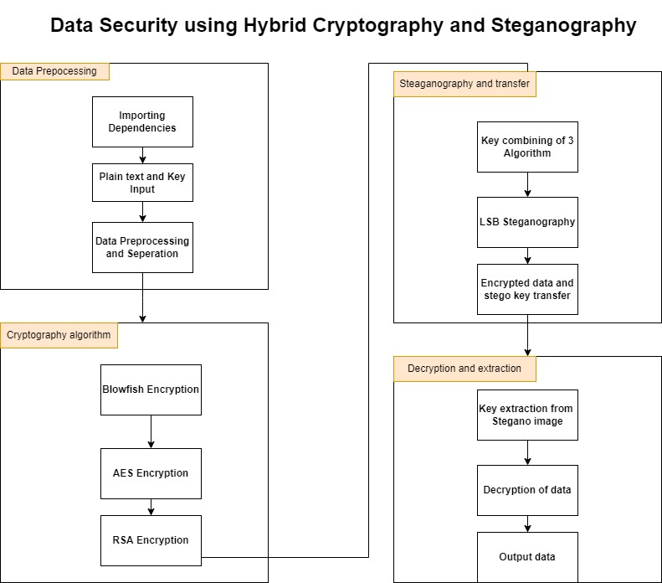
System Architecture:

Slide 11
List of Modules:
DATA PREPROCESSING
CRYPTOGRAPHY ALGORITHM
STEGANOGRAPHY AND TRANSFER
DECRYPTION AND EXTRACTION

Slide 12
Data Pre-processing:
Data to be sent in encrypted manner is received from the user along the key/password going to be used to encryption.
The data given the user in any format such as pdf or word is converted to a text sequence enabling us to make encryption.
Key generation block is used to generate random keys for the cryptography algorithm , which is generally 16 bit long.
Input: File to encrypted, password.
Output: Processed text sequence and Keys for cryptography algorithm.

Slide 13
Cryptography Algorithm:
Three Cryptography algorithm such as blow fish, AES,RSA are implemented in this module in a cascading manner.
First the text sequence is applied to Blow Fish algorithm along with the generated key to obtain a cipher text.
The obtained ciphertext is based on to AES algorithm whose output cipher is passed to RSA to obtain a final cipher text in encrypted file.
Input: Text sequence, keys
Output: Encrypted files , keys.

Slide 14
Steganography and Transfer:
Least significant bit steganography technic is used to with a selected cover image.
The keys generated and used in crypto-algorithms are combined and hidden in the image using stego key which is obtained as password from the user.
The stegano-image where the keys are hidden in the least significant bit of the image along with the encrypted file is send to the receiver in email.
Input: Encrypted files, keys.
Output: Encrypted Files, stegano-image , password.

Slide 15
Decryption and Extraction:
The Stegano-image obtained from the

Slide 16
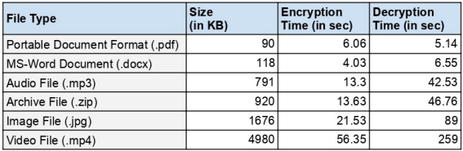
Evaluation metrics: The Hybrid Crypto-system implemented in Python was tested against different file types of varying sizes

Slide 17
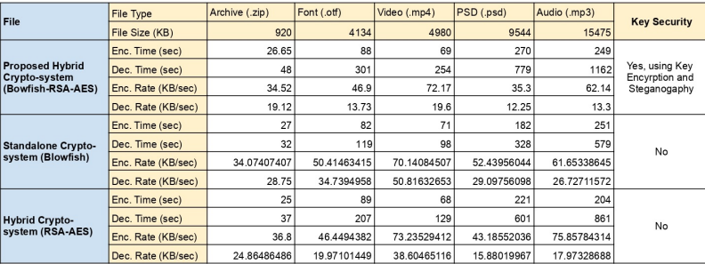
Testing two existing systems - one Hybrid (AES-RSA) and one Standalone (Blowfish) with the Proposed Cryptosystem gives the following results.

Slide 18
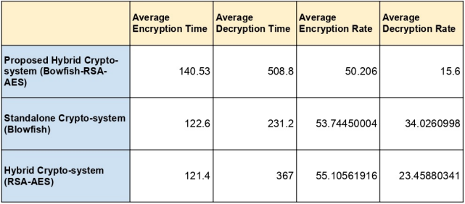
The Aggregate results of the comparison testing is given below.
The results of the Comparison test shows that the Proposed System has a significantly higher Decryption Time, compared to the other two, indicating that the Proposed System is hard to break and will take higher computing power and time to break than the other two, making is highly secured.

Slide 19
Reference Papers:
1.Secure File Storage Using Hybrid Cryptography: 2021 6th International Conference on Communication and Electronics Systems (ICCES)
Authors: Putta Bharathi, Gayathri Annam, Jaya Bindu, Kandi Vamsi, Krishna Duggana and Anjali T.
2.An Efficient Algorithm for Confidentiality, Integrity and Authentication Using Hybrid Cryptography and Steganography 2019 :
International Conference on Electrical, Computer and Communication Engineering ( ECCE), 7­9 February, 2019
Authors: Chitra Biswas, Udayan Das Gupta and Md. Mokammel Haque
3.Hybrid Implementation of Twofish, AES, ElGamal and RSA Cryptosystems:
2020 IEEE East­West Design &amp; Test Symposium (EWDTS)
Authors: Elza Jintcharadze Maksim Iavich
4. Exploring LSB Steganography Possibilities in RGB Images:
2021 12th International Conference on Computing Communication and Networking
Technologies
Authors: Rutvik Dumre and Aashka Dave

Slide 20
5.Combined Cryptography and Steganography for Enhanced Security in Suboptimal Images: 2020 International Conference on Artificial Intelligence and Signal Processing (AISP)
AUTHORS:S. Joseph Gladwin and Pasumarthi Lakshmi Gowthami
6.Enhancing Data Security by using Hybrid Cryptographic Algorithm
Authors, Publication & Year: Jigar Chauhan, Neekhil Dedhia, BhagyashriKulkarni ‐ IJESIT, 2013
7.Performance Comparison Between AES256‐Blowfishand Blowfish‐AES256 Combinations
Authors, Publication & Year:Muhammad Abdul Muin, Muhammad AbdulMuin, Arief Setyanto, Sudarmawan, Kartika Imam Santoso ‐ ICITACEE,2018
8 .An Analytical Study for Some Drawbacks and Weakness Points of the AES Cipher (Rijndael Algorithm) The 1 st International Conference on Information Technology (ICoIT'17) At Lebanese French University Erbil, Kurdistan Region – Iraq 10th April, 2017 Authors: Omar A. Dawood, Othman I Hammadi

