Slide 1
Air Monitoring System
Introduction to Air Monitoring System
Presented by
GAISER
ASWIN
SARAVANAN
VIGNESH
KENSTAR

Slide 2
Title of contents
Introduction to air quality monitoring
Why Monitor Air Quality?
Components of an air monitoring system
Working principle of an air monitoring system
Data analysis and interpretation
Types of Pollutants Monitored
Benefits of using an air monitoring system
Case studies or real-life examples
Conclusion

Slide 3
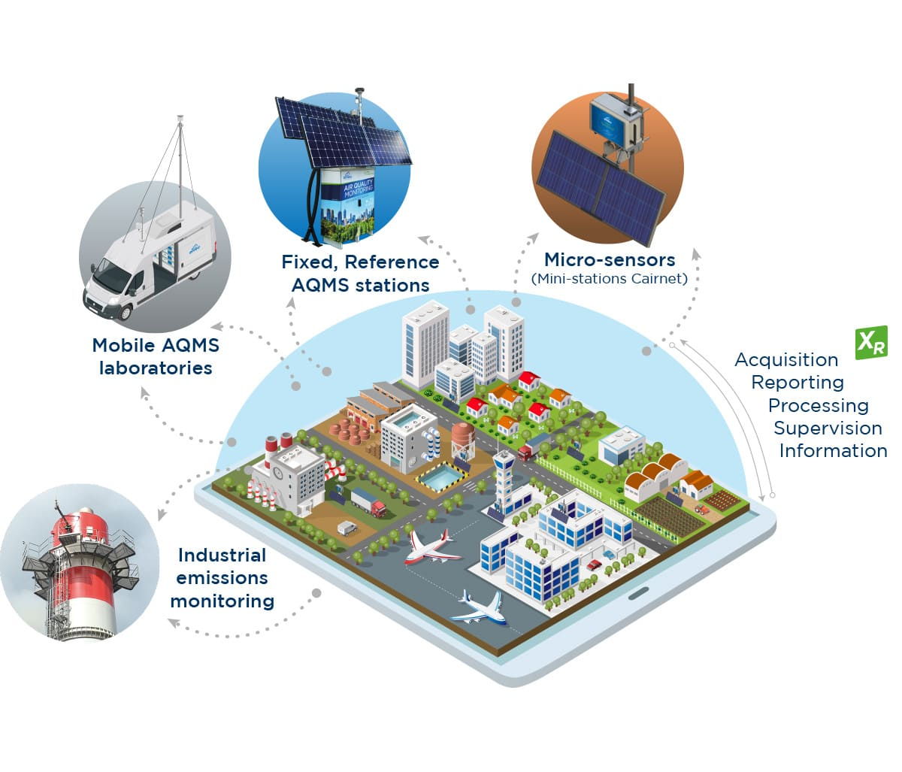
Introduction to Air Quality Monitoring
Brief overview of air quality monitoring
Importance of monitoring air quality for human health and the environment

Slide 4

Why Monitor Air Quality?
Health implications of poor air quality
Environmental impacts of air pollution

Slide 5
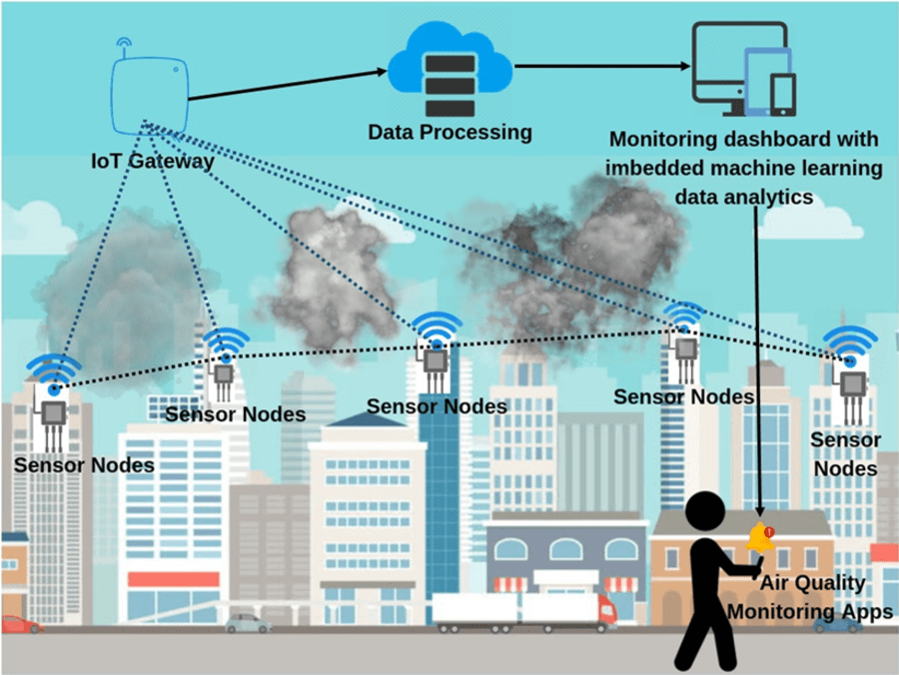
Components of an Air Monitoring System
Sensors and data collection devices
Data processing and analysis units
Communication systems
Display and reporting mechanisms

Slide 6

AIR QUALITY MONITORING SYSTEM

Slide 7
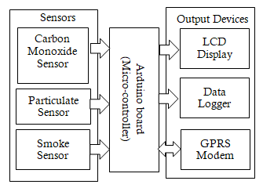
Working Principle of Air Monitoring System
How sensors detect pollutants
Data collection and processing
Real-time monitoring vs. periodic sampling

Slide 8
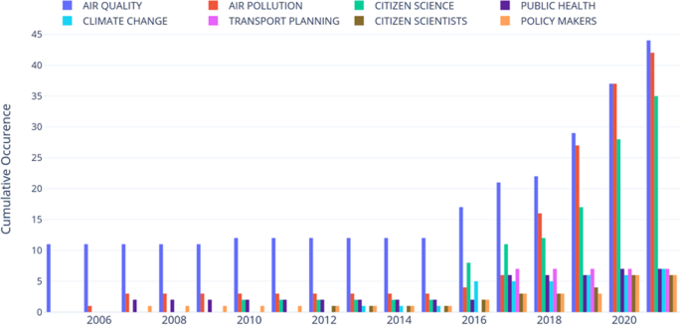
Data Analysis and Interpretation
Overview of data analysis techniques
Visualization of air quality data
Interpretation for actionable insights

Slide 9
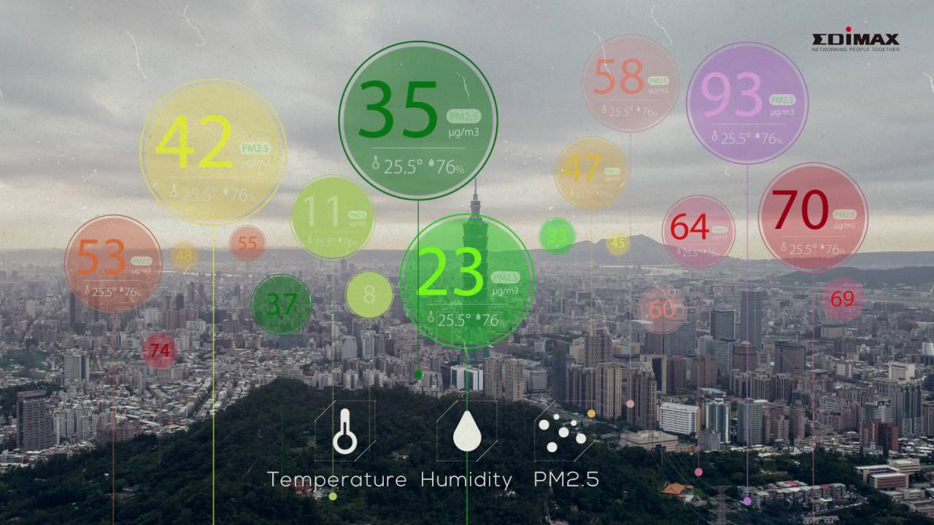
Types of Pollutants Monitored
Common air pollutants
Particulate matter (PM)
Nitrogen dioxide (NO2)
Sulfur dioxide (SO2)
Ozone (O3)
Carbon monoxide (CO)

Slide 10
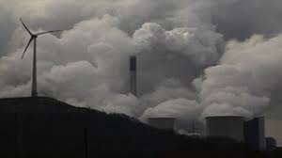
Benefits of Using an Air Monitoring System
Early detection of pollution events
Informed decision-making for policymakers
Public awareness and education
Improving air quality and health outcomes

Slide 11
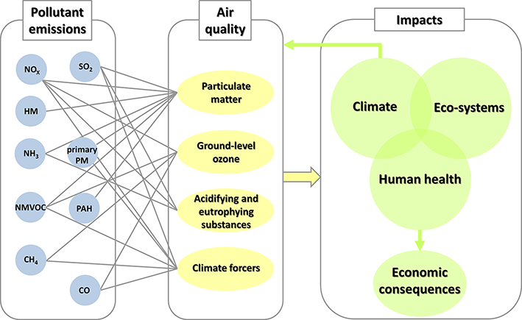
Case Studies or Real-Life Examples
Showcase real-world applications and success stories of air monitoring systems
Present real-world examples or case studies where air monitoring systems have made a positive impact (e.g., reducing pollution in a city, identifying sources of indoor air pollution)

Slide 12
Conclusion
Summarize the key points of the presentation.
Emphasize the importance of air monitoring for a healthier environment.

