Slide 1
Yelp review analysis and rating prediction
Team Members
Sanket Sanap (NUID: 002136240)
Aniket Mirjakar (NUID: 001563245)
Vignesh Kumar Baskar (NUID: 002196442)
Shankar Subramaniyan Ganapathy (NUID: 001529711)

Slide 2
Dataset overview
In this project, we have used the Yelp Restaurants dataset which comprises of the US restaurants details along with the customer reviews
Performed data profiling, merged the restaurants data with the reviews, and finally segregated the restaurants based on Philadelphia city
Among the list of restaurants in Philadelphia, we have considered only one restaurant which has the highest customer reviews count

Slide 3
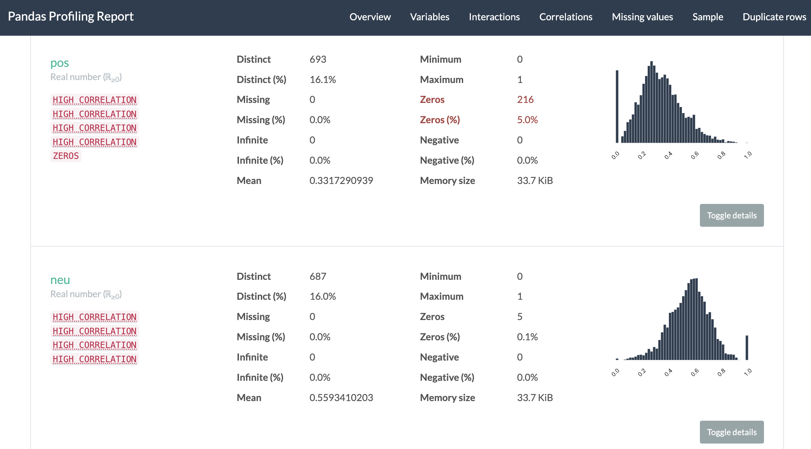
Exploratory data analysis
Once after analyzing we took the King Steaks Restaurant in Philadelphia and merged its customer reviews
Processed the data, and performed text analysis to figure out the underlying polarity ratings for the reviews
Using pandas_profiling library, we did exploratory data analysis to find the histogram plots of the features

Slide 4
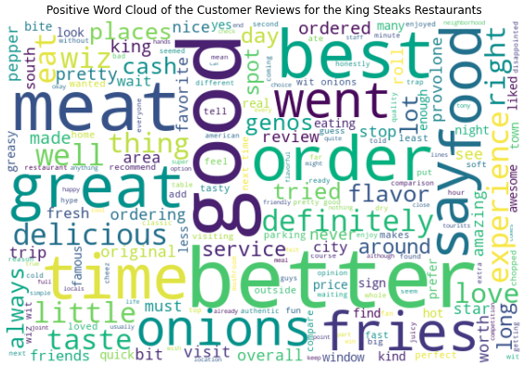
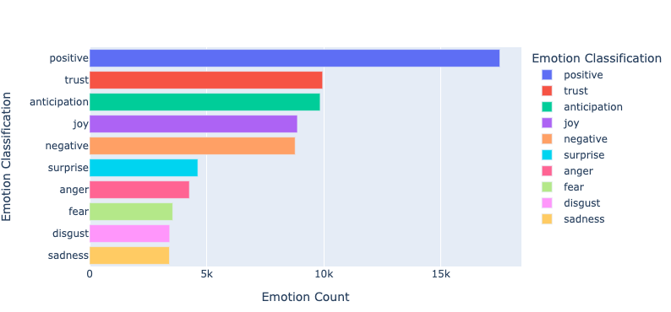
Sentiment analysis
Performed contextual mining of text by identifying and extracting the customers reviews based on the sentiment analysis
We have analyzed the sentiment analysis of all the customer reviews for a particular restaurant and plotted the emotion bar chart
Removed stop words, infrequent words and performed lemmatization to identify the polarity scores of the individual reviews
Plotted word cloud based on the positive and negative review tokens

Slide 5
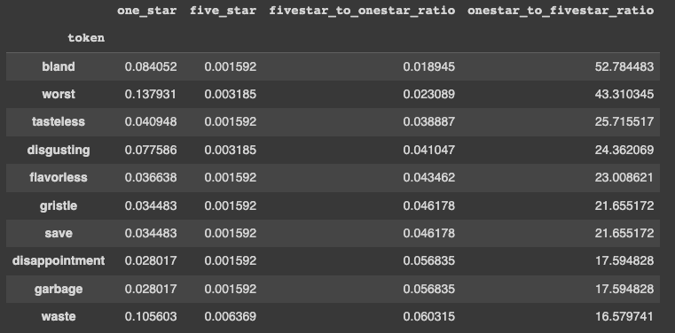
Customer review token analysis
Once performed sentiment analysis, we have further proceeded with the individual text token analysis by which we can be able to find the best or worst ratings for the individual review tokens
Used the Count Vectorizer to create document term matrices of the review tokens and implemented the model by using Multinomial Naive Bayes

Slide 6
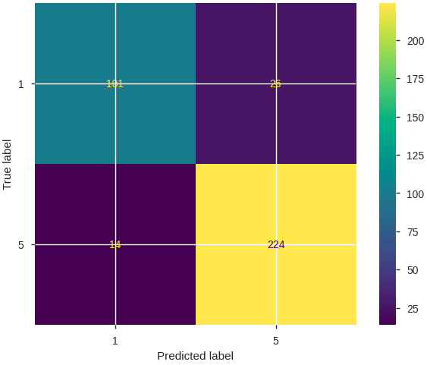
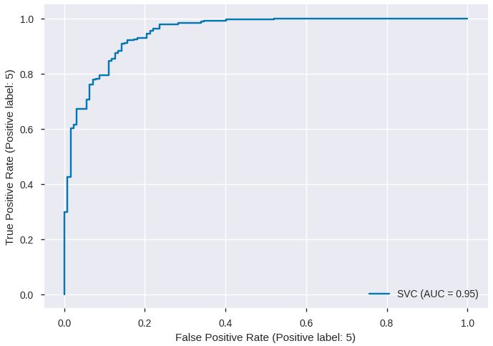
Machine learning models
As part of this project, we have trained and tested our data with three machine learning models
Random Forest Classifier
Stochastic Gradient Descent (SGD) Classifier
Support Vector Classifier
Calculated the Accuracy, F1 score and RSME. Plotted the confusion matrix and ROC curve for all the respective models

Slide 7
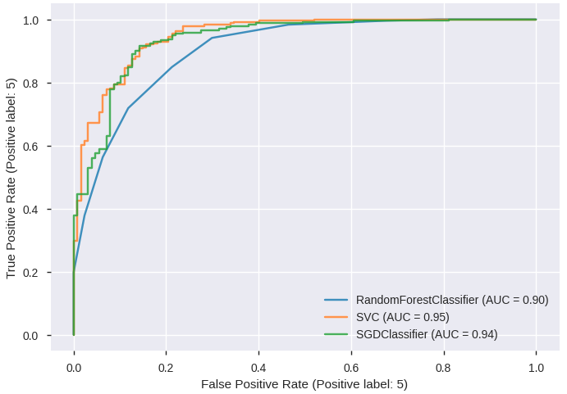
Comparison of ml models
Accuracy Prediction
Random Forest Classifier – 82.73 %
Stochastic Gradient Descent (SGD) Classifier – 89.04 %
Support Vector Classifier – 89 %
ROC Plot Curve Comparison

Slide 8
Thank you!

