Slide 1
SLIDE 1 | HOW SLM WORKS
Architecture and Processing Pipeline of Small Language Models
1. English Input
Raw text & domain glossary prompt e.g. '>>tel<< Firewall'
2. Tokenization
Subword segmentation using SentencePiece / BPE vocabulary
3. Embedding
Dense vector projection + Positional Encodings
4. Transformer Encoder
6 Self-Attention & FFN layers Extracts bidirectional context
5. Transformer Decoder
6 Cross-Attention layers Autoregressive target decoding
6. Telugu Output
Probabilistic output generation ఫైర్వాల్ (Cleaned translation)
Key Operational Principles of Small Language Models (SLMs):
• Focused Parameter Budget: SLMs (~50M–3B parameters) are trained for task-specific efficiency rather than open-ended multi-tasking.
• Compact Encoder-Decoder: Dual-stack Transformer architecture specializes in direct cross-lingual translation with minimal compute.
• High-Throughput Edge Inference: Consumes < 300 MB RAM, enabling instantaneous offline translation on standard consumer CPUs.

Slide 2
SLIDE 2 | SLM ARCHITECTURES & INDUSTRY MODELS
Recognized Compact Language Models and Production Deployments
Model Name | Year | Architecture & Characteristics | Organizations Using It | Limitations | Practical Products
MarianMT (Opus-MT) | 2020 | 6L Enc - 6L Dec (~77M params) Seq2Seq NMT; lightweight CPU execution | Helsinki-NLP, Mozilla, Wikimedia | Restricted general reasoning; sensitive to domain shift | Firefox Offline Translations, Wikipedia tools
Microsoft Phi-3 Mini | 2024 | 3.8B parameter decoder-only Trained on curated high-quality textbook data | Microsoft, Epic Systems, Azure AI | Cannot memorize vast factual knowledge bases | Copilot on-device, clinical note assistants
Google Gemma 2B | 2024 | 2.6B parameter decoder Derived from Gemini research, lightweight KV | Google DeepMind, Android Developers | Limited multilingual vocabulary in base variant | Android AICore, on-device mobile AI
Apple OpenELM | 2024 | 270M–3B parameter scaling Layer-wise non-uniform parameter allocation | Apple Machine Learning Research | Strict context window constraints | On-device Siri features, text prediction
DistilBERT / DistilBART | 2019 | 6-layer distilled Transformer (~66M) Knowledge distillation from BERT/BART | Hugging Face, Grammarly, Bloomberg | Loss of ~3-5% nuance compared to teacher model | Real-time search indexing, edge NLP pipelines

Slide 3
SLIDE 3 | HOW LLM WORKS
Autoregressive Transformers & Resource Demands in Large Language Models
LLM Generation Pipeline:
1. Input Prompt: User query / instructions received.
2. Tokenization: Byte-Pair Encoding (tiktoken / Llama BPE).
3. Embedding & RoPE: High-dimensional projection + Rotary Position.
4. Deep Transformer Blocks: 32 to 128 stacked decoder layers.
5. Multi-Head Self-Attention: Dynamic Query-Key-Value (Q,K,V) relevance.
6. Feed Forward (MLP): Non-linear parameter transformation (SwiGLU).
7. Softmax & Next-Token Prediction: Generates token distribution.
8. Autoregressive Loop: Tokens appended sequentially to context.
Why LLMs Require High Computational Resources:
• Massive Parameter Footprint:
7B to 400B+ parameters require tens to hundreds of gigabytes of high-bandwidth VRAM just to store model weights in memory.
• Quadratic Attention Complexity:
Standard self-attention computes an O(N²) matrix across token sequences, causing exponential memory growth over long contexts.
• KV-Cache Scaling:
Storing Key and Value tensors during generation consumes vast memory for every concurrent user request.
• Hardware Specialization:
Requires clusters of dedicated AI accelerators (NVIDIA H100 / A100) with tensor parallelism and liquid cooling.

Slide 4
SLIDE 4 | SLM VS LLM COMPARISON
Comprehensive Dimensional Comparison Between Small and Large Models
Evaluation Dimension | Small Language Models (SLMs) | Large Language Models (LLMs)
Model Size (Disk) | ~50 MB to 1.5 GB | 15 GB to 800+ GB
Parameter Count | < 100M up to ~3B parameters | 7B to 400B+ parameters
Hardware Requirements | Standard Laptop CPU / 1–2 GB RAM (No GPU needed) | High-end GPUs (A100/H100, 24GB–80GB+ VRAM)
Inference Speed | Fast (< 50–100 ms per token on standard CPU) | Requires high-compute GPU clusters & tensor parallelism
Cost & Energy | Near-zero runtime cost; energy-efficient on edge devices | Significant API pricing & high server electricity costs
Deployment Flexibility | Runs locally, on-device, offline, embedded systems | Predominantly cloud-hosted APIs / datacenter servers
Data Privacy & Security | 100% private; data never leaves the local machine | Often sends sensitive text across external cloud networks
Typical Use Cases | Domain translation, glossary lookup, classification, IoT | Open-domain creative reasoning, complex coding, multi-turn chat

Slide 5
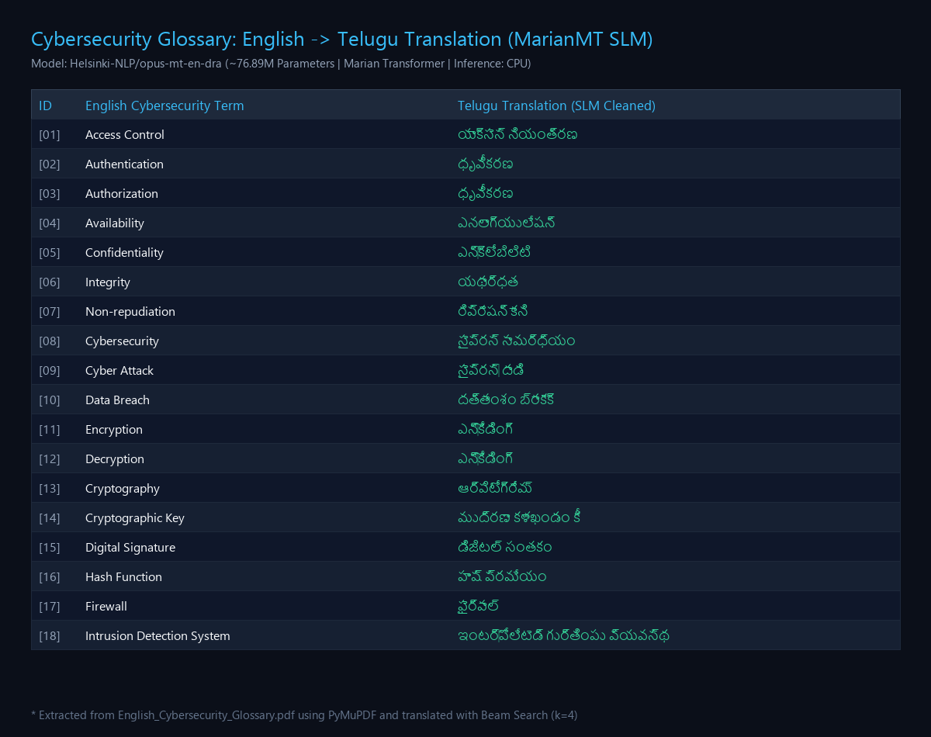
SLIDE 5 | MY IMPLEMENTATION
Cybersecurity Glossary Translation: English → Telugu Using MarianMT SLM
Pipeline Architecture:
Glossary PDF → PyMuPDF → English Terms → MarianMT SLM → Beam Search (k=4) → Artifact Cleaner → Telugu Glossary
Verified Model Output Samples (76.89M SLM):
• Firewall → ఫైర్వాల్
• Authentication → ధృవీకరణ
• Authorization → ధృవీకరణ
• Digital Signature → డిజిటల్ సంతకం
• Password → సంకేతపదం
• Risk → ప్రమాదం
• Phishing → ఫిష్సింగ్
* Note: Beam search (k=4) and automated post-processing were used to reduce decoding artifacts. Specialized cybersecurity terminology remains a limitation of the general-domain model.

Slide 6
SLIDE 6 | IMPLEMENTATION & SOURCE CODE
Public Project Repository, Tech Stack & Reproducibility
Official GitHub Repository (Public):
https://github.com/vignesh28102006/nlp-cybersecurity-slm-english-telugu
Clone & Run: git clone https://github.com/vignesh28102006/nlp-cybersecurity-slm-english-telugu.git
Technologies & Libraries Used:
• Python 3.12: Core scripting & data processing runtime
• PyTorch: Tensor computation & CPU matrix acceleration
• Transformers: Hugging Face MarianMT model loading & tokenization
• PyMuPDF (fitz): High-performance PDF text & term extraction
• Pandas: Tabular dataset generation & CSV structuring
• Jupyter Notebook: Cell-by-cell demonstration & visualization
SLM Benchmark Summary:
• Model Identifier:
Helsinki-NLP/opus-mt-en-dra
• Architecture:
MarianMT Transformer (6L Enc / 6L Dec)
• Exact Parameters:
76,894,208 parameters (~76.89M)
• RAM Footprint:
293.3 MB (Well within 1 GB limit)
• Load Time on CPU:
1.27 seconds
• Inference Speed:
56 terms translated in 39.1 seconds (~698 ms/pair)

