Slide 1
1M1B AI SUSTAINABLE DEVELOPMENT PRESENTATION
TOPIC : GOVERNMENT-AI-COPILOT
NAME : JANMANCHI VIGNESH
MAIL : jvignesh369@gmail.com
AICTE ROLL NO :STU671b4639a962b1729840697

Slide 2

Government AI Copilot
AI-Powered Digital Governance
Team
Members
Civic Innovators
5-member cross-functional team: PM · AI Architect · UX · Backend
Event
36-hour GovTech Hackathon — 2026-07-04
Notes:
1

Slide 3


Problem Statement
Current citizen services are slowed by manual steps, language gaps, and opaque workflows — resulting in long waits, inconsistent responses, and low trust.
Long waiting times
Backlogs and manual triage extend resolution times.
Manual paperwork
Repeated data entry increases errors and cost.
Language barriers
Many citizens need multilingual support to access services.
Slow workflows & low transparency
Lack of auditability and unclear handoffs undermine accountability.
Key stat: typical case turnaround often exceeds several days — automation can reduce that to hours.
Notes:
2

Slide 4

Existing System — Process & Drawbacks
Citizen Request
Clerk Triage
Department Routing
Officer Response
Drawbacks: manual routing, single-language forms, no standard drafting, poor logging, and limited monitoring — all causing delays and inconsistent outcomes.
Notes:
3

Slide 5



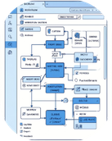
Proposed Solution: Government AI Copilot
A secure, auditable AI assistant that automates citizen intake, drafts official documents, routes workflows, and supports officers — with mandatory human approval before finalization.
AI Chatbot
Voice Support
Officer AI Assistant
Workflow Automation
24/7 triage via text & voice; intent detection and structured intake.
Multilingual speech-to-text and text-to-speech for inclusive access.
Draft replies, suggest routing, summarize case history for quick decisions.
Auto-classification, department routing, and notifications with audit trails.
Notes:
4

Slide 6
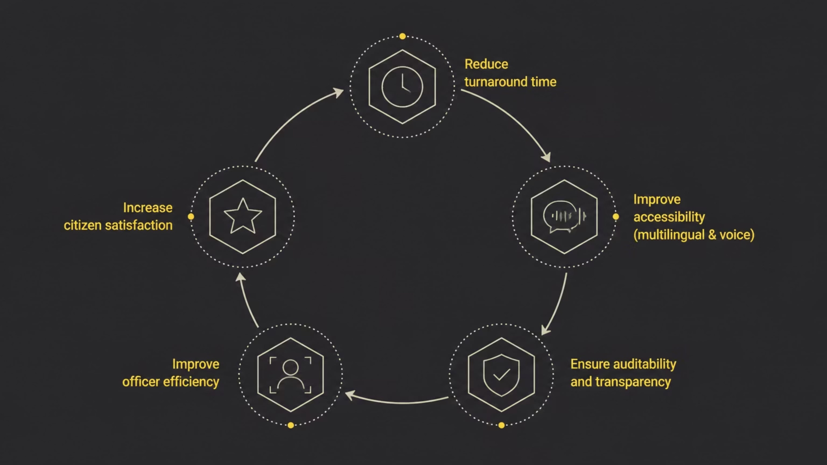
Objectives
These objectives prioritise speed, inclusivity, accountability, operational efficiency, and measurable citizen outcomes.
Notes:
5

Slide 7
Key Features
Citizen Portal
Conversational intake, status tracking, receipts.
Officer Portal
Case queue, AI suggestions, approval workflow.
Admin Portal
Role management, logs, system configuration.
AI Chatbot
Intent detection, FAQ handling, escalation triggers.
Voice Recognition
Multilingual STT/TTS for kiosks and helplines.
AI Document Drafting
Template-based official drafts requiring human sign-off.
Multilingual Support
Seamless language translation and localized responses.
Analytics Dashboard
Service KPIs, backlog heatmaps, SLA monitoring.
Role-Based Access & Audit Logs
Complete chain-of-custody for every action.
Notifications
Automated citizen and officer alerts (email/SMS/push).
Notes:
6

Slide 8

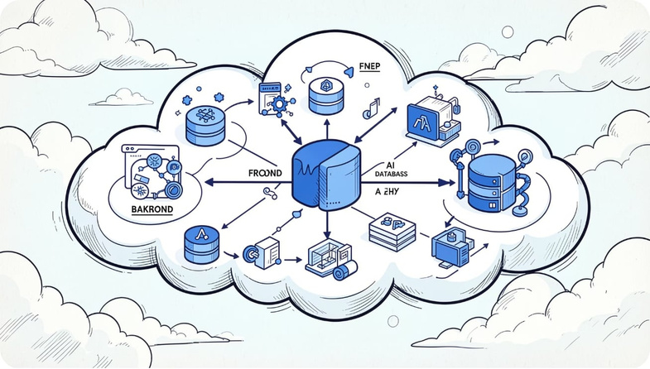
System Architecture
Notification Service
React Frontend
Deliver alerts via channels
Interactive citizen & officer UIs
System Architecture Flow
Secure API Gateway
MySQL Database
Primary store with Audit Logs
Enforces TLS and rate limits
Gemini AI API
Spring Boot Backend
NLU, drafting, translation
Business logic, RBAC, JWT auth
Flow (high level)
  React Frontend — interactive citizen & officer UIs
  Spring Boot Backend — business logic, RBAC, APIs
  Gemini API — NLU, drafting, translation, summarization
  MySQL — primary relational store; Audit Logs table for traceability
  Notification Service — async delivery (email/SMS/push)
  Admin Dashboard — monitoring, user & policy controls
Notes:
7

Slide 9
Technology Stack
AI
Gemini API — intent detection, drafting, translation
Frontend
React · HTML · CSS · JavaScript
Tools & DevOps
Git · Docker · Postman · Maven
Deployment
Backend
Render / Railway for rapid prototype deployment
Spring Boot · Java · Spring Security · JWT
Database
MySQL (relational schema, audit tables)
Notes:
8

Slide 10

Core Workflows
Login
Submit Complaint
AI Intent
Dept Classification
Assign Officer
Designed for clear handoffs, mandatory human approval before document generation, and an immutable audit trail for every action.
Notes:
9

Slide 11
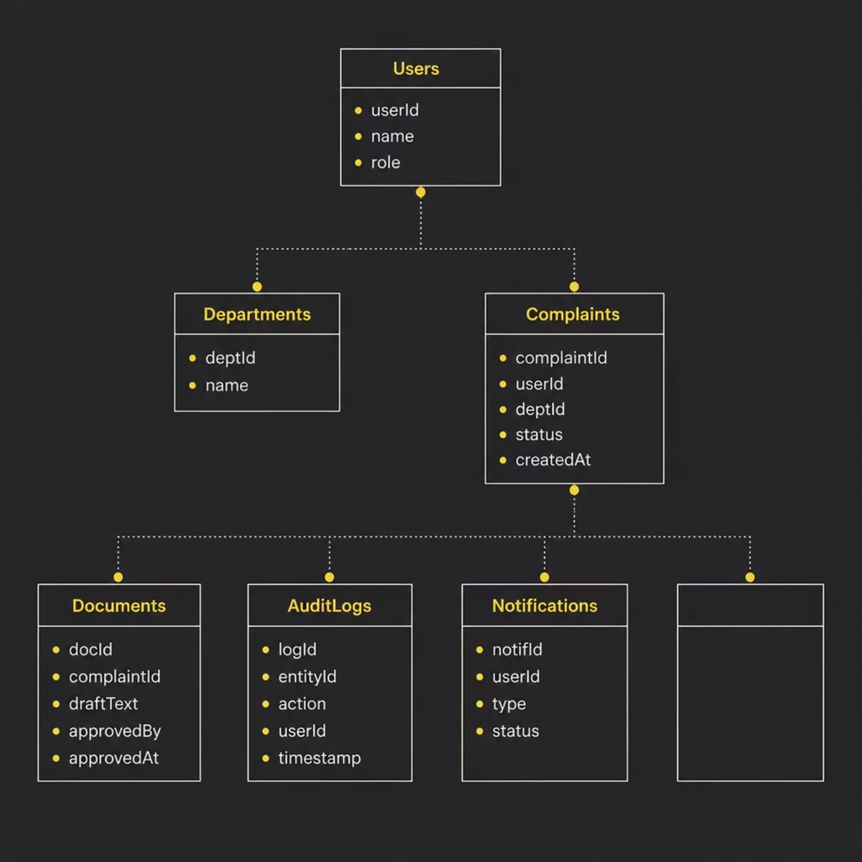
Database & ER Design
Primary relationships:
  Users 1—* Complaints (citizen & officer roles)
  Departments 1—* Complaints (classification)
  Complaints 1—* Documents (drafts & final)
  AuditLogs record all CRUD actions linked to entity IDs
  Notifications reference Users and Complaints for targeted delivery
ER supports full traceability and reporting for governance audits.
Notes:
10

