Slide 1

Deep Learning Approach for Kidney CT Segmentation Using Attention U-Net++
VASAVI COLLEGE OF ENGINEERING (Autonomous)
ACCREDITED BY NAAC WITH 'A++' GRADE
Department of Information Technology
Internal Guide:
Mrs. DRL Prasanna
Assistant Professor
Team Id:​
A13
Team Members
V. Vignesh (1602-22-737-060)
T. Lasya Priya (1602-22-737-301)

Slide 2
AGENDA
Introduction
Abstract
Objectives of the proposed work
Literature Survey
Proposed Methodology
Implementation
Datasets
Results
Conclusion
Future Scope
Publication Details
References
PO-PSO Mapping
SDG Mapping

Slide 3
Introduction & Problem Statement
Introduction
Kidney segmentation from medical images is an important step in diagnosis, treatment planning, and disease monitoring. However, manual segmentation is time-consuming and prone to human variability. This project proposes an Attention U-Net++ based automated kidney segmentation system for accurate and reliable extraction of kidney regions from medical images, improving consistency and supporting clinical decision-making for radiologists.
Problem Statement
Kidney segmentation systems often struggle due to low contrast, anatomical variability, complex organ boundaries, and background interference in medical images.
There is a need for an advanced deep learning framework that can accurately focus on kidney-specific regions and provide robust, precise, and automated segmentation for clinical applications.

Slide 4
Abstract
This project presents an Attention U-Net++ based kidney segmentation system for accurate and automated analysis of medical images. The model is designed to precisely identify kidney regions by combining nested skip connections, attention mechanisms, and deep supervision, enabling better feature extraction and boundary localization. It is trained on the KiTS19 to handle challenges such as low contrast, anatomical variability, and background noise commonly present in kidney imaging.
Advanced validation strategies such as data augmentation, patient-wise splitting, and cross-validation are used to improve the robustness and generalization of the model. While the proposed system performs effectively in segmenting kidney structures, challenges remain in cases with unclear boundaries and highly complex anatomical variations, indicating scope for future improvements using hybrid attention modules, transformer-based architectures, and 3D segmentation techniques.

Slide 5
Objectives of the proposed work
To develop an Attention U-Net++ based kidney segmentation system for accurate and automated extraction of kidney regions from medical images, handling low contrast and complex anatomical structures.
Objective 1
To design a robust feature learning framework by integrating attention mechanisms and nested skip connections to improve segmentation accuracy and boundary detection.
Objective 2
To implement efficient training and validation strategies such as data augmentation, patient-wise splitting, and cross-validation to ensure generalization, reliability, and clinical applicability of the model.
Objective 3

Slide 6
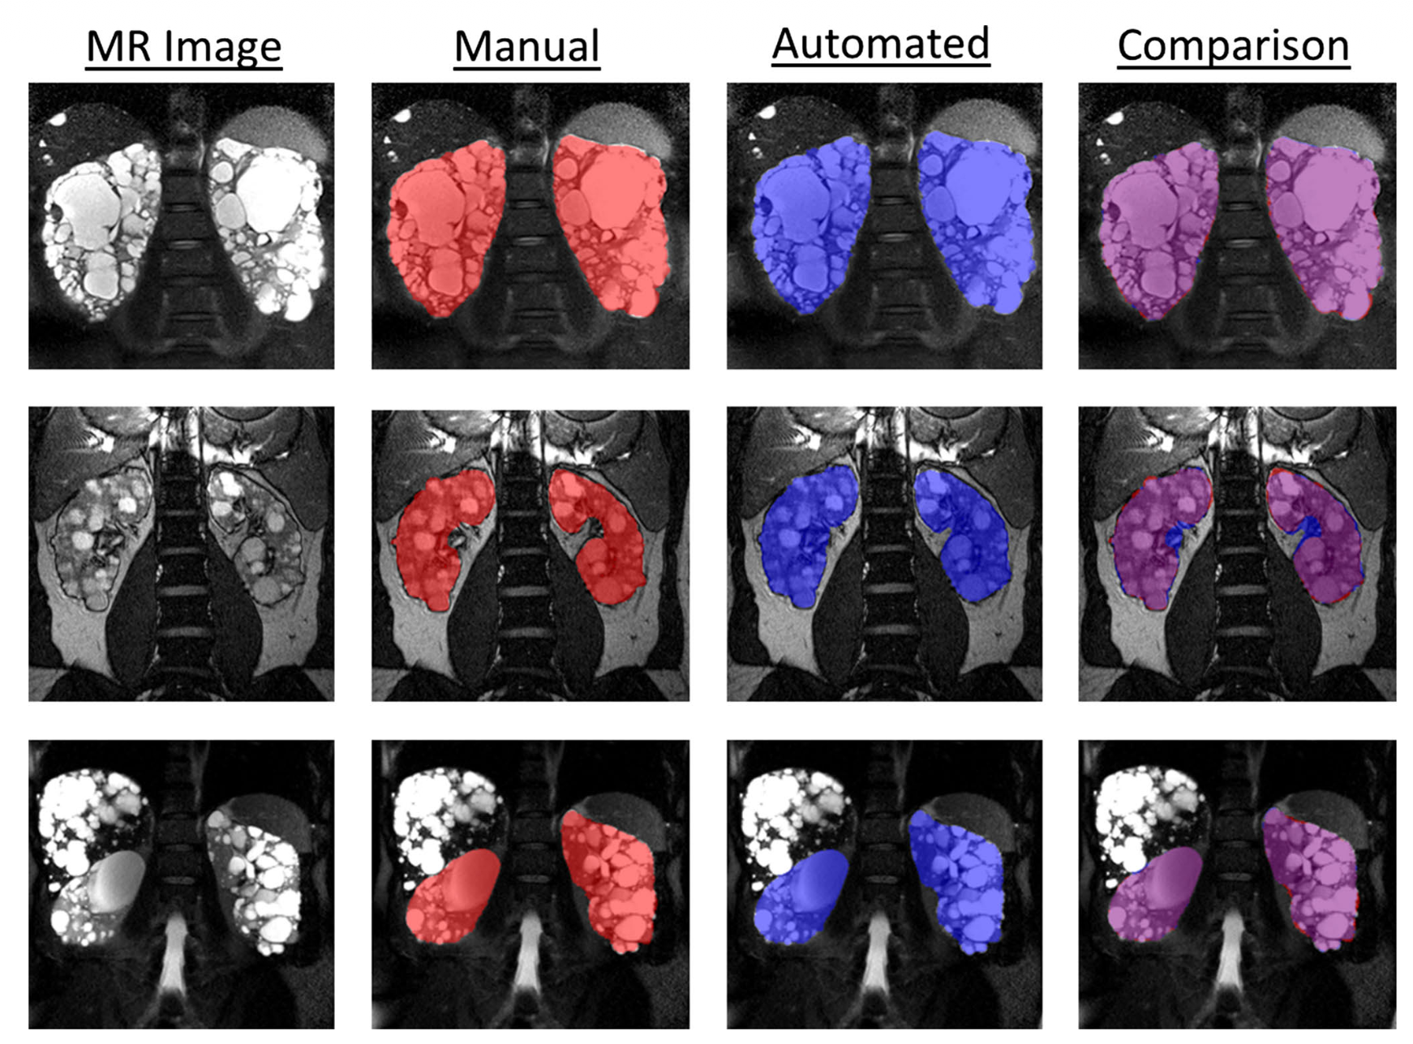
Literature Survey
Base paper-1 title:
Kidney Segmentation in Renal Magnetic Resonance Imaging – Current Status and Prospects
Summary:
This paper presents a survey of existing methods for kidney segmentation in renal MRI, including manual, semi-automatic, and deep learning-based approaches. It discusses the importance of accurate kidney segmentation for clinical diagnosis and volume estimation, while highlighting the challenges caused by low contrast, organ ambiguity, and variability in imaging data.
Diagram of the existing work
Research Gap Identified:
Existing methods either depend heavily on manual intervention or lack robustness and generalization for accurate automated kidney segmentation across different imaging conditions.
Base Paper-1 citation:
Zoellner, F. G., et al. (2021). Kidney segmentation in renal magnetic resonance imaging – Current status and prospects. IEEE Access, 9, 27037–27066.

Slide 7
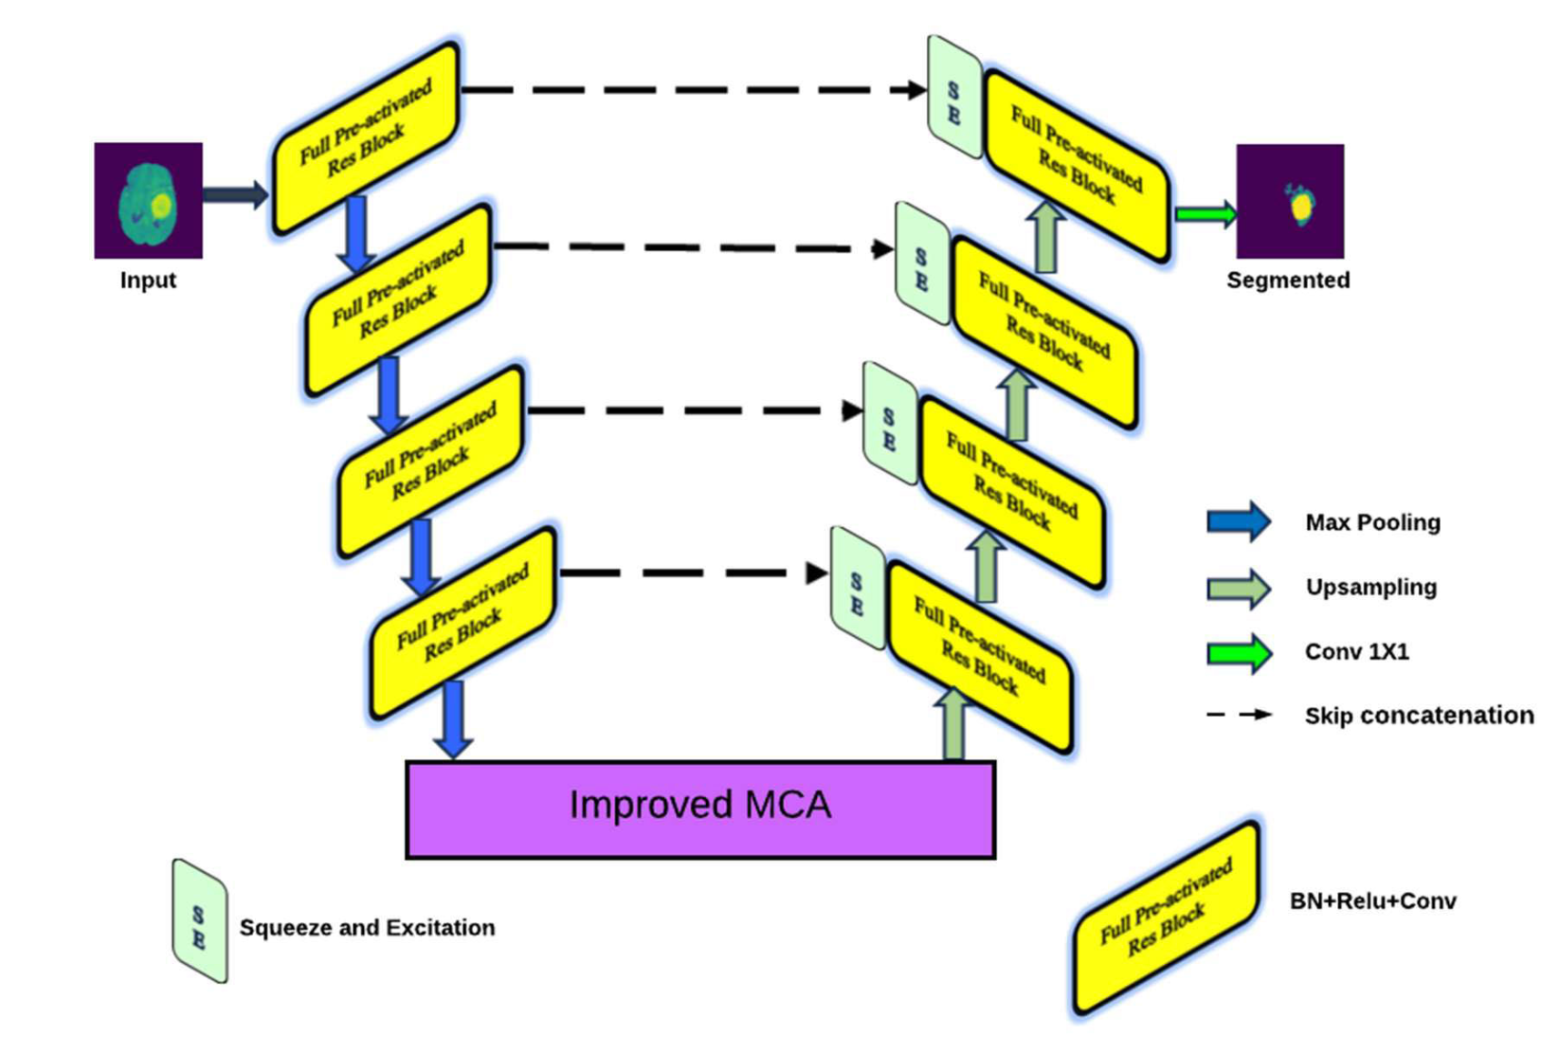
Literature Survey
Base paper-2 title:
An Attention-Based Residual U-Net for Tumour Segmentation Using Multi-Modal MRI Brain Images
Summary:
This paper proposes a Residual U-Net integrated with attention mechanisms for accurate tumor segmentation in MRI images. It combines multi-scale feature extraction, residual learning, and attention modules to improve segmentation performance, especially for irregular shapes and complex regions.
Diagram of the existing work
Research Gap Identified:
The model has high architectural complexity and may not generalize well to different datasets or organ-specific segmentation tasks like kidney segmentation.
Base Paper-2 citation:
Naqvi, N. Z., & Seeja, K. R. (2025). An Attention-Based Residual U-Net for
Tumour Segmentation. IEEE Access.

Slide 8
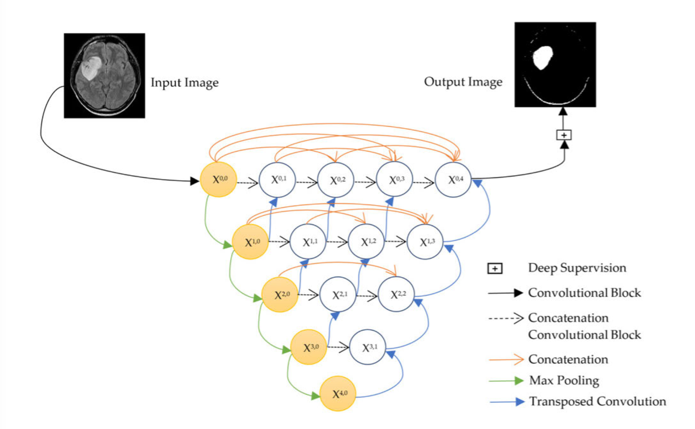
Literature Survey
Base paper-3 title:
U-Net++DSM: Improved U-Net++ for Brain Tumor Segmentation With Deep Supervision Mechanism
Diagram of the existing work
Summary:
This paper introduces U-Net++ architecture with deep supervision, which enhances segmentation by improving feature propagation and gradient flow. The use of nested skip connections helps capture multi-scale features and improves segmentation accuracy.
Research Gap Identified:
The model is computationally expensive and may require additional optimization and tuning for real-time or large-scale clinical applications.
Base Paper-3 citation:
Wisaeng, K. (2023). U-Net++ DSM: Improved U-Net++ for medical image segmentation. IEEE Access.

Slide 9
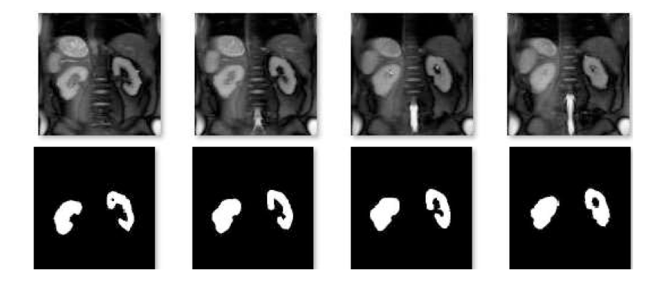
Literature Survey
Base paper-4 title:
VisioRenalNet: Spatial Vision Transformer UNet for Enhanced T2-Weighted Kidney MRI Segmentation
Summary:
This paper proposes a Vision Transformer-based U-Net architecture for kidney MRI segmentation. It integrates spatial attention and transformer blocks to capture both local and global contextual information, improving segmentation accuracy for kidney structures in T2-weighted MRI images.
Diagram of the existing work
Research Gap Identified:
The model is trained on a limited dataset and lacks multi-center or cross-modality validation, which may reduce its generalization ability in diverse clinical scenarios.
Base Paper-4 citation:
Afnaan, K., et al. (2024). VisioRenalNet: Spatial vision transformer UNet for enhanced T2-weighted kidney MRI segmentation. Procedia Computer Science.

Slide 10
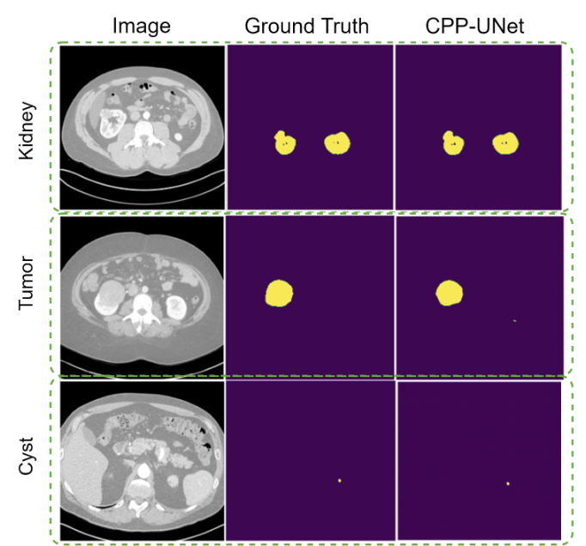
Literature Survey
Base paper-5 title:
CPP-UNet: Combined Pyramid Pooling Modules in the U-Net Network for Kidney, Tumor and Cyst Segmentation
Summary:
This paper introduces CPP-UNet, which enhances the traditional U-Net by incorporating Pyramid Pooling Module (PPM) and Atrous Spatial Pyramid Pooling (ASPP) for better multi-scale feature extraction. The model improves segmentation performance for kidney, tumor, and cyst regions in CT images.
Diagram of the existing work
Research Gap Identified:
The model is based on 2D slice-wise segmentation, which limits its ability to fully capture 3D spatial relationships and may reduce performance for small or complex structures.
Base Paper-5 citation:
Matos, C. E. F., et al. (2024). CPP-UNet: Combined pyramid pooling modules in the U-Net network for kidney, tumor and cyst segmentation. IEEE Latin America Transactions.

Slide 11
Literature Survey
Summary of Research Gaps
Kidney Segmentation in Renal MRI: Existing methods rely heavily on manual or semi-automatic segmentation, making them time-consuming and less scalable for clinical use.
Attention-Based Residual U-Net: Improves focus on important regions, but the high model complexity may reduce efficiency and generalization across datasets.
U-Net++ with Deep Supervision: Enhances feature propagation and segmentation accuracy, but requires higher computational resources and careful optimization.
VisioRenalNet: Captures global context using transformers, but is trained on a limited dataset, affecting robustness in diverse clinical environments.
CPP-UNet: Improves multi-scale feature extraction, but its 2D slice-based approach limits the capture of full 3D anatomical relationships.

Slide 12
Proposed Methodology
Develop an Attention U-Net++ based segmentation model to accurately identify and extract kidney regions from medical images.
Address challenges such as low contrast, anatomical variability, and background interference using attention mechanisms to focus on kidney-relevant regions.
Utilize nested skip connections in U-Net++ to improve multi-scale feature fusion and enhance segmentation boundary precision.
Incorporate deep supervision to improve gradient flow, accelerate convergence, and strengthen feature learning at multiple decoder levels.
Apply data preprocessing and augmentation techniques to improve model robustness and handle variability in medical imaging data.
Ensure reliable model evaluation using patient-wise data splitting, cross-validation, and performance metrics such as Dice Similarity Coefficient (DSC).

Slide 13
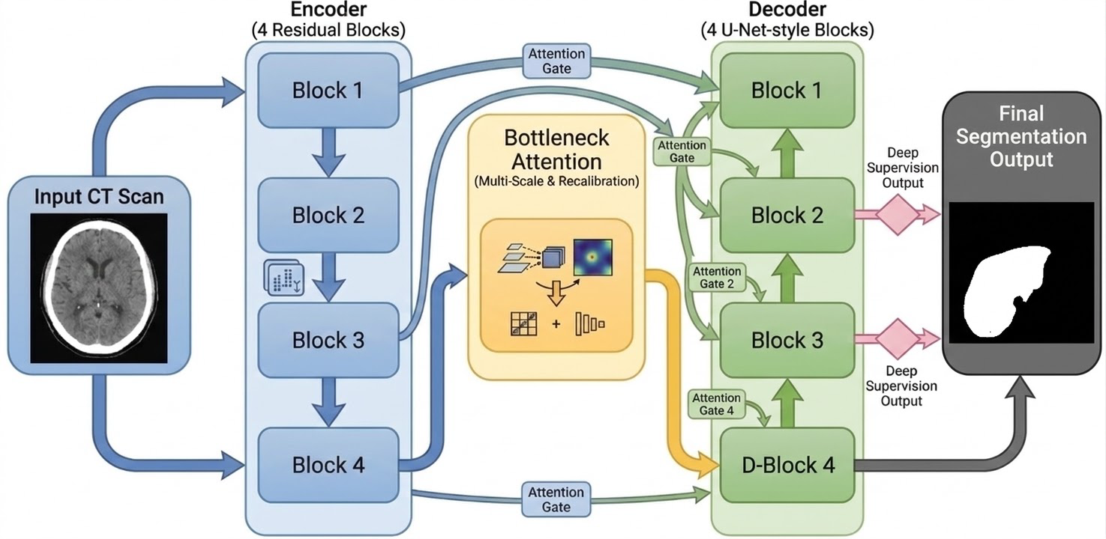
Architecture

Slide 14
Implementation
Step 1: Data Preparation
Extract 2D slices from the 3D scans.
Discard any slice that does not contain the target organ.
Apply contrast windowing and resize images to 256x256.
Step 2: Network Setup
Initialize the Attention U-Net++ architecture.
Split dataset into 80% Training and 20% Validation data.
Step 3: Training Cycle
Apply random shape distortions (Augmentation) to the training images.
Have the model predict the boundaries and calculate internal errors.
Update the network parameters to penalize those errors.
Step 4: Validation Cycle
Test the model on pristine, unseen validation images.
Calculate the accuracy (Dice Score) against the doctor's ground truth.
Save the network weights to a file if the accuracy improves upon the previous best.
Step 5: System Deployment
Load the finalized model file into a graphical web dashboard.
Predict and display the predicted organ overlay in real-time.

Slide 15
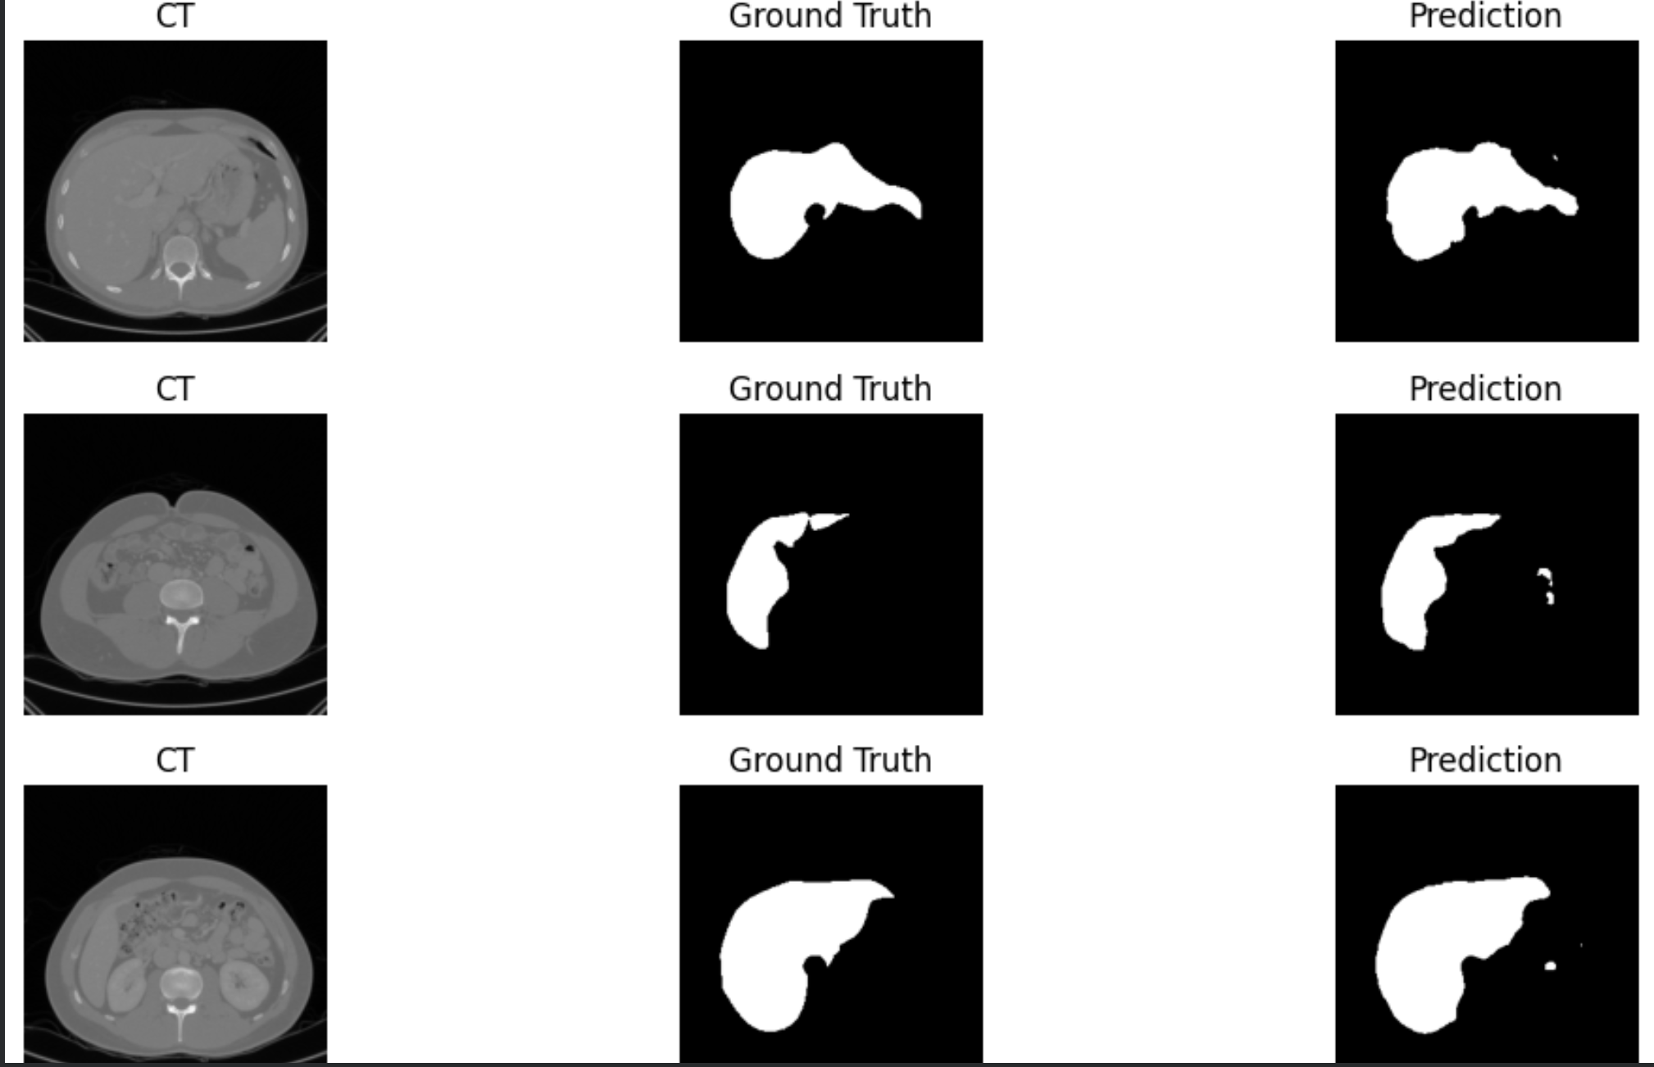
Implementation

Slide 16
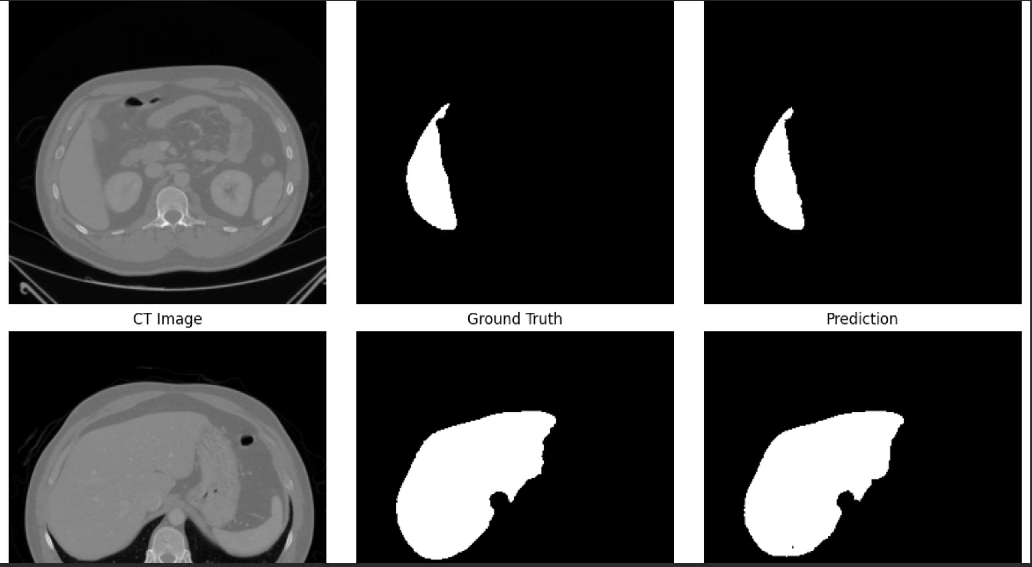
Implementation

Slide 17
Datasets
SNO | NAME OF THE DATASET | SOURCE OF THE DATASET | REFERENCE LINK OF THE CHOSEN DATASET | DESCRIPTION OF THE DATASET
1 | KiTS19 (Kidney Tumor Segmentation Challenge 2019) Dataset | University of Minnesota Medical Center / MICCAI (Medical Image Computing and Computer Assisted Intervention) Society | https://kits19.grand-challenge.org/ https://github.com/neheller/kits19 | The dataset is widely considered the academic gold standard for this physical anatomical region because it features incredibly precise spatial ground-truth masks. These masks meticulously outline both the healthy kidney organ boundaries and any associated renal tumors, painstakingly annotated by medical professionals.

Slide 18
Results
The proposed Attention U-Net++ model successfully segmented kidney regions from medical images with improved boundary localization and reduced background interference.
Integration of attention mechanisms helped the model focus more effectively on kidney-specific regions, improving segmentation quality compared to basic segmentation approaches.
The use of nested skip connections and deep supervision enhanced feature learning and improved multi-scale representation of kidney structures.
Validation strategies such as patient-wise splitting, data augmentation, and cross-validation contributed to better robustness and generalization of the model.
The model demonstrated reliable performance in handling challenges such as low contrast, anatomical variability, and complex kidney boundaries.
Overall, the proposed system shows strong potential for supporting automated clinical kidney analysis and medical decision-making.

Slide 19
Conclusion
This project presents an Attention U-Net++ based deep learning model for automated kidney segmentation from medical images. By integrating attention mechanisms, nested skip connections, and deep supervision, the proposed system improves feature extraction and segmentation accuracy.
The model effectively addresses challenges such as low contrast, anatomical variability, and background interference, which are common in kidney imaging. Validation techniques such as data augmentation, patient-wise splitting, and cross-validation further improve the robustness and reliability of the system.
Overall, the proposed approach demonstrates strong potential for accurate, consistent, and automated kidney segmentation, making it useful for clinical diagnosis, treatment planning, and medical image analysis.

Slide 20
Future Scope
Extend the proposed model for 3D kidney segmentation to capture richer spatial and anatomical information.
Improve segmentation performance by integrating transformer-based modules and more advanced attention mechanisms.
Expand the system to segment not only kidneys but also tumors, cysts, and other abdominal organs for broader clinical applications.
Train and validate the model on larger and more diverse medical datasets to improve generalization and real-world reliability.
Develop a real-time clinical support system that can assist radiologists in diagnosis and treatment planning.
Explore deployment of the model in hospital imaging workflows for practical healthcare applications.

Slide 21
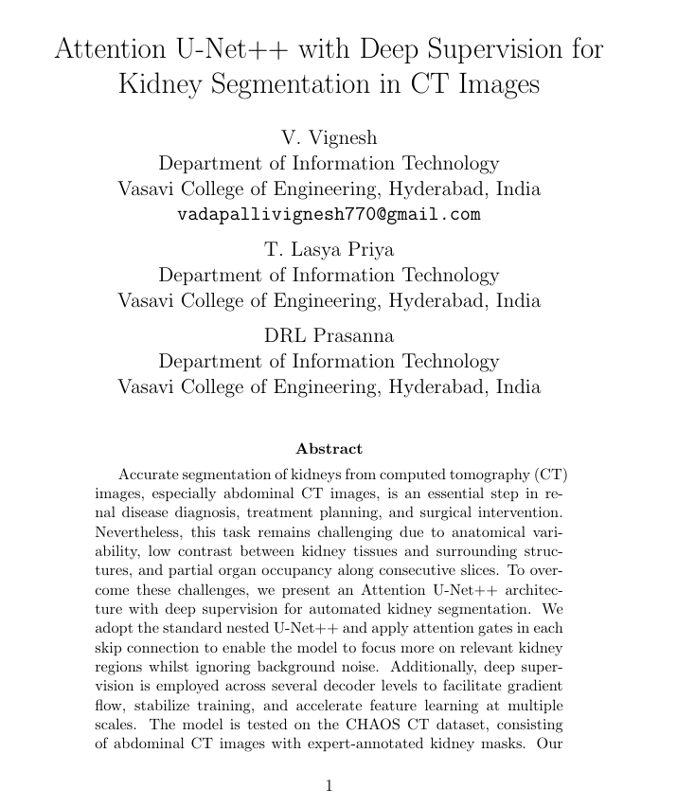
Publication Details
Title: Deep Learning Approach for Kidney CT Segmentation Using Attention U-Net++
​Conference: IEEE​
Status: Under review

Slide 22
References
Zoellner, F. G., Schock, D., Kertzscher, G., et al. (2021). Kidney segmentation in renal magnetic resonance imaging: Current status and prospects. IEEE Access, 9, 27037–27066.
Naqvi, N. Z., & Seeja, K. R. (2025). An attention-based residual U-Net for tumour segmentation using multi-modal MRI brain images. IEEE Access.
Wisaeng, K. (2023). U-Net++ DSM: Improved U-Net++ for brain tumor segmentation with deep supervision mechanism. IEEE Access, 11, 132268–132285.
Afnaan, K., et al. (2024). VisioRenalNet: Spatial vision transformer UNet for enhanced T2-weighted kidney MRI segmentation. Procedia Computer Science.
Matos, C. E. F., et al. (2024). Cpp-UNet: Combined pyramid pooling modules in the U-Net network for kidney, tumor and cyst segmentation. IEEE Latin America Transactions, 22(8).
Omarxadel. (n.d.). CHAOS combined CT-MR healthy abdominal organ dataset. Kaggle. https://www.kaggle.com/datasets/omarxadel/chaos-combined-ct-mr-healthy-abdominal-organ

Slide 23
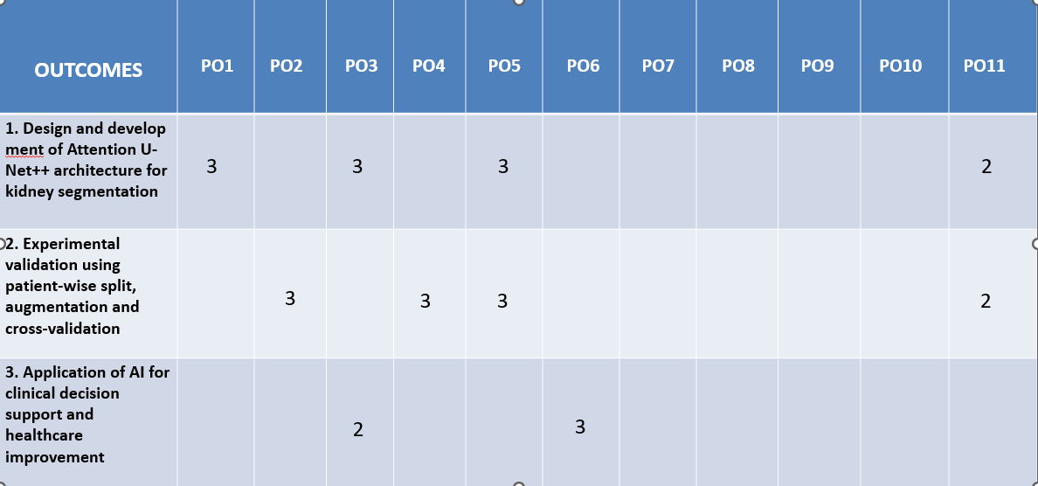
PO Objective

Slide 24
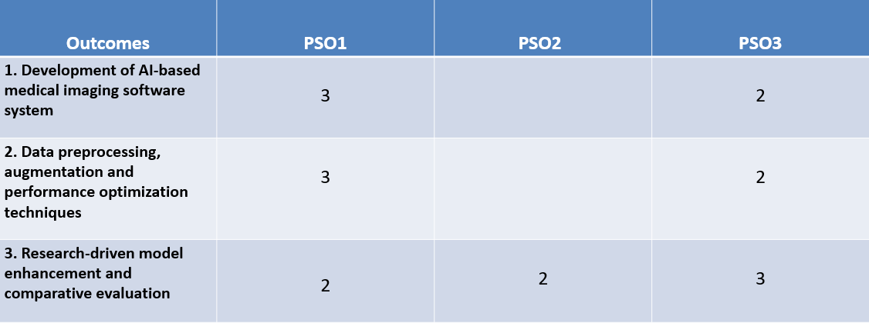
PSO Mapping Table
JUSTIFICATION
PSO1 –
• Development of an AI/ML-based medical image segmentation system using deep learning architectures.
PSO2 –
• Implementation and management of medical imaging datasets with proper preprocessing and validation techniques.
PSO3 –
• Analysis and evaluation of intelligent model architectures through experimental comparison and performance studies.

Slide 25
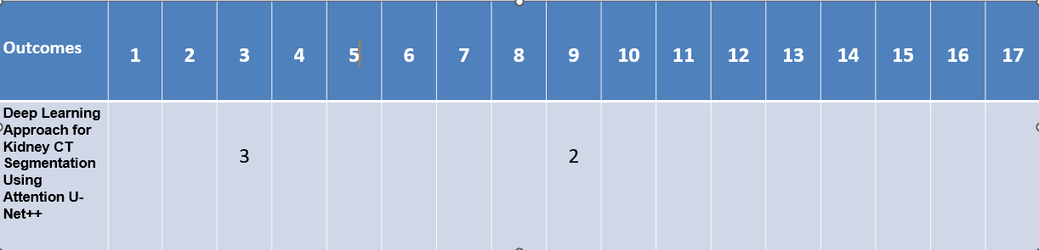
SDG Goals
SDG 3 – Good Health and Well-Being (3) • AI-based kidney segmentation system supports accurate medical diagnosis and improves healthcare outcomes.
SDG 9 – Industry, Innovation and Infrastructure (2) • Development of advanced deep learning architecture promotes innovation in medical imaging technology.

Slide 26
Thank You

