Slide 1
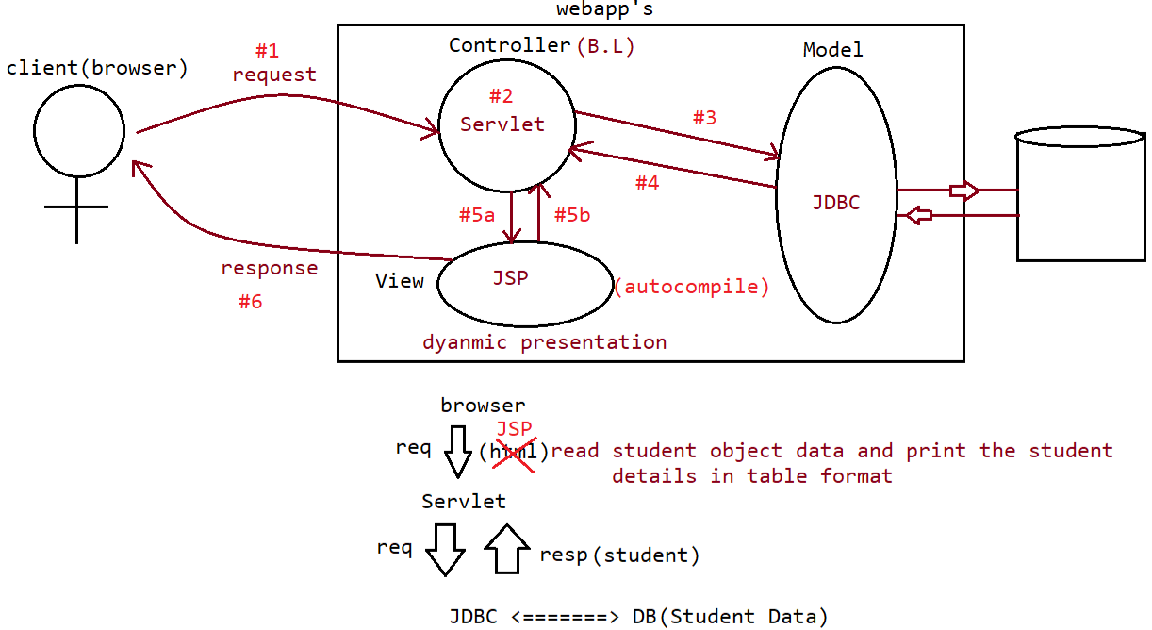
Model : JDBC
View : JSP (PresentationLogic Code)
Controller : Servlet (BusinessLogic/ProcessingLogic Code)
Plain html is not useful for giving dynamic nature.
Embedding HTML code as a response in servlet is not at all good and efficient. So, instead use the language java server pages which has java along with html and ask servlet to use this as a response

Slide 2
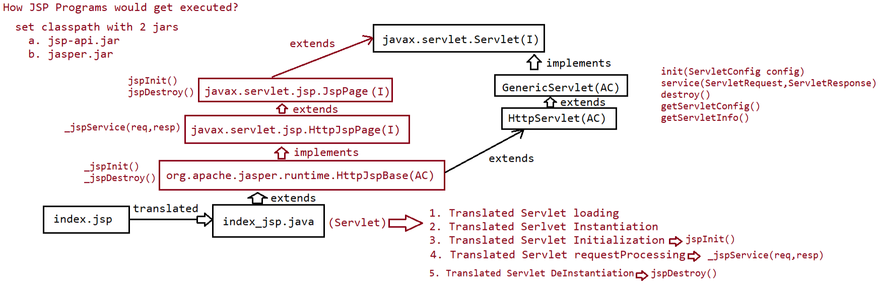
Jsp files are converted into servlet files by the server
jspInit() {
_jspInit();
}
As _jspService(), _jspInit(), _jspDestroy() are automatically generated you cannot write code inside them explicitly, and use them. Instead you can override jspInit(), jspDestroy() and _jspService() method is anway automated from the code you written in jsp file.
jspDestroy() {
_jspDestroy();
}

Slide 3
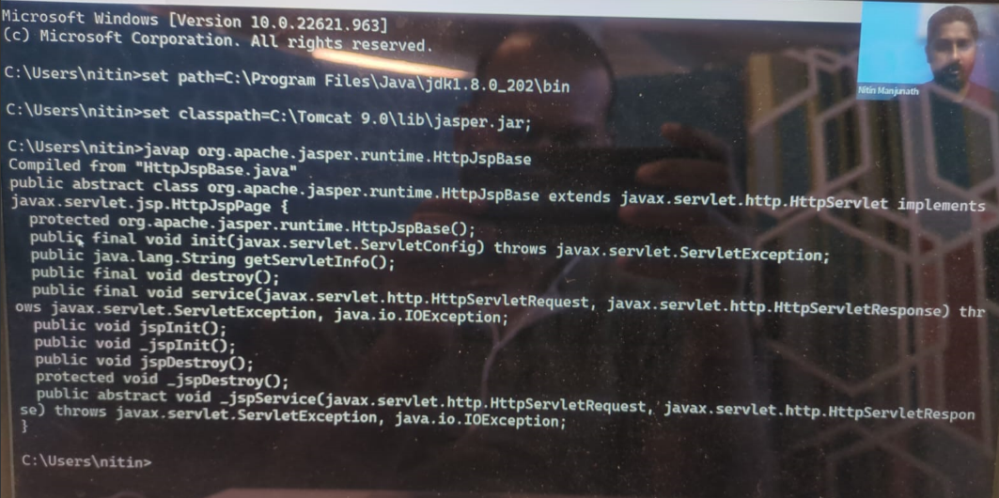

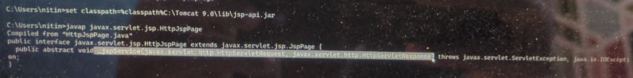

Slide 4
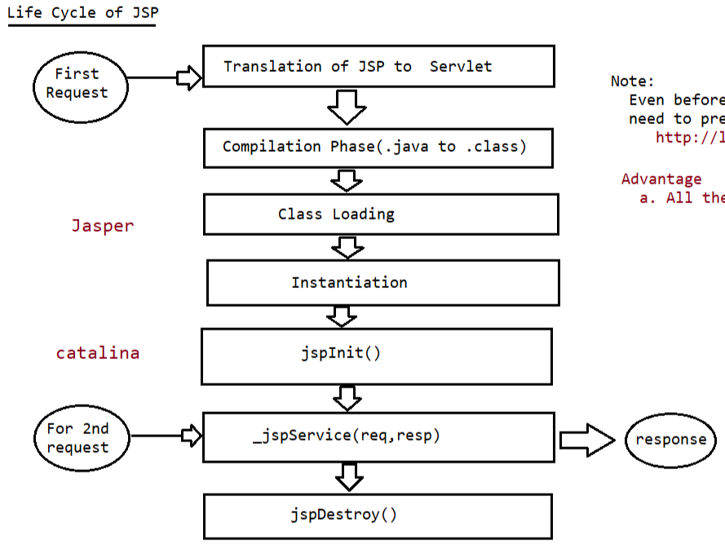

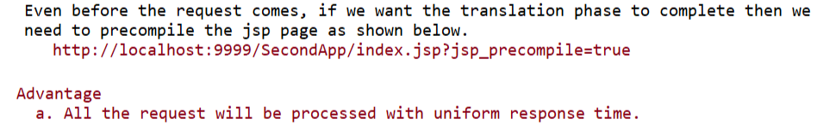
In servlets, compilation and class loading would already be done for the first request itself.
In order to do that here also we have to use something like loadonstartup which we had done for servlets.
It’s an engine which does translating, compiling, class loading and instantiation
Starts working from here
from
This doesn’t send a request for index.jsp page it just compiles and loads it.

Slide 5
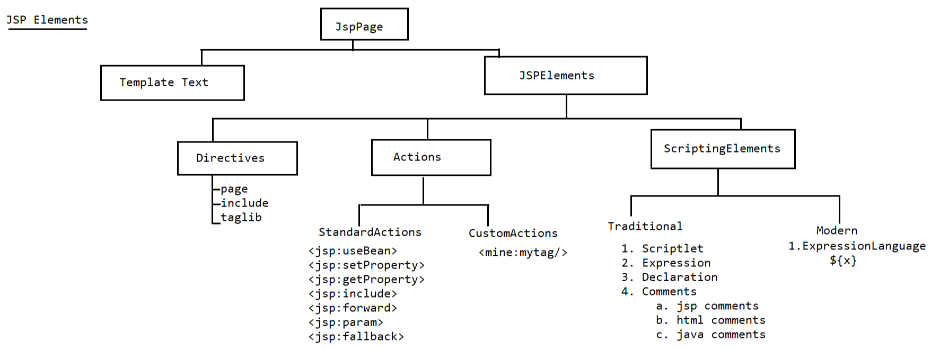

Slide 6
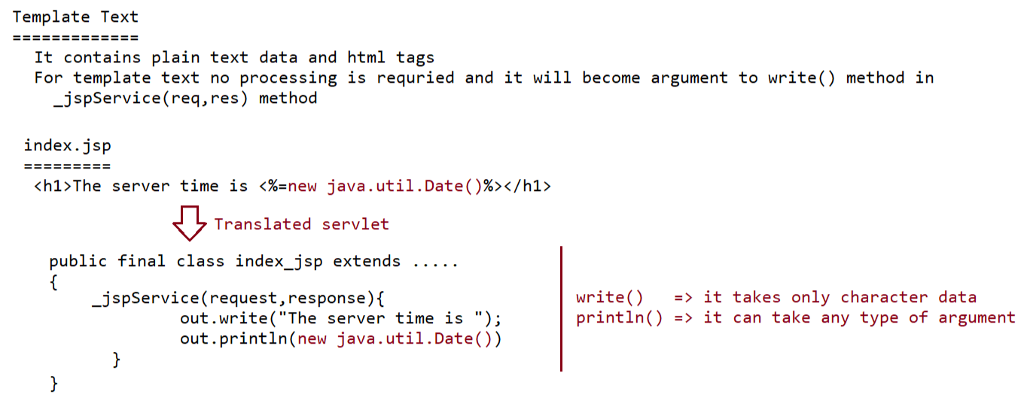

Slide 7
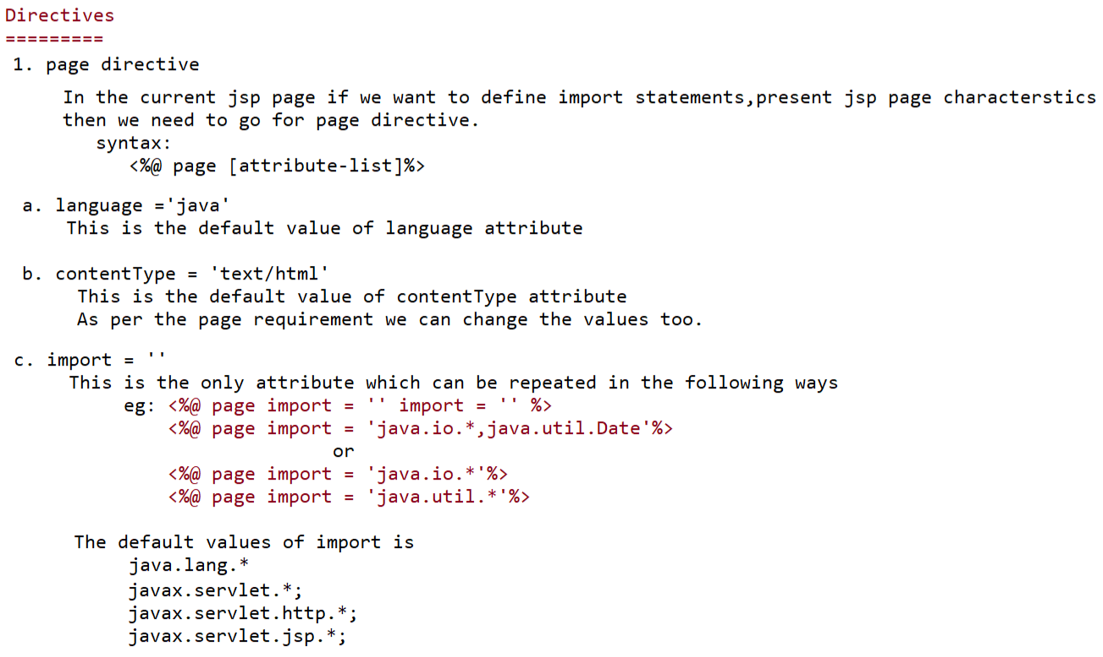

Slide 8
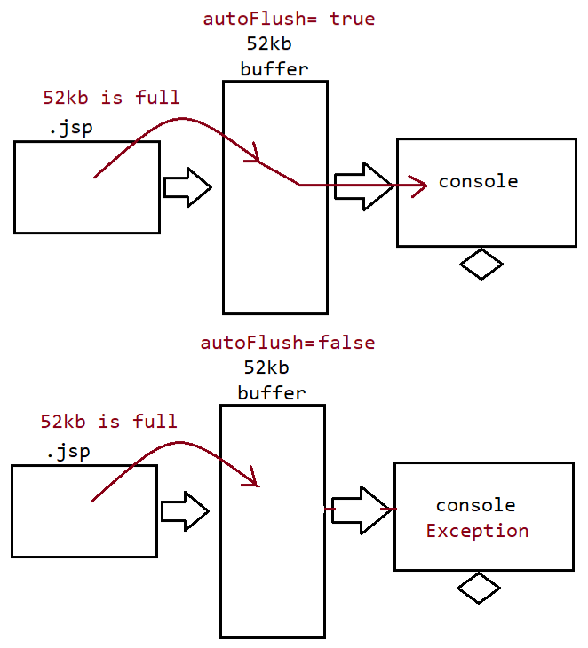
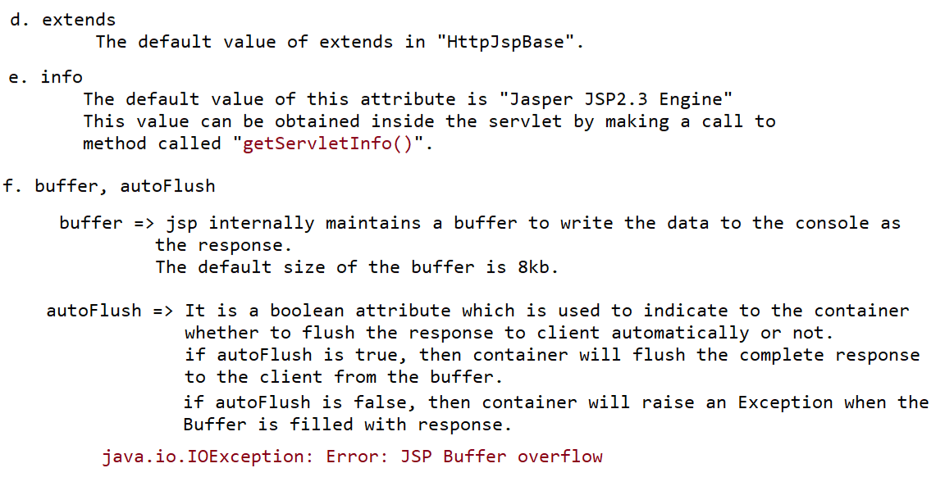

Slide 9
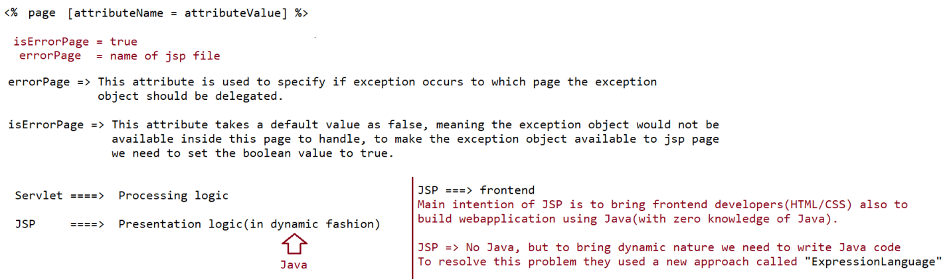
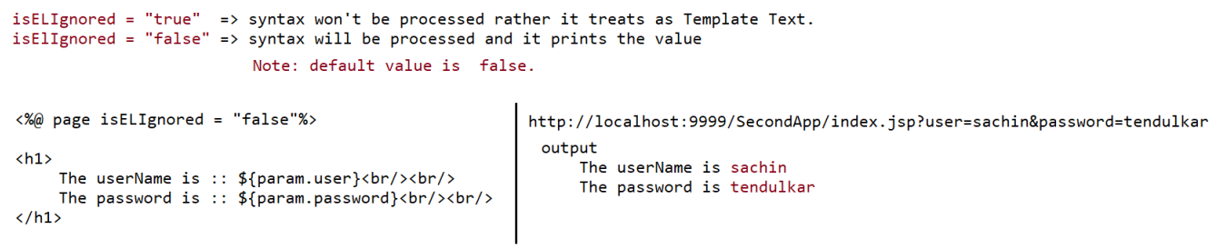

Slide 10
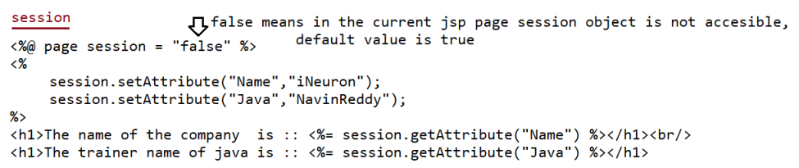
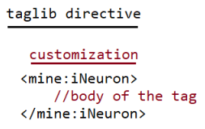
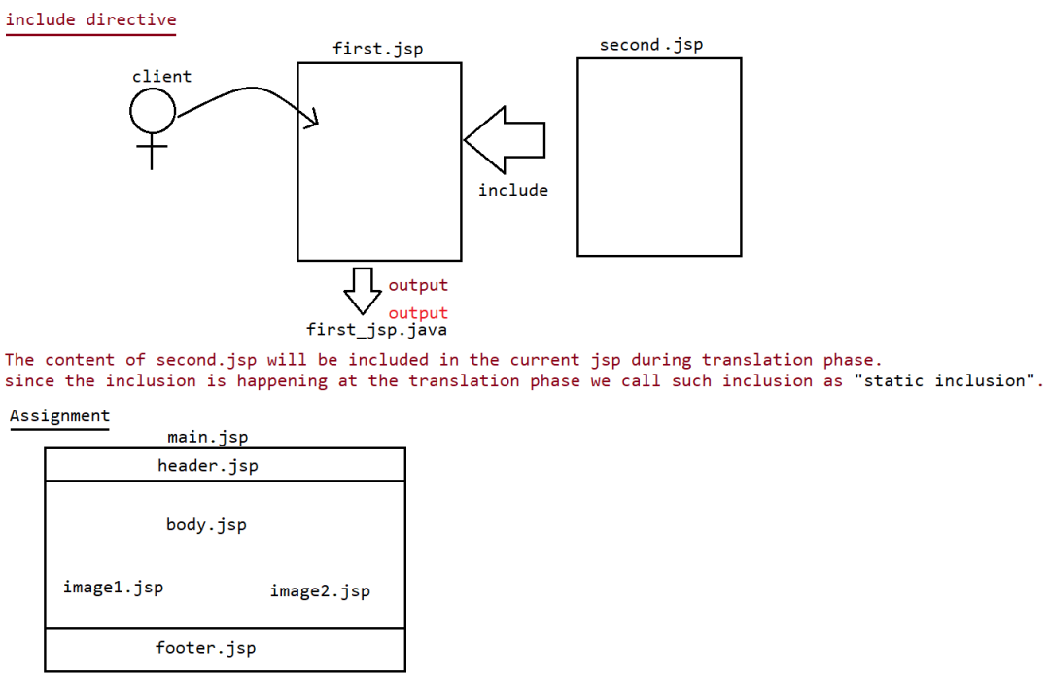

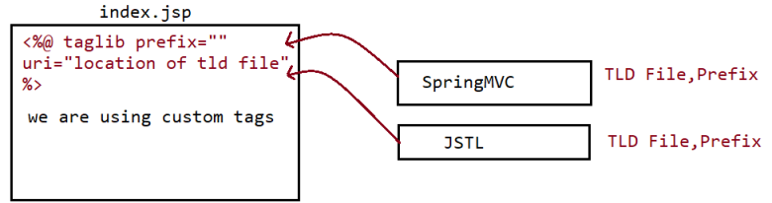

Slide 11
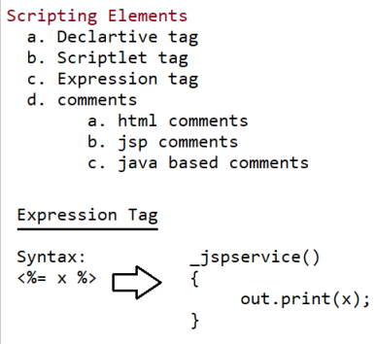
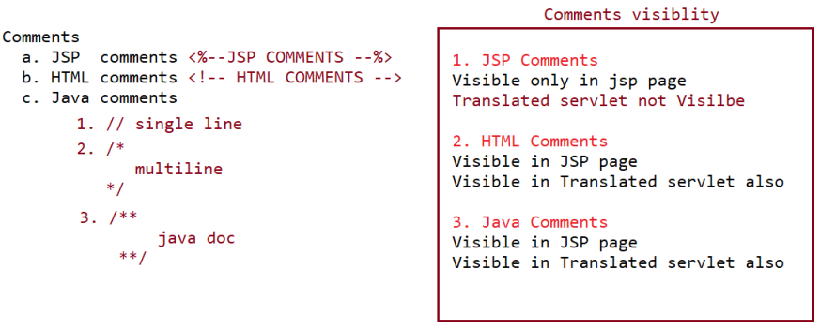
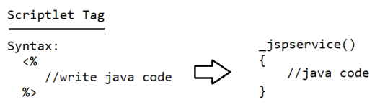
Scripting Elements are most important
Because you are going to use them always when you work with jsp.

Slide 12
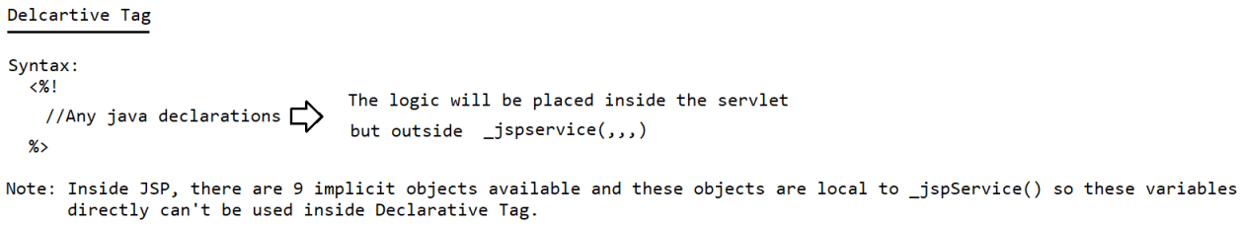
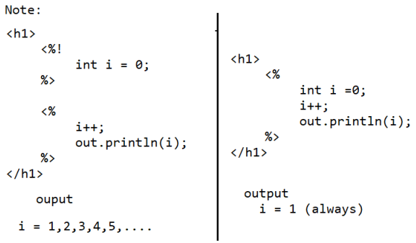
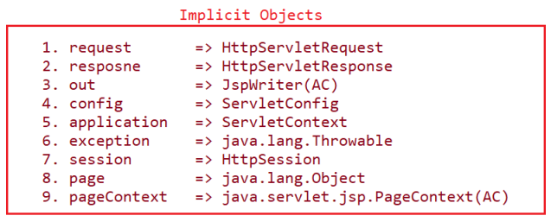
Any thing declared in declarative tag are instance members, can be accessed anywhere in the jsp code.
on refreshing
on refreshing
You can’t use the above objects anywhere else expect _jspservice() method (i.e scriplet tag)

Slide 13
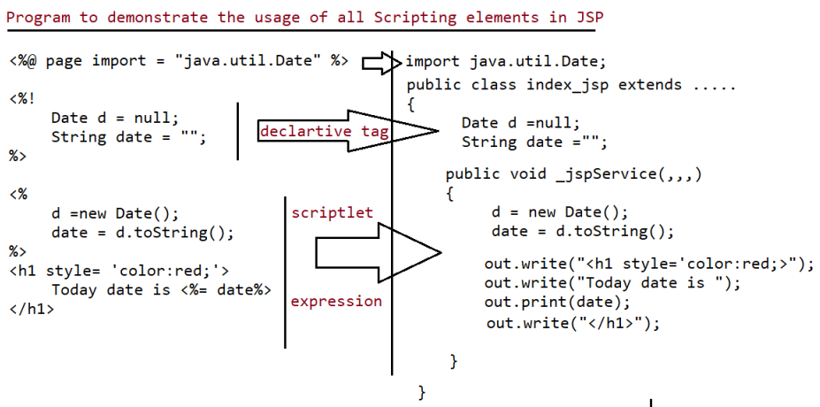


Slide 14

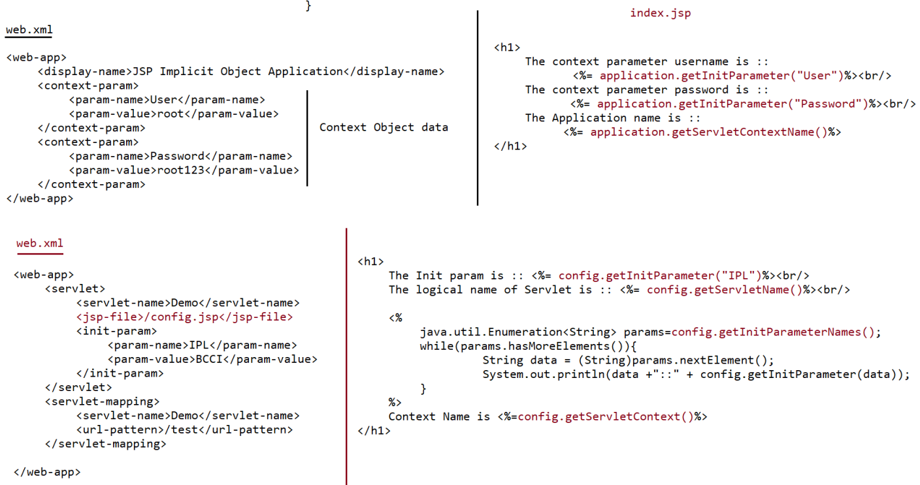

Slide 15
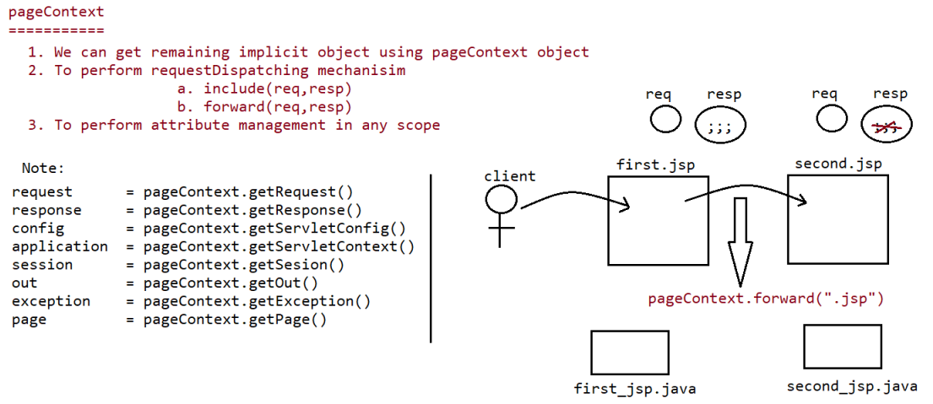
It is an implicit object, using this the following things can be done.
(In java files, not in jsp because you already have all implicit objects in jsp)

Slide 16
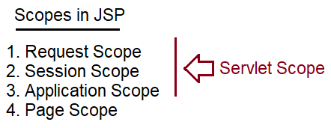
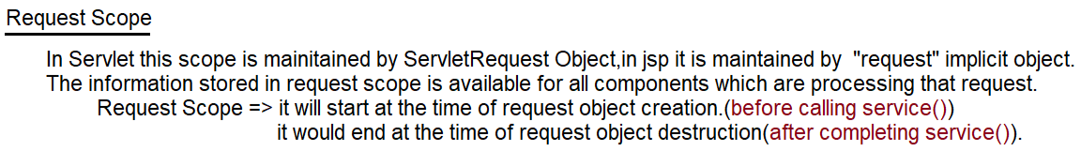
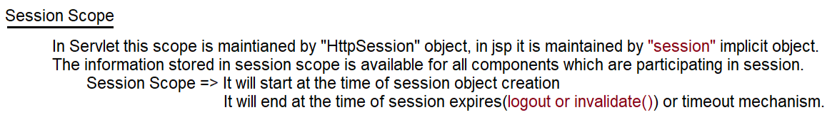
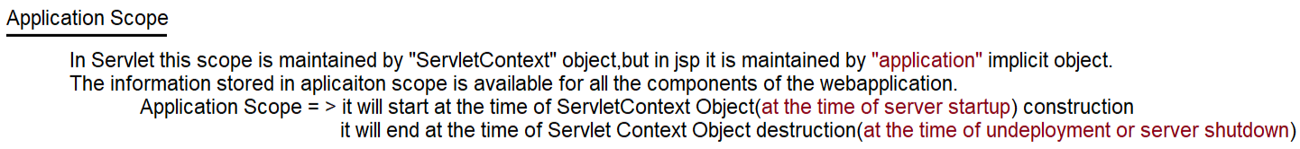

Slide 17
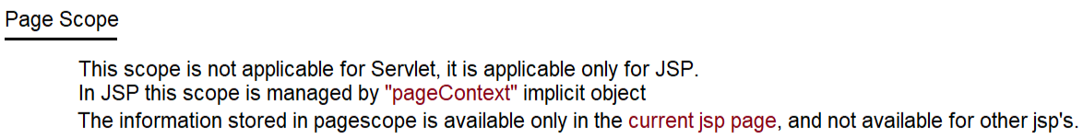
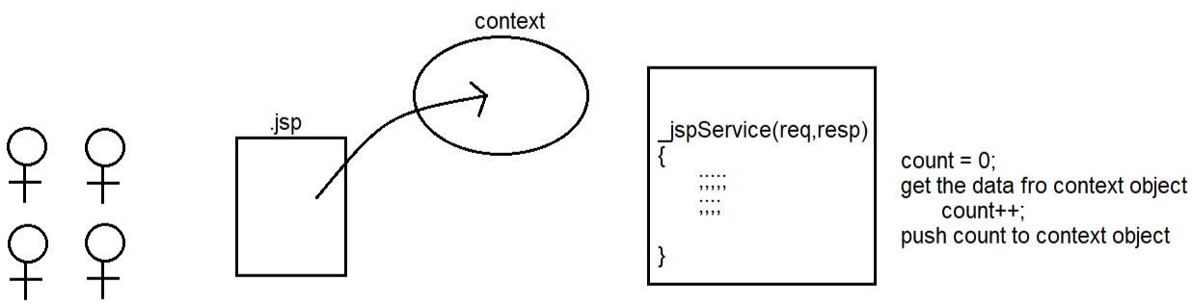

Slide 18
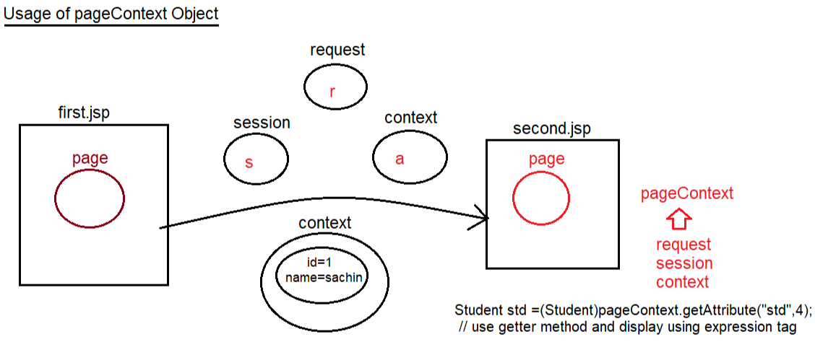

Slide 20
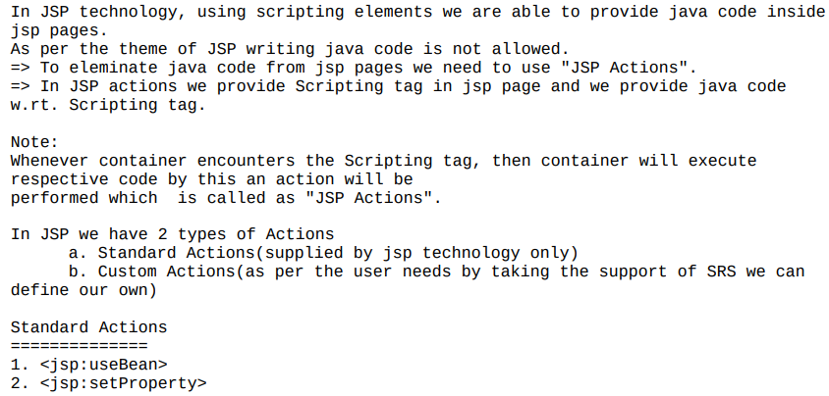
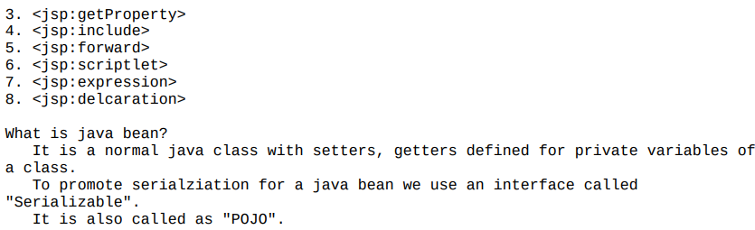

Slide 21
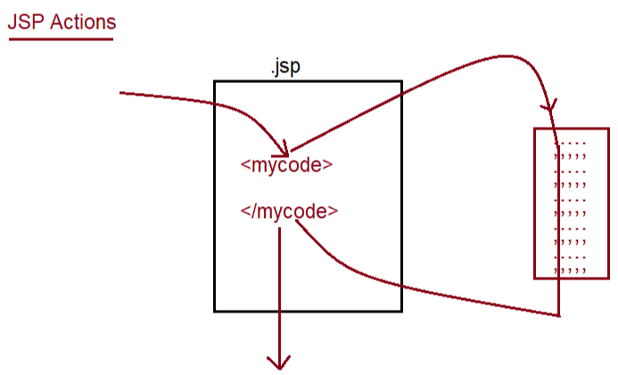
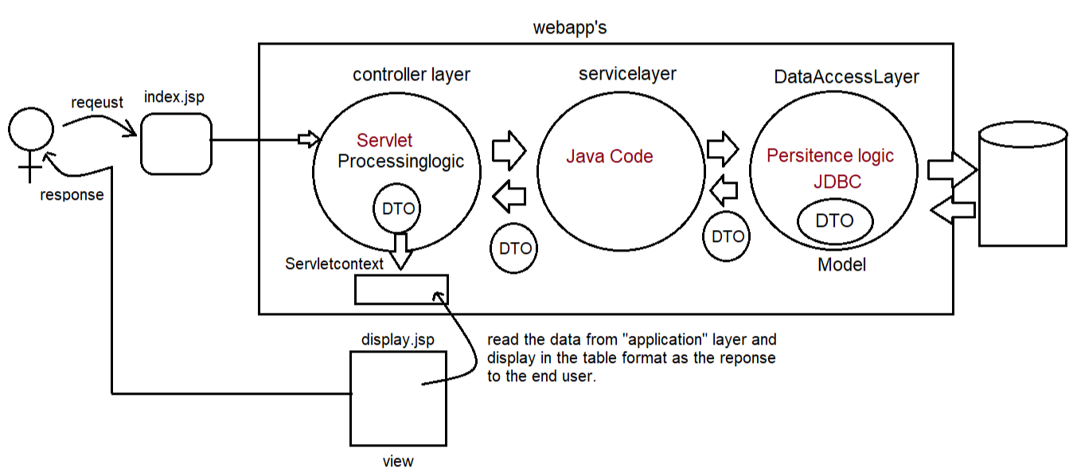
DTO: data transfer object

Slide 22
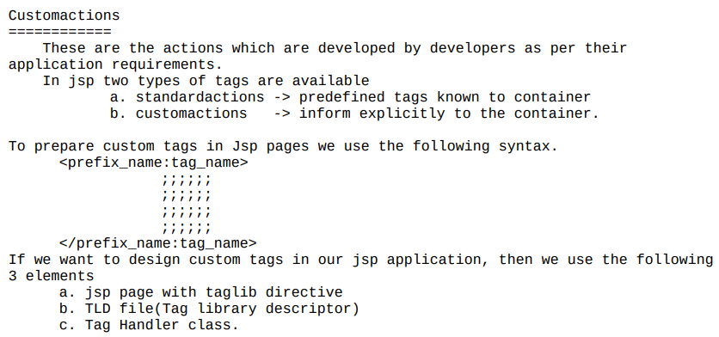

Slide 23
