Slide 1
Next-Generation Access Control Framework for mHealth Systems

Slide 2
What is mHealth?
In recent years, mHealth technology has begun to gain traction due to advances in information technology and mobile-computing. We could be on the verge of a new revolution in healthcare technology, with mHealth as a dominant player.
An mHealth system is basically one which involves the use of mobile computing devices in discharging healthcare-related services.
In this paper, we look into the various privacy issues involved in an mHealth system, and attempt to fabricate a Next-Generation Access Control (NGAC) framework for the same.

Slide 3
mHealth System Architecture
Legend
Sensor Node
Mobile Node
Body-area network (wireless)
Physicians
Preprocessing
Insurance companies
Health Record System
Legal teams
Researchers
Electronic Health Record/ Personal Health Record
Patient

Slide 4
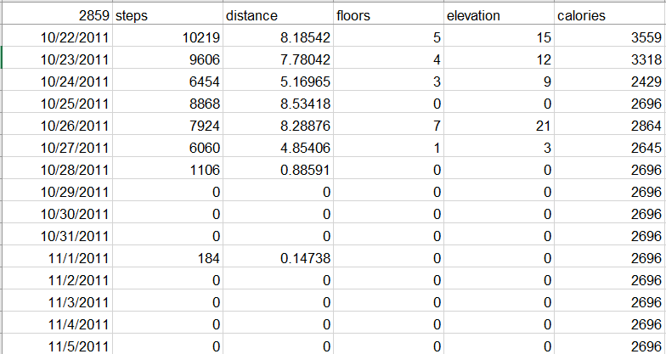
Data Model
We consider our data to consist of 4 features: Patient ID, Data-Time, Calories and Steps Taken, which are taken from a FitBit dataset.

Slide 5
Threat Model
Sources of Threats:
Patient (the patient himself or herself)
Internal (someone already with authorized access)
External (someone without authorized access)
Vulnerable Assets:
Mobile Internet Device
Sensor Nodes
Preprocessing Unit
Health Record System

Slide 6
Threat Model
The types of access threats enforced by each of these categories are described in the following points.
The patient himself/ herself:
Gaining access beyond authorized limits.
Performing changes in the system which they’re not supposed to be able to.
Insiders:
Unintentionally doing changes which they’re not supposed to (due to unintentional appropriation of privileges).
Gaining unauthorized access.

Slide 7
Threat Model
Outsiders:
Gaining unauthorized access.
Performing modifications which are illegal.
These threats may affect the:
Data quality and integrity
Patient confidentiality
Access to the data

Slide 8
Scope
It may be possible to attack the MID through a malicious mobile application but in this project, since we do not take into account Mobile Operating System-based security, we consider the MID to be secure.
We also do not intend to secure against integrity violations, where the patient’s data might be altered.
Therefore, we concern ourselves with only securing the patient’s confidentiality (C) with respect to the Health Records System when under threat from the patient, insiders or outsiders. [(P, I, O), HRS, C]

Slide 9
Solution Overview
In the existing system, Role-Based Access Control is made use of.
However, RBAC is difficult to manage. Determining roles is hard in a sizeable organization. Hence, we intend to formulate an access-control mechanism using policy-machine.
Also, in RBAC, access can only either be given or refused. Therefore, it cannot be considered to be privacy-aware.
We describe the structure of the access-control in the form of a graph database.

Slide 10
Solution Overview
In this graph database, we consider subjects accessing objects under certain constrictions.
We assume subjects in this case to be physicians, patient, insurance companies and lawyers.
The objects would comprise of the patient’s data – ID, Data-time, Calories and steps-taken.
The constrictions which can apply are read, write and release.

Slide 11
Enforcement Point
Sensor Node
Patient
Mobile Node
Physician
Web Server
Insurance companies
Legal teams
Preprocessing
Health-Record System
NGAC enforcement point

Slide 12
Graph Construction Process
There are two sources from where we receive data. It can either be (1) the MID from where sensor-node data is received and (2) a web-based API from where the patient may register for the mHealth services, and other participants such as physicians and insurance companies can request access.
Firstly, let’s consider a patient who registers on his/ her device. Once this is done, a UID is assigned and a node is added to the graph, with the respective policy.
O:Calories
R: User
UID1

Slide 13
Policy Machine 1
UID1
R:User
UID2
O:Calories
HIPPA:Y
R, W, Re
R, W, Re
O:Steps
R, W, Re
R, W, Re
Researcher & HIPPA:Y
R, W, Re
R, W, Re
R, W, Re
R2
R:Research
R, W, Re
D1
HIPPA:N
R:Doctor
R1

Slide 14
Policy Machine 2
UID1
O:Calories
R:User
UID2
R1
R, W, Re
R, W, Re
O:Steps
R:Research
Re
R, W, Re
R, W, Re
R, W, Re
Re
R:Doctor
> 10 patients
D1

Slide 15
Policy Machine 3
UID1
UID1
O:Calories
O:Calories
R:User
UID2
R:User
R:Research
R, W, Re
R:Research
R, W, Re
O:Steps
O:Steps
R, W, Re
R, W, Re
R1
R1
R:Doctor
R:Doctor
Content not drugs-related
D1
D1

Slide 16
Policy Machine 4
UID1
O:Calories
R:User
UID2
R, W, Re
R:Research
R, W, Re
O:Steps
R, W, Re
R, W, Re
R1
R:Doctor
Annual Data only
D1

Slide 17
Challenges Unique to mHealth
Larger volume of health-data collected continuously.
The data collected is more comprehensive and could be related to the general lifestyle of the patient.
Has a broader range of applications and may involve the need to share data with a number of different entities (at the discretion of the patient).

Slide 18
References
[1] S. Avancha, A. Baxi, D. Kotz. Privacy in Mobile Technology for Personal Healthcare

