Slide 1
CS556 – Project 1
An Exploration of the ‘Heartbleed’ Vulnerability and ‘John the Ripper’ Security Tool
Vignesh M. Pagadala

Slide 2
Heartbleed
A security flaw discovered in 2012 in OpenSSL, which is extensively made use of by Transport Layer Security (TLS) protocols.
Fundamentally, this vulnerability presents itself in the form of a buffer over-read, a scenario where more than allowable data is, inadvertently, read.
Discovered by Neel Mehta of Google.

Slide 3
Consequences of a Heartbleed Attack
A Heartbleed attack can lead to confidential data leakage (mostly from a server). This can include unencrypted messages, session cookies, passwords and private keys.
It could essentially allow an attacker to extract a segment of active memory from a server, with the associated client being operated by the attacker.
Constitutes a significant threat for server systems, but clients could also be subject to attack through ‘Reverse Heartbleed’.
The results were severe, leading an article from The Verge going on to state that this was “the most dangerous security flaw on the web”.

Slide 4
Consequences of a Heartbleed Attack
As of April, 2014, vulnerabilities were identified in several websites including Yahoo!, Stack Overflow and Imgur. Also forced the temporary closure of the Canadian Revenue Agency’s website over Heartbleed concerns.
Reasons behind Heartbleed’s significant impact:
Because it is rooted in OpenSSL (which was used by 2 out of 3 servers on the internet).
It took two years before it was made known to the public (in 2014).

Slide 5
Working
To understand how Heartbleed works, it is necessary to understand what a ‘Heartbeat’ is.
A Heartbeat is a TLS protocol extension used to check if communication between a server and a client is still active.
The protocol required both, server and client, to keep exchanging regular ‘heartbeat’ messages (to ensure that the connection was alive).
This was brought in since the previously existing methodology was too expensive.

Slide 6
OpenSSL Heartbeat
TLS Protocols
Reliable Transport Protocol
Unreliable Transport Protocol
HeartbeatRequest
HeartbeatRequest
Device A
Device B
Device A
Device B
HeartbeatResponse
HeartbeatResponse
if(HeartbeatResponseTime > 10 seconds)
{
connection closed;
}
if(NumberOfRetransmissions > 5)
{
connection closed;
}
Receiver should send back an exact copy of the received message in HeartbeatRequest to the sender, which is checked by the sender to see if it’s the same.

Slide 7
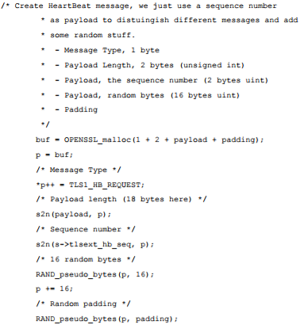
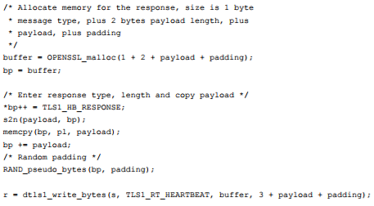
HeartbeatRequest
HeartbeatResponse

Slide 8
Mitigation
In the excerpt of code shown for HeartbeatResponse, there is a critical problem. This is illustrated below.
HeartbeatRequest (from Client)
Server
Payload Extracted
copied to HeartbeatResponse payload
This procedure is performed without checking if length of payload (received from client) is equal to the actual payload length
Heartbeat Response Payload
HeartbeatResponse (to Client)

Slide 9
HeartbeatResponse

Slide 10
Mitigation
This may allow the sender to receive additional data (stored in the memory space after the payload length gets exhausted).
Will also allow the sender to write additional instructions maliciously into the servers memory.
A Heartbeat message payload can go up to a maximum of 65535 bytes.

Slide 11
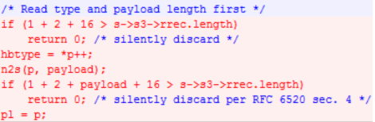
Mitigation
Two tasks are done here:
The received payload is checked to see if the length is zero. If yes, then the message is discarded.
The received payload is checked to see if the payload length is equal to the actual payload length. If not, the message is discarded.

Slide 12
Mitigation
The following steps are recommended to all systems subjected to Heartbleed (after patching).
Changing passwords
Regenerating private keys
Replacement of certificates

Slide 13
John the Ripper
A password-cracking tool which works with various different encryption frameworks.
Was initially built solely for the UNIX operating system and then extended to cover fifteen different platforms.
Primarily used for the purpose of detecting weak UNIX passwords.
John the Ripper is a result of contributions made by Shinnok, Aleksey Cherepanov and Mathieu Laprise (who worked on it as a part of their GSOC project).

Slide 14
Relevance
Concise Cybersecurity considers John the Ripper to be one of the most popular password crackers in use.
In an article by AgileBits (the company behind the development of the password manager 1Password) in 2012, John the Ripper is mentioned as one of the most sophisticated and popular password cracking tool prevalent.
In the same article, they go on to postulate that, John the Ripper’s functionality could indeed be extended to make it suitable for breaking into password managers.

Slide 15
Use-Case Scenarios
Most systems store passwords as hashes. The ideal use-case of John the Ripper would be in a scenario where the following conditions are satisfied:
The password file with the stored hashes, is obtained (either through masquerading or sniffing on a network), and is in the attackers possession.
The hash is unsalted (which, as a side note, is highly unlikely).
The users of the system make use of simple, common passphrases such as ‘123456’ or ‘qwerty’.

Slide 16
Working
John the Ripper can be used for performing attacks through various modes, which involve the following methodologies:
Dictionary attack
Brute-Force

Slide 17
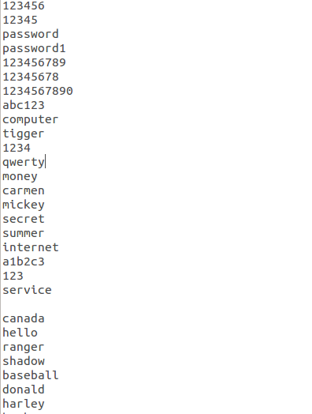
Dictionary Attack
A list of all possible passphrases or the commonly used ones are maintained, and encrypted using the same hash algorithm used for the passwords.
In the ‘single crack mode’ different variations of these common words are also used, constantly checking the hashed version of each one with the password hashes.
Fig: Common Passwords List

Slide 18
Brute-Force
In this mode, every possible permutation of plaintext are run through, hashing it each time and comparing with the passwords to see if a match is obtained.
The average frequency with which characters occur is also used, to give the program a little bias to try high-frequency characters first.
This method might be able to zero in on much more complicated passphrases, but would take an enormous amount of time.

Slide 19
Example Uses
For example, to simply run with the default mode-order (single crack, use wordlist with rules, incremental mode) . We run:
john mypasswd
To see cracked passwords:
john --show mypasswd
For incremental mode:
john --incremental mypasswd

Slide 20
Summary
John the Ripper is indeed a very popular, password cracking tool, which can be used to uncover hashed passwords.
It has the inherent ability to automatically detect the hash algorithm used, and can process multiple types of hashing formats.
However, its use becomes significantly limited when salted password hashes are involved and the passwords don’t happen to be common, thereby making them invulnerable to dictionary attacks.

Slide 21
End of presentation.

