Slide 1
CHURN PREDICTION USING ANN ALGORITHM
PREPARED BY
-VIGNESH T A

Slide 2
INTRODUCTION
We will take a brief intro on the fundamentals of the topic. We are predicting customer churn by using the artificial neural network.
Let’s have a brief understanding of Artificial Neural Networks (ANN).

Slide 3

What Is an Artificial neural network?
The artificial neural network is based on collection nodes which we call artificial neurons. In the form of a computer network, we create a network of artificial neurons that is similar to brain neurons.
These neurons are interconnected with each other through nodes and managed in the form of an ‘n’ number of layers, which completes the Artificial Neural Network(ANN).

Slide 4
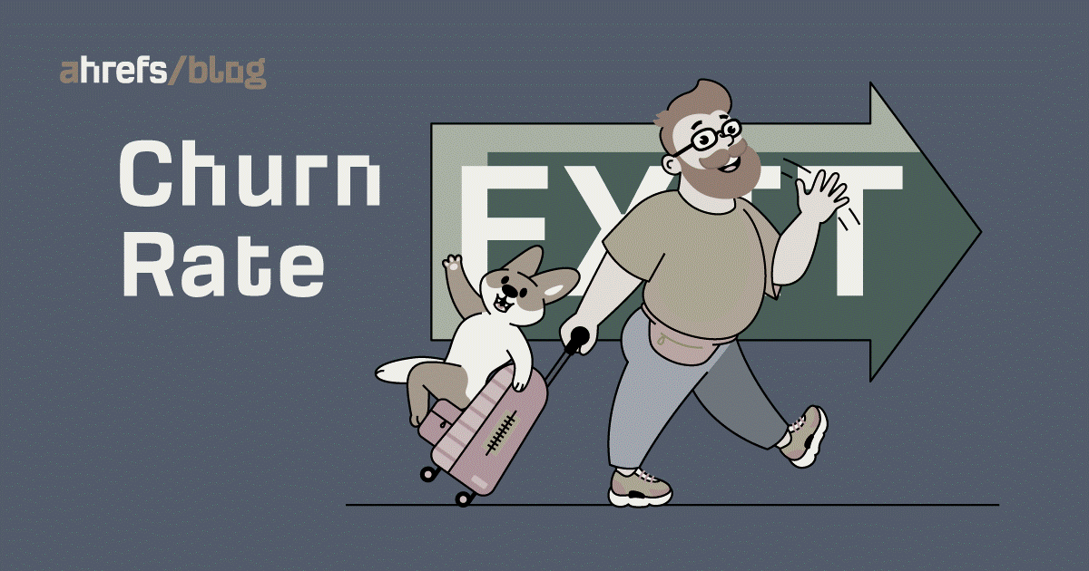
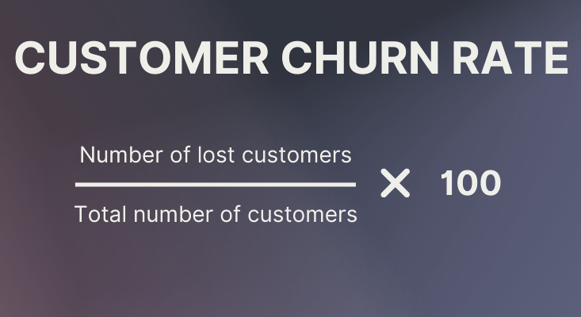
What is customer churn?
Customer churn is the rate at which customers leave doing business with an entity. In other words, if a consumer has purchased a subscription to a particular service, we must determine the likelihood that the customer would leave or cancel the membership.
It is a critical prediction for many businesses because acquiring new clients often costs more than retaining existing ones. Customer churn measures how and why are customers leaving the business, and helps implementing the solution to retain the customer.

Slide 5
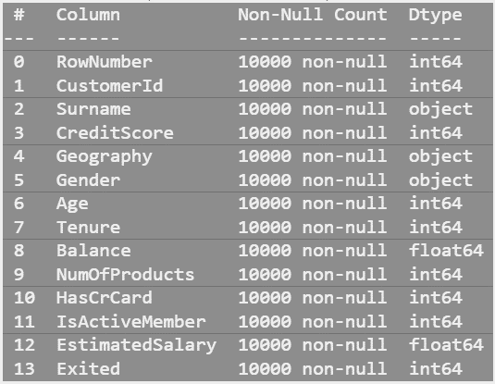
Customer churn dataset
Bank Customer Churn Dataset which was obtained from Kaggle is being used in building the ANN model. The dataset contains several features and based on those features customer churn is predicted.
The dataset consists of 10,000 rows, with no null values. Hence, the missing value analysis is averted.
There are fourteen variables out of which thirteen are independent variables [0 to 12] and the remaining one is a dependent variable [Exited].
There are three categorical variables and eleven numerical variables present in the dataset.

Slide 6
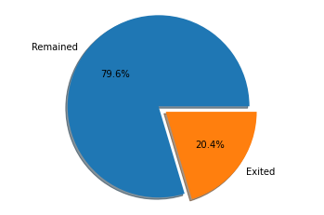
EDA
 | RowNumber | CustomerId | CreditScore | Age | Tenure | Balance | NumOfProducts | HasCrCard | IsActiveMember | EstimatedSalary | Exited
count | 10000.00000 | 1.000000e+04 | 10000.000000 | 10000.000000 | 10000.000000 | 10000.000000 | 10000.000000 | 10000.00000 | 10000.000000 | 10000.000000 | 10000.000000
mean | 5000.50000 | 1.569094e+07 | 650.528800 | 38.921800 | 5.012800 | 76485.889288 | 1.530200 | 0.70550 | 0.515100 | 100090.239881 | 0.203700
std | 2886.89568 | 7.193619e+04 | 96.653299 | 10.487806 | 2.892174 | 62397.405202 | 0.581654 | 0.45584 | 0.499797 | 57510.492818 | 0.402769
min | 1.00000 | 1.556570e+07 | 350.000000 | 18.000000 | 0.000000 | 0.000000 | 1.000000 | 0.00000 | 0.000000 | 11.580000 | 0.000000
25% | 2500.75000 | 1.562853e+07 | 584.000000 | 32.000000 | 3.000000 | 0.000000 | 1.000000 | 0.00000 | 0.000000 | 51002.110000 | 0.000000
50% | 5000.50000 | 1.569074e+07 | 652.000000 | 37.000000 | 5.000000 | 97198.540000 | 1.000000 | 1.00000 | 1.000000 | 100193.915000 | 0.000000
75% | 7500.25000 | 1.575323e+07 | 718.000000 | 44.000000 | 7.000000 | 127644.240000 | 2.000000 | 1.00000 | 1.000000 | 149388.247500 | 0.000000
max | 10000.00000 | 1.581569e+07 | 850.000000 | 92.000000 | 10.000000 | 250898.090000 | 4.000000 | 1.00000 | 1.000000 | 199992.480000 | 1.000000
From the above data derived using .describe(), we can arrive at the following insights:
the churn rate is around 20%, which is obvious from the pie chart.
the average age of the Customers is 39
there are Customers who remained in the bank for over 10 years
maximum no. of products subscribed by the customers is 4
70% of the Customers possess a credit card
Active Customers’ rate is more or less equal

Slide 7
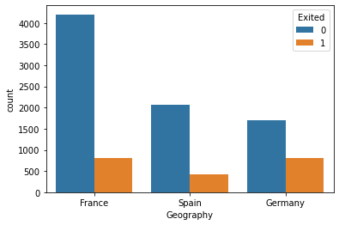
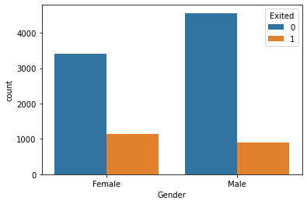
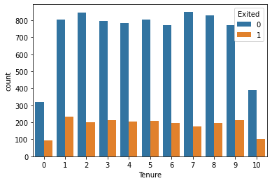
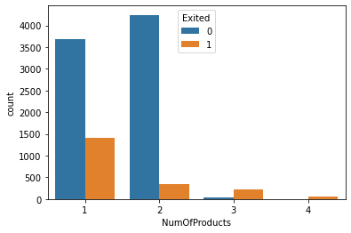
Visualization
COUNT PLOTS
← The churn rate is higher in Germany at almost 50%, followed by Spain and France at around 50%
Based on Gender, we can see that Female customers tend to quit more than Male customers. →
← Churn rates are spread more or less equally based on the Tenure of the Customers.
-More than 30% of Customers using a single product are churned.
-Around 10% of Customers using two products are churned.
-More than 80% of the Customers churned are using 3 products.
-Mostly all the Customers using four products are churned. →

Slide 8
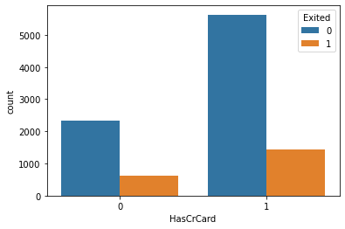
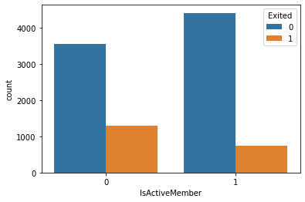
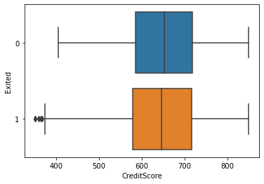
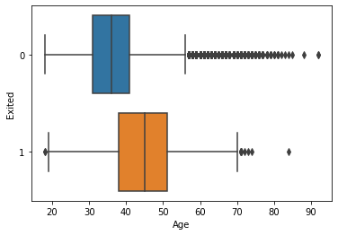
← Only 15% of the customers without a credit card are churned out, whereas, more than 20% of the customers with a credit card are churned out.
More than 35% of the Inactive members are churned, while less than 10% of the active members are churned →
BOX PLOTS
←Credit Score does not have a huge impact on the Churn Rate
Customers between the age group of 30 and 40 are churned more than customers of other ages. →

Slide 9
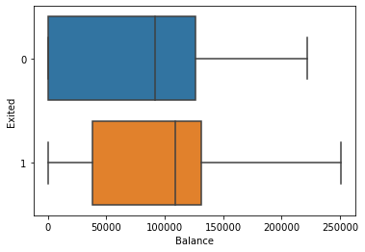
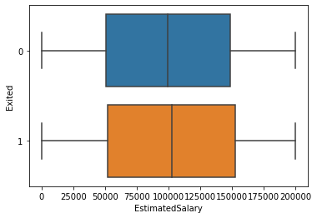
Customers with huge amounts of balances are leaving the bank, which should be reduced to safeguard the revenue generated by those customers. Also, around 25% of the Customers who remained in the bank are maintaining very low balances in their accounts.
The estimated salary of the Customers does not have a great impact on the Churn rate, even though the churn rate is a bit high comparatively where the Salary is high.

Slide 10
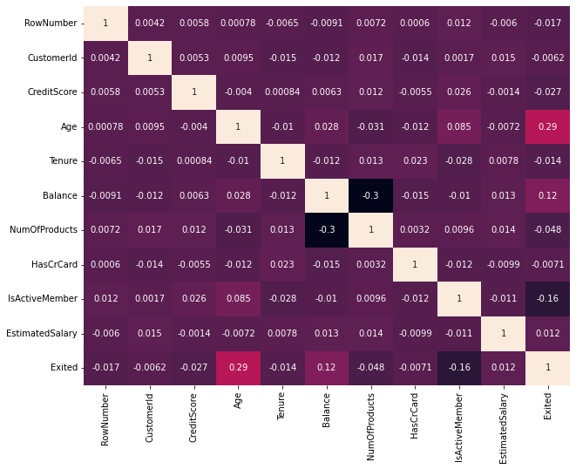
Multi-collinearity:
There is no collinearity present between the variables. Hence we can take all the columns into account based on Multi-collinearity.
-We have derived some useful insight from the visualized data. Now, let us move on to the feature selection for building the ANN model.

Slide 11
FEATURE SELECTION AND ENGINEERING
Feature selection:
Feature selection is a way of selecting the subset of the most relevant features from the original features set by removing the redundant, irrelevant, or noisy features.
In our dataset, we can observe that the features such as 'RowNumber', 'CustomerId’, and 'Surname’ are unwanted features as they may have a negative impact on the accuracy of the model. Hence, those features are dropped using the .drop() function.
Feature Engineering:
Feature engineering refers to manipulation — addition, deletion, combination, mutation — of your data set to improve machine learning model training, leading to better performance and greater accuracy.
Effective feature engineering is based on sound knowledge of the business problem and the available data sources. Here are some steps used to prepare the dataset for building the model.
Split the input variables(X) and output variable(y) using .iloc[] to train and test the model.
Creating dummy variables for the Categorical features using pd.get_dummies(). Concatenating them with the original dataset and dropping the variables for which the dummies are created.
Applying the train_test_split() for the input and output variables(X, y) and scaling the data using StandardScaler() to standardize the independent features present in the data in a fixed range.

Slide 12
MODEL BUILDING
Below are the steps involved in building the ANN model to predict the Customer churn based on the given dataset:
Import the libraries required for model building:
from tensorflow.keras.models import Sequential
from tensorflow.keras.layers import Dense
from tensorflow.keras.layers import ReLU
from tensorflow.keras.layers import Dropout
Assign the Sequntial() function to a variable to fit the train and test data.
Apply the function to create the input layer, first hidden layer, second hidden layer and the output layer. Take a note that we can create as many hidden layers as we want based on the size of the dataset.
Compile the model with the necessary hyperparameters. We have used adam optimizer(since it is one of the best optimizers), binary_crossentropy for loss function, and accuracy as metrics.
Also, to avoid running the epochs even after the model does not show improvement in accuracy we have created the early_stopping with some adjustments to its parameters.

Slide 13
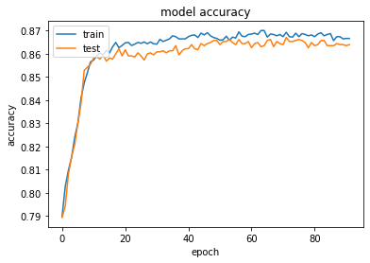
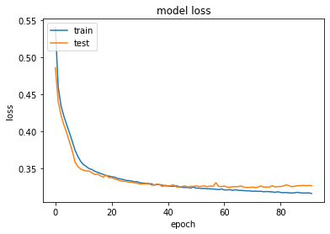
Now, we can fit the train data(X_train,y_train) to the model using model.fit(). We have used the hyperparameters such as validation_split = 0.3, epochs = 150, callbacks = early_stopping.
We run this command and we get stopped at the epoch 92, since the accuracy stopped improving at this point, as we have used early_stopping parameter.
Graphical Illustration of the accuracy and loss during the model building are shown below:
Using the confusion_matrix and accuracy_score function, the accuracy score we got for the ANN model built is 85%

Slide 14
THANK YOU

