Slide 1
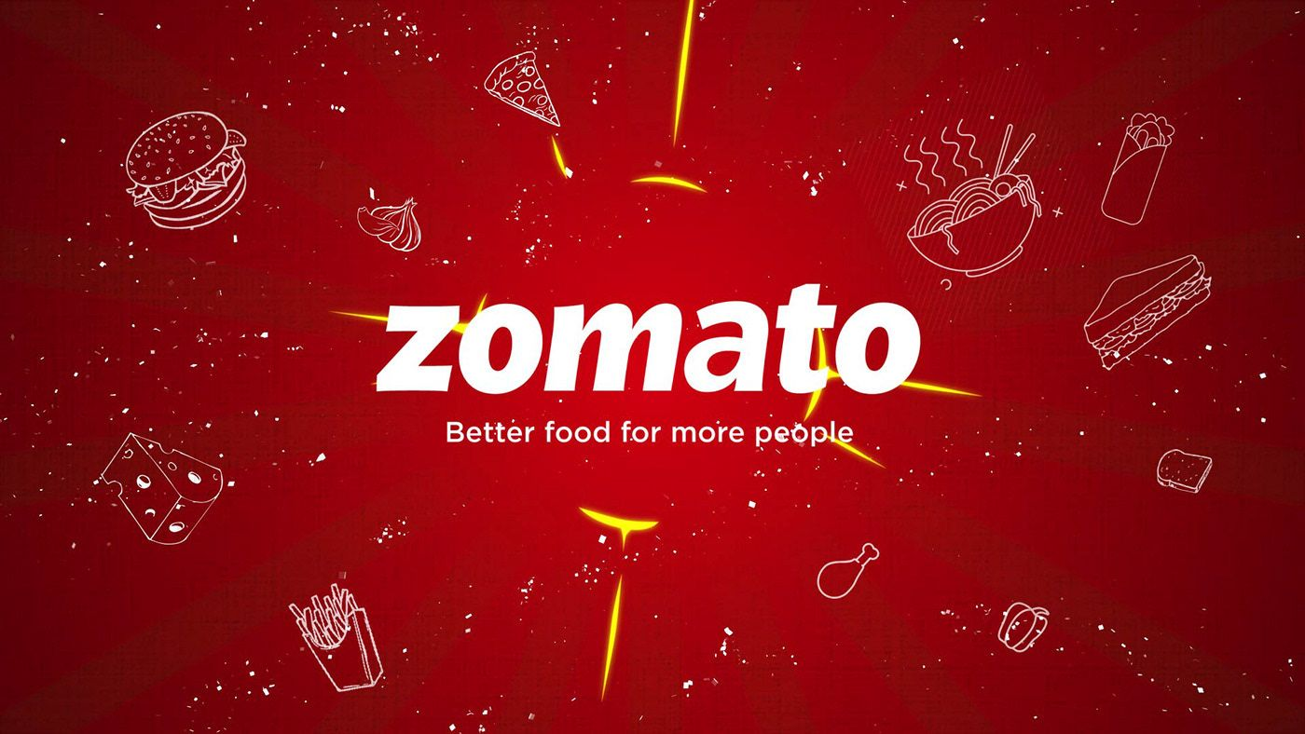
ZOMATO RESTAURANTS ANALYSIS FOR OPENING NEW BRANCH
B VIGNESH 08-06-2024

Slide 2
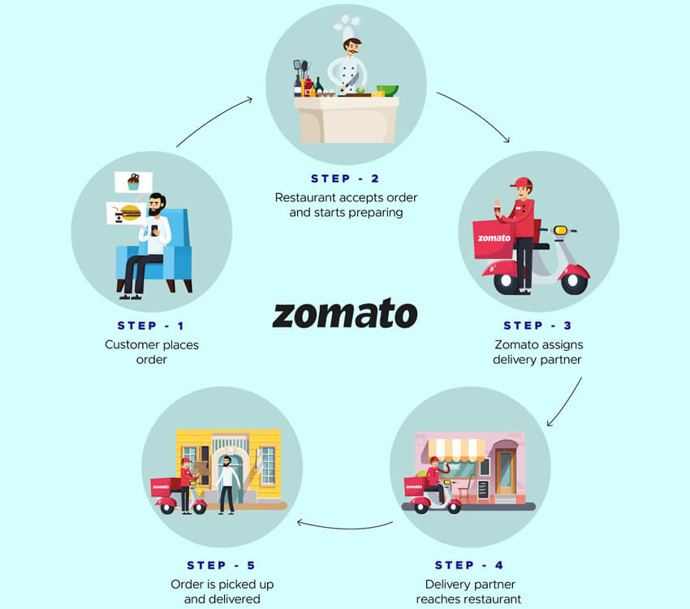
ABOUT ZOMATO
HOW ZOMATO WORKS
Launched in 2010, Our technology platform connects customers, restaurant partners and delivery partners, serving their multiple needs.
Customers use our platform to search and discover restaurants, read and write customer generated reviews and view and upload photos, order food delivery, book a table and make payments while dining-out at restaurants.
On the other hand, we provide restaurant partners with industry-specific marketing tools which enable them to engage and acquire customers to grow their business while also providing a reliable and efficient last mile delivery service.
We also operate a one-stop procurement solution, Hyperpure, which supplies high quality ingredients and kitchen products to restaurant partners.
We also provide our delivery partners with transparent and flexible earning opportunities.

Slide 3


Data Overview
In the dataset, we have information about various restaurants, including their addresses, cuisines served, accepted currencies, availability of online delivery services, whether table booking options are offered, and the average price for a couple dining at each establishment.
This data helps us understand where the restaurants are located, what types of food they offer, how they handle transactions, whether they provide delivery services, if reservations can be made in advance, and how much a typical meal for two might cost.
TOTAL NUMBER OF RESTAURANTS 9551
Total City Have Branch 140
Total Country Have Branch 15
AVG VOTES BY COUNTRY 156.8

Slide 4

Problem Statement
You are hired as a consultant data analyst by zomato where the team is looking for expansion and opening restaurants. Your task is to come up with strategies/suggestions about opening newer restaurants.
In Further slide we will be analysing and suggesting location for opening new branch
DATA CLEANING AND PRE PROCESSING
Fetched country name from country description sheet using lookup and filled the country column in raw data
There are few blank value in the columns which is not needed in our analysis so removed from dataset
Date columns were formatted and year data are extracted for further analysis
This data set gives the detail of restaurants which is located in the different area in the world and what kind of foods are sold on particular area , online delivery is available or not , how many number of new restaurants opened by year wise , rating detail etc…

Slide 5
Global Restaurant Count: Exploring the World's Dining Landscape
In the global restaurant arena, India boasts the highest number of restaurants, while the USA closely follows in second place.
With such a vast presence, competition for opening new restaurants is notably heightened.
Understanding this landscape is crucial for navigating the challenges and seizing opportunities in the culinary industry.

Slide 6
Global Average Votes: Evaluating Consensus Across Borders
In a global survey, Indonesia, the United Arab Emirates, the United States of America, and Turkey emerged as the countries with the highest average number of votes across the world.
Surprisingly, despite its large number of restaurants, India does not top the list in terms of average votes.
This indicates that while India may have numerous restaurants, the level of voter engagement is lower compared to Indonesia, the UAE, USA, and Turkey.
Understanding this distinction is crucial for assessing the dynamics of the restaurant industry in different regions.

Slide 7
Restaurant Openings Over Time: Tracking Growth by Year
From 2010 to 2018, a steady stream of new restaurants emerged onto the global scene.
However, it's noteworthy that the years 2011, 2017, and 2018 stand out as the periods when the highest number of restaurants were opened worldwide.
Conversely, in 2012, 2015, and 2016, although significant numbers of restaurants were established, they appeared relatively lower compared to the peak years of restaurant openings.
Understanding these trends provides valuable insights into the evolving landscape of the restaurant industry over the past decade.

Slide 8
Average Ratings Across Countries: Exploring Culinary Consensus Globally
In terms of average ratings, the Philippines, Indonesia, and Turkey stand out as the top three countries, boasting the highest average ratings for restaurants.
However, India's average rating falls behind, ranking as the lowest among the compared countries.
This highlights significant variations in the quality perception of restaurants across different nations, with the Philippines, Indonesia, and Turkey leading the pack in customer satisfaction.

Slide 9
Restaurant Distribution by Price Range: Analyzing Affordability Across the Market
The distribution of restaurants by price range reveals an interesting trend.
Price ranges 1 and 2 dominate the landscape, boasting the highest counts of restaurants.
Conversely, price range 4 exhibits a notably lower number of establishments.
This disparity underscores the prevalence of more affordable dining options compared to higher-end establishments, reflecting consumer preferences and market dynamics.

Slide 10
Average Expenditure by Country: Assessing Dining Habits Worldwide
When analyzing the average amount spent per meal by country, a clear contrast emerges.
The Philippines and Singapore top the charts with the highest average expenditure, indicating relatively higher food costs compared to other nations.
Conversely, India and Turkey register lower averages, suggesting more affordable dining options in these countries.
This disparity underscores the diverse economic landscapes and consumer spending habits across different regions.

Slide 11


Restaurant Availability for Online Delivery: Mapping Digital Accessibility in the Dining Industry
Out of the 9542 restaurants in our dataset, only 2451 offer online delivery services.
This means that a significant majority of 7091 restaurants, comprising the majority, do not provide online delivery options.
This highlights the prevailing trend where the majority of restaurants are not actively participating in online delivery services.

Slide 12

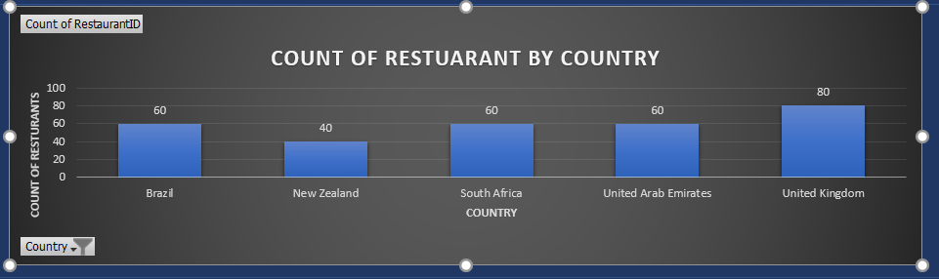
Ideal Locations for Expansion: Identifying Optimal Countries for New Restaurant Branches
Brazil New Zealand South Africa United Arab Emirates United Kingdom
To capitalize on higher competition markets, we're focusing on Brazil, New Zealand, South Africa, United Arab Emirates, and United Kingdom, excluding USA and India.
In these countries, competition is relatively lower, and Zomota already operates over 40 successful restaurants.
Therefore, we see an opportunity to establish new restaurants in these markets.
We're overlooking other countries due to their fewer than 40 existing restaurants and lesser familiarity with Zomota's brand.

Slide 13
Ideal Locations for Expansion: Identifying Optimal States/Cities within Recommended Countries for New Restaurant Branches
Brazil | Sí£o Paulo
 | Rio de Janeiro
 | Brasí_lia
New Zealand | Wellington City
 | Auckland
South Africa | Johannesburg
 | Cape Town
 | Pretoria
 | Sandton
 | Inner City
 | Randburg
United Arab Emirates | Sharjah
 | Abu Dhabi
 | Dubai
United Kingdom | Edinburgh
 | Manchester
 | London
 | Birmingham
We have identified 18 promising states or cities across the suggested countries where new restaurants can be opened.
These selections are based on areas where the average restaurant rating exceeds 4, indicating a thriving dining scene and high levels of customer satisfaction.

Slide 14
Optimal Cuisines for Target Locations: Identifying Recommended Culinary Offerings for Suggested Locations
Based on the country and cities , the cuisines may differ from various locations
From my suggested Country and cities , picked the famous cuisines based on location , so that we can satisfy the customer and can get good feedback and rating as well
Brazil
New Zealand
South Africa
UAE
UK
Asian Fusion, Thai, Chinese, Sushi, Taiwanese , Street Food, European, Café , Mediterranean , Seafood, Kiwi , Asian , Italian , French , Fast Food , Vietnamese, Fish ,Chips , Ice Cream, Desserts , American , Malaysian , Mexican
Patisserie , Japanes Cafe, Bakery, Tea, Vegetarian, Ice Cream, Indian, Asian, Durban, African , Healthy Food, French, Continental ,Burger, Tapas , Spanish , Street Food , American, German, Mexican , Italian, Pizza , Beverages, Mediterranean , Contemporary , European, South African
Italian, Pizza , Seafood ,Thai, Japanese, Indonesian , Lebanese, Filipino, Hyderabadi ,Turkish, Asian, Street Food, Continental , International , Desserts , Fast Food, Pakistani, Indian , Café, Mughlai, South Indian, Biryani , Bakery, Desserts , African, Portuguese , American, Mexican, Burger, North Indian
Mexican , Grill, American , Italian , International , Brazilian, Bar Food, Desserts, Café , Bakery ,Sandwich , Seafood , Lebanese , Japanese , Juices, Healthy Food , Pizza , Beverages, Fast Food , North Eastern , Gourmet Fast Food, Burger , French, Arabian , Steak, BBQ
Mexican, Latin American, Scottish,Bakery,Asian ,Desserts , Pakistani, Curry , Chinese, Dim Sum , Japanese, Sushi , Street Food,Taiwanese,Thai,Argentine, American,British,French,European, Mediterranean, Contemporary , Italian , Indian, Curry , Burger, Café , Steak, Seafood, Grill

Slide 15
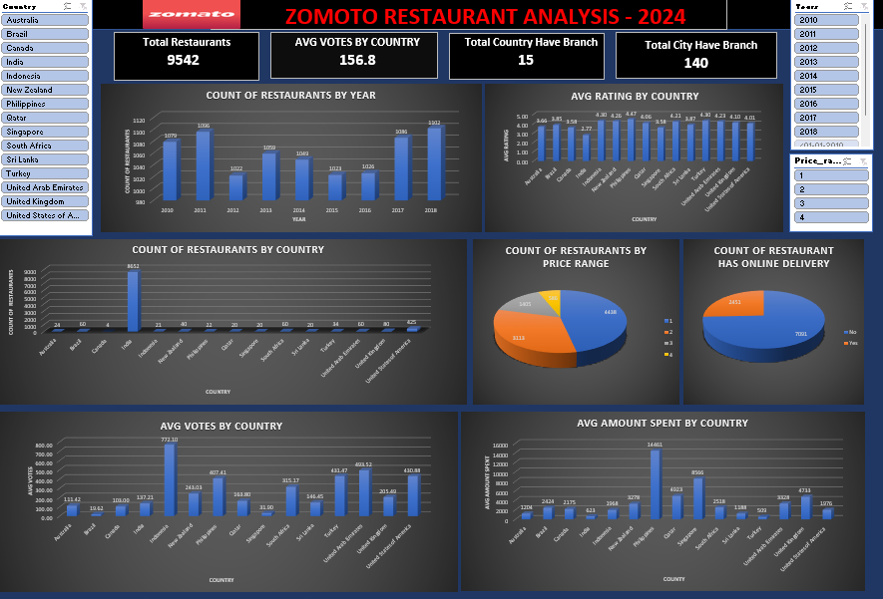
DASHBOARD

Slide 16
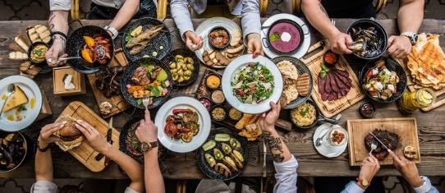
Conclusion
After thorough analysis of the problem statement and considering our objective of expansion and opening new restaurants, we recommend the following countries and cities as suitable locations for launching new branches:
Countries : Brazil, New Zealand ,South Africa ,United Arab Emirates ,United Kingdom
Cities:
São Paulo ,Rio de Janeiro ,Brasília ,Wellington City ,Auckland ,Johannesburg ,Cape Town ,Pretoria , Sandton,Inner City ,Ransburg , Sharjah , Abu Dhabi, Dubai , Edinburgh , Manchester ,London, Birmingham
These selections have been made based on factors such as market potential, customer demand, and favorable business environments, ensuring optimal opportunities for successful expansion and growth.

