Slide 1

M2T
Moto2Travel
A Smart Motorcycle Ownership & Management Platform
Guided By: Mr Vijayasankar
Presented By: Vignesh Biji C
Roll no:49

Slide 2
INTRODUCTION
Motorcycle owners often maintain fuel, service, expense, and vehicle information separately.
Managing records becomes more difficult when owning multiple motorcycles.
Important information such as fuel consumption, mileage, and maintenance history may be difficult to track over time.
M2T centralizes motorcycle ownership data and converts it into useful insights through a web-based dashboard.

Slide 3
PROBLEM STATEMENT
To develop a centralized motorcycle ownership management system that allows users to manage multiple motorcycles and organize fuel, maintenance, expenses, mileage, and ownership data in one platform while providing useful analytical insights.

Slide 4
LITERATURE REVIEW
Paper name | Year | Methodology | Result | Limitation
Systematic Literature Review on Predictive Maintenance of Vehicles and Diagnosis of Vehicle's Health Using Machine Learning Techniques | 2022 | Reviewed machine-learning techniques used for automobile predictive maintenance and vehicle-health diagnosis. The study examined ML methods, extraction of information from on-board diagnostic systems, and challenges faced by predictive models. | The review found that machine learning provides promising approaches for predictive maintenance and vehicle-health analysis, including situations where available vehicle data may be limited. | Predictive maintenance faces problems such as restricted sensor accessibility, limited vehicle data and unavailable design applications, which can make early breakdown prediction difficult.

Slide 5
LITERATURE REVIEW
Paper name | Year | Methodology | Result | Limitation
Vehicle Management System: Fuel, Mileage, Cost, and Maintenance Tracker | 2023 | Developed a vehicle-management system for tracking fuel usage, mileage, vehicle cost and maintenance records. Vehicle-related information is organized within a centralized system so users can monitor operating and maintenance data. | The system demonstrated how fuel, mileage, cost and maintenance information can be brought together for more organized vehicle record management. | Focuses on general vehicle management. It does not provide the broader motorcycle-focused approach proposed in M2T, such as multi-bike ownership profiles and integrated motorcycle ownership analytics.

Slide 6
LITERATURE REVIEW
Paper name | Year | Methodology | Result | Limitation
Impact of Real-World Driving Characteristics on the Actual Fuel Consumption of Motorcycles and Implications for Traffic-Related Air Pollution Control in Vietnam | 2023 | A data logger was installed on motorcycles to collect second-by-second speed and fuel-consumption data under real-world conditions. The collected data was processed and driving parameters, particularly Vehicle Specific Power (VSP), were analyzed against fuel consumption. | The study found a strong relationship between riding characteristics and actual motorcycle fuel consumption. VSP showed a strong relationship with fuel consumption (R² = 0.88), and average motorcycle fuel consumption in the studied Hanoi conditions was 3.01 L/100 km. | The research mainly analyzes fuel consumption and riding characteristics rather than providing a complete motorcycle ownership-management system. The results also relate to the specific real-world operating conditions examined in the study.

Slide 7
LITERATURE REVIEW
Paper name | Year | Methodology | Result | Limitation
On Construction of Real-Time Monitoring System for Sport Cruiser Motorcycles Using NB-IoT and Multi-Sensors | 2024 | Developed an IoT-based motorcycle monitoring system integrating NB-IoT, MQTT, multiple sensors, database management and data visualization. Professional mechanics were also involved in defining required motorcycle data and system architecture. | The system enabled real-time motorcycle monitoring, including observation of inappropriate riding behaviour and mechanical abnormalities. The study indicates that NB-IoT and multi-sensor integration can improve operational monitoring and riding safety. | The approach depends on additional sensors, NB-IoT communication and installed hardware. The authors also identify future work around improving sensor technology and data-processing/transmission efficiency.

Slide 8
GAP IDENTIFIED
Existing research addresses vehicle management, fuel consumption, and predictive maintenance separately.
Vehicle management research demonstrates value of recording fuel, mileage, and maintenance data.
No unified platform combining motorcycle profiles, fuel, maintenance, expenses, and ownership analytics.

Slide 9
PROPOSED SOLUTION
M2T provides a centralized motorcycle ownership platform that:
Maintains multiple motorcycle profiles under one user account
Records fuel transactions and calculates mileage automatically
Tracks service and maintenance history comprehensively
Records motorcycle-related expenses with categorization
Organizes records separately for each motorcycle
Calculates ownership-related metrics and analytics
Provides dashboard-based insights and visualizations

Slide 10
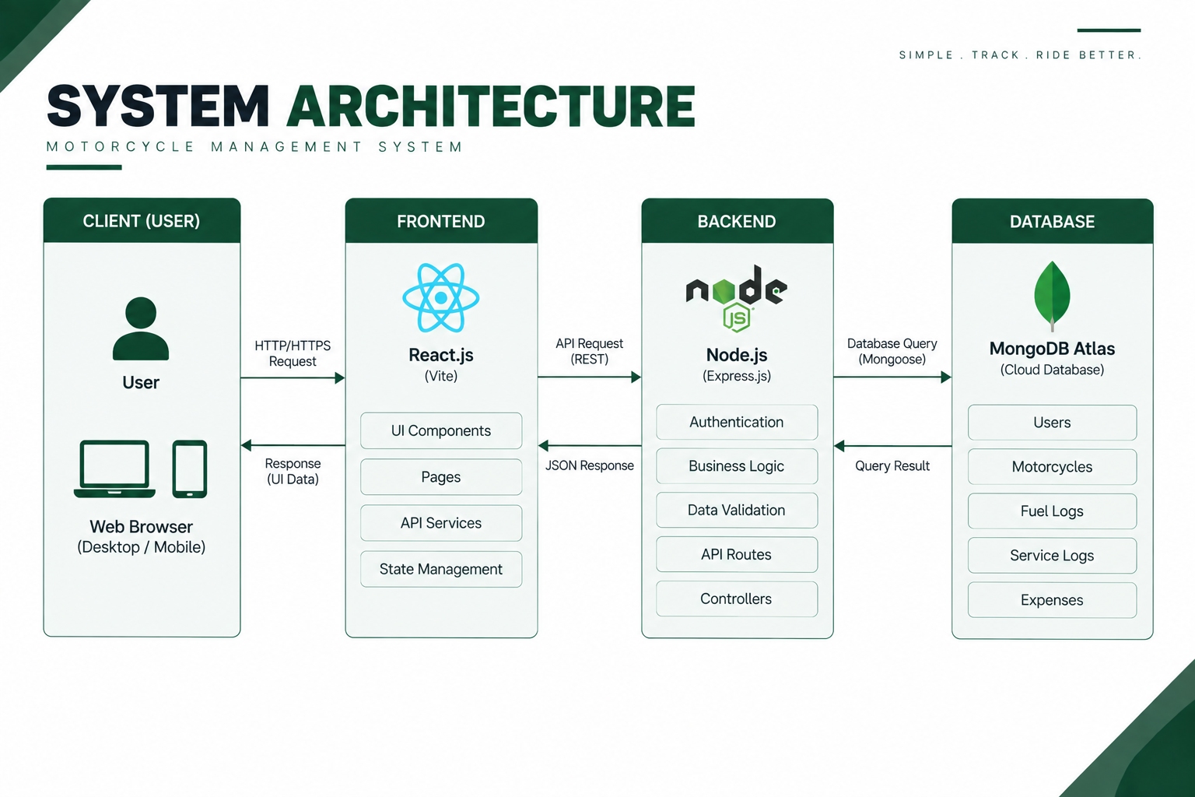

Slide 11
ARCHITECTURE OVERVIEW
M2T follows a web-based client-server architecture.
React.js with Vite provides responsive frontend interface.
Node.js and Express.js handle backend API and business logic.
MongoDB Atlas serves as NoSQL database for all application data.
JWT provides token-based authentication for secure access.
Mongoose acts as data modeling layer between application and database.

Slide 12
MODULE DESCRIPTION
1. Frontend UI
Provides a simple and responsive interface for the motorcycle owner.
Displays motorcycles, fuel records, maintenance, expenses, and dashboard analytics.
2. Authentication Module
Manages user registration and login.
Uses JWT authentication and bcrypt password hashing to secure user access.
3. Motorcycle Management Module
Adds, updates, views, and manages multiple motorcycles under one account.
Stores motorcycle details such as brand, model, year, registration number, engine capacity, and odometer.
4. Fuel Management Module
Records fuel quantity, price, odometer, fuel station, and payment details.
Calculates fuel cost, mileage, distance travelled, and cost per kilometre.

Slide 13
MODULE DESCRIPTION
5. Service & Maintenance Module
Records periodic services, repairs, oil changes, and other maintenance activities.
Tracks service dates, odometer readings, parts cost, labour cost, and total maintenance cost.
6. Expense Management Module
Records motorcycle-related expenses such as accessories, parts, repairs, insurance, and modifications.
Categorizes expenses and tracks overall ownership spending.
7. Database Module
Uses MongoDB Atlas to store user, motorcycle, fuel, service, and expense data.
Uses Mongoose ODM to manage database schemas and relationships.
8. Reports & Analytics Module
Analyzes fuel, mileage, maintenance, and expense records.
Displays ownership insights, trends, and key metrics through the dashboard.

Slide 14
SOFTWARE REQUIREMENTS SPECIFICATION
Purpose
The purpose of M2T (Moto2Travel) is to provide a centralized web-based platform for motorcycle owners to manage and monitor their motorcycle ownership activities.
The system shall allow users to maintain information about multiple motorcycles and record related fuel consumption, mileage, maintenance, service activities and expenses in a structured manner.
The system shall process the collected data and present useful ownership information through dashboards, reports and analytics.
Scope of the System
M2T shall provide the following major capabilities:
User registration and authentication
User profile management
Multiple motorcycle management
Motorcycle information management
Fuel record management
Automatic mileage calculation
Fuel expenditure tracking
Service and maintenance history
Motorcycle-related expense tracking
Dashboard and statistical analysis
Search and filtering
Basic reminders
Secure storage of ownership data
The architecture should also allow future extensions such as predictive maintenance, advanced analytics, email notifications and intelligent recommendations.

Slide 15
SOFTWARE REQUIREMENTS
Operating System: Windows / Linux / macOS
Frontend: React.js with Vite build tool
Backend: Node.js and Express.js framework
Database: MongoDB Atlas (NoSQL)
ODM: Mongoose for data modeling
Authentication: JWT tokens
Security: bcryptjs for password hashing
Version Control: Git & GitHub
Package Manager: npm

Slide 16
HARDWARE REQUIREMENTS
Minimum Development System
Computer/Laptop with dual-core or equivalent processor
Minimum 4 GB RAM, at least 10 GB available storage
Internet connection and modern web browser
Recommended Specifications
8 GB RAM or higher for smooth development
Modern multi-core processor
Stable internet connection
No dedicated motorcycle hardware required for core system

Slide 17
FUNCTIONAL REQUIREMENTS
User Authentication: Provide secure user registration and login using JWT authentication.
Motorcycle Management: Add, update, delete and view multiple motorcycles under a single user account.
Fuel Management: Record fuel purchases with date, quantity, price, odometer and fuel station details.
Mileage Calculation: Calculate mileage, distance travelled and fuel cost per kilometre from fuel records.
Service Management: Record motorcycle service and maintenance activities with date, odometer, parts cost and labour cost.
Expense Management: Record and categorize motorcycle-related expenses such as accessories, repairs, insurance and parts.
Dashboard & Analytics: Display motorcycle information, fuel expenditure, mileage, maintenance costs and ownership insights.
Search & Filter: Search and filter fuel, service and expense records based on motorcycle, date and category.

Slide 18
NON FUNCTIONAL REQUIREMENTS
Performance: The system should provide quick response times and efficient data retrieval.
Security: User passwords shall be securely hashed, and protected resources shall use JWT authentication.
Scalability: The system should support multiple motorcycles and allow future expansion of modules.
Usability: The application should provide simple navigation and easy-to-use forms.
Reliability: The system should provide consistent access to stored motorcycle and ownership records.
Responsiveness: The user interface should adapt to different screen sizes, including desktop and mobile devices.
Maintainability: The system should use a modular architecture to simplify future development and maintenance.

Slide 19
DATA FLOW DIAGRAM

Slide 20
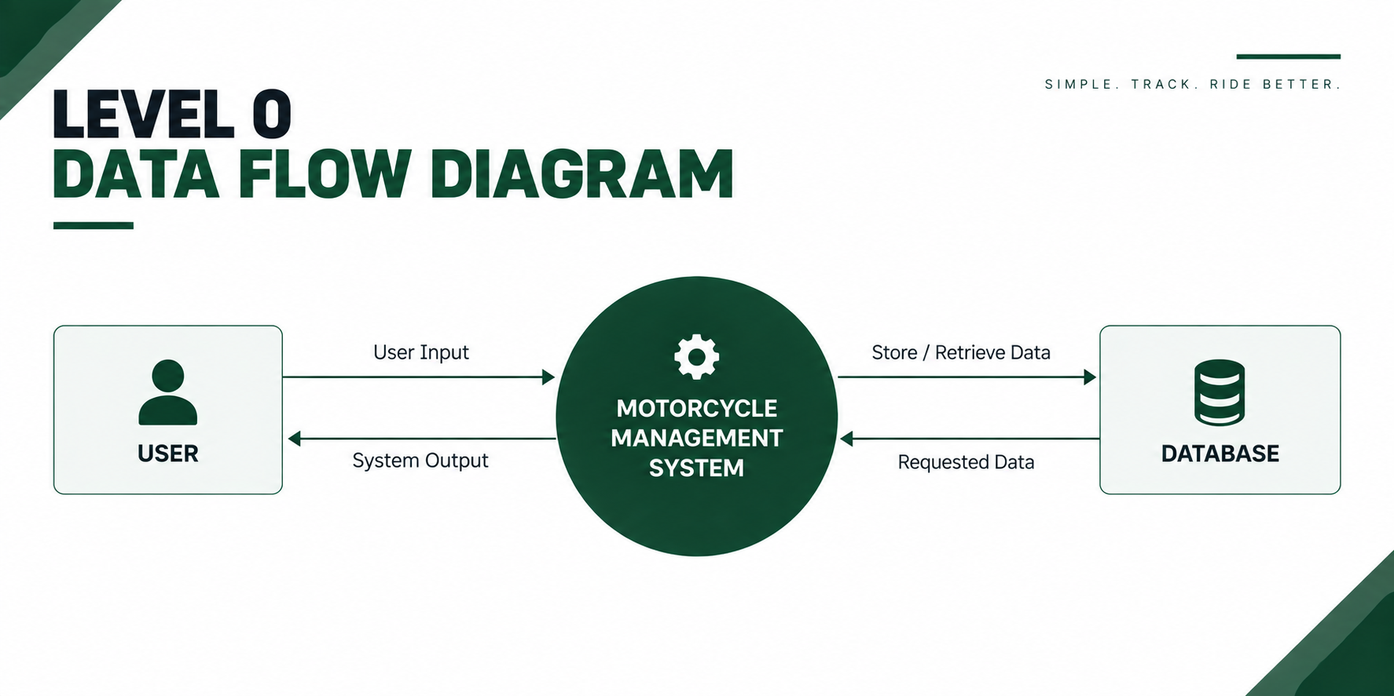

Slide 21
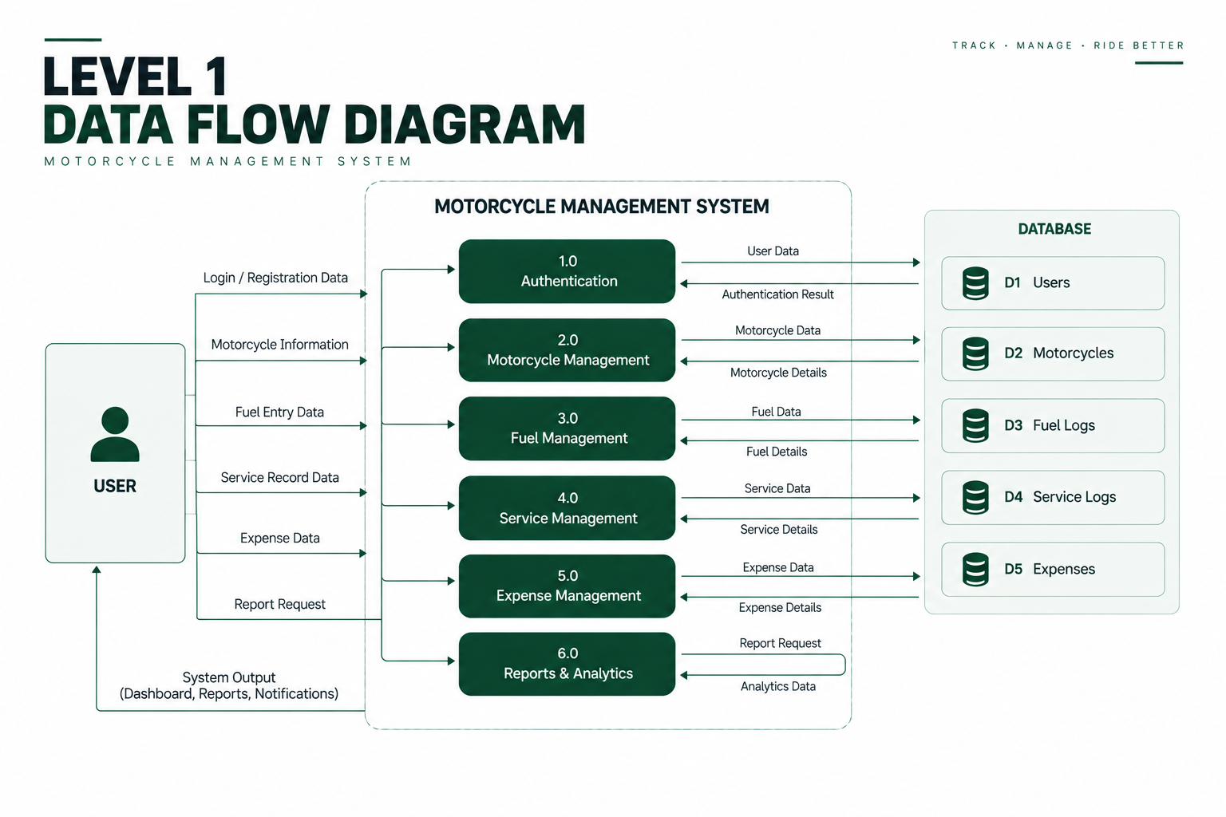

Slide 22
DATABASE REQUIREMENT
Database Type: MongoDB Atlas (NoSQL Document Database)
The database shall store application-related data such as users, motorcycles, fuel logs, service records, and expenses.
The database shall provide secure and organized storage for motorcycle ownership data.
The system shall support adding, updating, deleting, and retrieving application data.
The database shall maintain relationships between users, motorcycles, fuel, service, and expense records.
The database shall support efficient data access for mileage calculations, analytics, dashboard and reports.

Slide 23
RESULT

Slide 24
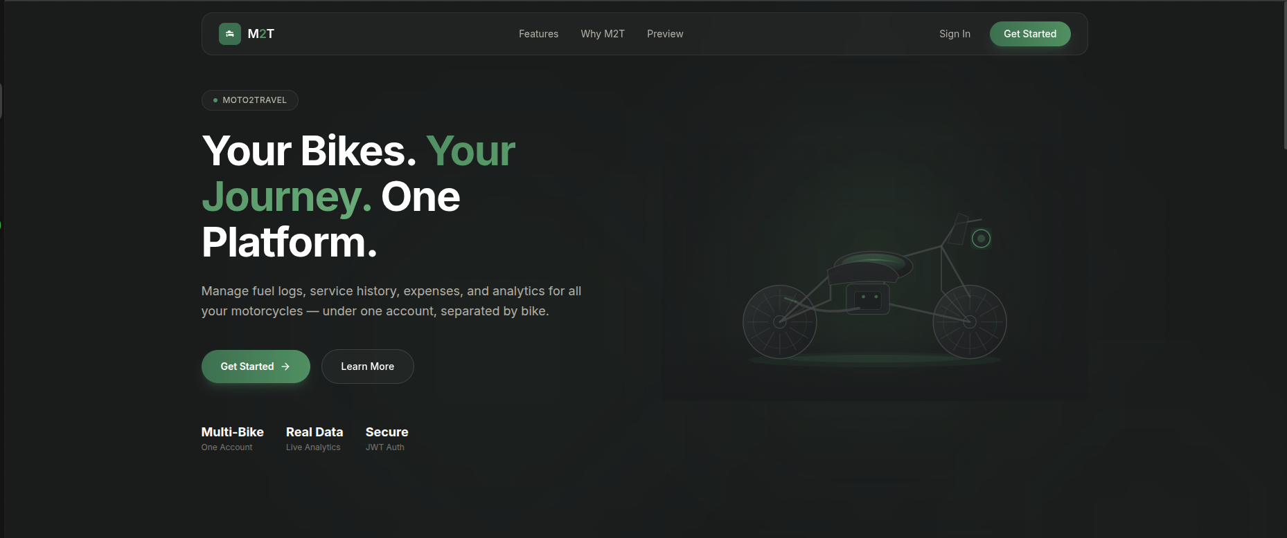

Slide 25
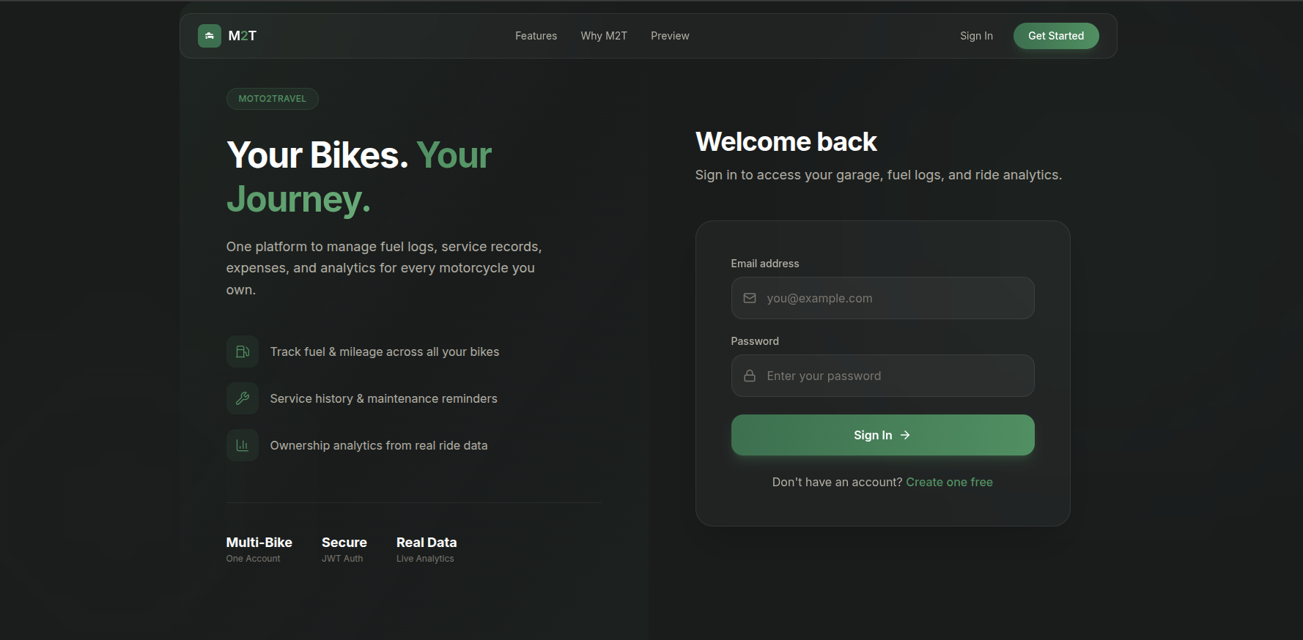

Slide 26
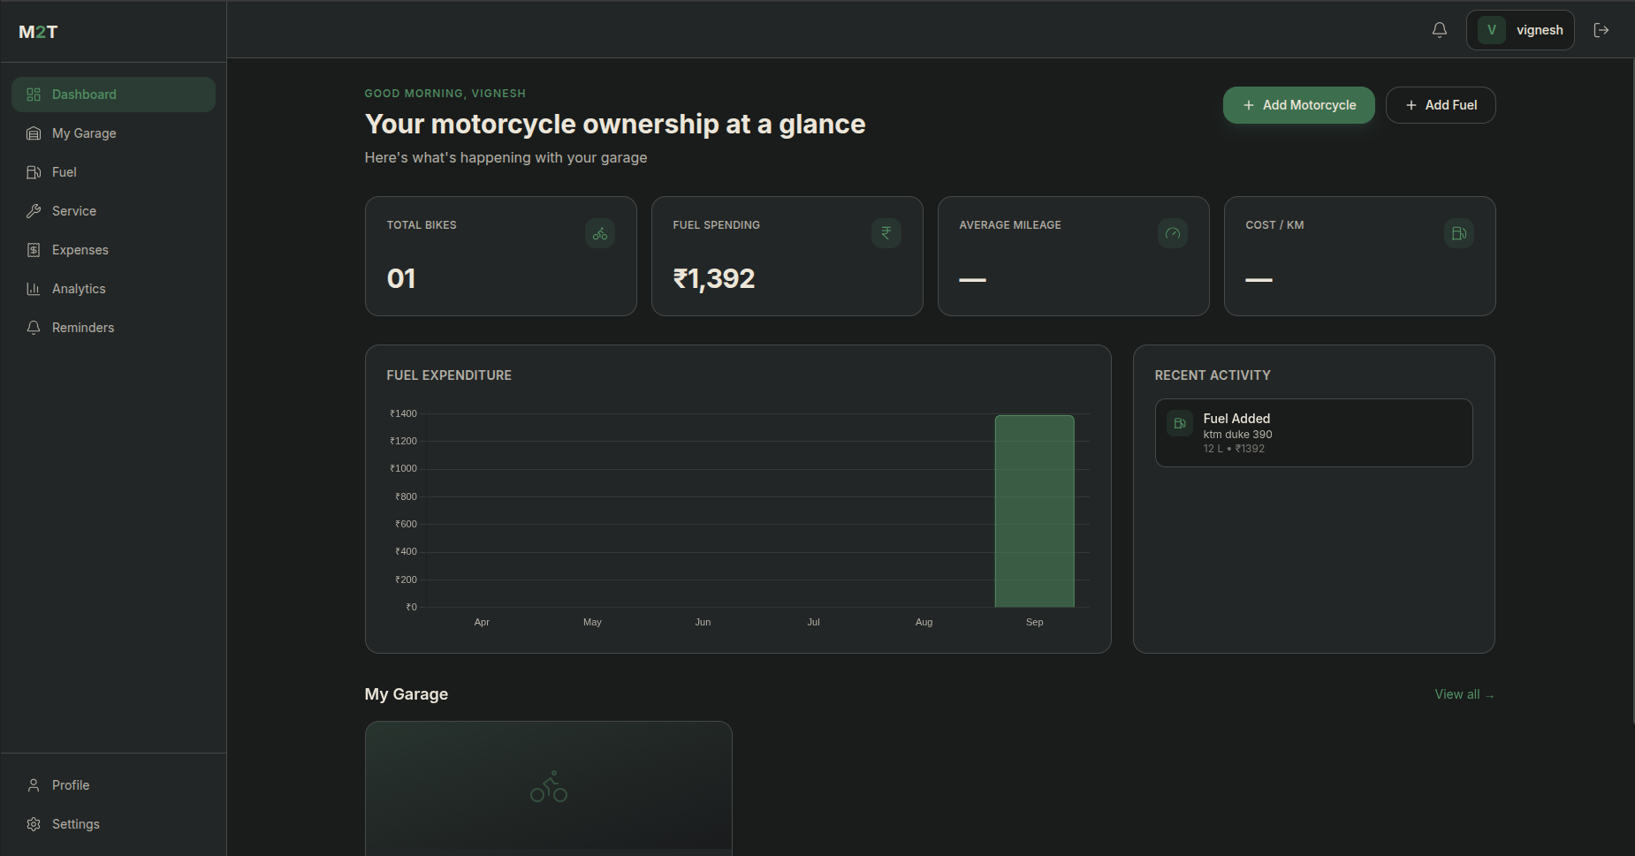

Slide 27
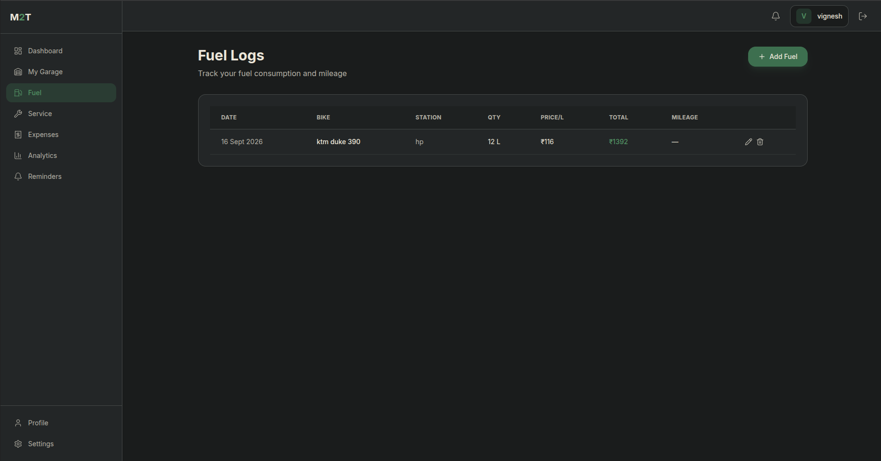

Slide 28
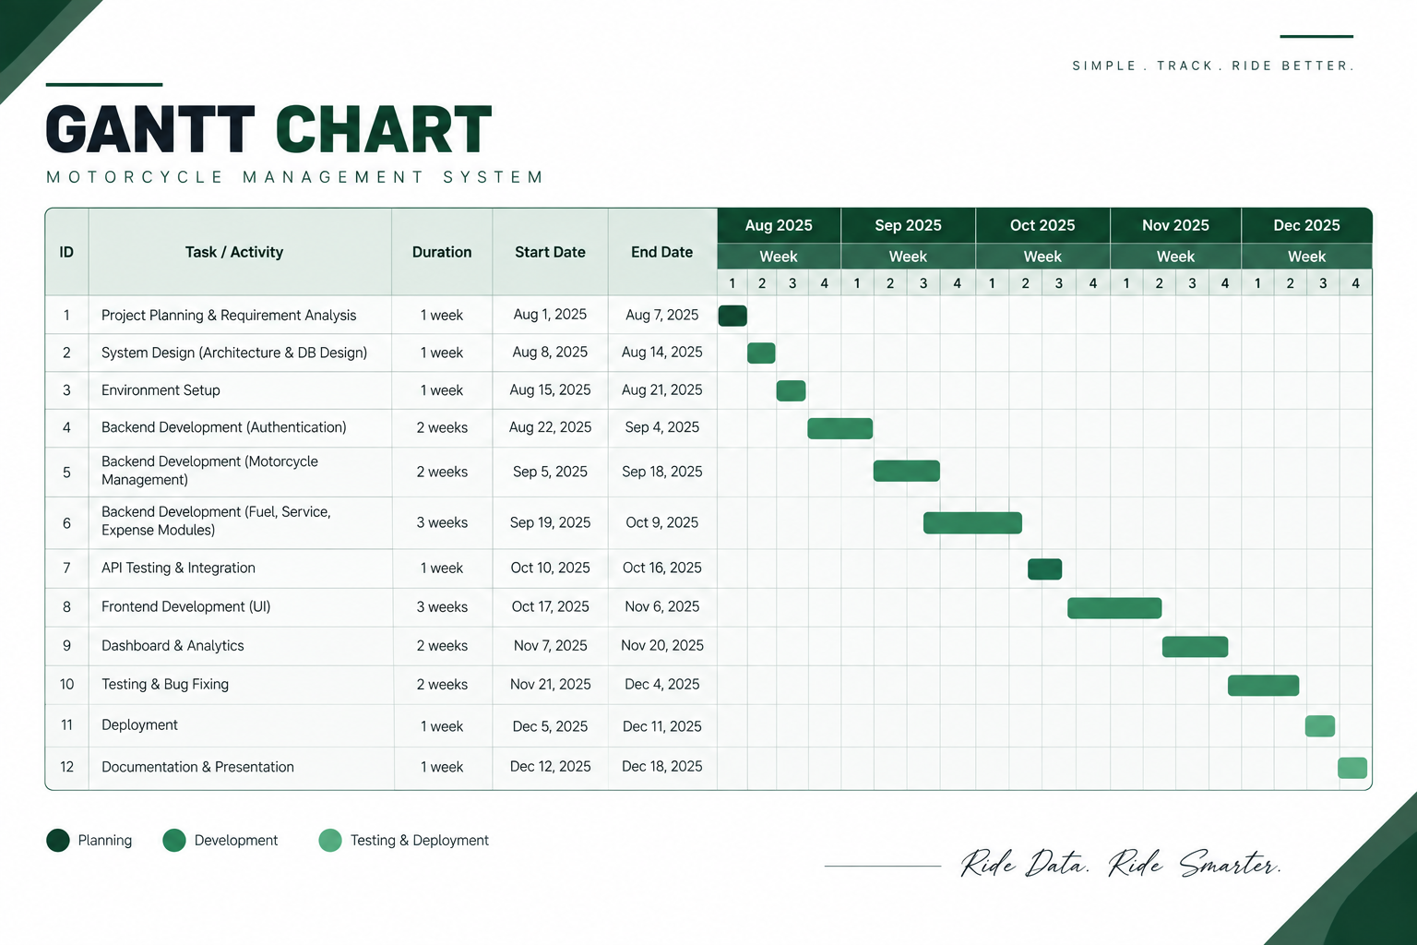

Slide 29
CONCLUSION
M2T (Moto2Travel) provides a centralized platform for motorcycle owners to manage multiple motorcycles, fuel records, maintenance activities, expenses, and ownership data in one place. The system organizes these records and converts them into useful information such as mileage, fuel expenditure, maintenance costs, and ownership insights through a unified dashboard.M2T provides a structured foundation for future enhancements such as service reminders, advanced analytics, predictive maintenance, and rider-focused features.

Slide 30
REFERENCES
Kamolsin, C., Rungkul, W., Limpalasuk, C., et al. (2023). Vehicle Management System: Fuel, Mileage, Cost, and Maintenance Tracker. 2023 International Conference on Cyber Management and Engineering (CyMaEn). DOI: 10.1109/CyMaEn57228.2023.10051089.
Jain, M., Vasdev, D., Pal, K., & Sharma, V. (2022). Systematic Literature Review on Predictive Maintenance of Vehicles and Diagnosis of Vehicle's Health Using Machine Learning Techniques. Computational Intelligence, 38(6), 1990–2008. DOI: 10.1111/coin.12553.
Nguyen, Y.-L. T., Nguyen Duc, K., Le, A.-T., Nghiem, T.-D., & Than, H.-Y. T. (2023). Impact of Real-World Driving Characteristics on the Actual Fuel Consumption of Motorcycles and Implications for Traffic-Related Air Pollution Control in Vietnam. Fuel, 345, 128256. DOI: 10.1016/j.fuel.2023.128256.
Kristiani, E., Yu, T.-H., & Yang, C.-T. (2024). On Construction of Real-Time Monitoring System for Sport Cruiser Motorcycles Using NB-IoT and Multi-Sensors. Sensors, 24(23), 7484. DOI: 10.3390/s24237484.

Slide 31
THANK YOU

