Slide 1
f(x) = ŷ
BCS405A — Discrete Mathematical Structures
Functions in
Machine Learning Models
Group 9 • 4th Semester
Vignesh B S
Rohit Maiya M
Sanskar Patil
Shailesh Nayak
Shreenivas CS

Slide 2
What We'll Cover Today
01
What is a Function? — DMS Foundation
05
Pigeonhole Principle → Model Limitations
02
Cartesian Products → Feature Spaces in ML
06
Function Composition → Neural Network Layers
03
One-to-One (Injective) → Embeddings
07
Inverse Functions → Autoencoders
04
Onto (Surjective) → Classification Coverage
08
Our ML Project Demo

Slide 3


Live ML Demo (https://function-in-ml.streamlit.app)

Slide 4
What is a Function? — DMS Definition
📐 Formal Definition
🤖 In Machine Learning
A function f : A → B is a relation from set A to set B where every element a ∈ A maps to exactly ONE element b ∈ B.
Every ML model IS a function! f : X → Y where X = input features (Domain) and Y = predictions (Codomain)
Domain (A)
Codomain (B)
Set of all valid inputs
Set of all possible outputs
Real ML Examples:
Range
▸ Spam Detector
Email text → Spam / Not Spam
Actual outputs produced by f
▸ Face Recognizer
Image pixels → Person's name
Key Property:
Each input gives exactly one output. No ambiguity — deterministic!
▸ Iris Classifier
Petal/Sepal sizes → Flower species
▸ ChatBot
User message → AI response

Slide 5
Cartesian Products → Feature Spaces in ML
DMS: Cartesian Product
Visual: Iris Feature Space
A × B = {(a, b) | a ∈ A and b ∈ B} Every element is an ordered pair. Example: A={1,2}, B={x,y} A×B = {(1,x),(1,y),(2,x),(2,y)}
F₁ = Sepal Length
{4.3, 4.4 ... 7.9} cm
F₂ = Sepal Width
{2.0, 2.2 ... 4.4} cm
ML: Feature Space
F₃ = Petal Length
Each ML data point is an element of a Cartesian product of feature sets! Iris Dataset: Sepal_Length × Sepal_Width × Petal_Length × Petal_Width × Species_Label Every data row = one ordered tuple (x₁,x₂,x₃,x₄,y)
{1.0, 1.1 ... 6.9} cm
F₄ = Petal Width
{0.1, 0.2 ... 2.5} cm
Y = Species
{Setosa, Versicolor, Virginica}
Input Space = F₁ × F₂ × F₃ × F₄ Output = Y

Slide 6
Types of Functions — DMS to ML Mapping
1→1
→All
⇌
f(x)
One-to-One (Injective)
Onto (Surjective)
Bijective (Both)
Plain Function
📐 DMS
📐 DMS
📐 DMS
📐 DMS
Different inputs map to different outputs. f(a)=f(b) ⟹ a=b
Every element in codomain is covered. Range = Codomain
One-to-One AND Onto. Perfect pairing of A and B elements
Each input has exactly one output (basic requirement)
🤖 In ML
🤖 In ML
🤖 In ML
🤖 In ML
Embeddings & Encoders Each data point gets a unique representation
Good Classifiers All classes get predicted (no dead outputs)
Invertible Networks Autoencoders that can perfectly reconstruct
All ML Models Deterministic prediction for every input

Slide 7
One-to-One (Injective) Functions → Embeddings in ML
DMS: Injective Function
Other ML Injective Examples
Face Embeddings (FaceNet)
f : A → B is injective (one-to-one) if: f(a₁) = f(a₂) ⟹ a₁ = a₂ No two different inputs give the same output. Each output 'fingerprints' its unique input.
Each person's face → unique 128-d vector
Image Encoders (VAE)
Each image → unique latent code z
Graph Embeddings (node2vec)
ML: Word Embeddings (Word2Vec)
Each graph node → unique embedding
Each word → unique vector in ℝⁿ space "cat" → [0.21, -0.45, 0.88, ...] "dog" → [0.19, -0.41, 0.91, ...] "bank" → [0.72, 0.33, -0.12, ...] Different words = different vectors (injective!) Similar words = nearby vectors (bonus property)
Why Injectivity Matters
✔ Unique representations prevent confusion ✔ Model can distinguish between all inputs ✔ Information is preserved (no data loss) ✔ Enables reconstruction (inverse possible) ✗ May need high-dimensional output space

Slide 8
Onto (Surjective) Functions → Classification in ML
DMS: Surjective Function
Surjective vs Non-Surjective ML
f : A → B is surjective (onto) if: ∀b ∈ B, ∃a ∈ A such that f(a) = b Every element of the codomain B is hit by at least one input from A. Range = Codomain
✅ Surjective Classifier
Training data → Model predicts all 3 classes Setosa ✔ Versicolor ✔ Virginica ✔ All outputs are reachable → Useful model
ML: Multi-class Classification
A good classifier is surjective: Classes = {Setosa, Versicolor, Virginica} For EVERY class, the model must be capable of predicting it — otherwise that class is 'dead' (unreachable output). Softmax output layer ensures surjectivity: All class probabilities sum to 1.0
❌ Non-Surjective (Bad) Classifier
Imbalanced training data → Model never predicts 'Virginica' (dead class) Virginia ✗ — output unreachable! Bias in training causes surjectivity failure

Slide 9
The Pigeonhole Principle → ML Model Limitations
DMS Pigeonhole Principle:
If n+1 pigeons are placed into n holes, at least one hole contains 2 or more pigeons.
Compression Cannot Be Lossless for All Inputs
Classifiers Must Misclassify Some Inputs
If a compressor maps 1000-bit inputs to 999-bit codes, by pigeonhole: ≥2 inputs share the same code. Some data MUST be lost. ML models compressing high-dim → low-dim always have this limit.
If input space |X| > output classes |Y|, by pigeonhole: multiple inputs share one output. The model cannot perfectly distinguish ALL inputs. This is why 100% test accuracy is suspicious!
Dimensionality Reduction (PCA, t-SNE)
Hash Collisions in Feature Hashing
Reducing 784 pixels → 2D for visualization: Many different images map to the same 2D point. Pigeonhole guarantees information loss. We accept this trade-off for visualization.
NLP trick: hash words → fixed-size vector. If vocabulary (10000 words) > buckets (1000), pigeonhole guarantees collisions. Designed intentionally but mathematically proven.

Slide 10
Function Composition → Neural Network Layers
DMS: (g ∘ f)(x) = g(f(x))
Apply f first, then apply g to the result. Composition is NOT commutative: g∘f ≠ f∘g in general.
Input Layer
Hidden Layer 1
Hidden Layer 2
Output Layer
Prediction
x ∈ ℝ⁴
f₁(x)= ReLU(W₁x+b₁)
f₂(·)= ReLU(W₂·+b₂)
f₃(·)= Softmax(W₃·+b₃)
ŷ ∈ {0,1,2}
Sepal/Petal measurements
Feature detector
Higher-order patterns
Class probabilities
Setosa / Versicolor / Virginica
Complete Model = f₃ ∘ f₂ ∘ f₁ (x) = f₃(f₂(f₁(x)))
← DMS Composition!
Order matters! Changing layer order gives different results. Matches DMS property: g∘f ≠ f∘g
Key DMS Theorem Applied:
If f:A→B and g:B→C, then (g∘f):A→C | Neural Network is a chain of function compositions mapping raw input to prediction!

Slide 11
Inverse Functions → Autoencoders & Decoders
DMS: Inverse Function
Autoencoder as Inverse Function
If f : A → B is bijective, then f⁻¹ : B → A satisfies: f⁻¹(f(a)) = a and f(f⁻¹(b)) = b Only BIJECTIVE functions have true inverses. Injective-only functions have left inverses.
Input x (784 pixels)
Encoder E(x) → Z (32-dim)
ML: Autoencoder Architecture
Latent Code z
Encoder: E : X → Z (compress to latent space) Decoder: D : Z → X (reconstruct from latent) D ∘ E ≈ Identity function! D(E(x)) ≈ x ← This IS the inverse! Used for: ▸ Image denoising ▸ Anomaly detection ▸ Feature learning ▸ Data generation (VAE)
Decoder D(z) → X̂
Output X̂ (784 pixels)
Loss = ||x - D(E(x))||² → 0 Minimize reconstruction error ≡ Making D = E⁻¹

Slide 12
Our ML Project — Iris DMS Function Visualizer
🌸 Iris Flower Classifier — Every DMS Concept Shown Live
📐 Cartesian Product
🔢 Function f: X → Y
1→1 Injective Layer
→All Surjective Output
4 features = F₁×F₂×F₃×F₄ Input space shown as feature matrix
Neural net as deterministic mapping: input → species
Hidden layer creates unique embedding per data point
Softmax predicts all 3 classes; no dead class outputs
f∘g Composition
f⁻¹ Inverse (Bonus)
🐦 Pigeonhole Demo
📊 Live Accuracy
Visualize layer-by-layer transformation of data
Autoencoder reconstructs original features from embedding
Show why 4D→2D projection loses info (PCA visualization)
Test set results, confusion matrix, class coverage check
Tech Stack: Python • scikit-learn • TensorFlow/Keras • Matplotlib • NumPy • Pandas

Slide 13
DMS ↔ Machine Learning — Concept Map Summary
DMS Concept
Mathematical Definition
ML Application
Our Project Example
Plain Function f:A→B
Each a∈A → exactly one b∈B
Any ML Model
Iris Neural Network
Cartesian Product A×B
Set of all ordered pairs from A,B
Feature Space / Dataset
4-feature Iris input
Injective (1-to-1)
f(a₁)=f(a₂) ⟹ a₁=a₂
Embeddings, Encoders
Hidden layer vectors
Surjective (Onto)
∀b∈B, ∃a∈A: f(a)=b
Good Classifiers
Softmax all 3 classes
Bijective
Both 1-to-1 and Onto
Invertible Networks
Autoencoder Demo
Function Composition
(g∘f)(x) = g(f(x))
Deep Neural Networks
3-layer composition
Inverse Function f⁻¹
f⁻¹(f(a))=a for bijective f
Autoencoder Decoder
Reconstruction from z
Pigeonhole Principle
n+1 pigeons, n holes → collision
Model Limits, PCA loss
4D→2D PCA demo

Slide 14
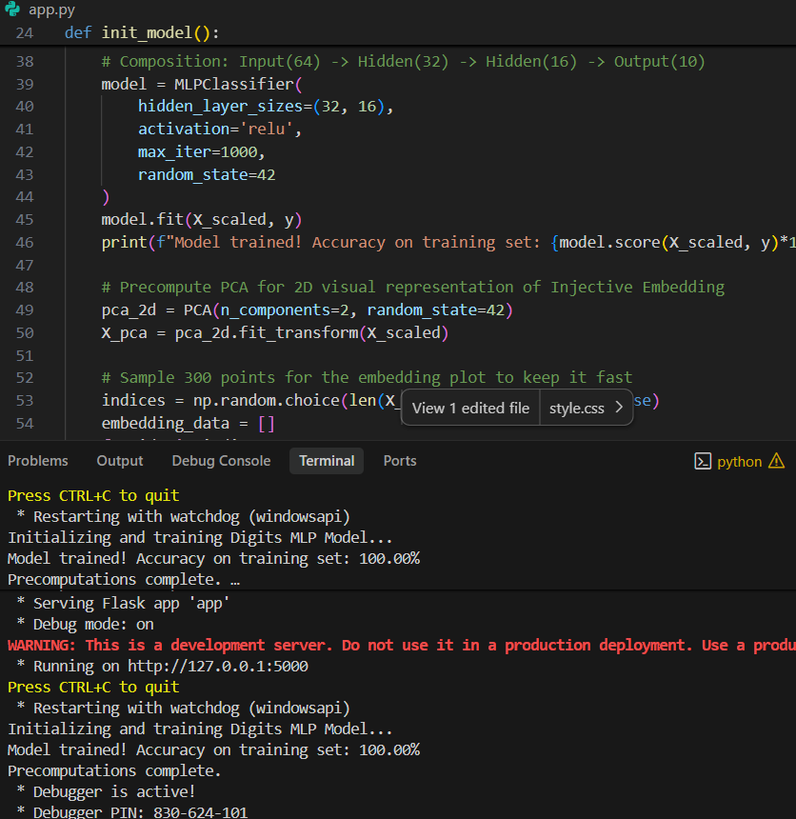
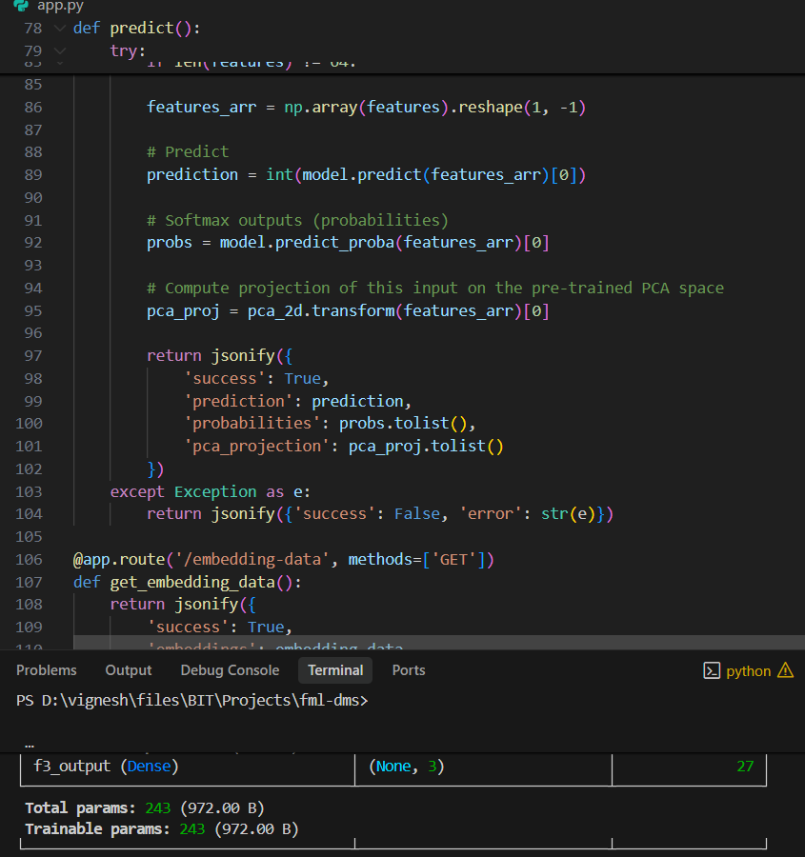
ML Model Code (https://github.com/vigneshbs33/fml-dms)

Slide 15
Thank You!
Questions & Answers
Group 9
Vignesh B S • Rohit Maiya M • Sanskar Patil • Shailesh Nayak • Shreenivas CS
BCS405A — Discrete Mathematical Structures 4th Semester |
Key Takeaway:
Every Machine Learning model is fundamentally a composition of mathematical functions. DMS concepts — injectivity, surjectivity, composition, and inverses — are not just theory. They are the mathematical backbone of every AI system we build today.

