Slide 1
Ayurvedic Diet Recommendation System
M.Aditi Madhumitha-24N31A05Q5
M.Vennela-24N31A05Q6
K. Ragya Naik-24N31A05L0

Slide 2
ABSTRACT
The Ayurvedic Diet Recommendation System is a web-based application developed to provide personalized diet suggestions based on a user’s health information. The system collects basic details such as name, age, height, weight, and selected health issues, and then calculates the user’s Body Mass Index (BMI) to determine their health category. Based on this information, the application recommends suitable Ayurvedic food items and suggests foods that should be avoided for better health management. The system is developed using Python with the Flask framework, along with HTML and CSS for the user interface, and SQLite database to store patient details and health records. The main goal of this application is to promote healthier dietary habits using Ayurvedic principles while providing a simple, efficient, and user-friendly platform for users.

Slide 3
Introduction
The application recommends Ayurvedic diet plans based on user health conditions.
Users enter name, age, height, weight and health issues.
The system calculates BMI and suggests foods to eat and avoid.
Patient details are stored in a database.

Slide 4
Existing System
Patient records are maintained using paper files.
Diet suggestions are given manually by dieticians.
Managing large patient records is difficult.
Paper records can be lost or damaged.

Slide 5
Proposed System
A web application that automates Ayurvedic diet recommendations.
Users enter health information through a digital form.
The system calculates BMI and suggests diet automatically.
Patient data is stored in a database.

Slide 6
Software Tools Used
Frontend: HTML, CSS, JavaScript
Backend: Python (Flask)
Database: SQLite
IDE: Visual Studio Code
Version Control: GitHub
Browser: Chrome,edge

Slide 7
UML Diagrams

Slide 8
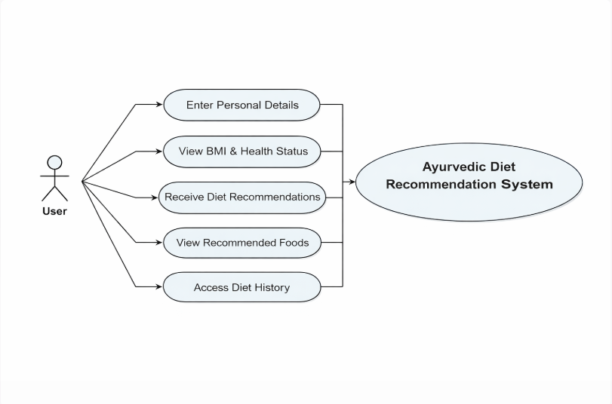
Use Case Diagram

Slide 9
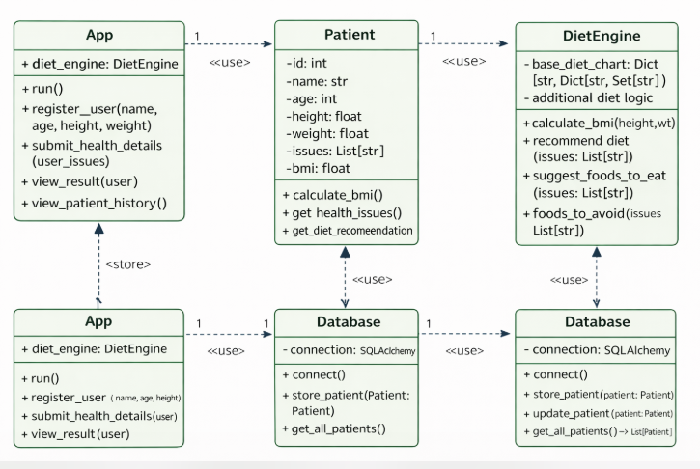
Class Diagram

Slide 10
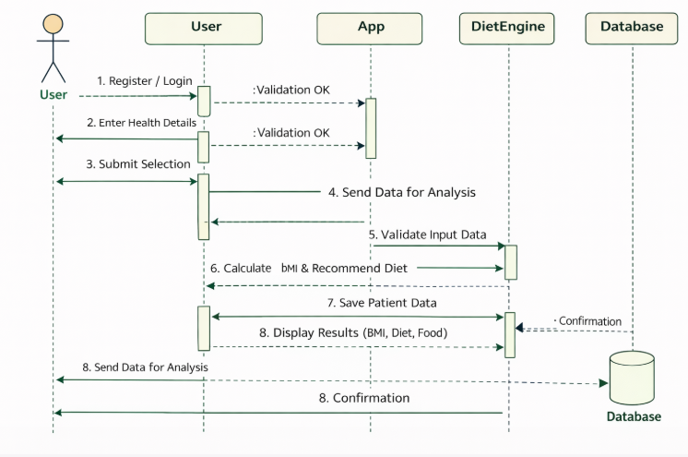
Sequence Diagram

Slide 11
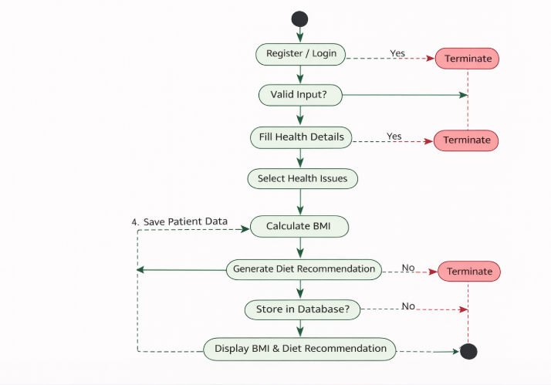
Activity Diagram

Slide 12
THANK YOU

