Slide 1
Multi-Model Machine Learning Approach to Predicting Employee Salaries
CAPSTONE PROJECT
Presented By:
Student Name : Mara Vignesh
College Name : MITS Deemed to be University
Department : CSE- Artificial Intelligence
AICTE Id : STU676ea855e4fc01735305301

Slide 2
OUTLINE
Problem Statement (Should not include solution)
System Development Approach (Technology Used)
Algorithm & Deployment (Step by Step Procedure)
Result
Conclusion
Future Scope(Optonal)
References

Slide 3
Problem Statement
Pay Disparity Despite Similar Roles Organizations face challenges in ensuring equitable compensation, where employees with comparable experience, roles, and qualifications often receive significantly different salaries, leading to perceptions of unfairness and workplace dissatisfaction.
Bias in Salary Decision-Making Unconscious biases related to gender, age, or educational background can influence compensation decisions, resulting in systemic inequality and reduced trust in HR practices.
Inconsistent Salary Benchmarking HR departments struggle to benchmark salaries consistently due to rapidly changing industry standards, diverse job functions, and varying regional compensation trends.
Impact on Employee Retention and Morale Unstructured or poorly managed salary frameworks can lead to reduced motivation, lower job satisfaction, and higher employee turnover—especially when pay progression is unclear or perceived as unfair.
Complexity in Determining Competitive Offers Determining an optimal and fair salary for new hires or promotions is complex, requiring analysis of multiple variables such as location, market demand, role value, and internal parity—often resulting in inefficiencies or missed hiring opportunities.

Slide 4
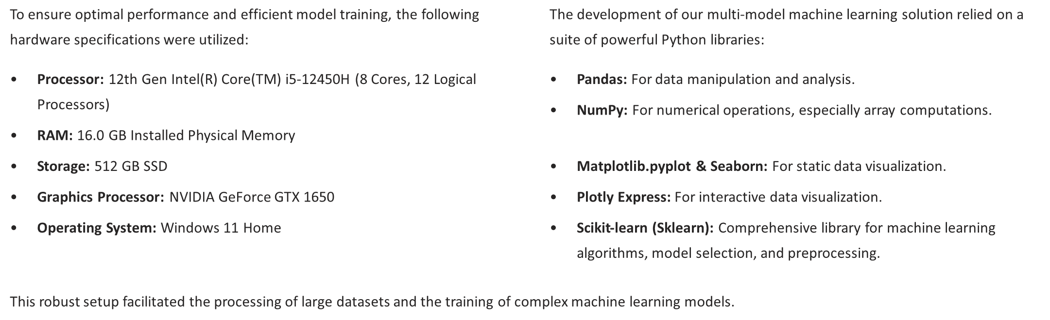
System Approach

Slide 5
Algorithm & Deployment
1. Problem Definition
Code : # Sample definition of target and features
target = 'Salary’
features = ['Experience', 'Education_Level', 'Role’]
2.Import the data set and checks head ,tail and shape of the data
# Import the dataset
data = pd.read_csv("Salary Data.csv")
# Take a look at the first ten rows of the dataset
data.head(10)
# Display the last three rows of the dataset
data.tail(3) # Display the shape of the dataset
data.shape
3.Compare the age distribution with mean and median
# Compute statistics
mean_age = data['Age'].mean()
median_age = data['Age'].median()

Slide 6
Algorithm & Deployment
# Create histogram
fig = px.histogram(
data_frame=data,
x="Age",
nbins=20,
title="📊 Age Distribution with Mean and Median",
template="plotly_dark",
labels={"Age": "Age of Individuals"},
color_discrete_sequence=["#00BFFF"] # Light Blue
) # Add mean line (Green)
fig.add_vline(
x=mean_age,
line_dash="dash",
line_color="lime",
line_width=2,
annotation_text=f"📈 Mean: {mean_age:.1f}",
annotation_position="top left",
annotation_font_color="lime",
annotation_bgcolor="rgba(0,255,0,0.2)"
)

Slide 7
Algorithm & Deployment
# Add median line (Red)
fig.add_vline(
x=median_age,
line_dash="dot",
line_color="red",
line_width=2,
annotation_text=f"📊 Median: {median_age:.1f}",
annotation_position="top right",
annotation_font_color="red",
annotation_bgcolor="rgba(255,0,0,0.2)"
)
# Update layout for better readability
fig.update_layout(
xaxis_title="Age of Individuals",
yaxis_title="Number of People",
title_font=dict(size=24),
font=dict(size=14),
bargap=0.1,
title_x=0.5,
legend=dict(orientation="h", y=-0.2)
)
fig.show()
4. Gender Distribution in Dataset :
gender = data["Gender"].value_counts(normalize=1) * 100
gender.apply(lambda x: f"{x:0.2f}%")

Slide 8
Algorithm & Deployment
# Create bar chart
fig = px.bar(
data_frame=gender,
x=gender.index,
y=gender.values,
color=gender.index,
title="👥 Gender Distribution in Dataset (in %)",
labels={"x": "Gender", "y": "Percentage"},
color_discrete_sequence=["#45FFCA", "#FF9B9B"],
template="plotly_dark",
text=gender.apply(lambda x: f"{x:.1f}%")
) # Update layout for better readability
fig.update_layout(
title_font_size=24,
title_x=0.5,
xaxis_title="Gender",
yaxis_title="Frequency (%)",
font=dict(family="Arial", size=14),
plot_bgcolor="rgba(0,0,0,0)",
paper_bgcolor="rgba(0,0,0,0)",
showlegend=False
# Update text and hover styling
fig.update_traces(
textposition="outside",
textfont=dict(size=16, family="Arial", color="#FFFFFF"),
hovertemplate="Gender: %{x}<br>Percentage: %{y:.1f}%"
) # Show the plot
fig.show()

Slide 9
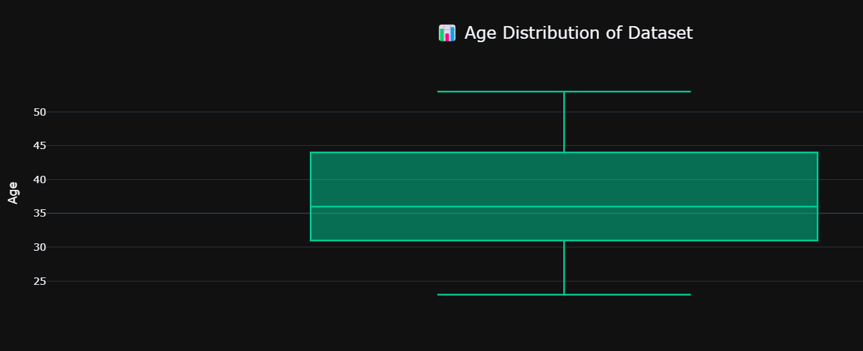
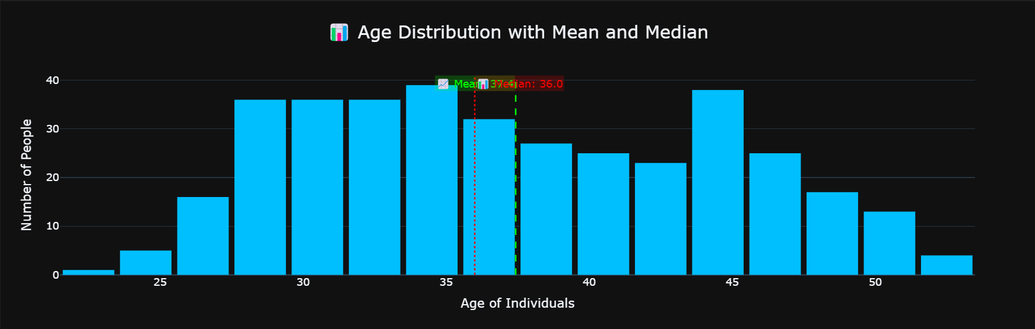
Result

Slide 10
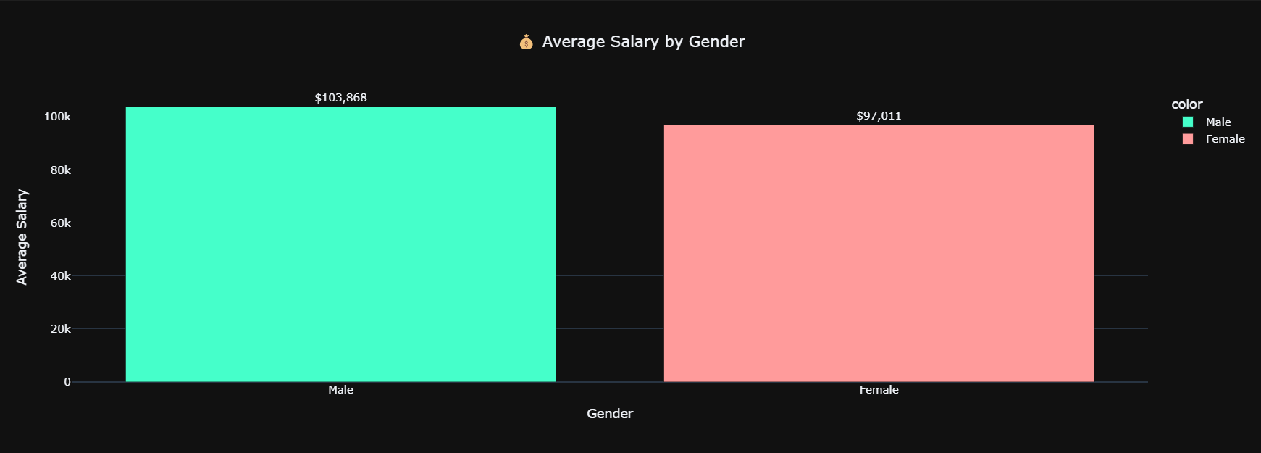
Result

Slide 11
Algorithm & Deployment
5.Education Level Distribution :
education = data["Education Level"].value_counts(normalize=1) * 100
education.apply(lambda x: f"{x:0.2f}%")
#Create the bar chart with increased height
fig = px.bar(
x=education.index,
y=education.values,
color=education.index,
text=education.apply(lambda x: f"{x:.1f}%"),
title="🎓 Education Level Distribution (in %)",
labels={"x": "Education Level", "y": "Percentage"},
color_discrete_sequence=px.colors.qualitative.Set3,
template="plotly_dark",
height=600 # <- Increased height here
)
#Update layout for clarity
fig.update_layout(
title_x=0.5,
font=dict(family="Arial", size=14),
xaxis_title="Education Level",
yaxis_title="Frequency (%)",
showlegend=False,
plot_bgcolor="rgba(0,0,0,0)"
)

Slide 12
Algorithm & Deployment
#Improve trace appearance
fig.update_traces(
textposition="outside",
textfont=dict(size=14, color="white"),
hovertemplate="Education Level: %{x}<br>Percentage: %{y:.2f}%"
)
#Show the chart
fig.show()
6.Calculating Average Salary by Gender :
salary_by_gender = data.groupby("Gender")["Salary"].mean().sort_values(ascending=False)
salary_by_gender.apply(lambda x: f"${x:,.2f}")
# Step 2: Create bar chart
fig = px.bar(
x=salary_by_gender.index,
y=salary_by_gender.values,
color=salary_by_gender.index,
title="💰 Average Salary by Gender",
labels={"x": "Gender", "y": "Average Salary"},
color_discrete_sequence=["#45FFCA", "#FF9B9B"],

Slide 13
Algorithm & Deployment
template="plotly_dark",
text=salary_by_gender.apply(lambda x: f"${x:,.0f}")
)
# Step 3: Customize layout and hover
fig.update_layout(
title_x=0.5,
yaxis_title="Average Salary",
xaxis_title="Gender",
height=500
)
fig.update_traces(
textposition='outside',
hovertemplate="Gender: %{x}<br>Avg Salary: $%{y:,.0f}"
)
fig.show()
7. Calculating Average Salary via Education Level :
salary_by_education = data.groupby("EducationLevel")["Salary"].mean().round(2).sort_values(ascending=False)
salary_by_education.apply(lambda x: f"${x:,.2f}")
fig = px.bar(
x=salary_by_education.index,
y=salary_by_education.values,
color=salary_by_education.index,
title="🎓 Average Salary via Education Level",
labels={"x": "Education Level", "y": "Average Salary"},

Slide 14
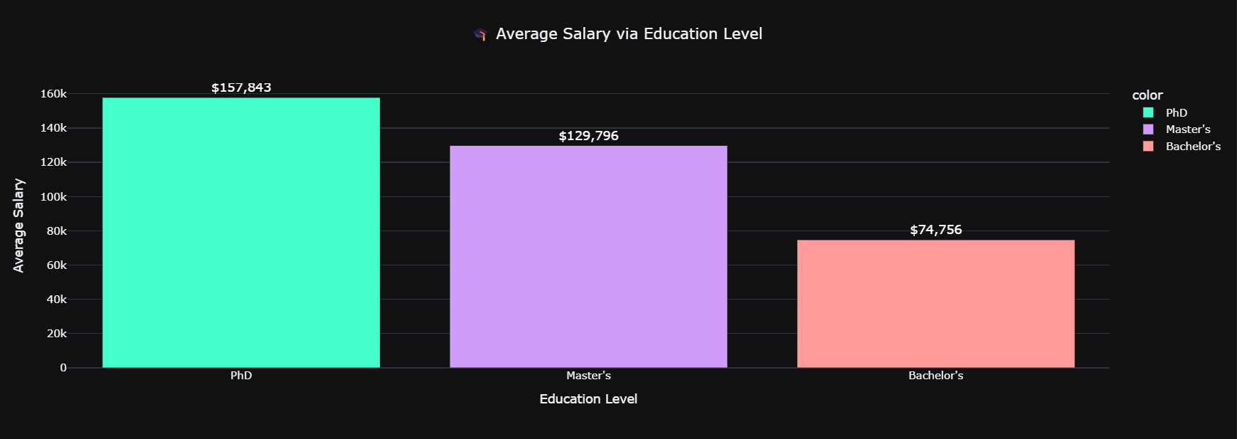
Result

Slide 15
Algorithm & Deployment
color_discrete_sequence=["#45FFCA", "#D09CFA", "#FF9B9B"], # Adjust as needed
template="plotly_dark",
text=salary_by_education.apply(lambda x: f"${x:,.0f}"))
fig.update_layout(
title_x=0.5,
yaxis_title="Average Salary",
xaxis_title="Education Level",
height=500 )
fig.update_traces(
textposition='outside',
textfont=dict(size=14, color="#FFFFFF"),
hovertemplate="Education: %{x}<br>Avg Salary: $%{y:,.0f}")
fig.show()
8. Calculating Average Salary by Experience Range :
# To Convert Years of Experience into 5 Categories
def groupping_exp(exp):
if exp >= 0 and exp <= 5:
return "0-5 years"
elif exp > 5 and exp <= 10:
return "6-10 years"
elif exp > 10 and exp <= 15:
return "11-15 years"
elif exp > 15 and exp <= 20:
return "16-20 years"
else:
return "20+"

Slide 16
Algorithm & Deployment
salary_by_exp = data.groupby(data["YearsofExperience"].apply(groupping_exp))["Salary"].mean().sort_values(ascending=False)
salary_by_exp.apply(lambda x: f"${x:,.2f}")
fig = px.bar(
x=salary_by_exp.index,
y=salary_by_exp.values,
color=salary_by_exp.index,
title="💼 Average Salary by Experience Range",
labels={"x": "Experience Range", "y": "Average Salary"},
color_discrete_sequence=px.colors.sequential.Viridis,
template="plotly_dark",
text=salary_by_exp.apply(lambda x: f"${x:,.0f}"))
# Customize layout
fig.update_layout(
title_x=0.5,
xaxis_title="Years of Experience (Grouped)",
yaxis_title="Average Salary",
height=500 )
# Customize trace appearance
fig.update_traces(
textposition="outside",
textfont=dict(size=14, color="#FFFFFF"),
hovertemplate="Experience: %{x}<br>Avg Salary: %{y:$,.0f}"
)
# Show plot
fig.show()

Slide 17
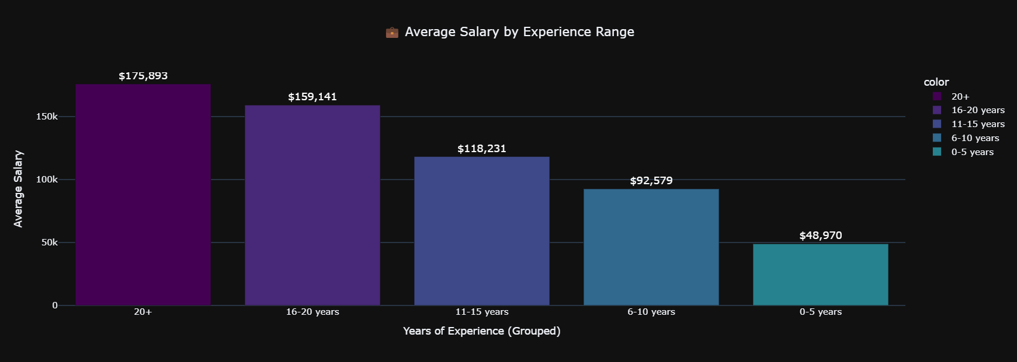
Result

Slide 18
Algorithm & Deployment
9. Relationships Between Numerical Features:
# Generate scatter matrix for numeric columns
fig = px.scatter_matrix(
data,
dimensions=data.select_dtypes(include="number").columns,
color="Salary", # Color based on salary (optional)
opacity=0.6,
height=800,
title="📊 Relationships Between Numerical Features",
template="plotly_dark"
)
# Enhance layout
fig.update_layout(
title={
"text": "📊 Relationships Between Numerical Features",
"x": 0.5,
"xanchor": "center",
"font": {
"size": 26,
"family": "Tahoma"
}
},
dragmode='select'
)
fig.update_traces(diagonal_visible=True)
# Show the plot
fig.show()

Slide 19
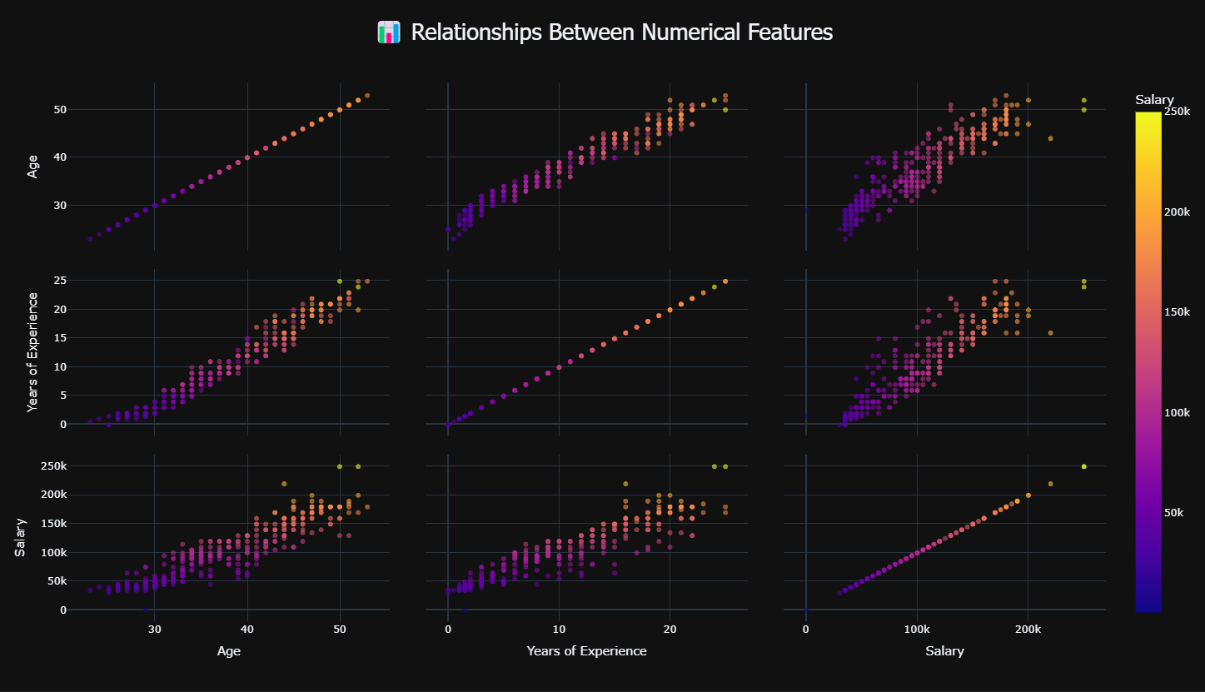
Result

Slide 20
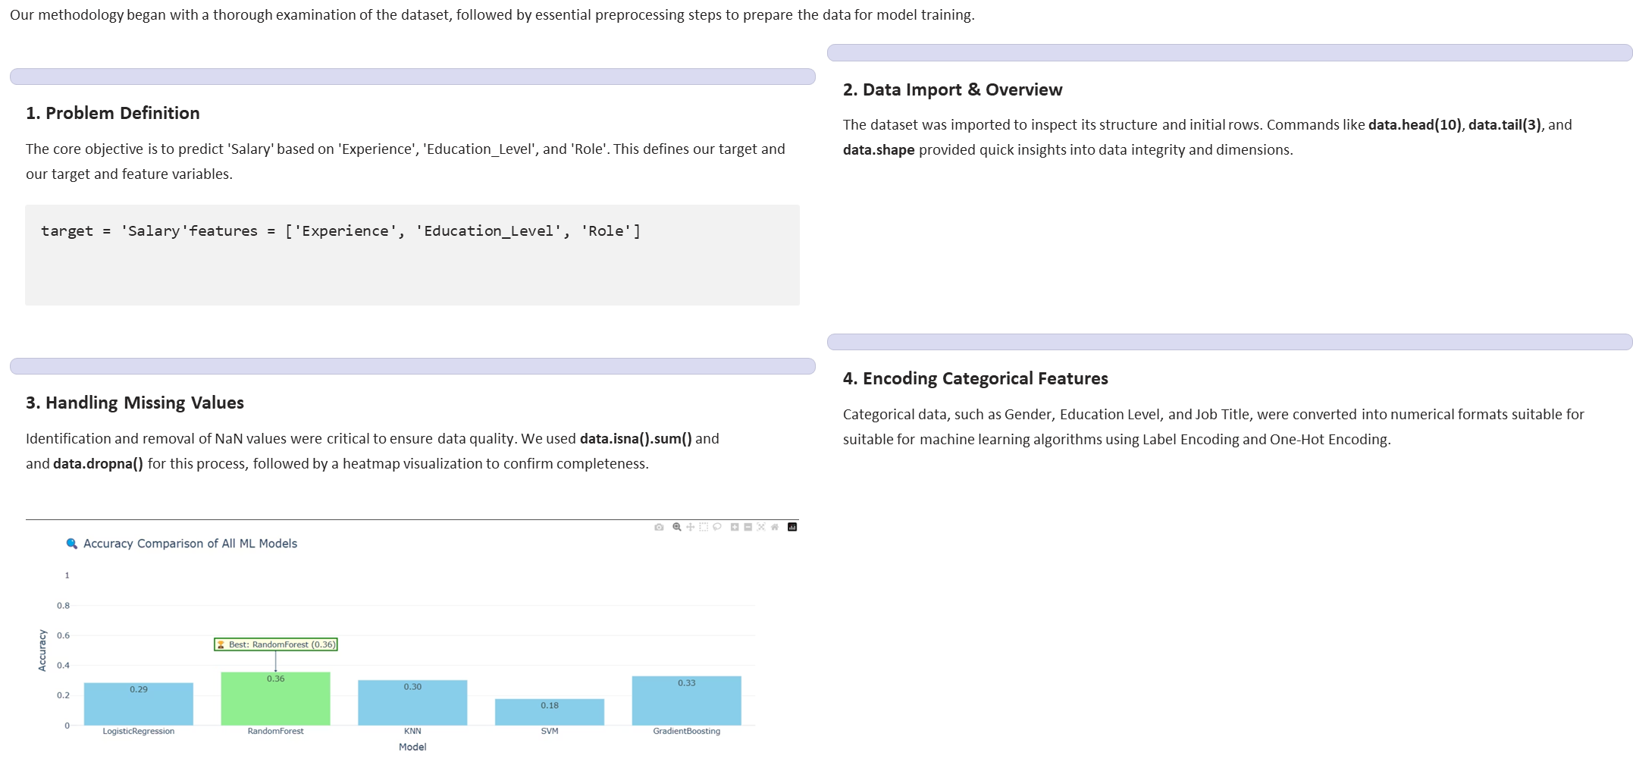
Algorithm & Deployment

Slide 21
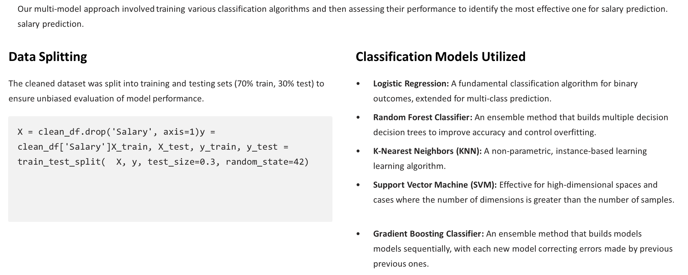
Algorithm & Deployment

Slide 22
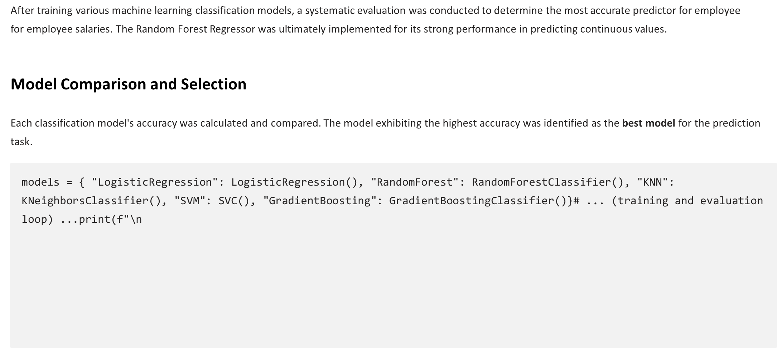
Algorithm & Deployment

Slide 23
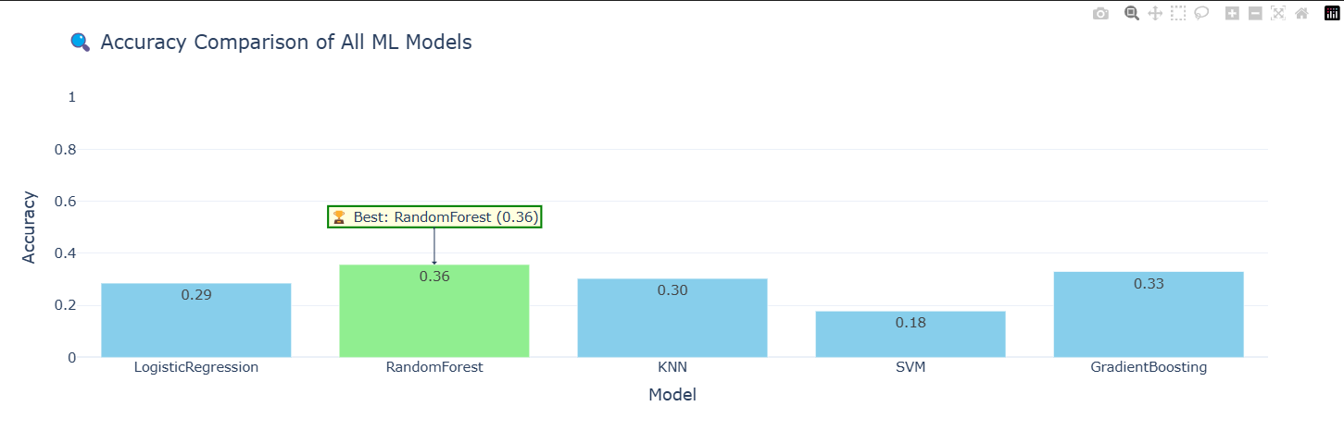
Result

Slide 24
Algorithm & Deployment
20. Implement RandomForest Regression:
rf = RandomForestRegressor(n_estimators=500, random_state=11) rf.fit(X_train, y_train)
predicted_salary = np.round(rf.predict(X_test))
d = {
"Actual_Salary" : y_test,
"Predicted_Salary" : predicted_salary,
"error": predicted_salary - y_test}
predected_df = pd.DataFrame(d)
predected_df.head()
21. Checking the Model Score:
score = r2_score(y_test, predicted_salary)*100
print(f"Model Score: {np.round(score, 2)}%")
21. Showing the Predict vs Actual:
fig = px.scatter(
predected_df ,
x = "Actual_Salary",
y = "Predicted_Salary",
color = "error",
opacity=0.8,
title= "Predicted Vs. Actual",
template="plotly_dark",
trendline="ols") fig.update_layout(
title = {
"font" :{
"size" : 28,
"family" : "tahoma"}})
iplot(fig)

Slide 25
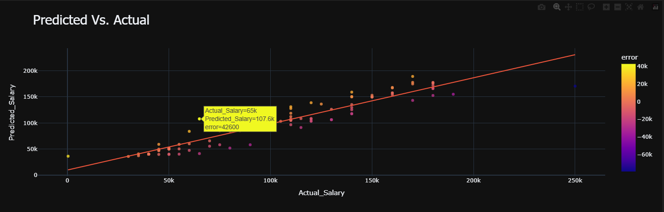
Result

Slide 26
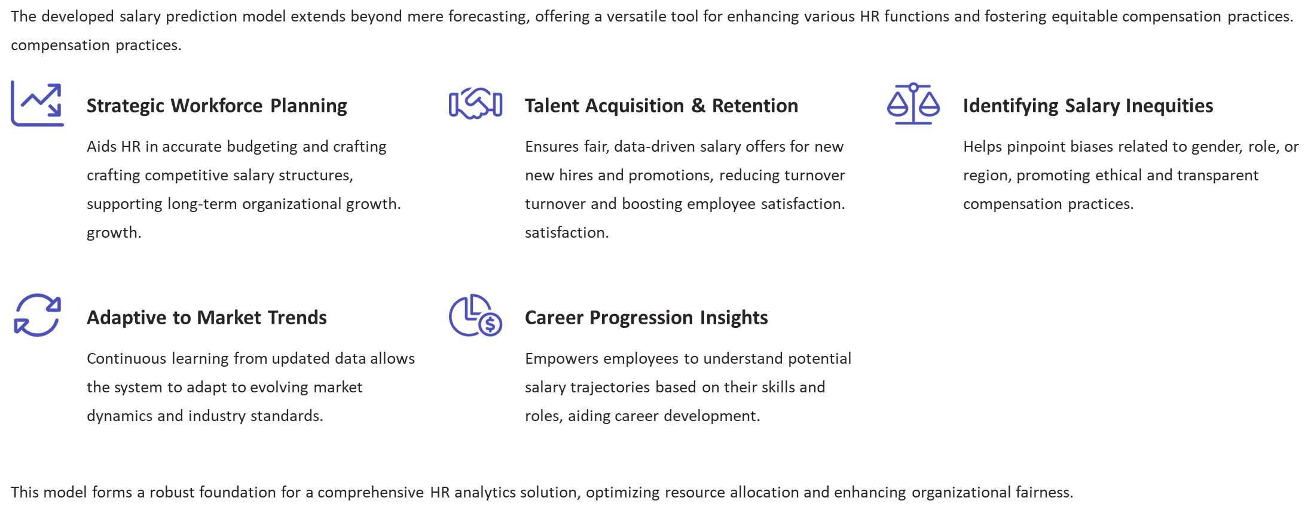
Conclusion

Slide 27
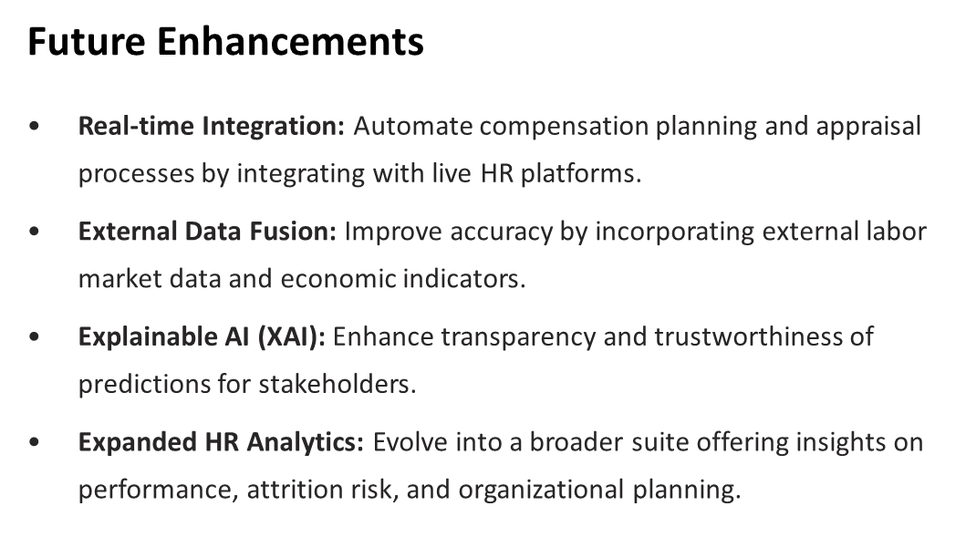
Future scope(Optional)

Slide 28
References
Dataset in Kaggle : https://www.kaggle.com/
Scikit-Learn Documentation – ML Algorithms : https://scikit-learn.org/stable/
Jupyter Notebook : https://jupyter.org/try-jupyter/notebooks/
Pandas Official : https://pandas.pydata.org/
Matplotlib Official : https://matplotlib.org/
Plotly Official : https://plotly.com/

Slide 29
GitHub Repository Link :

Slide 30
THANK YOU

