Slide 1

Comprehensive SEO Audit & Optimization for Organic Traffic Growth
Welcome to our comprehensive SEO audit and optimization plan for DinePlan.net. Our goal is to increase organic traffic and engagement for this restaurant technology website. We'll analyze the current performance, identify areas for improvement, and implement strategies to boost search engine rankings and user experience. This presentation will cover our initial audit findings, keyword research, on-page and technical SEO recommendations, and a content strategy to drive organic growth.
by Vignesh Gowda

Slide 2
Initial Audit Findings
1
Authority Score
2
Organic Search Traffic
3
Backlinks
The website's authority score is 19, indicating room for improvement in overall domain strength and credibility.
Current organic search traffic is 226 visits per month, presenting an opportunity for significant growth.
The site has 6.5K backlinks, which is a good foundation but can be expanded for better authority.
4
Site Performance
With a site performance score of 89% and an average page load speed of 1.38 seconds, the technical foundation is strong.

Slide 3
Traffic Distribution and Site Health
Traffic by Country
Site Health Metrics
Focus Areas
South Africa: 94% India: 2.2% US: 1.3% Others: 2.7%
Site Health: 77% Internal Linking: 85% HTTPS Implementation: 99% International SEO: 83%
Improve global reach Enhance site health Optimize internal linking Maintain strong HTTPS

Slide 4
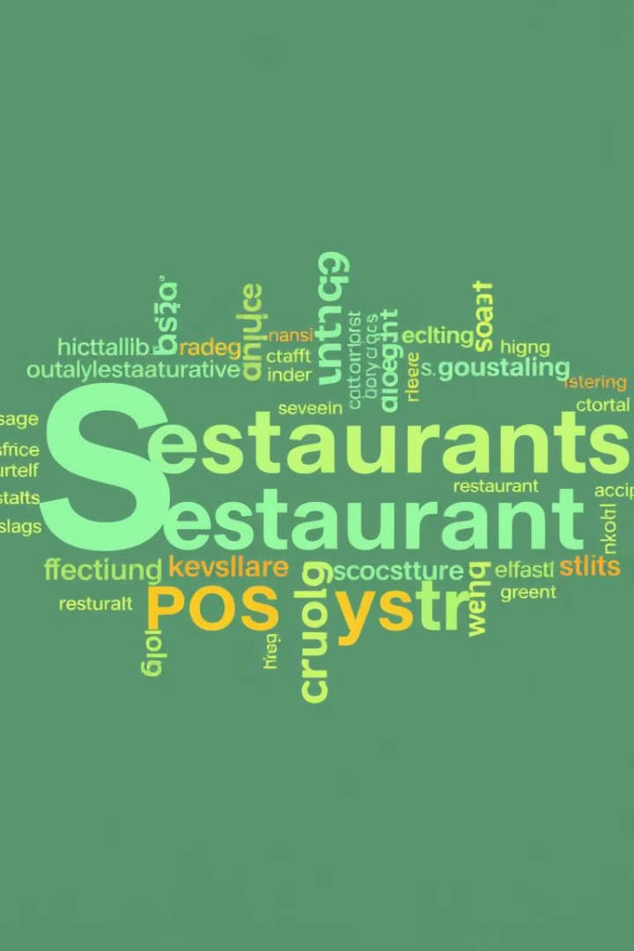
Keyword Research: High Potential Targets
POS Terminology
Target keywords: "POS meaning", "What is POS", "Point of sale meaning"
Restaurant Operations
Focus on: "Restaurant Reviews", "Food truck price", "Loyalty Program"
Competitor Keywords
Include: "Restaurant building", "Simple restaurant", "Restaurant software", "Restaurant website maker", "Café computer"

Slide 5
On-Page SEO Optimization: Table Ordering Page
1
Keyword Usage
Use target keywords in meta tags, title, and body content
2
Content Enrichment
Expand and improve page content to provide more value
3
Backlink Acquisition
Earn links from diverse, authoritative sources
4
Schema Markup
Implement aggregate rating markup for enhanced SERP visibility
5
Readability
Improve text content readability for better user experience

Slide 6
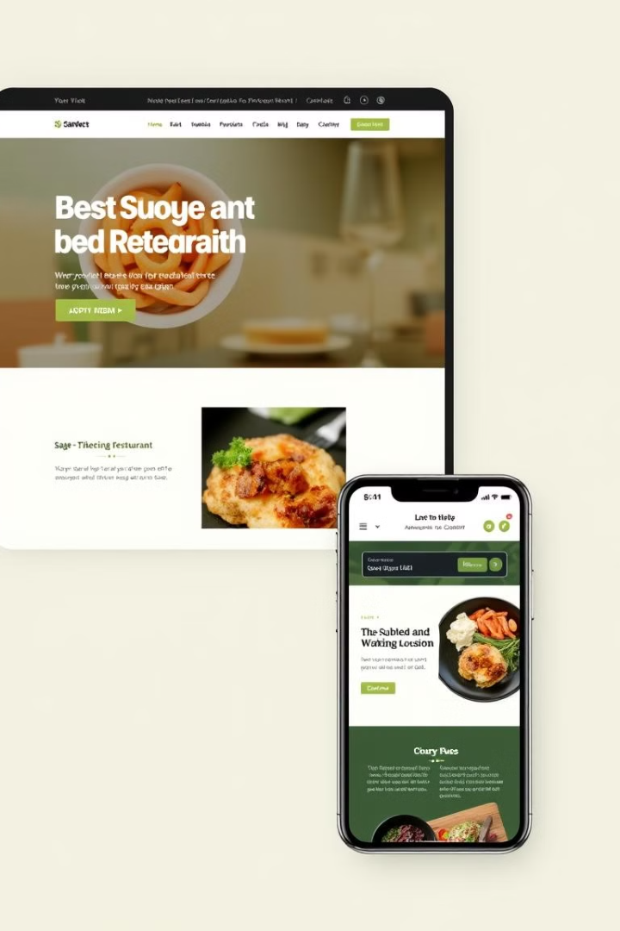

On-Page SEO Optimization: Homepage
Title Tag Optimization
Use target keywords in the header tags

Slide 7
Technical SEO Overview
Crawlability
95%
HTTPS
99%
International SEO
83%
Site Performance
89%
Internal Linking
85%
Markup
52%

Slide 8

Technical SEO Issues
1
Structured Data
2
Hreflang Conflicts
Invalid structured data items need to be corrected for proper implementation.
Resolve conflicts within page source code for improved international targeting.
3
Duplicate Titles
4
Hreflang Link Issues
Eliminate duplicate title tags to enhance search engine understanding.
Fix incorrect hreflang links to ensure proper language/region targeting.

Slide 9
Site Speed Improvement Practices
1
Structured Data Validation
Use validation tools to check and correct structured data on webpages.
2
Hreflang Configuration
Resolve conflicting hreflang and canonical URLs, ensure self-referencing.
3
Meta Descriptions
Provide unique, relevant meta descriptions for each webpage.
4
Code Optimization
Reduce Javascript and CSS file sizes for faster loading times.

Slide 10
Content Strategy: Themes and Topics
POS Systems
Restaurant Operations
Digital Presence
- Understanding POS Systems - POS Technology Benefits - System Comparisons
- Restaurant Building/Design - Review Management - Food Truck Operations
- Website Creation - Loyalty Programs - Online Marketing Tips

Slide 11
Content Calendar: First Quarter
1
Month 1
Week 1: POS System Guide Week 2: Restaurant Building Tips Week 3: Food Truck Costs Week 4: Effective Restaurant Websites
2
Month 2
Week 1: Modern POS Benefits Week 2: Top Review Sites Week 3: Loyalty Program Strategies Week 4: Best Website Builders
3
Month 3
Week 1: Choosing POS Systems Week 2: Restaurant Layout Design Week 3: Starting a Food Truck Week 4: Must-Have Website Features

Slide 12

Content Creation and Optimization
On-Page SEO
Internal Linking
Incorporate target keywords in titles, headings, meta descriptions, and throughout the content.
Create a strong network of internal links between related articles to improve site structure.
Visual Elements
User Experience
Enhance content with relevant images, infographics, and videos to increase engagement.
Ensure content is easily readable, well-structured, and provides value to the target audience.

Slide 13





Content Promotion and Off-Page SEO
Social Media
Share content on Facebook, Twitter, LinkedIn, and Instagram to increase visibility.
Email Marketing
Include content highlights in newsletters to engage subscribers.
Paid Advertising
Use targeted ads to boost content visibility and reach new audiences.
Link Building
Develop a strategy to earn high-quality backlinks from relevant industry websites.

Slide 14





Monitoring, Analysis, and Iteration
Track Performance
Analyze Data
Adjust Strategy
Continuous Improvement
Use Google Analytics and other tools to monitor key metrics and SEO progress.
Evaluate content performance, user behavior, and search rankings regularly.
Refine SEO and content approaches based on data-driven insights.
Conduct regular audits, update older content, and stay current with SEO best practices.

Slide 15
Tools Used for Research
Google Keyword Planner - Comprehensive keyword research tool to identify high-volume, relevant keywords and topics.
SEMrush - Advanced SEO platform for competitor analysis, keyword tracking, and content ideation.
Google Search Console - Provides deep insights into website performance, crawling, indexing, and impressions.
Google Analytics - Powerful data platform to analyze user behavior, traffic sources, and content performance.
Ahrefs - Robust link analysis tool to identify high-quality backlink opportunities and monitor competitor links.

Slide 16

Thank You
We appreciate your time and attention. This presentation has covered the key components of our comprehensive SEO audit and optimization strategy to drive sustainable organic traffic growth for your business.

