Slide 1
ECE 463/563 Microprocessor Architecture
Basic Cache Operation (Examples)
Prof. Eric Rotenberg

Slide 2
Cache Parameters
SIZE = total amount of data storage, in bytes
BLOCKSIZE = total number of bytes in a single block
ASSOC = associativity, i.e., # of blocks in a set

Slide 3
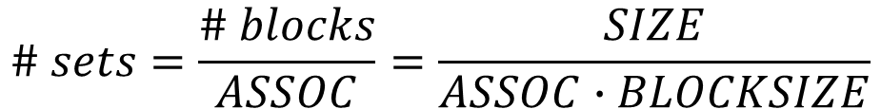
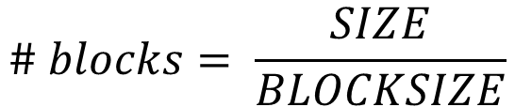
Cache Parameters (cont.)
Equation for # of blocks in the cache:
Equation for # of sets in the cache:
$$\# blocks= \frac{SIZE}{BLOCKSIZE}$$
$$\# sets=\frac{\# blocks}{ASSOC}=\frac{SIZE}{ASSOC∙BLOCKSIZE}$$

Slide 4
Address Fields
31
0
block
offset
tag
index
Used to lookup a “set”, which contains one or more memory blocks. (The number of blocks in a set is the “associativity”.)
Once block is found,
offset selects a
particular byte or word
of data in the block.
Tag field is compared
to the tag(s) of the indexed
cache block(s).
If there is a match, memory
block is there (hit).
If there isn’t a match, memory
block is not there (miss).

Slide 5
Address Fields (cont.)
Widths of address fields (# bits)
# index bits = log₂(# sets)
# block offset bits = log₂(block size)
# tag bits = 32 - # index bits - # block offset bits
assuming 32-bit addresses
31
0
block
offset
tag
index

Slide 6
31
Address (from processor)
0
block
offset
tag
index
V
TAG
DATA
==
byte or word select
requested data (byte or word)
hit = (valid & match)
(to processor)
miss = !hit = (!valid | !match)

Slide 7
Example
Example: Processor accesses a 256 Byte direct-mapped cache, which has block size of 32 Bytes, with following sequence of addresses. Show contents of cache after each access, count # of hits, count # of replacements.

Slide 8
Example address sequence
address (hex) | tag (hex) | index || block offset (binary) | index (decimal) | comment
FF0040E0
BEEF005C
FF0040E2
FF0040E8
101078
2183E0
101064
12255C
122544

Slide 9
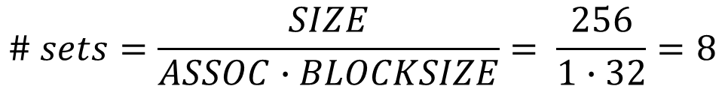
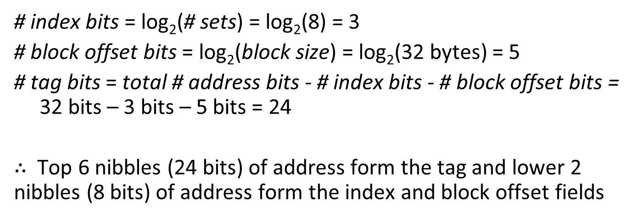
Example (cont.)
$$\# sets=\frac{SIZE}{ASSOC∙BLOCKSIZE}= \frac{256}{1∙32}=8$$
# index bits = log₂(# sets) = log₂(8) = 3
# block offset bits = log₂(block size) = log₂(32 bytes) = 5
# tag bits = total # address bits - # index bits - # block offset bits = 32 bits – 3 bits – 5 bits = 24
$∴$ Top 6 nibbles (24 bits) of address form the tag and lower 2 nibbles (8 bits) of address form the index and block offset fields

Slide 10
address (hex) | tag (hex) | index || block offset (binary) | index (decimal) | comment
FF0040E0 | FF0040 | 11100000 | 7 | Miss
BEEF005C | BEEF00 | 01011100 | 2 | Miss
FF0040E2 | FF0040 | 11100010 | 7 | Hit
FF0040E8 | FF0040 | 11101000 | 7 | Hit
101078 | 1010 | 01111000 | 3 | Miss
2183E0 | 2183 | 11100000 | 7 | Miss/Repl
101064 | 1010 | 01100100 | 3 | Hit
12255C | 1225 | 01011100 | 2 | Miss/Repl
122544 | 1225 | 01000100 | 2 | Hit

Slide 11
31
8
7
5
4
0
tag
index
block
offset
FF0040
7
3
V
TAG
DATA
0
0
1
0
2
0
3
0
4
0
5
0
24
6
0
7
0
1
FF0040
Match?
Valid?
Get block from
memory (slow)
MISS

Slide 12
31
8
7
5
4
0
tag
index
block
offset
BEEF00
2
3
V
TAG
DATA
0
0
1
0
2
0
1
BEEF00
3
0
4
0
5
0
Get block from
memory (slow)
24
6
0
7
1
FF0040
Match?
Valid?
MISS

Slide 13
31
8
7
5
4
0
tag
index
block
offset
FF0040
7
3
V
TAG
DATA
0
0
1
0
2
1
BEEF00
3
0
4
0
5
0
24
6
0
7
1
FF0040
Match?
Valid?
HIT

Slide 14
31
8
7
5
4
0
tag
index
block
offset
FF0040
7
3
V
TAG
DATA
0
0
1
0
2
1
BEEF00
3
0
4
0
5
0
24
6
0
7
1
FF0040
Match?
Valid?
HIT

Slide 15
31
8
7
5
4
0
tag
index
block
offset
1010
3
3
V
TAG
DATA
0
0
1
0
2
1
BEEF00
3
0
1
1010
4
0
5
0
24
6
0
Get block from
memory (slow)
7
1
FF0040
Match?
Valid?
MISS

Slide 16
31
8
7
5
4
0
tag
index
block
offset
2183
7
3
V
TAG
DATA
0
0
1
0
2
1
BEEF00
3
1
1010
4
0
5
0
24
6
0
2183
7
1
FF0040
Match?
Get block from
memory (slow)
Valid?
MISS & REPLACE

Slide 17
31
8
7
5
4
0
tag
index
block
offset
1010
3
3
V
TAG
DATA
0
0
1
0
2
1
BEEF00
3
1
1010
4
0
5
0
24
6
0
7
1
2183
Match?
Valid?
HIT

Slide 18
31
8
7
5
4
0
tag
index
block
offset
1225
2
3
V
TAG
DATA
0
0
1
0
1225
2
1
BEEF00
3
1
1010
4
0
Get block from
memory (slow)
5
0
24
6
0
7
1
2183
Match?
Valid?
MISS & REPLACE

Slide 19
31
8
7
5
4
0
tag
index
block
offset
1225
2
3
V
TAG
DATA
0
0
1
0
2
1
1225
3
1
1010
4
0
5
0
24
6
0
7
1
2183
Match?
Valid?
HIT

Slide 20
Revised Example
Example: Processor accesses a 256 byte 2-way set-associative cache, which has block size of 32 bytes, with following sequence of addresses. Show contents of cache after each access, count # of hits, count # of replacements.

Slide 21
31
Address (from processor)
0
block
offset
tag
index
V
TAG
V
TAG
DATA
DATA
(32 bytes)
(32 bytes)
==
==
select a block
select certain bytes
hit

Slide 22
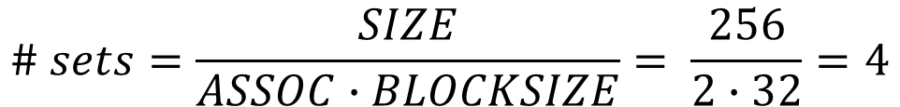
Example (cont.)
$$\# sets=\frac{SIZE}{ASSOC∙BLOCKSIZE}= \frac{256}{2∙32}=4$$
# index bits = log₂(# sets) = log₂(4) = 2
# block offset bits = log₂(block size) = log₂(32 bytes) = 5
# tag bits = total # address bits - # index bits - # block offset bits = 32 bits – 2 bits – 5 bits = 25

Slide 23
Example of splitting address into fields
FF0040E0
Hex: F F 0 0 4 0 E 0
Binary: 1111 1111 0000 0000 0100 0000 1110 0000
Hex Tag:1 F E 0 0 8 1
index
block offset
tag

Slide 24
address (hex) | tag (hex) | index || block offset (binary) | index (decimal) | comment
FF0040E0 | 1FE0081 | 1100000 | 3 | Miss
BEEF005C | 17DDE00 | 1011100 | 2 | Miss
101078 | 2020 | 1111000 | 3 | Miss
FF0040E2 | 1FE0081 | 1100010 | 3 | Hit
101078 | 2020 | 1111000 | 3 | Hit
2183E0 | 4307 | 1100000 | 3 | Miss/Repl
101064 | 2020 | 1100100 | 3 | Hit

Slide 25
31
7
6
5
4
0
tag
index
block
offset
1FE0081
3
2
V TAG V TAG
0
0
0
1
0
0
2
0
0
25
3
0
1FE0081
DATA
not shown
for convenience
1
0
Match?
Match?
Valid?
Valid?
MISS

Slide 26
31
7
6
5
4
0
tag
index
block
offset
17DDE00
2
2
V TAG V TAG
0
0
0
1
0
0
0
2
1
17DDE00
0
25
3
1
1FE0081
0
DATA
not shown
for convenience
Match?
Match?
Valid?
Valid?
MISS

Slide 27
31
7
6
5
4
0
tag
index
block
offset
2020
3
2
V TAG V TAG
0
0
0
1
0
0
2
1
17DDE00
0
25
1
DATA
not shown
for convenience
3
1
1FE0081
0
2020
Match?
Match?
Valid?
Valid?
MISS

Slide 28
31
7
6
5
4
0
tag
index
block
offset
1FE0081
3
2
V TAG V TAG
0
0
0
1
0
0
2
1
17DDE00
0
25
3
1
1FE0081
1
2020
DATA
not shown
for convenience
Match?
Match?
Valid?
Valid?
HIT

Slide 29
31
7
6
5
4
0
tag
index
block
offset
2020
3
2
V TAG V TAG
0
0
0
1
0
0
2
1
17DDE00
0
25
3
1
1FE0081
1
2020
DATA
not shown
for convenience
Match?
Match?
Valid?
Valid?
HIT

Slide 30
31
7
6
5
4
0
tag
index
block
offset
4307
3
2
V TAG V TAG
0
0
0
1
0
0
2
1
17DDE00
0
4307
25
3
1
1FE0081
1
2020
DATA
not shown
for convenience
Match?
Match?
Valid?
Valid?
MISS & REPLACE LRU BLOCK

Slide 31
31
7
6
5
4
0
tag
index
block
offset
2020
3
2
V TAG V TAG
0
0
0
1
0
0
2
1
17DDE00
0
25
3
1
4307
1
2020
DATA
not shown
for convenience
Match?
Match?
Valid?
Valid?
HIT

Slide 32
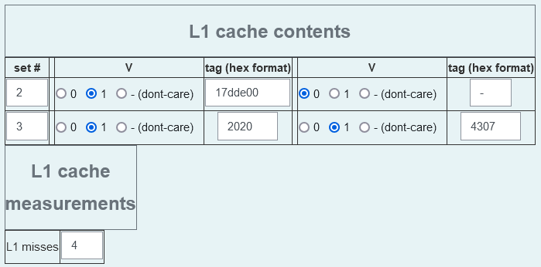
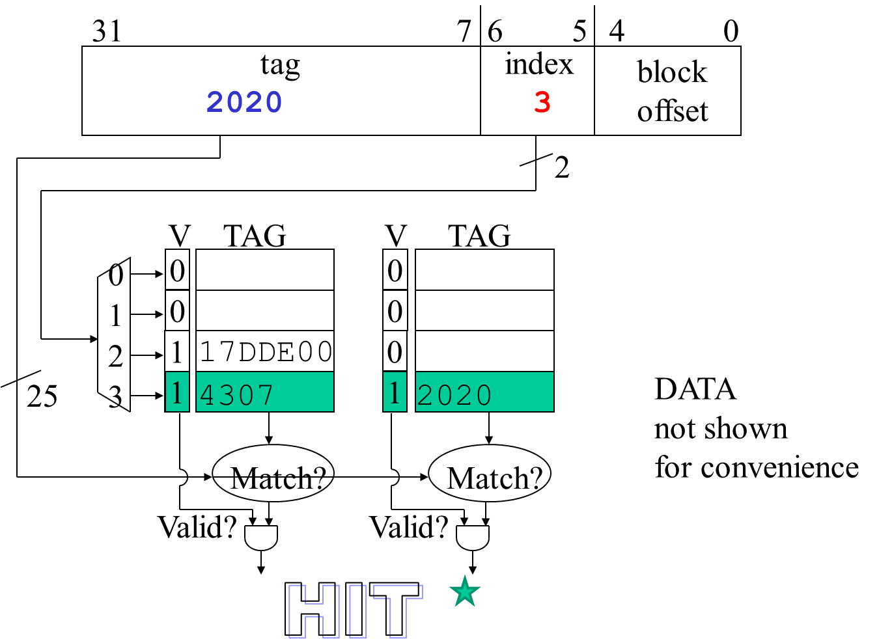
Showing Cache Contents on Quizzes/Exams
Notice that the table(s) only have enough rows for displaying those sets that are ever used by the address trace. Therefore, at each row, you must indicate the set #, i.e., the index into the cache.
VERY IMPORTANT: The auto-grader requires that you enter sets in the table in ascending order (from lowest to highest set #).
VERY IMPORTANT: The auto-grader accepts the set # (cache index) in either decimal or hexadecimal format. Do NOT include leading zeroes. Do NOT use '0x' notation before hex numbers.
VERY IMPORTANT: If a given cache is set-associative, then, when transferring your solution from paper to the table, blocks within a set must be listed from most-recently-used to least-recently-used. The auto-grader requires this.
VERY IMPORTANT: Tags must be specified in hexadecimal format. Do NOT include leading zeroes. Do NOT use '0x' notation before hex numbers.
VERY IMPORTANT: The auto-grader requires that you enter a tag for each block, even for blocks that are invalid. Enter - (a single hyphen) for the tag of an invalid block.
MRU
LRU
MRU

Slide 33
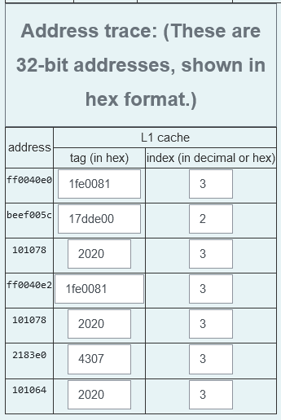
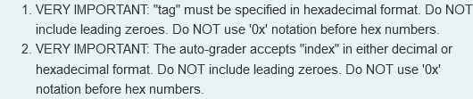
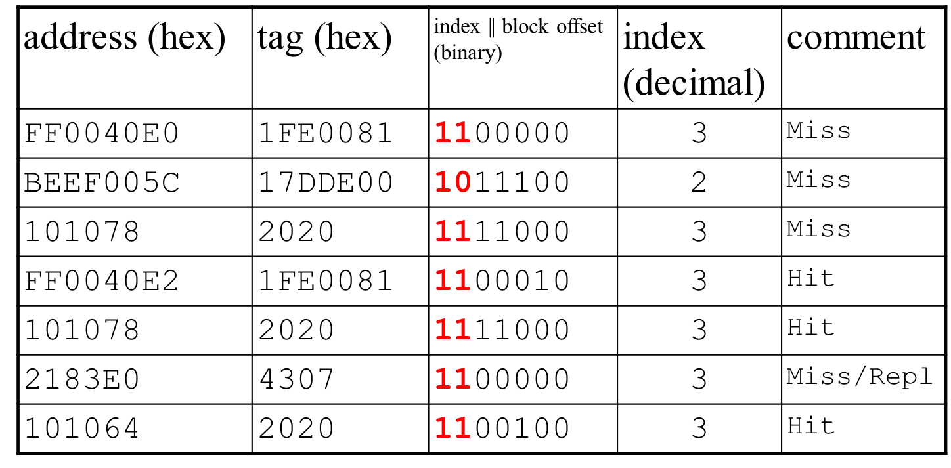
Showing decoded address traces on quizzes/exams

