Slide 1
ECE 463/563 Microprocessor Architecture
Virtual Memory
Prof. Eric Rotenberg

Slide 2
Virtual Memory
“Virtual memory” is a collaboration between the operating system (O/S) and hardware, facilitated by a specification of virtual memory in the instruction set architecture (ISA)
I strongly recommend you take a solid operating systems course sometime in your career to learn more about the O/S side of virtual memory implementation
Processes (programs that are being run)
Page tables
Memory management

Slide 3
Virtual Memory
ISA abstraction: every program has its own virtual memory
Large virtual address space
Divided into virtual pages (e.g., 4KB)
When a program runs, it needs physical memory
Physical memory is actual storage:
DRAM: main memory
“Swap File” in Hard Disk: overflow storage for main memory
Operating System (O/S) manages physical memory as a shared resource among many concurrent processes. O/S maps virtual pages to physical pages.
A process incurs a “page fault” when it references a virtual page that is not mapped to a physical page in DRAM. Either:
First-ever reference to the virtual page, or
the virtual page was referenced before and at one time was mapped to a physical page in DRAM, but its physical page currently resides in the swap file and needs to be brought back into the DRAM.
Page faults are resolved by the O/S page fault handler
A program that is being run is called a “process”.

Slide 4
Virtual Memory (cont.)
Virtual Memory for Process #1
Virtual Memory for Process #2
Physical Memory
Virtual Page Number
(VPN)
0
Virtual Page Number
(VPN)
0
1
1
2
DRAM: Main Memory
2
3
3
4
0
4
5
Physical Page Number (PPN)
1
5
6
2
6
7
3
7
8
4
8
5
…
…
N
…
1 physical page
swap file
1 virtual page
other files
Hard Disk: Overflow Storage for Main Memory

Slide 5
Virtual Memory (cont.)
Virtual Memory for Process #1
Virtual Memory for Process #2
Physical Memory
Virtual Page Number
(VPN)
0
Virtual Page Number
(VPN)
0
1
1
2
DRAM: Main Memory
2
3
3
4
0
4
5
Physical Page Number (PPN)
1
5
6
2
6
7
3
7
8
4
8
page fault
5
…
??
…
N
…
1 physical page
swap file
1 virtual page
other files
Hard Disk: Overflow Storage for Main Memory

Slide 6
Virtual Memory (cont.)
Virtual Memory for Process #1
Virtual Memory for Process #2
Physical Memory
Virtual Page Number
(VPN)
0
Virtual Page Number
(VPN)
0
1
1
2
DRAM: Main Memory
2
3
3
4
0
4
5
Physical Page Number (PPN)
1
5
6
2
6
7
3
7
8
4
8
5
…
page fault
…
N
??
…
1 physical page
swap file
1 virtual page
other files
Hard Disk: Overflow Storage for Main Memory

Slide 7
Virtual Memory Benefit #1
Automatically allows multiple processes, which use the same virtual addresses, to share a machine without conflicting
Without virtual memory (no virtual addresses), either only one process could run at a time or everyone would need to coordinate which physical addresses they could use!

Slide 8
Virtual Memory (cont.)
Virtual Memory for Process #1
Virtual Memory for Process #2
Physical Memory
VPN:
VPN:
0
0
1
1
2
DRAM: Main Memory
2
3
PPN:
3
4
0
4
5
1
5
6
2
6
7
3
7
8
4
8
5
…
…
N
…
swap file
other files
Hard Disk: Overflow Storage for Main Memory

Slide 9
Virtual Memory (cont.)
Virtual Memory for Process #1
Virtual Memory for Process #2
Physical Memory
VPN:
VPN:
0
0
1
1
2
DRAM: Main Memory
2
3
PPN:
3
4
0
4
5
1
5
6
2
6
7
3
7
8
4
8
9
5
10
…
11
12
…
page fault
N
…
??
swap file
other files
Hard Disk: Overflow Storage for Main Memory

Slide 10
Virtual Memory Benefit #2
Many processes with large memory footprints can all run even if main memory is exhausted
Swap file provides an extension to main memory

Slide 11
Virtual Memory Benefit #3
Access control
Pages can be annotated with attributes such as read-only vs. read-write, executable vs. non-executable, etc.

Slide 12
Page Table
A process’ Page Table is a software data structure created and managed by the O/S and used by the CPU’s Memory Management Unit (MMU) to translate the process’ virtual addresses to physical addresses. O/S maintains a Page Table per process.
There is one Page Table Entry (PTE) for each virtual page used by the process. Contents of a PTE (for example):
Whether or not the virtual page has been mapped to a physical page yet
Whether corresponding physical page is in main memory or in the swap file
If in main memory: PTE provides physical page number
If in swap file: PTE provides location in swap file
PTE typically has other information too (recency of access, access control bits, etc.)

Slide 13
Virtual-to-Physical Address Translation
translate virtual address to physical address
10s-100s of cycles
A running program (process)
MMU searches (“walks”) the process’ Page Table
Access L1 I/D caches (entry point to memory hierarchy)
CPU
is executing application
virtual address and pid*
physical address
page fault
translation
O/S page fault handler
CPU
is executing O/S page fault handler
If no swap file activity needed (first-time reference and free physical page available in DRAM): microseconds.
If swap file activity needed (swap-out a physical page and/or swap-in the needed physical page): milliseconds, so run a different process in the meantime.
* pid = process id, which is held in a special-purpose system register in the CPU

Slide 14
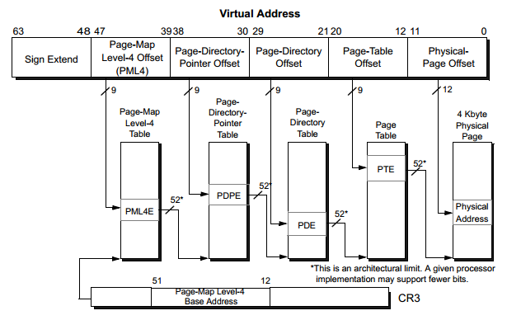
Example: x86-64 Page Table Walk
translate virtual address to physical address
10s-100s of cycles
A running program (process)
MMU searches (“walks”) the process’ Page Table
Access L1 I/D caches (entry point to memory hierarchy)
CPU
is executing application
virtual address and pid
physical address
actual fetch, load, or store
3rd load
4th load
2nd load
1st load

Slide 15
Overhead of Virtual Memory
Program counter is a virtual address
Each instruction fetch requires address translation
Loads and stores generate virtual addresses
Each load and store requires address translation
So, for each instruction fetch, load, and store, we must walk the page table?
Being literal about this would have unacceptable performance: e.g., in x86-64, the MMU performs four loads to obtain the PTE, and some of them may cache miss (hence, 10s-100s of cycles).

Slide 16
Translation Lookaside Buffer (TLB)
The TLB is a small cache of recently used address translations

Slide 17
Virtual-to-Physical Address Translation, with TLB
translate virtual address to physical address
A running program (process)
TLB
Access L1 I/D caches (entry point to memory hierarchy)
virtual address and pid
physical address
1 cycle
CPU
is executing application
TLB miss
Fill TLB
MMU searches (“walks”) the process’ Page Table
10s-100s of cycles
page fault
translation
O/S page fault handler
CPU
is executing O/S page fault handler
microseconds- milliseconds

Slide 18
TLB Organization
TLB organization
Can be direct-mapped, set-associative, or fully-associative
Unified versus split TLBs
Unified: One TLB for both instruction and data address translation
Split: Separate TLBs for instruction and data address translation
I-TLB: TLB for instruction address translation (program counter). I-TLB sits alongside L1 I-cache.
D-TLB: TLB for data address translation (loads and stores). D-TLB sits alongside L1 D-cache.

Slide 19
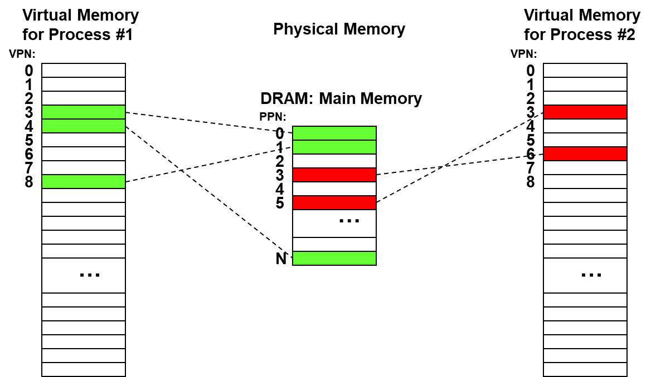
Using the TLB for translation
Example: Fully-associative TLB
pid=2, VPN=3
valid bit
process id (pid)
Note: including process ids (pid) in TLB entries means we don’t have to clear the TLB on context switches (CPU switching to a different process).
virtual page number (VPN)
physical page number (PPN)
=?
1
1
1
8
Example from slide 7:
=?
5
1
2
3
=?
0
1
1
3
=?
3
1
2
6
PPN=5

Slide 20
TLB increases hit time
Without Virtual Memory
With Virtual Memory
virtual address
address
TLB
1 cycle
L1 Cache
1 cycle
physical address
L1 Cache
1 cycle

Slide 21
Using the TLB for translation: A closer look
31
12
11
0
Ex: page size = 4KB
# page offset bits = log₂(4KB) = 12
virtual address
virtual page number
page offset
TLB
31
12
11
0
physical address
physical page number
page offset
31
0
This is how cache interprets
the physical address
tag
index
block
offset
Observation: What if index bits were entirely contained in page offset bits?
Then first part of cache access (indexing) would not wait on TLB

Slide 22
Accessing TLB and Cache in Parallel
31
12
11
0
virtual page number
page offset
tag array
data array
TLB
11
0
index
block offset
31
12
physical page number
31
12
=?
word select
tag
Cache hit time reduces from two cycles to one!
Because cache can now be indexed in parallel with TLB access (only the final tag match uses the output from TLB)
But some constraints...

Slide 23
Constraint: Size of 1 cache way
Constraint for “physically-indexed cache with parallel cache/TLB access”
Index and block offset bits contained within page offset bits
Therefore: Total amount of storage in 1 way of the cache should not exceed page size
block size
set
Way 1
Way 2
Way N
# sets
N-way set-assoc. cache
…

Slide 24
Page size / associativity tradeoff
From previous slide:
Cache size equation:
Therefore:
Example: MC88110
Page size = 4KB
I$, D$ both: 8KB 2-way set-associative
(8KB/4KB) = 2 ways
Example: VAX series
Page size = 512B
For a 16KB cache, need assoc. = (16KB / 512B) = 32-way set-associative!
Moral: sometimes associativity is thrust upon you

Slide 25
Physically-indexed vs. virtually-indexed caches
 | hit time impact | cache constraints | synonym problem
physically-indexed cache accessed after TLB | negative: increase hit time because TLB must be accessed first | positive: no constraints on size or associativity | positive: no synonym problem
physically-indexed cache accessed in parallel with TLB | positive: minimize hit time because don’t wait for TLB (except for final tag comparisons) | negative: constraints on size or associativity | positive: no synonym problem
virtually-indexed cache | positive: minimize hit time because don’t wait for TLB (except for final tag comparisons) | positive: no constraints on size or associativity | negative: synonym problem, requires anti-synonym solutions

Slide 26
Virtually-indexed cache
31
12
11
0
virtual page number
page offset
tag array
data array
12
TLB
13
11
0
index
block offset
31
12
upper two bits of index are virtual (low two bits of untranslated VPN)
physical page number
31
12
=?
word select
tag

Slide 27
Synonym Problem
Synonyms: two different virtual addresses that map to the same physical address
May lead to a cache coherence issue – multiple copies of the same block – within the same cache
These multiple copies become an issue if there is a write to one of the virtual addresses (one copy is updated, the other is not)

Slide 28
Synonym Example
16B block
4KB page
virtually-indexed 16KB direct-mapped cache (1024 sets, 10 index bits)
first virtual address X
000000000000000000 0000000000 0000
physical address A
second virtual address Y
000000000000001111 1100000000 0000
110000000000000000 0100000000 0000
10 index bits (top 2 are virtual)
4 block offset bits
12 page offset bits
set 0:
L1 cache
block A
set 256:
block A
set 512:
set 768:

Slide 29
Anti-synonym solutions
Software
Allow O/S to use synonyms, but require O/S to ensure the same virtual index for synonyms (O/S needs to know cache configuration of the machine)
Hardware
Before installing a cache-missed block at the virtual index, search for another copy at all possible other sets (e.g., 3 other sets if there are two virtual index bits) and invalidate that copy if found. Ensures there is only one copy at all times.

Slide 30
VI-PT vs. VI-VT
Virtually-indexed physically-tagged (VI-PT)
Note that physical tags must be the full PPN (all bits of the physical address minus the page offset), because the untranslated upper bits of the virtual index may differ from their physical counterpart.
ECE 506 cache coherence stuff: To correctly snoop invalidation/updation requests from other cores, which use physical addresses, need to search multiple sets (e.g., 4 sets if there are two untranslated virtual index bits)
Virtually-indexed virtually-tagged (VI-VT)
TLB is accessed only on a cache miss, to know which physical block address to demand from the next level in the memory hierarchy
Solutions to the synonym problem involve an additional step
Hardware solution: We still handle the synonym problem on a cache miss, using the physical block address of the missing block. For the alternate sets that are searched for a synonym, we need to translate all the virtual block addresses (VT || VI) in these sets to physical block addresses and compare them with the physical block address of the cache-missed block. Also, the same must be done even within this set (where we intend to install the block), because a presumed miss using virtual block address may actually be a hit using physical block address (if there is a synonym even within this set).
Software solution: The trick of forcing the same virtual index among synonyms is helpful but not complete. The trick ensures synonyms map to the same set, but without further hardware intervention, multiple copies of the same physical block might exist in the same set (assuming set-associativity) due to having different virtual tags. The fix is to use the hardware solution above; all that the software measure did was eliminate checking alternate sets and now we just need to check the same set.
Homonym problem: Homonyms are the same VPN in two different processes pointing to different PPNs (which is the major motivation for Virtual Memory): {pid=1, VPN=3 → PPN=0}, {pid=2, VPN=3 → PPN=5} link: homonyms in TLB
Alternative solutions are the same as those put forth for the TLB
Solution #1: Flush the VI-VT cache on context switches
Solution #2: Include process id (pid) as part of the tag to differentiate homonyms
ECE 506 cache coherence stuff: To correctly snoop invalidation/updation requests from other cores, which use physical addresses, need a reverse-TLB to translate physical addresses to {pid, virtual address}! (to search the VI-VT cache)

