Slide 1
ECE 463/563 Microprocessor Architecture
Overview
Prof. Eric Rotenberg

Slide 2
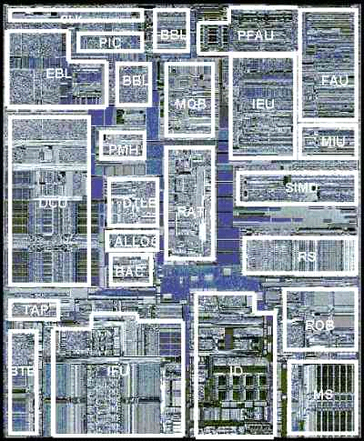

Computer Architecture & Systems
Microprocessor Architecture (CPUs)
Hard:
Correct & Fast CPU
Easy:
Correct CPU

Slide 3
Review: Types of Instructions
ALU type
ALU = Arithmetic/Logic Unit
add r3, r1, r2 // RF[r3] = RF[r1] + RF[r2]; PC = PC + 4
xor r5, r3, r4 // RF[r5] = RF[r3] xor RF[r4]; PC = PC + 4
Memory types (loads and stores)
lw r1, #4(r2) // addr = RF[r2] + 4
// RF[r1] = MEM[addr]; PC = PC + 4
sw #4(r2), r1 // addr = RF[r2] + 4
// MEM[addr] = RF[r1]; PC = PC + 4
Conditional branch (and other branch types)
beq r1, r2, #offset // cond = (RF[r1] == RF[r2]) // NPC = PC + 4 // PC = (cond ? (NPC + offset) : NPC)

Slide 4
Simple Processor Datapath
Register File
1
IF
ID
EX
MEM
WB
(instr. fetch)
(instr. decode)
(execute)
(memory)
(writeback)
Memory (DRAM & Disk)

Slide 5
Pipelining
Invention #1
Register File
1
2
3
4
5
6
IF
ID
EX
MEM
WB
(instr. fetch)
(instr. decode)
(execute)
(memory)
(writeback)
Memory (DRAM & Disk)

Slide 6
Problem: Data-Dependent Instructions
Register File
1
2
3
4
5
6
IF
ID
EX
MEM
WB
(instr. fetch)
(instr. decode)
(execute)
(memory)
(writeback)
Memory (DRAM & Disk)

Slide 7
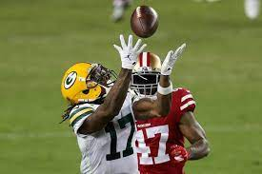

Register File Bypasses
Invention #2
Register File
1
2
3
4
5
6
IF
ID
EX
MEM
WB
(instr. fetch)
(instr. decode)
(execute)
(memory)
(writeback)
Memory (DRAM & Disk)

Slide 8
Problem: Branch Instructions
Register File
2
?
1
IF
ID
EX
MEM
WB
2
(instr. fetch)
(instr. decode)
(execute)
(memory)
(writeback)
Memory (DRAM & Disk)

Slide 9
Branch Prediction
Invention #3
Register File
2
3
4
Branch Predictor
?
1
IF
ID
EX
MEM
WB
2
(instr. fetch)
(instr. decode)
(execute)
(memory)
(writeback)
Memory (DRAM & Disk)

Slide 10
Problem: “Memory Wall”
Register File
Branch Predictor
IF
ID
EX
MEM
WB
(instr. fetch)
(instr. decode)
(execute)
(memory)
(writeback)
Memory (DRAM & Disk)

Slide 11
Caches
Invention #4
Register File
Branch Predictor
IF
ID
EX
MEM
WB
(instr. fetch)
(instr. decode)
(execute)
(memory)
(writeback)
Instr. Cache
Data Cache
Memory (DRAM & Disk)

Slide 12
Caches (cont.)
Locality of reference
Temporal locality: If you access an item, likely to access it again in near future
Spatial locality: If you access an item, likely to access a nearby item in the near future

Slide 13
Problem: Stalled Instructions
Register File
Branch Predictor
4
3
2
1
IF
ID
EX
MEM
WB
(instr. fetch)
(instr. decode)
(execute)
(memory)
(writeback)
Instr. Cache
Data Cache
cache miss
Memory (DRAM & Disk)

Slide 14
Out-of-Order Execution
Invention #5
Register File
Branch Predictor
4
5
6
7
3
2
1
IF
ID
EX
MEM
WB
(instr. fetch)
(instr. decode)
(execute)
(memory)
(writeback)
Dynamic Scheduler
Instr. Cache
Data Cache
cache miss
Memory (DRAM & Disk)

Slide 15
Superscalar Execution
Register File
Branch Predictor
1
4
7
IF
2
5
8
ID
EX
MEM
WB
3
6
9
(instr. decode)
(execute)
(memory)
(writeback)
(instr. fetch)
Dynamic Scheduler
Instr. Cache
Data Cache
Memory (DRAM & Disk)

Slide 16
Deep Pipelining
Register File
Branch Predictor
IF1
IF2
ID1
ID2
EX1
EX2
M1
M2
W1
W2
Dynamic Scheduler
Instr. Cache
Data Cache
Memory (DRAM & Disk)

Slide 17
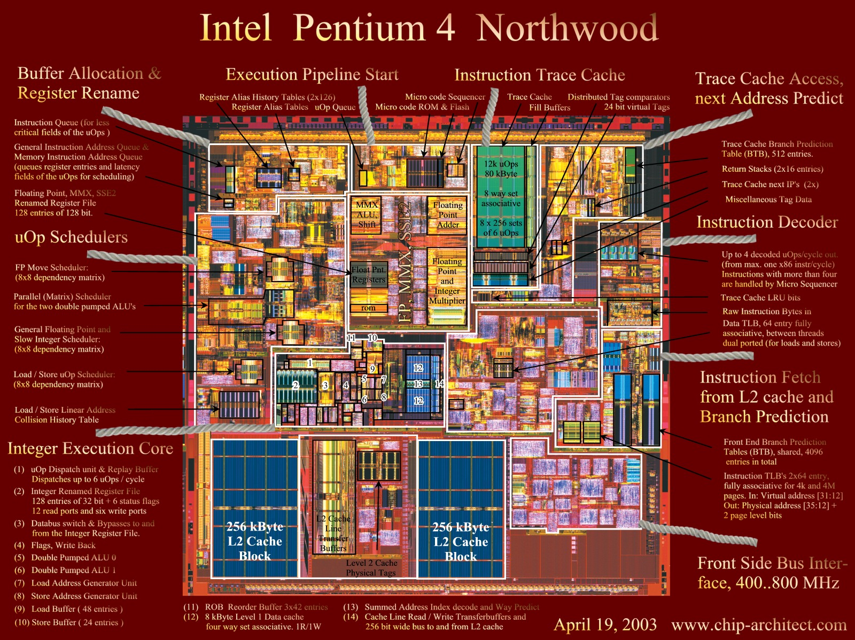
BRANCH PREDICTION
L1 Instr. Cache
OOO EXECUTION
SUPPORT
R.F. BYPASSES
L1 Data Cache
R.F. BYPASSES

Slide 18
Computer System
ECE 209, 309
Application
Operating
ECE 306, CSC 501 or ECE 465/565
System
ECE 466/566
Compiler
Firmware
Instruction Set
Architecture
ECE 109, 463/563
Machine Organization
(ECE 506, 786)
Processor
Mem.
I/O system
ECE 721
ECE 310, 464/564
Datapath & Control
ECE 212
Digital Design
ECE 211, 403
Circuit Design
ECE 546
Layout
Computer Architecture = Instruction Set Architecture + Machine Organization
(Microarchitecture)

Slide 19
What is Computer Architecture?
Computer Architecture =
Instruction Set Architecture +
Machine Organization
Programmable storage (registers, memory)
Data types and their encodings (integer, floating-point, SIMD)
Instruction set
Instruction formats and encodings
Modes of addressing and accessing data and instructions
Exceptions and interrupts
Virtual memory
Memory consistency model
Capabilities and performance characteristics of principal components
e.g., register files, ALUs, memory system, etc.
Ways in which these components are interconnected
Choreography of components to realize the ISA
Performance-enhancing techniques and components
e.g., pipelining, caches, predictors, dynamic scheduling, superscalar execution, etc.

Slide 20
CPU time equation (brief version)
CPU time = time to execute a program on CPU
Two factors
# cycles = number of clock cycles to execute a program
Cycle Time (CT) = clock period = 1 / (clock frequency)
CPU time = (# cycles)x(CT)
Example:
clock frequency (f) = 1 GHz = 10⁹ Hz = 10⁹ cycles/s
CT = 1/f = 10⁻⁹ s/cycle = 1 ns/cycle
# cycles = 10⁹ cycles (1 billion cycles)
CPU time = (10⁹ cycles) x (10⁻⁹ s/cycle ) = 1 s

Slide 21
Static vs. Dynamic Instructions
#include <stdio.h>
#include <inttypes.h>
#define HUGE 1000000
int main(int argc, char *argv[]) {
uint64_t a[HUGE];
uint64_t sum = 0;
// I know, a[] uninitialized... just a demo.
for (uint64_t i = 0; i < HUGE; i++)
sum += a[i];
printf("sum = %lu\n", sum);
return(0);
}
Loop has 4 static instructions.
Dynamically, at run-time, the loop executes 1 million times.
# static instructions = 4
# dynamic instructions = 4 million
Dynamic instruction count influences number of cycles.
a5: starts with address of first element of array a[] (&a[0])
a3: contains address just after last element of array a[] (&a[1000000])
a1: contains on-going sum, initialized to 0
1a538: ld a4,0(a5) // a4 = a[i]
1a53c: addi a5,a5,8 // increment address to point to next element of a[]
1a540: add a1,a1,a4 // sum += a[i]
1a544: bne a5,a3,1a538 <main+0x34> // branch to top of loop if not after last element of a[]

Slide 22
Influence on CPU time
Programmer influence
Algorithm affects dynamic instruction count: more (fewer) instructions to fetch and execute may cause more (fewer) cycles
Algorithm affects temporal and spatial locality: more (fewer) cache misses may cause more (fewer) cycles
Compiler influence
Compiler optimizations affect dynamic instruction count (up or down): more (fewer) instructions to fetch and execute may cause more (fewer) cycles
Instruction scheduling aims to increase instruction level parallelism and hence reduce cycles
Influence of instruction-set architecture (ISA)
Complex interactions between ISA, compiler, and microarchitecture. Unresolved debate on whether ISA (e.g., CISC vs. RISC) influences performance as much as microarchitecture.
Microarchitecture influence
Pipeline optimizations aim to reduce cycles, by increasing instruction-level parallelism (ILP) (the number of concurrently executing instructions and the extent of their overlapped execution)
Pipeline optimizations may increase CT due to increased logic complexity
Deeper pipelining aims to decrease CT
Circuit design influence
Faster circuits aim to decrease CT
Technology influence
Faster transistors and wires aim to decrease CT
CYCLES
CYCLES
?
CYCLES, CT
CT
(e.g., pipelining, data bypassing, branch prediction, caches,
dynamic scheduling,
superscalar, etc.)
CT

Slide 23
Overview of Topics in 463/563
Measuring Performance and Cost
Caches and Memory Hierarchies
Instruction-Set Architecture (ISA)
Defines software/hardware interface
Simple Pipelining
Data and control (branch) dependencies
Register file bypasses
Branch prediction

Slide 24
Overview of Topics in 463/563
Complex Pipelining and Instruction-Level Parallelism (ILP)
Data hazards
Issue Queue (IQ): from in-order to out-of-order scheduling
Reorder Buffer (ROB): speculation and register renaming
Precise interrupts
Superscalar, VLIW, and vector processors

Slide 25
Projects
Three projects
Cache simulator
Branch predictor simulator
Superscalar pipeline simulator
Programming for projects is harder than anything many of you have encountered before

Slide 26
Course Grading
40% projects
Project 1, caches: 15%
Project 2, branch predictors: 10%
Project 3, superscalar pipeline: 15%
20% Moodle quizzes
Can be thought of as homework assignments
Each quiz tests a unit of knowledge or a whole topic, or gives practice on manually doing a computer architecture simulation
The current plan is 10 quizzes but there could be more
A quiz may be assigned with a group of lectures (most common) or a pre-recorded video
20% Midterm
Covers Performance/Cost, Caches
20% Final (NOT comprehensive)
Covers ISA, Simple and Complex Pipelining, ILP

Slide 27
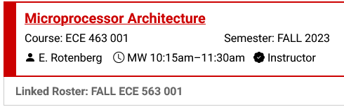
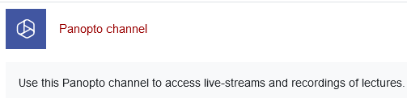
Course Web Page
Moodle site
wolfware.ncsu.edu
Login
Select ECE 463/563
Content
Link to Panopto for live-stream (webcast) and recordings
Syllabus
Schedule
Contact information and office hours
Q&A and discussion forums
Projects: specifications, benchmark traces, validation runs, etc.
Moodle (on-line) quizzes and exams
Check frequently (I announce updates)

