Slide 1
ECE 463/563 Fall `21
Performance and Cost
Prof. Eric Rotenberg

Slide 2
Outline of topics
Static instructions vs. dynamic instructions
CPU time equation
Influence of programmer, compiler, microarchitecture, circuit design, and technology on CPU time
Comparing performance of two processors
What we mean by “n times faster”
Benchmarks
Choice of benchmarks
Summarizing performance (arithmetic, harmonic, and geometric means)
Speedup
Amdahl’s Law
Cost
Area
Power

Slide 3
Static vs. Dynamic Instructions
#include <stdio.h>
#include <inttypes.h>
#define HUGE 1000000
int main(int argc, char *argv[]) {
uint64_t a[HUGE];
uint64_t sum = 0;
// I know, a[] uninitialized... just a demo.
for (uint64_t i = 0; i < HUGE; i++)
sum += a[i];
printf("sum = %lu\n", sum);
return(0);
}
Loop has 4 static instructions.
Dynamically, at run-time, the loop executes 1 million times.
# static instructions = 4
# dynamic instructions = 4 million
Dynamic instruction count influences number of cycles.
a5: starts with address of first element of array a[] (&a[0])
a3: contains address just after last element of array a[] (&a[1000000])
a1: contains on-going sum, initialized to 0
1a538: ld a4,0(a5) // a4 = a[i]
1a53c: addi a5,a5,8 // increment address to point to next element of a[]
1a540: add a1,a1,a4 // sum += a[i]
1a544: bne a5,a3,1a538 <main+0x34> // branch to top of loop if not after last element of a[]

Slide 4
CPU time equation
CPU time = time to execute a program on CPU
# cycles = number of clock cycles to execute a program
Cycle Time (CT) = clock period = 1 / (clock frequency)
CPU time = (# cycles)x(CT)
Instruction Count (IC) = number of instructions executed
Cycles-per-Instruction (CPI) = (# cycles)/(IC) → (# cycles) = (IC)x(CPI)
CPU time = (IC)x(CPI)x(CT)
CPU time = IC x CPI x CT

Slide 5
Influence on CPU time
Programmer influence (IC, CPI)
Algorithm affects IC
Algorithm affects temporal and spatial locality. E.g., tiling -> lower D$ miss rates -> fewer cycles per load -> lower CPI
Compiler influence (IC, CPI)
Compiler optimizations affect IC
Compiler affects temporal and spatial locality. E.g., tiling -> lower D$ miss rates -> fewer cycles per load -> lower CPI
Instruction scheduling aims to increase instruction-level parallelism (ILP) -> increase IPC -> decrease CPI
Microarchitecture influence (CPI, CT)
Pipeline optimizations aim to increase instruction-level parallelism (ILP) (the number of concurrently executing instructions and the extent of their overlapped execution) -> increase IPC -> decrease CPI
Pipeline optimizations may increase CT due to increased logic complexity
Deeper pipelining aims to decrease CT
Circuit design influence (CT)
Faster circuits aim to decrease CT
Technology influence (CT)
Faster transistors and wires aim to decrease CT
(e.g., pipelining, data bypassing, branch prediction, caches,
dynamic scheduling,
superscalar, etc.)

Slide 6
Comparing performance of two processors
Run benchmark program on both processors
Measure CPU time
When we say “Computer X is n times faster than Computer Y”, it means:
n = Time(Y) / Time(X)

Slide 7
Benchmarks
Benchmark
Test program
Measure time it takes for processor to execute it
Why use benchmarks
Processor designer: Evaluate performance impact of proposed mechanisms, enhancements, etc.
Run benchmark on processor without enhancement
Run benchmark on processor with enhancement
Observe speedup
Customer: Compare performance of different computers
Run benchmark on computer A
Run benchmark on computer B
Observe which one takes less time to run benchmark

Slide 8
Benchmarking Challenges
Choice of benchmark
Which benchmark is a good testcase?
Good means representative of real usage
Benchmarking pitfall:
Observe big speedup on benchmark due to gizmo
Conclude gizmo is good idea
Gizmo doesn’t speedup applications actually run by users, maybe even slows them down (and consumes power, increases cost, etc.)
One benchmark is probably not representative of all usage scenarios. Use benchmark suite (collection of benchmarks targeting a certain computing market).
SPEC CPU: PCs, laptops, smart phones (application processors)
SPEC WEB: web servers
TPC: database servers
EEMBC: embedded systems

Slide 9
Benchmarking Challenges (cont.)
Summarizing performance of benchmark suite as a whole
Processor designer:
A proposed microarch. technique may speedup some benchmarks and slow down others
Or, it may give big speedup on a few benchmarks and no effect on most benchmarks
Should the proposed microarch. technique be used?
Customer:
Some benchmarks run faster on Computer A and some run faster on Computer B
Which computer should customer buy?

Slide 10
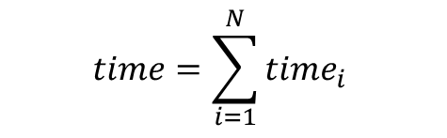
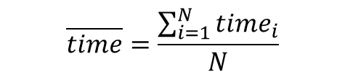
Summarizing performance
A is 10 x faster than B for P1
B is 10 x faster than A for P2
A is 20 x faster than C for P1
C is 50 x faster than A for P2
etc.
Total execution time gives clearest picture:
B is 1001/110 = 9.1 x faster than A for both programs
C is 25 x faster than A for both programs
C is 2.75 x faster than B for both programs
Which would you buy? (Answer: C is fastest, overall)
Arithmetic mean of times is good too (A:500.5, B:55, C:20)
$$time=\sum_{i=1}^{N}{{time}_{i}}$$
$$\overline{time}=\frac{\sum_{i=1}^{N}{{time}_{i}}}{N}$$

Slide 11
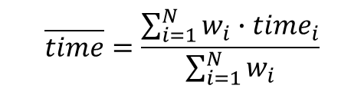
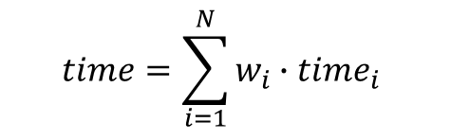
Applying weights
Some benchmarks may be more valuable than others (relative importance, frequency of use, etc.)
Use weighted time or weighted arithmetic mean
$$time=\sum_{i=1}^{N}{w_{i}∙{time}_{i}}$$
$$\overline{time}=\frac{\sum_{i=1}^{N}{w_{i}∙{time}_{i}}}{\sum_{i=1}^{N}{w_{i}}}$$

Slide 12
Definitions
metric acronym | description | unit
IC | “dynamic instruction count” i.e., # instructions executed at run-time (different from “static instruction count”, which is # compiled instr. in the program binary) | instr.
CPI | “cycles-per-instruction” CPI = 1/IPC | cycles/instr.
IPC | “instructions-per-cycle” IPC = 1/CPI | instr./cycle
CT | “cycle time”, a.k.a., “clock period” CT = 1/f | s/cycle
f | “clock frequency” or “frequency” f = 1/CT | cycles/s (Hz)
IPS | “instructions-per-second” IPS = IPC · f | instr./s

Slide 13

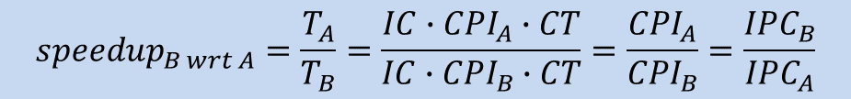
On the use of IPC and IPS
CPU time = IC x CPI x CT
= IC x (1/IPC) x (1/f)
= IC / (IPC x f)
= IC / IPS
Time is the only true measure of performance
When is it valid to compare computers based on IPC alone?
Only if IC and CT are the same
When is it valid to compare computers based on IPS alone?
Only if IC is the same
$${speedup}_{B wrt A}=\frac{T_{A}}{T_{B}}=\frac{IC∙{CPI}_{A}∙CT}{IC∙{CPI}_{B}∙CT}=\frac{{CPI}_{A}}{{CPI}_{B}}=\frac{{IPC}_{B}}{{IPC}_{A}}$$
$${speedup}_{B wrt A}=\frac{T_{A}}{T_{B}}=\frac{{IC}/{{IPS}_{A}}}{{IC}/{{IPS}_{B}}}=\frac{{IPS}_{B}}{{IPS}_{A}}$$

Slide 14


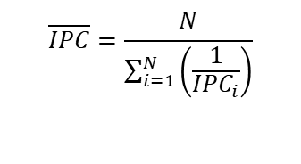


On the proper use of means for summarizing metrics of a benchmark suite
What | Example | Proper mean | Formula | Formula with all weights 1
A quantity | time (s), cycles, CPI, energy (J) | Arithmetic mean
A rate (quantity per unit time) | IPS (1/s), IPC (1/cycle), power (J/s) | Harmonic mean
A ratio (unitless) | Speedup w.r.t. a reference computer | Geometric mean
$$\overline{time}=\frac{\sum_{i=1}^{N}{w_{i}∙{time}_{i}}}{\sum_{i=1}^{N}{w_{i}}}$$
$$\overline{time}=\frac{\sum_{i=1}^{N}{{time}_{i}}}{N}$$
$$\overline{IPC}=\frac{\sum_{i=1}^{N}{w_{i}}}{\sum_{i=1}^{N}{w_{i}∙\left(\frac{1}{{IPC}_{i}}\right)}}$$
$$\overline{IPC}=\frac{N}{\sum_{i=1}^{N}{\left(\frac{1}{{IPC}_{i}}\right)}}$$
$$\overline{speedup}=\sqrt[N]{\prod_{i=1}^{N}{{speedup}_{i}}}$$

Slide 15
Speedup
Enhance a processor with some new mechanism
speedup = Time_{OLD} / Time_{NEW}

Slide 16
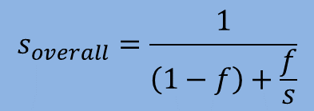
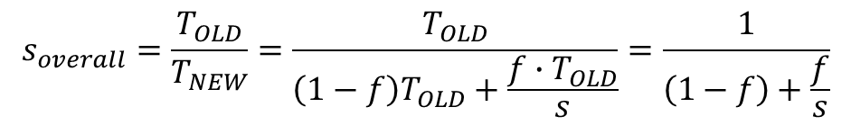


Amdahl’s law
Performance improvement (“speedup”) is limited by the part you cannot improve.
T_{OLD}
(1-f)T_{OLD}
(f)T_{OLD}
$$0≤f≤1$$
$$\left(1−f\right)T_{OLD}+\left(f\right)T_{OLD}=\left(1−f+f\right)T_{OLD}=T_{OLD}$$
x
T_{NEW}
speedup fraction f by a factor of s
(1-f)T_{OLD}
(f)T_{OLD} / s
$s=\frac{x}{x^{′}}=\frac{f∙T_{old}}{x^{′}}$ $x^{′}=\frac{f∙T_{old}}{s}$
x’
$$s_{overall}=\frac{T_{OLD}}{T_{NEW}}=\frac{T_{OLD}}{\left(1−f\right)T_{OLD}+\frac{f∙T_{OLD}}{s}}=\frac{1}{\left(1−f\right)+\frac{f}{s}}$$
$$s_{overall}=\frac{1}{\left(1−f\right)+\frac{f}{s}}$$

Slide 17
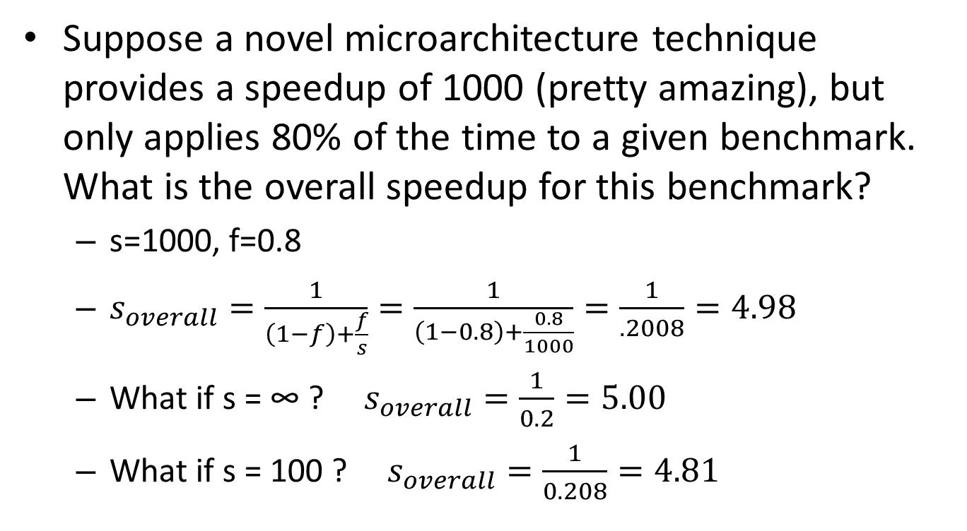
Amdahl’s law: Example #1
Suppose a novel microarchitecture technique provides a speedup of 1000 (pretty amazing), but only applies 80% of the time to a given benchmark. What is the overall speedup for this benchmark?
s=1000, f=0.8
$s_{overall}=\frac{1}{\left(1−f\right)+\frac{f}{s}}=\frac{1}{\left(1−0.8\right)+\frac{0.8}{1000}}=\frac{1}{.2008}=4.98$
What if s = ∞ ? $s_{overall}=\frac{1}{0.2}=5.00$
What if s = 100 ? $s_{overall}=\frac{1}{0.208}=4.81$
First interpretation of Amdahl’s Law: Overall speedup is limited by the part you cannot improve.
(20% of time is not reduced, so you are limited to an overall speedup of no more than 5.)

Slide 18
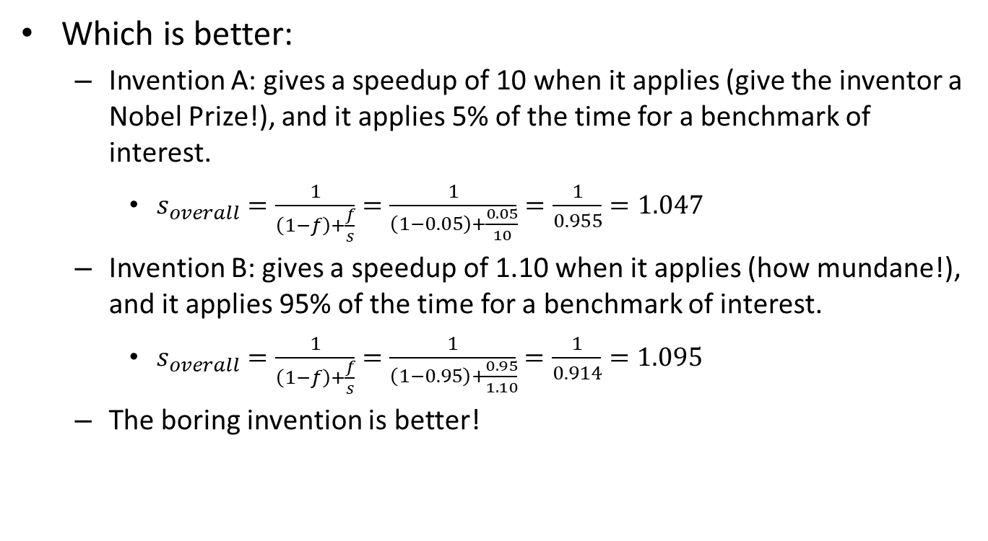
Amdahl’s law: Example #2
Which is better:
Invention A: gives a speedup of 10 when it applies (give the inventor a Nobel Prize!), and it applies 5% of the time for a benchmark of interest.
$s_{overall}=\frac{1}{\left(1−f\right)+\frac{f}{s}}=\frac{1}{\left(1−0.05\right)+\frac{0.05}{10}}=\frac{1}{0.955}=1.047$
Invention B: gives a speedup of 1.10 when it applies (how mundane!), and it applies 95% of the time for a benchmark of interest.
$s_{overall}=\frac{1}{\left(1−f\right)+\frac{f}{s}}=\frac{1}{\left(1−0.95\right)+\frac{0.95}{1.10}}=\frac{1}{0.914}=1.095$
The boring invention is better!
(even for s = ∞ : 1.053)
(close to 1.10)
Second interpretation of Amdahl’s Law: The common case matters most. (It was better to do an incremental idea that applied frequently.)

Slide 19
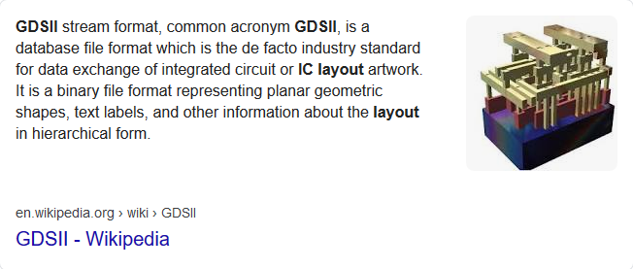
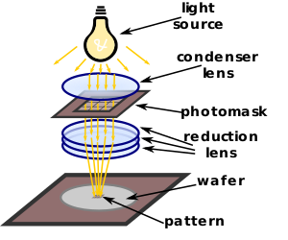
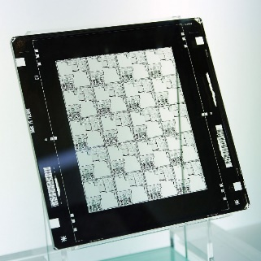
Cost of a Chip
100s of engineers:
Microarchitecture
Performance modeling
RTL design
Design-for-test
Verification (functional, timing, phys. design)
Physical design (RTL to layout)
Layout in GDSII:
Patterns for many layers. These patterns guide lithographic fabrication of the layers of the chip.
Masks: quartz plates with patterns on them. A mask for one or several fabrication steps.

Slide 20
Cost of a Chip (cont.)
Designing a chip means designing and manufacturing a tool (masks) to fabricate that chip
NRE cost of the tool
e.g., 5 years of salaries and benefits of 100s of engineers
Cost of the masks themselves (expensive, too)
Example:
Suppose the NRE cost of the tool is $10,000,000 (includes 5 years of design effort and cost of mask set).
Suppose we fabricate only 1 chip. What is the cost to the consumer of that 1 chip? Answer: $10,000,000!
So we have to fabricate many chips to bring the cost per chip down.
Cost has a time factor to it
A given CPU design has an expiration date, which is the time at which the next generation of CPU is going to come out.
We have until this expiration date to mass-produce chips for the current generation of CPU.
This is why “yield” from each silicon wafer is a critical factor in the cost of a chip. Yield is how many working chips we get out of each wafer, which affects how many working chips are produced in, say, a week.
(NRE cost: non-recurring engineering cost, i.e., one-time cost)

Slide 21
Cost of a Chip (cont.)
Example: cost of tool = $10,000,000 (5 years design effort + cost of masks)
lifetime of current CPU generation = 2 years
wafers processed per week = 50 wafers/week
2 years of useful manufacturing lifetime
yield example for chip design 1: 10 working chips from each wafer
$${cost}/{chip}for chip design 1=\frac{\$10,000,000}{10\frac{chips}{wafer}×50\frac{wafers}{week}×52\frac{weeks}{year}×2 years}=\frac{\$10,000,000}{52,000 chips}=\$192$$
yield example for chip design 2: 5 working chips from each wafer (1/2 the yield of above)
$${cost}/{chip}for chip design 2=\frac{\$10,000,000}{5\frac{chips}{wafer}×50\frac{wafers}{week}×52\frac{weeks}{year}×2 years}=\frac{\$10,000,000}{26,000 chips}=\$384$$

Slide 22
Cost of a Chip (cont.)
Cost is exponential with die area
Cost depends on yield: average number of working die from each wafer
Yield is very sensitive to die area
Two effects as die area increases:
1. Fewer die per wafer.
2. Lower percentage yield among die for the same defect pattern.

Slide 23
Other costs: Energy and Power
Energy
Energy is a quantity
Why we care
Battery-powered devices: Battery contains finite amount of charge (Q), hence, finite amount of energy (E=QV)
Plugged-in devices: Utility bill
Power
Power is a rate
Power is the rate at which energy is consumed
P = E / time
Why we care
Sustained power
Higher sustained power results in higher temperature
Cooling technology limits the sustained power of the chip, called the thermal design power (TDP)
This means power has become a performance limiter in the semiconductor industry
Microarchitects need to be inventive to increase performance without exceeding TDP
Instantaneous power
Inductive noise problem, Δv = L(di/dt)
Spike in current draw can cause a transient fluctuation in Vdd, unreliable operation

Slide 24
CMOS Dynamic Power
See ECE 546 (or lower level circuits courses?) for formal derivation. Here’s a naïve derivation:
Energy consumed in 1 processor cycle: E = QV = αCV²
Multiply by frequency to convert to a rate
α = switching activity factor (fraction of devices switching each cycle, on average)
Number between 0 and 1
C = total capacitance of all devices on chip
V = supply voltage
f = clock frequency (rate of switching)

Slide 25
CMOS Static Power
Static power
Power consumed even when there is no switching activity
In CMOS, this is due to leakage currents in MOSFETs that are supposedly turned off (cut-off region)
CMOS technology scaling
Lowering V_{t} with each technology generation
Increase # transistors being switched (C) + Increase clock frequency (f) = Too much dynamic power !
Lower V_{dd} (supply voltage) to help dynamic power
Lowering V_{dd} without also lowering V_{t} slows down transistors (see ECE 546, etc.)
So must also lower V_{t}
But lowering V_{t} exponentially increases leakage current
Whereas 10 years ago most power was dynamic, now as much as half of chip power may be static
Circuit and microarchitectural tricks are being used to keep static power in check

Slide 26
Energy

Slide 27
Remarks
Consider which power-related metric applies in a particular scenario
Consider dynamic and static energy in your design decisions
How much will enhancement increase performance?
How much will enhancement increase dynamic energy?
How much will enhancement increase area (more devices which leak), hence, static energy?
How much additional energy are you willing to pay for the performance increase?
What am I concerned with? (scenario) |  | Relevant metric | Comment
Battery lifetime |  | energy | Important for battery-operated devices (smart phones, tablets, and other mobile devices).
Utility cost |  | energy | Important for large data centers (e.g., Google, cloud computing, etc.).
Reliability | inductive noise | instantaneous power | Current spikes cause Vdd fluctuation (Δv = L di/dt) which can cause faulty operation. Power supply takes time to recover.
 | TDP | sustained power | Running too hot for the cooling technology causes overheating of chip which may lead to failure. TDP has become a performance-limiter in the computing industry and has contributed to frequency stagnating.

Slide 28
Efficiency
A processor enhancement will increase power consumption
Is this necessarily a bad thing?
Recall that power is the rate at which energy is consumed
P = E/t
What higher power could mean:
IDEAL: Same energy consumption, less time
The higher power is due to consuming same energy in less time
The performance enhancement came at the price of no extra energy consumption. This is fantastic.
NON-IDEAL: Higher energy consumption, less time
The higher power is due to consuming more energy in less time
The performance enhancement came at the price of extra energy consumption. This is more typical, and the goal of the processor designer is to minimize the extra energy cost paid for the higher performance.

