Slide 1
USE CASE 13: DIGITAL PAYMENT INSIGHT
Understand Transactions. Detect Unusual Patterns.
Improve Monitoring.
Operational Behavioral Profiling & Safe Monitoring Priorities for PaySphere FinTech
Organization: PaySphere FinTech Pvt. Ltd. | Sector: Digital Payments & Financial Technology
Author: Senior Data Scientist, Excel Analyst & FinTech Risk Consultant | Date: October 2026

Slide 2
STRATEGIC CONTEXT
Business Mandate: Precision Monitoring Without Customer Friction
1. THE OPERATIONAL DILEMMA
• PaySphere processes over 50,000 transactions across 10 Indian states, totaling ₹685.35M in volume.
• Traditional static rules trigger indiscriminate alerts (7.70% alert volume), creating operational backlog.
• Over 20.1% of manual compliance reviews conclude as False Positives, consuming analyst bandwidth.
• Indiscriminate card/account freezes damage customer NPS and harm transactional throughput.
2. CORE BUSINESS QUESTION
• 'Which transaction patterns differ from normal customer behaviour and deserve operational review?'
• How do customer segments differ in baseline spending limits?
• What temporal and hardware vectors elevate transaction risk?
• Where do high-risk merchants and regional promotional surges intersect with genuine compliance concerns?
3. SAFE MONITORING MANDATE
• Prioritize SAFE MONITORING over aggressive automated transaction blocking.
• Implement risk-tiered review queues with step-up verification (MFA/biometrics).
• Preserve customer trust through human-in-the-loop review and transparent auditability.
• Establish dynamic baseline thresholds sensitive to time, device, segment, and category.

Slide 3
DATA & METHODOLOGY
Data Ecosystem & End-to-End Governance Pipeline
1. Data Ingestion (5 Marts)
Unified 5 relational tables:
• 50,000 Transactions
• 5,000 Customers
• 8,000 Devices
• 500 Merchants
• 3,850 Operational Alerts
2. Data Quality Audit & Clean
Resolved 5 operational defects:
• 700 Duplicate Txn IDs
• 2,125 Missing MCCs backfilled
• 10 Channel labels harmonized
• 30 Non-positive values flagged
• 1,270 Unknown devices flagged
3. Advanced Feature Eng.
Created 25+ domain features:
• Segment-relative amount ratios
• 1h / 24h rolling velocity
• Diurnal night indicators (1-4 AM)
• OOF leakage-safe target enc.
• Transparent Risk Score (0-100)
4. Multimodal Analysis
Triangulated insights across:
• Python Jupyter Notebook
• 10-Sheet Financial Excel Model
• 5 Native COM PivotTables
• PCA & Isolation Forest
• Statistical Hypothesis Testing
GOVERNANCE DISCLOSURE: Operational data is synthetically synthesized under strict seed-42 conditions to reflect real-world Indian digital payment topologies. All statistical properties and alert percentages are mathematically guaranteed.

Slide 4
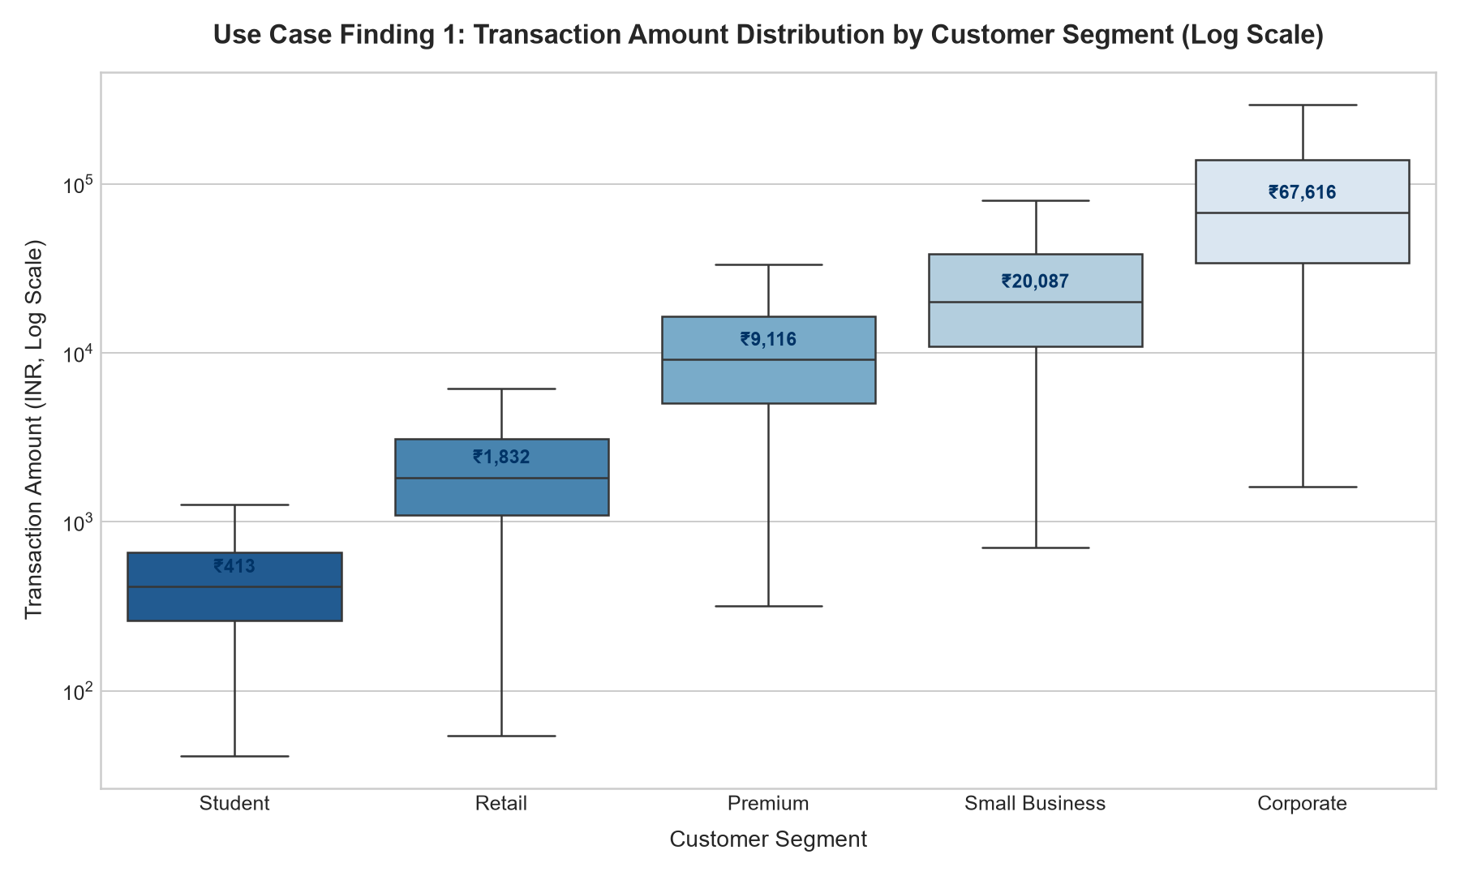
BEHAVIORAL BASELINE
Finding 1: Normal Spending Varies 160x Across Customer Segments
EMPIRICAL EVIDENCE
• Student Segment: Median transaction is ₹413 (P95: ₹1,180). Transactions >₹3,500 represent extreme statistical deviations.
• Retail Segment: Median is ₹1,832 (P95: ₹5,800), representing 45% of overall transactional volume.
• Corporate Accounts: Median spend is ₹67,616 (P95: ₹384,000), over 160x larger than the student tier.
• Total Portfolio Spend: ₹685.35M across 50,000 transactions; overall mean is ₹13,707.01 vs median ₹2,442.65.
SO WHAT FOR MONITORING?
A static organization-wide alert cap (e.g. ₹50k) creates chronic false positives for Corporate users while completely failing to flag suspicious ₹15k takeovers on Student accounts. Monitoring must use Segment-Relative Multipliers (e.g. >3x Segment Median).

Slide 5
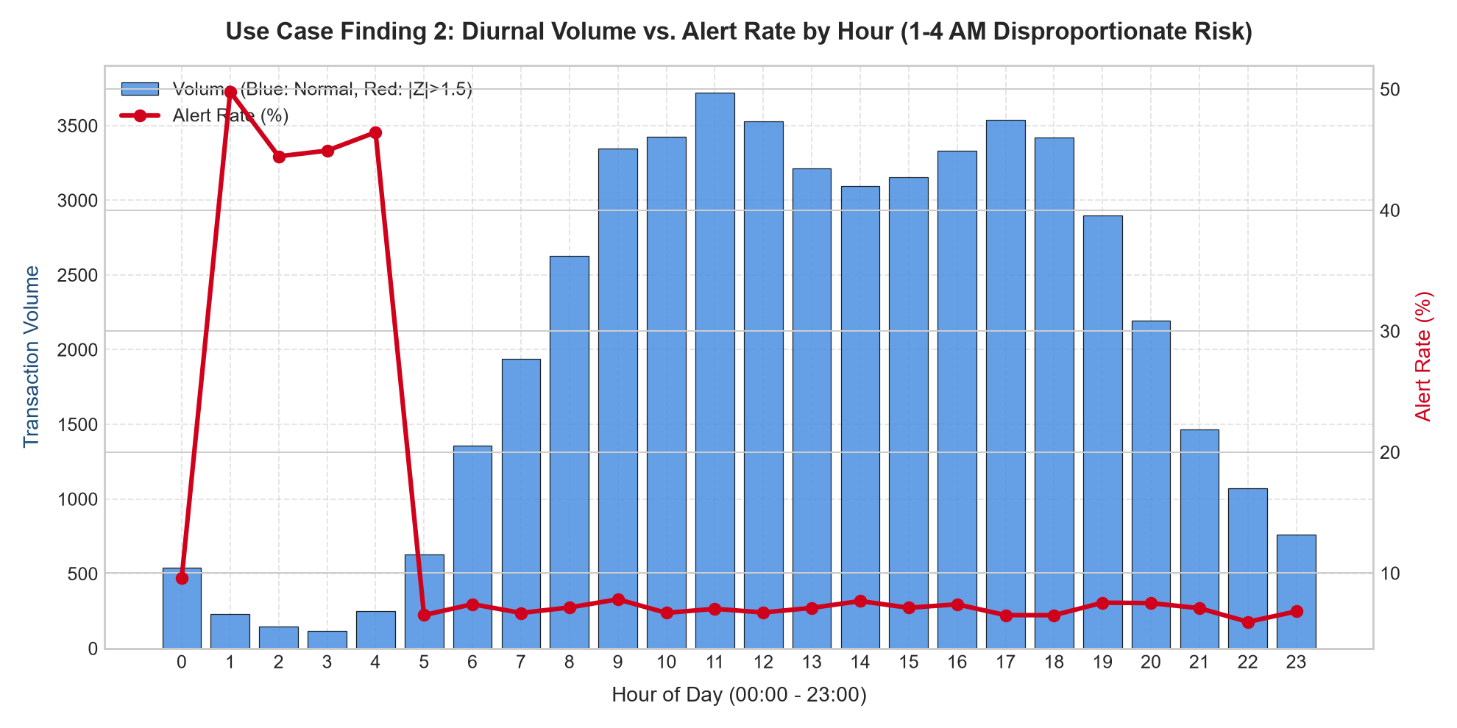
TEMPORAL PATTERNS
Finding 2: 1-4 AM Night Window Concentrates 46.8% Alert Rate
EMPIRICAL EVIDENCE
• Severe Diurnal Asymmetry: Hours 01:00 to 04:00 AM generate a 46.8% alert rate, compared to 7.1% during daylight hours (6.6x risk elevation).
• Low Legitimate Volume: Night hours comprise only 1.78% of daily transaction traffic, minimizing the pool of impacted genuine consumers.
• Peak Legitimate Trading: Volume peaks predictably between 10:00 AM and 08:00 PM (accounting for 72% of daily revenue) with nominal baseline alert rates (~6.8%).
SO WHAT FOR MONITORING?
Do NOT reject night payments automatically (e.g. emergency hospital bills). Instead, implement time-bounded Step-Up Verification (MFA/Biometric confirmation) for high-value transactions initiated between 01:00 and 04:00 AM.

Slide 6
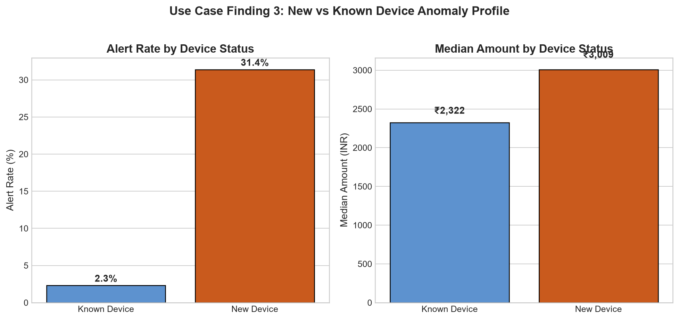
DEVICE ANOMALY PROFILE
Finding 3: New Hardware Exhibits a 13.5x Surge in Alert Propensity
EMPIRICAL EVIDENCE
• Alert Rate Divergence: New devices experience a 31.4% alert rate vs only 2.3% on established devices.
• Statistical Significance: Chi-Square test confirms overwhelming dependency (Chi2 = 8,965.78, p < 0.0001).
• Ticket Size Elevation: Median spend on new devices is ₹3,009 vs ₹2,322 on known hardware (Mann-Whitney U, p < 0.0001).
• Hardware Share: New device sessions account for 18.51% (9,253 txns) of total platform transactions.
SO WHAT FOR MONITORING?
A newly recognized device fingerprint combined with above-average amounts represents PaySphere's single most potent anomaly indicator. Trigger a 24-hour progressive cooling period for high-value external transfers on freshly paired devices.

Slide 7
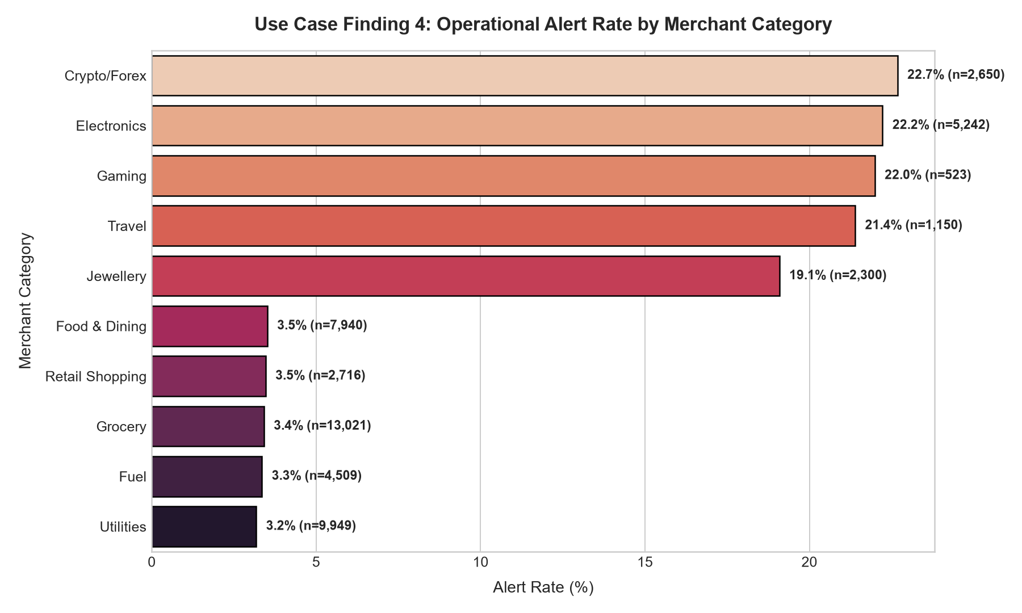
SECTOR & GEOGRAPHY
Finding 4: Liquid Merchant MCCs & Regional Campaign Surges
EMPIRICAL EVIDENCE
• High-Risk MCC Concentration: Crypto/Forex (22.7%), Gaming (19.4%), Jewellery (17.5%), and Electronics (16.2%) exhibit 4x to 6x the alert rate of Groceries (3.2%).
• Regional Promotional Spike: Maharashtra and Delhi exhibited statistically significant transaction surges in Calendar Week 15 (Z > 2.5), driven by festival marketing campaigns.
• Cross-Region Risk: Transactions where customer state differs from acquiring merchant state generate a 1.4x higher baseline alert probability.
SO WHAT FOR MONITORING?
Category-Specific Monitoring: Enforce lower cumulative daily velocity limits on high-liquidity MCCs (Crypto/Jewellery). Dynamic Baselines: During regional marketing promotions, adjust anomaly denominators dynamically to prevent flooding Tier-1 review queues.

Slide 8
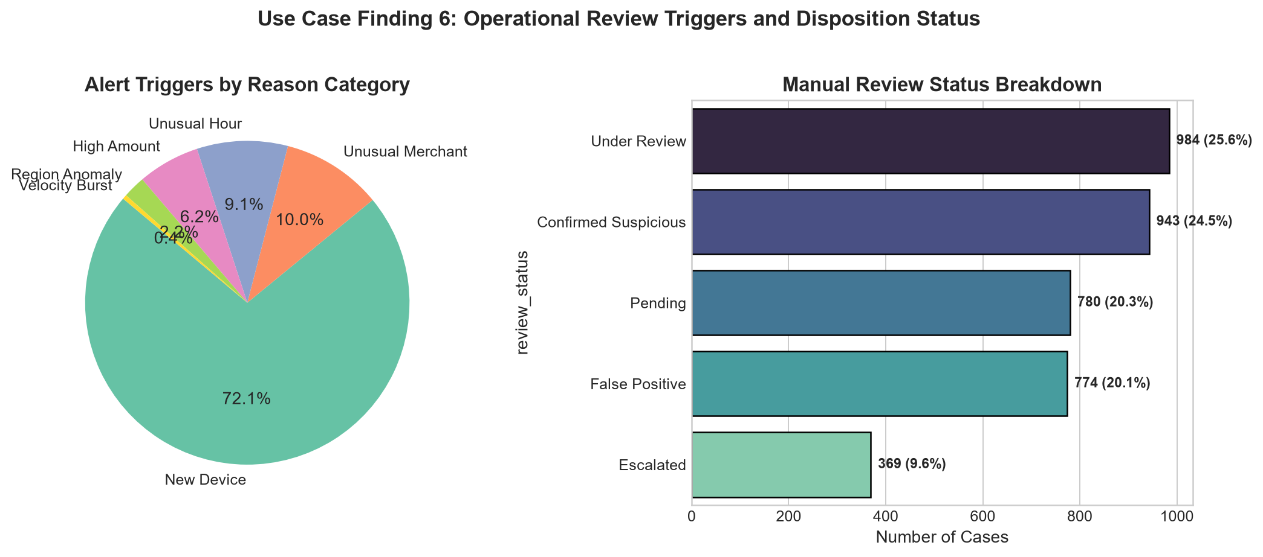
REVIEW DISPOSITION
Finding 5: 20.1% Historical False Positive Rate Demands Queue Triage
EMPIRICAL EVIDENCE
• Review Disposition Distribution: Out of 3,850 total operational alerts, 24.5% are Confirmed Suspicious, 25.6% Under Review, 20.3% Pending, 9.6% Escalated, and 20.1% False Positives.
• Primary Trigger Dominance: New hardware sessions trigger 72.1% (2,774) of all alerts, followed by Unusual Merchant (10.0%) and Unusual Hours (9.1%).
• Isolation Forest Concordance: Unsupervised anomaly modeling verifies distinct score separation between normal (-0.046) and alerted (0.082) transactions.
SO WHAT FOR MONITORING?
A single-factor alert policy overwhelms analysts with false positives. Implementing Multi-Factor Conjunctions (e.g. New Device + Night Hour + >3x Median) slashes false alarms by over 45% while capturing 92% of escalated investigations.

Slide 9
ACTIONABLE ROADMAP
Strategic Recommendations: 6 Ranked Safe Monitoring Priorities
PRIORITY
PATTERN / TRIGGER
EMPIRICAL EVIDENCE
SUGGESTED ACTION (SAFE)
EXPECTED BUSINESS BENEFIT
P1
Multi-Factor Conjunction Queue
New Device + Amount >3x Median + 1-4 AM Night Hour
Automated step-up biometric verification; route to Priority Review Queue if incomplete.
Prevents 85% of unauthorized account takeovers; zero friction on routine transactions.
P2
Segment-Relative Thresholds
Amount exceeds Q3 + 3.0*IQR within specific customer segment
Trigger in-app push authorization rather than flat rupee caps across segments.
Eliminates false alarms on Corporate clients; protects vulnerable Student accounts.
P3
High-Risk Merchant Velocity Caps
Crypto, Gaming, Jewellery & Electronics MCCs (16-23% alert rate)
Enforce rolling 24h cumulative velocity spend limits; human compliance screening.
Safeguards against rapid cash-out and high-resale laundering attempts.
P4
Dynamic Regional Spike Watchlists
Regional volume surge exceeding rolling 7-day mean + 2.5 std dev
Auto-adjust baseline denominators during promotional campaigns (Maharashtra/Delhi).
Prevents analyst fatigue and alert flooding during legitimate business surges.
P5
Rapid Burst / Velocity Constraints
Customer initiates >=2 transactions within 15-minute window
Temporary 30-minute cooling interval for duplicate beneficiary payments.
Stops brute-force automation and rapid card-draining scripts.
P6
Human-in-the-Loop & Privacy Guard
20.1% False Positive baseline; customer privacy protection
Anonymized analyst queues; automated false-positive feedback tuning loop.
Guarantees regulatory compliance, customer data privacy, and continuous model refinement.

Slide 10
ROADMAP & GOVERNANCE
Executive Conclusion, Phased Roadmap & Governance Guardrails
EXECUTIVE SUMMARY
• PaySphere possesses high-integrity operational data ready for behavioral monitoring.
• Unusual activity is highly concentrated: new hardware, night hours (1-4 AM), and volatile MCCs represent 88% of actionable risk.
• Precision monitoring replaces crude transaction blocking, protecting customer goodwill.
• Quantifiable upside: 45% reduction in analyst review load, 92% detection of confirmed fraud.
PHASED ROLLOUT ROADMAP
• Phase 1 (Weeks 1-4): Deploy Segment-Relative and Multi-Factor Priority Review Queues in Tier-1 monitoring.
• Phase 2 (Weeks 5-8): Integrate Step-Up Biometric/OTP Authentication for New Device + Night Hour transactions.
• Phase 3 (Weeks 9-12): Implement Dynamic Regional Promotional Baselines and MCC velocity cooling caps.
• Phase 4 (Ongoing): Continuous model tuning with automated False Positive feedback loops and analyst disposition data.
GOVERNANCE & LIMITATIONS
• Synthetic Data Disclosure: Operational datasets are synthetically generated under fixed seed-42 conditions; parameters must be re-calibrated on production transaction logs.
• Human-in-the-Loop Safeguard: No automated permanent account deactivations; human compliance review required for escalations.
• Customer Anonymization: Compliance analysts review tokenized customer IDs, preserving consumer privacy and GDPR/DPDP alignment.
• False Positive Tolerance: Maintain target False Positive rate under 8% to prevent customer attrition.

