Slide 1
ML Inspiration

Slide 2
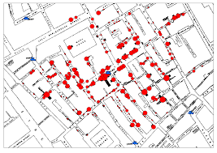
Cholera London 1850

Slide 3
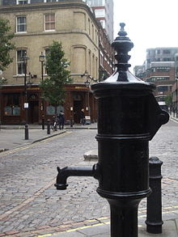
Contd.,.

Slide 4
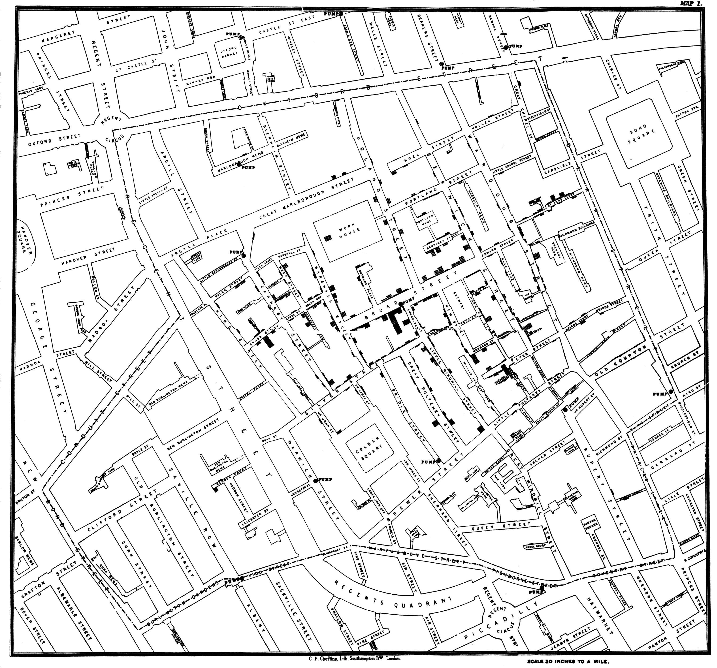
Contd.,.

Slide 5
Amazon recommendation system
35% sales of Amazon product are using recommendation system
Delivery date predection for products.
Amazon sells 426 items per second on 2013 Christmas.
Delivery pattern was predicted by Machine Learning TSM problem.

Slide 6
Fun Facts
UPS drivers don’t turn left—and it saves them 10 million gallons of gas a year.
Target Pregnancy Identification.
Facebook relationship status trend.
Walmart no sign board stratergy.

Slide 7
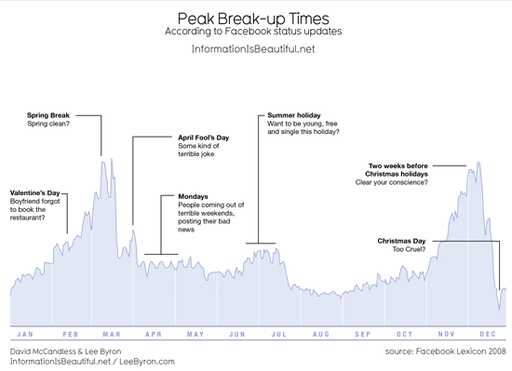
Facebook Relationship Status Trend

