Slide 1
Splunk SOC Monitoring Home Lab
By Vignesh Kilambi
Aspiring SOC Analyst

Slide 2
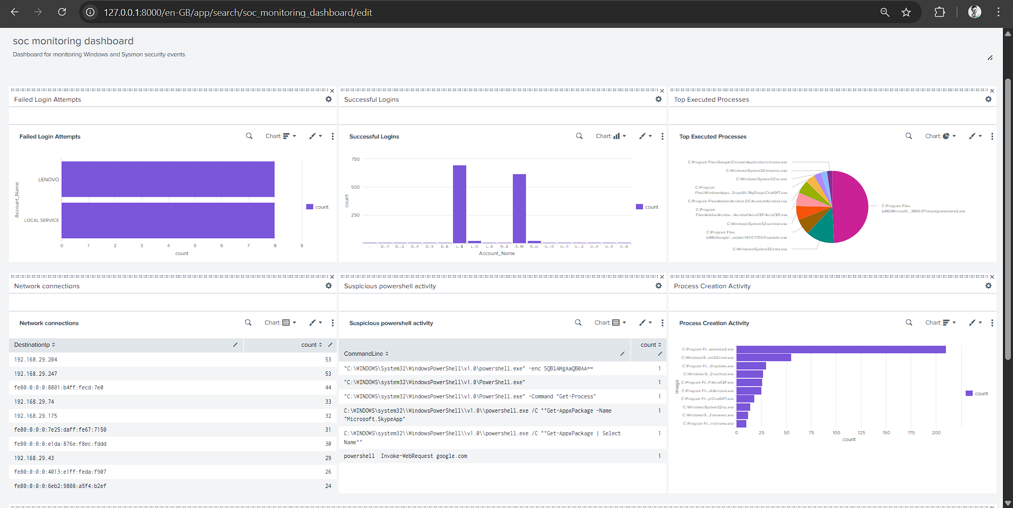
SOC Monitoring Dashboard (Splunk)
Dashboard built in Splunk to monitor security events including failed logins, network
connections, process execution, and suspicious PowerShell activity.

Slide 3
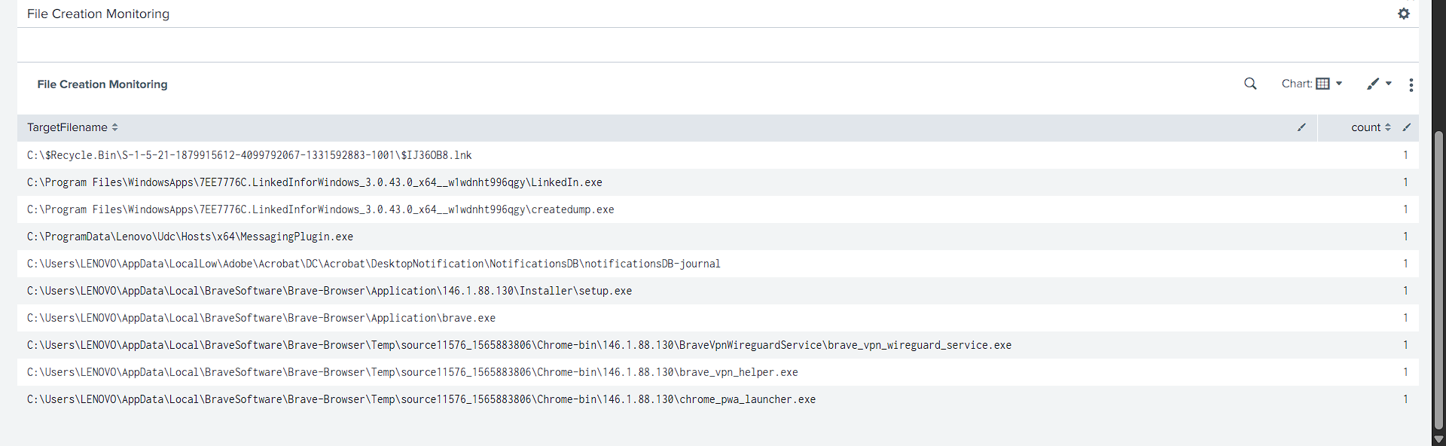
File Creation Monitoring - Sysmon Event ID 11
Monitoring file creation events using Sysmon to detect suspicious file drops or malware
activity on endpoints.

Slide 4
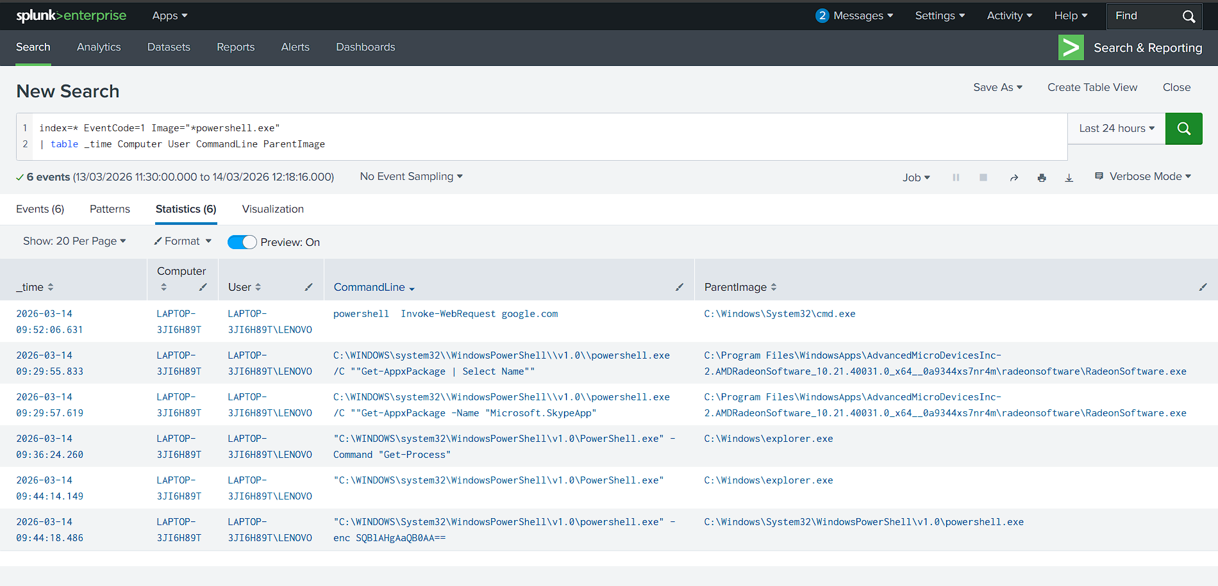
PowerShell Activity Detection Query
Splunk SPL query used to detect PowerShell execution activity from Sysmon process
creation events.

Slide 5
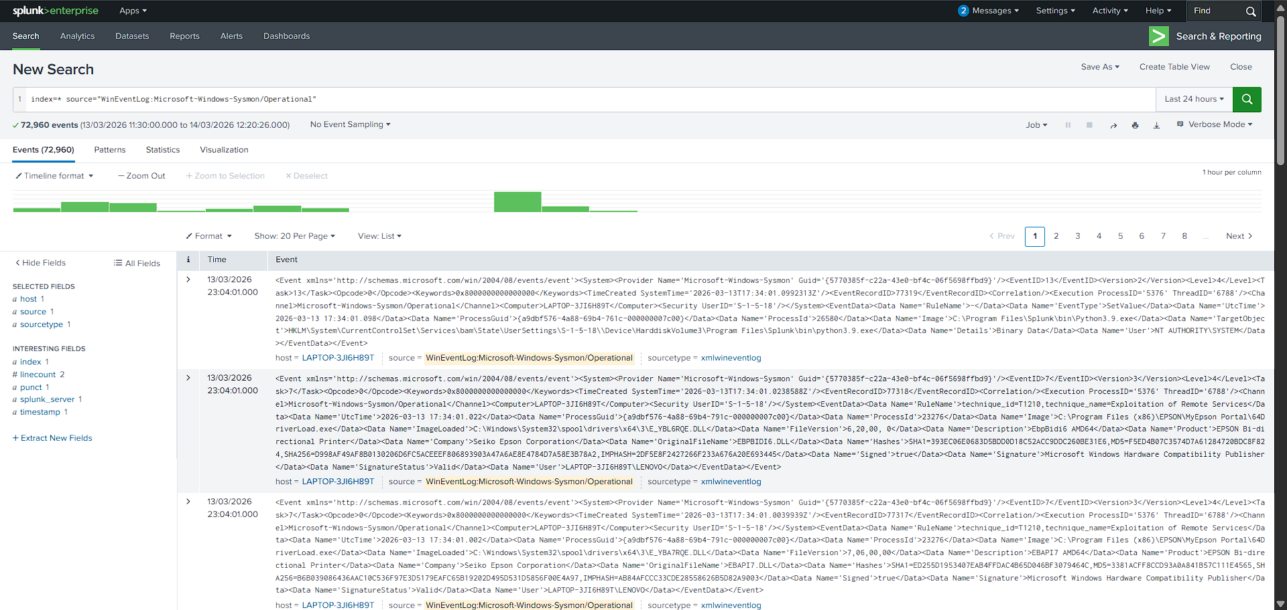
Sysmon Log Analysis in Splunk
Raw Sysmon event logs ingested into Splunk for analysis of endpoint activity and threat
detection.

