Slide 1
Computer Architecture
Project – 1
Branch Predictor Simulation, Benchmarking & Analysis

Slide 2
Contents
What is Branch Predictor ?
gem5 Simulation
Setting up gem5
Choosing the benchmark
Configurations for Benchmarks
Simulation

Slide 3


Where is my next instruction ?
Instruction Pointer
Pls wait. I’m calculating…

Slide 4
What is Branch Predictor ?
Branch Predictor is used to predict the next Address of the instruction (IP)
Improves the performance during branch instruction execution in pipelining
The CPU doesn’t need to stall by waiting to compute the next instruction to be executed
Basic things needed during prediction:
If it’s a branch instruction
Possible branch direction
Branch target address – if taken

Slide 5
What is needed for a Branch Predictor ??
A look up table to hold the previous values (commonly known as BTB – Branch Target Buffer or Branch History Table)
Mis predict recovery mechanism – incase the predicted value is wrong.
(actually, everyone makes mistakes :P )

Slide 6
What is gem5 ??
gem5 is a modular discrete event driven computer system simulator platform.
Primarily written in C++ & python, which allows capabilities to write our own custom modules for more complex simulations
gem5 has 3 main Branch Predictors.
Local Predictor
BiMod Predictor
Tournament Predictor

Slide 7
Local Predictor

Slide 8

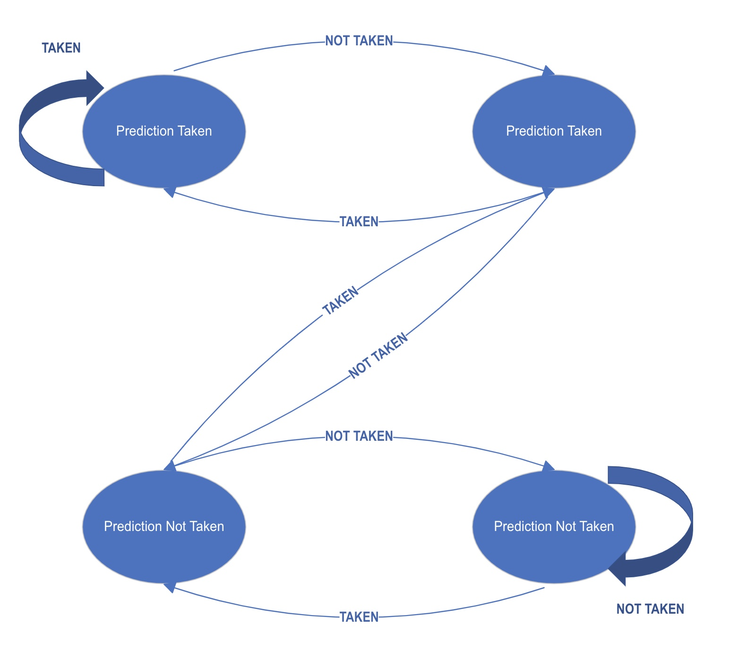

2 Bit predictor – using state machine representation

Slide 9
BiMod Predictor

Slide 10
Tournament Predictor

Slide 11
Setting up gem5

Slide 12
Configuring Branch Predictor

Slide 13
Local Predictor - Results

Slide 14
BImod Predictor - Results

Slide 15
Tournament Predictor - Results

Slide 16
Analysis of the outcome

