Slide 1

Title: Blood Donation and Request Management System
Student Name: D. Vignesh Kumar
Student ID: 2520090071
Cluster: 1
Section: 4
Under the Guidance
of
Supervisor Name: xxxxxxxx
Assistant Professor
Department of CSE

Slide 2
OUTLINE
Abstract
Existing System
Proposed System
System Architecture
Project Modules
Objectives
Co’s Attainments - FWD
Co1
Co2 …….. 5. Co5
Co’s Attainments - DSA
Co1
Co2 …….. 5. Co5
Screen Shots for FWD & DSA
Conclusion
Geo-Tagged Photos

Slide 3
Abstract
A full-stack web-based application designed to manage blood donation and request processes.
Helps streamline donor registration, blood requests, and donor–recipient coordination.
The main objective is to reduce delays in finding compatible blood donors.
Improves transparency in blood availability for hospitals and recipients.
Donors can register by providing blood group, location, contact details, and availability.
Recipients or hospitals can submit blood requests with type, quantity, urgency, and location.
The system automatically matches donors with requests based on blood group compatibility.

Slide 4
Existing System
• Blood donation and request activities are mostly managed manually in hospitals and blood banks.
• Information about donors, blood groups, and availability is usually stored in paper records or basic spreadsheets.
• People who need blood must contact hospitals, blood banks, or donors individually, which takes more time.
• There is no centralized system to quickly find available donors during emergencies.
• Communication between donors, recipients, and blood banks is often slow and inefficient.
• Manual systems may lead to data errors, delays, and difficulty in tracking donor history.
• Lack of awareness and proper platforms makes finding suitable blood donors difficult in urgent situations.

Slide 5
Proposed System
• Create a centralized database to store donor details such as name, blood group, contact information, and donation history.
• Allow donors to register online and update their availability for blood donation.
• Enable patients or hospitals to quickly search for available donors based on blood group and location.
• Provide a blood request feature where users can post emergency blood requirements.
• Send notifications or alerts to suitable donors when a blood request is made.
• Maintain accurate records and easy tracking of donors and blood requests.
• Improve communication between donors, recipients, and blood banks through a simple digital platform.

Slide 6
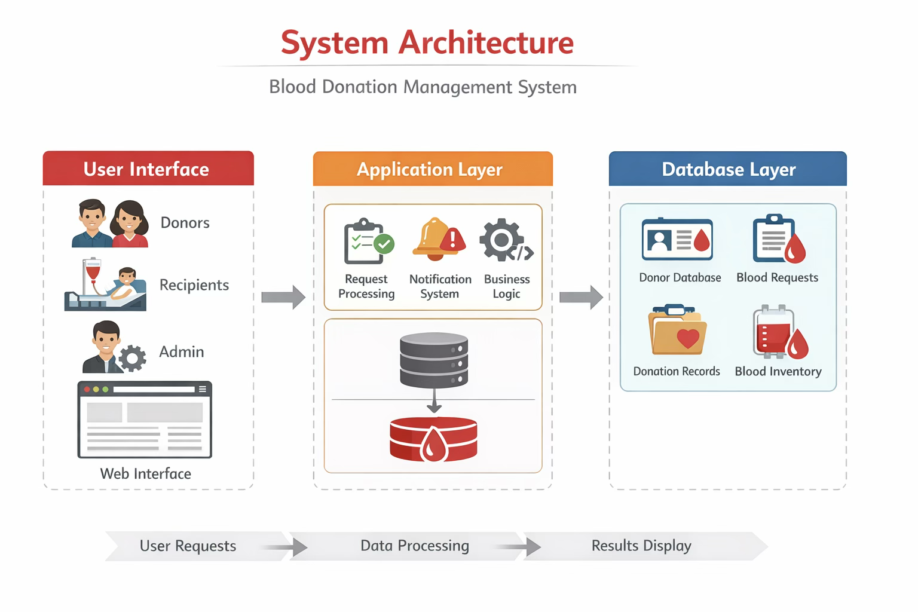
System Architecture
• User Interface (Front-End): Users such as donors, recipients, and administrators interact with the system through a web interface to register, search donors, and request blood.
• Application Layer (Server / Logic): Handles the business logic, processes user requests, verifies donor information, and manages blood request notifications.
• Database Layer: Stores all important data such as donor details, blood groups, request records, and donation history in a centralised database.
• Admin Module: Allows administrators to manage donor registrations, verify requests, and monitor blood availability.

Slide 7
Project Modules
1. Donor Registration Module
Allows donors to register with personal details such as name, age, blood group, contact number, and location.
Donors can update their profile and availability for blood donation.
2. Blood Request Module
Patients or hospitals can submit blood requests by specifying blood group, location, and urgency.
The system records and manages all blood requests.
3. Donor Search Module
Users can search for available donors based on blood group and location.
Displays a list of suitable donors with contact information.
4. Admin Management Module
Admin can manage donor records, verify requests, and monitor system activities.
Admin can also add, edit, or delete donor information if needed.

Slide 8
Objectives
To develop an efficient online system for managing blood donation and blood requests.
• To create a centralized database of blood donors with their blood groups and contact information.
• To help patients and hospitals quickly find suitable blood donors during emergencies.
• To simplify the blood donation process through online registration and request management.
• To improve communication between donors, recipients, and blood banks.
• To reduce manual work, time delays, and errors in the traditional blood donation system.

Slide 9
Co’s Attainments - FWD
CO-1 (Internet + HTML/CSS)
Static HTML pages (login, dashboard, etc.) use proper document structure and links.
CSS provides layout, typography, colours, spacing, and basic hover/transition effects.
CO-2 (Forms + Semantic + Layouts)
Login/registration forms with inputs and basic validation messages.
Structured layouts using header/menu/container; tables for lists; images via <img>.
CSS includes flex layout, transitions, and shared variables.
CO-3 (JS Essentials)
JS uses functions, conditionals, objects/arrays, and array methods.
Handles login/register logic and book list processing.
CO-4 (DOM & Interactivity)
Shows/hides sections, updates page content, and responds to clicks/typing.
Uses local Storage for persisting data (login state, books)Course Outcome 5 (Advanced + Deployment)
Basic input validation and error messages.
App is deployable as static site; can be improved with modules, meta tags, and API integration.

Slide 10
Co’s Attainments - DSA
CO1 – Data Structures Fundamentals
Arrays for Book Catalog Storage
Storage in Hash Maps
Memory Layout & Traversal Operations
Linked Lists & Pointer Reversal
Big O Time & Space Complexity
CO2 – Stack & Tree Implementation
Stack to Track Return Dates
Binary Search Trees Usage
BST for Sorted Catalog View
Ordered Tree Balancing
B-Tree Based Genre Hierarchy

Slide 11
CO3 – Queue & HashMap Usage
Book Reservation Queue
Returning Book FIFO Queue
HashMap for Fast Book Lookup
Merge Sort to Rank / Filter Results
Due Date Notification Queue
CO4 – Search & Sort Optimization
Binary Search for Indexed Catalog
Merge Sort for Ranked / Filtered Results
Hash Maps for Title / Author / ISBN Lookup
Binary Search for Ranked Results
Real-time Suggestion Engine

Slide 12
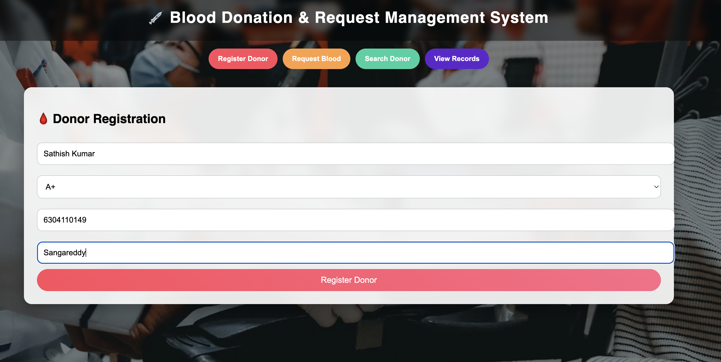
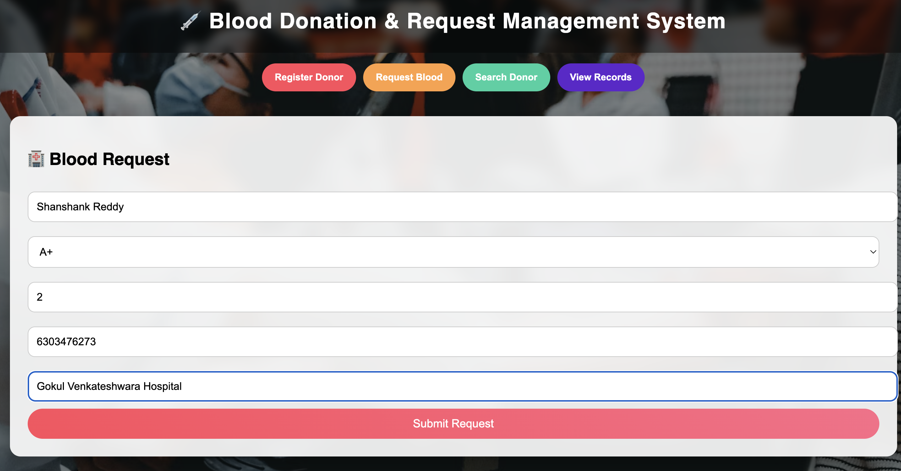
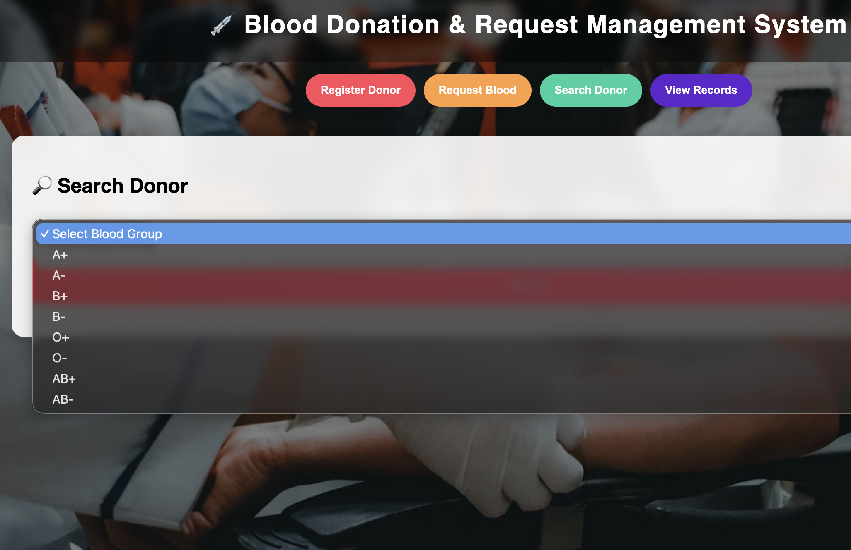
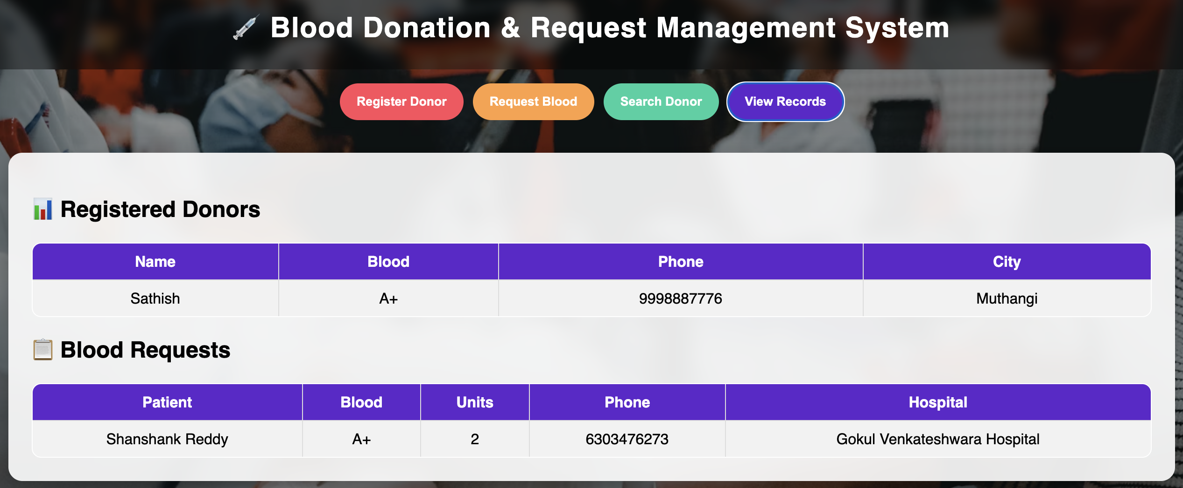
Screenshots for FWD & DSA

Slide 13
Conclusion
The Blood Donation & Request Management System provides an efficient and organized platform for managing blood donations and requests. The system simplifies the process of donor registration, blood request submission, and donor–recipient matching through a centralized web-based interface. By automatically identifying compatible donors based on blood group and location, the system helps reduce the time required to find suitable blood donors during emergencies.

Slide 14
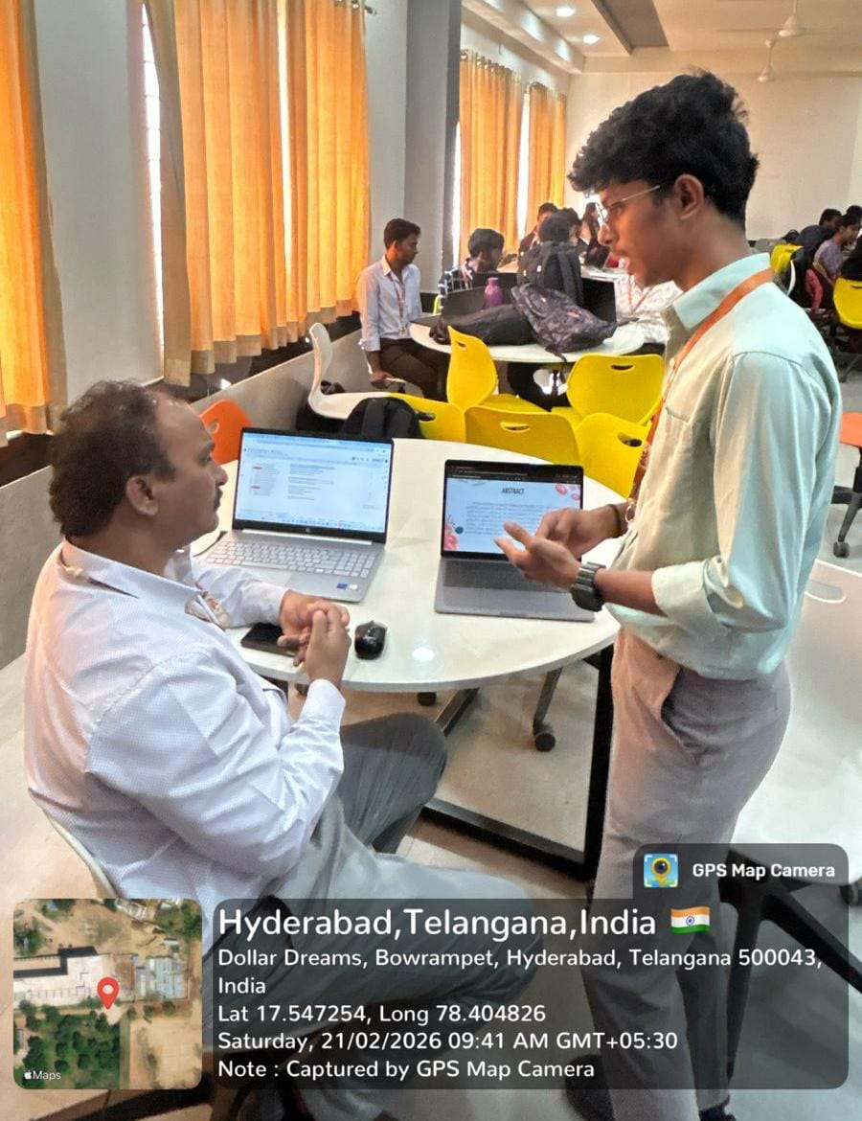
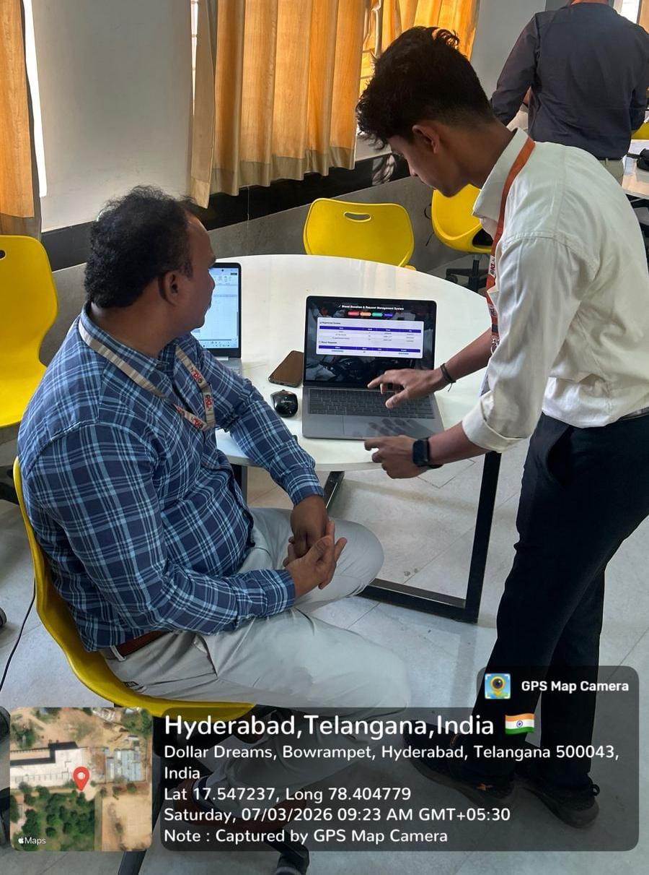
Geo- Tag Photos

Slide 15
THANK YOU

